Slide 1
Pharmaceutical Biotechnology
Lecture one
Introduction
Presented by
Lec. Nora Zawar Yousif
Lec. Zahraa AMER AL-JUBOORI

Slide 2
Biotechnology
In general biotechnology implies the use of microorganisms, plants and animals or parts thereof for the production of useful compounds.
Consequently, pharmaceutical biotechnology should be considered as the biotechnological manufacturing of pharmaceutical products.

Slide 3
Biotechnology
Various forms of biotechnology existed in ancient times.
For example, making vinegar from grapes.
Based merely on experience bioproducts were for many ages homemade in a traditional fashion without an understanding of the underlying principles.
An insight into the nature of the traditional processes was achieved in about 1870.
Pasteur illustrated that chemical conversions in these processes were performed by living cells, and thus the traditional processes should be considered biochemical conversions.

Slide 4
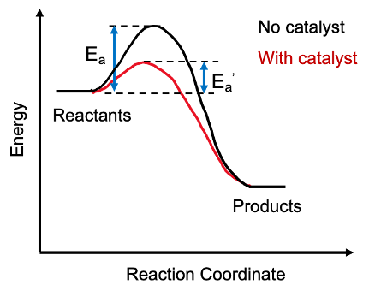
Biotechnology becomes science!
In the decades following Pasteur's discovery, biotechnological knowledge increased when the catalytic role of enzymes for most biochemical conversions became apparent, based on that knowledge tools became available for the control and optimization of the traditional processes.
Catalysis: An alternative fast reaction pathway for the production of more stable products than the starting material and has a lower activation energy than the reaction route not mediated by the catalyst.
E.g. The disproportionation of hydrogen peroxide creates water and oxygen due to the role of peroxidase enzyme in organisms, as shown below.
2 H₂O₂ → 2 H₂O + O₂

Slide 5
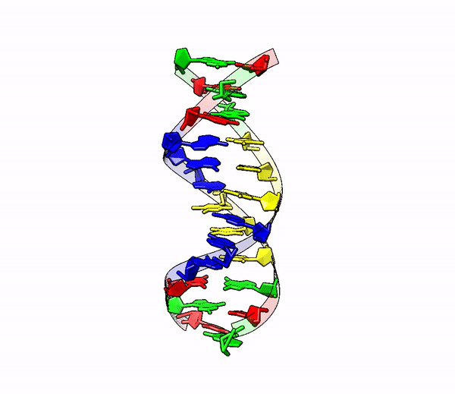
A further and very important breakthrough took place after the development of molecular biology.
The brought forward by the pioneers in molecular biology in around 1950, that DNA encodes proteins and in this way controls all cellular processes was the impetus (force) for a new period in biotechnology.

Slide 6
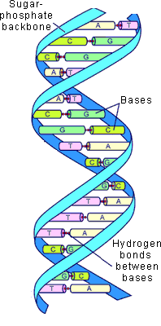
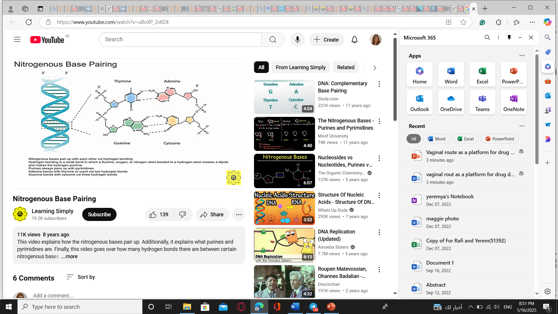
DNA molecule

Slide 7
Gene Expression
Genetic information, chemically determined by DNA structure, that is transferred during cell division to daughter cells by (DNA replication)
expressed by transcription (conversion of DNA into RNA)
followed by translation (conversion of RNA into protein)
Series of events DNA RNA Protein

Slide 8
The fast evolving (developing) DNA technologies, after the development of the recombinant DNA technology in the seventies, allowed biotechnologists to:
1.Control gene expression in the organisms used for biotechnological manufacturing.
2.Developed technologies opened ways for the introduction of foreign DNA into all kinds of organisms
3. Genetically modified organisms constructed in this way opened up completely new possibilities for biotechnology.

Slide 9
Molecular biotechnology
The new form of biotechnology, based on thorough knowledge of the DNA molecule and the availability of manipulation technologies of DNA, is frequently described as "molecular biotechnology."

Slide 10
Biotechnology became the subject of public debate
An important question in the debate deals with potential risks: do genetically modified organisms used in production facilities pose unknown risks for an ecosystem and for the human race itself?
Moreover, a profound ethical question was brought forward: is it right to modify the genetic structure of living organisms?

Slide 11
Pharmaceutical biotechnology
Pharmaceutical biotechnology, essentially, is used to make complex larger molecules with the help of living cells (like those found in the human body such as bacteria cells, yeast cells, animal or plant cells).
Unlike the smaller molecules that are given to a patient through tablets, the large molecules are typically injected into the patient's body.

Slide 12
Before biotech?
Insulin source ?
Growth hormone source ?

Slide 13
Biopharmaceutical Drugs
The conventional pharmaceutical formulations are relatively simple molecules manufactured mainly through trial-and-error technique for treating the symptoms of a disease or illness.
On the other hand, biopharmaceuticals are complex biological molecules, commonly known as proteins that usually aim at eliminating the underlying mechanisms for treating diseases.

Slide 14
The primary difference between biopharmaceuticals and traditional pharmaceuticals is the method by which the drugs are produced:
the former are manufactured in living organisms such as bacteria, yeast and mammalian cells, whereas the latter are manufactured through a series of chemical synthesis.
Bio pharmaceuticals are drugs produced using biotechnology.
They are proteins nucleic acids, DNA, RNA used for therapeutic or for in vivo diagnostic purposes, and are produced by means other than direct extraction from a native biological source.
The first such substance approved for therapeutic use was recombinant human insulin.

Slide 15
Pharmaceuticals and Biotechnology- Benefits of Combination
When the two disciplines- pharmaceuticals and biotechnology- come together, they result in many advantages for humankind in terms of healthcare.
Biopharmaceutical drugs aim at designing and producing drugs that are adapted to each person’s genetic makeup, Thus pharmaceutical biotechnology companies may develop tailor-made medicines for maximum therapeutic effects.

Slide 16
Example:
One more benefit of pharmaceutical biotechnology is in the form of better vaccines.
Biotech companies design and produce safer vaccines by organisms that are transformed through genetic engineering. These biotech vaccines minimize the risks of infection.

Slide 17
Pharmaceutical Biotechnology Products
The common pharmaceutical biotechnology products that are made by the biotech pharmaceutical companies include:
Antibodies,
Proteins, and
Recombinant DNA Products.

Slide 18
Antibodies
Antibodies are proteins that are produced by white blood cells and are used by the immune system to identify bacteria, viruses, and other foreign substances and to fight them off.
Monoclonal antibodies
They are one of the most exciting developments in biotechnology pharmaceuticals.
Monoclonal antibodies are monospecific antibodies that are the same because they are made by identical immune cells that are all clones of a unique parent cell.
Consequently, all of the antibody molecules secreted by a series of daughter cells derived from a single dividing parent beta lymphocyte are genetically identical.

Slide 19
Monoclonal antibodies are typically made by fusing myeloma cells with the spleen cells from a mouse that has been immunized with the desired antigen. However, recent advances have allowed the use of rabbit B-cells to form a Rabbit Hybridoma.
Polyethylene glycol is used to fuse adjacent plasma membranes, but the success rate is low so a selective medium in which only fused cells can grow is used.
This is possible because myeloma cells have lost the ability to synthesize hypoxanthine-guanine-phosphoribosyl transferase (HGPRT), an enzyme necessary for the salvage synthesis of nucleic acids.

Slide 20
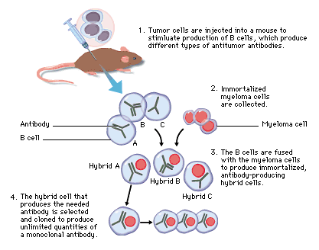
Monoclonal antibody production

Slide 21
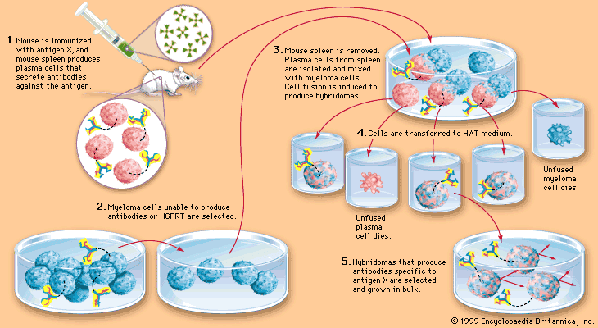

Slide 22
Given almost any substance, it is possible to produce monoclonal antibodies that specifically bind to that substance; they can then serve to detect or purify that substance.
This has become an important tool in biochemistry, molecular biology and medicine. When used as medications, the non-proprietary drug name ends in –mab.

Slide 23
Proteins
Proteins made of amino acids are large, complex molecules that do most of the work in cells and are required for the structure, function, and regulation of the body’s tissues and organs.
Protein biotechnology is emerging as one of the key technologies of the future for understanding the development of many diseases like cancer or amyloid formation for better therapeutic intervention.

Slide 24
Recombinant DNA Technologies
Genetic modification of organisms is done by Fusion of any DNA fragment to DNA molecules able to maintain themselves by autonomous replication.
Recombinant DNA Products
Recombinant Deoxyribonucleic Acid is the genetically engineered DNA created by recombining fragments of DNA from different organisms.

Slide 25
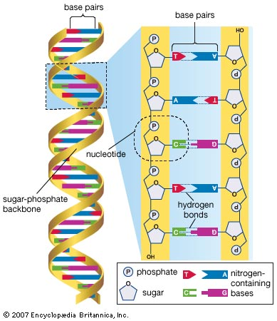
Recombinant DNA Technologies
Genetic modification of organisms is done by Fusion of any DNA fragment to DNA molecules able to maintain themselves by autonomous replication. Such molecules called replicons

Slide 26
Recombinant DNA Technologies
Plasmids: a small circle of DNA that replicates itself independently of chromosomal DNA, especially in the cells of bacteria.
For the application of plasmids in biotechnology, one has to fuse foreign DNA fragment to the isolated plasmid in order to create a recombinant DNA molecule;
the technology for this, the so-called recombinant DNA technology or DNA cloning technology.

Slide 27
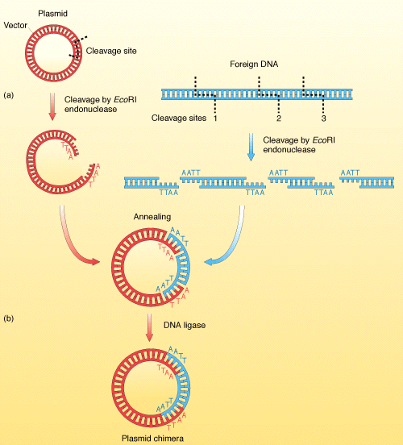
Recombinant DNA

Slide 28
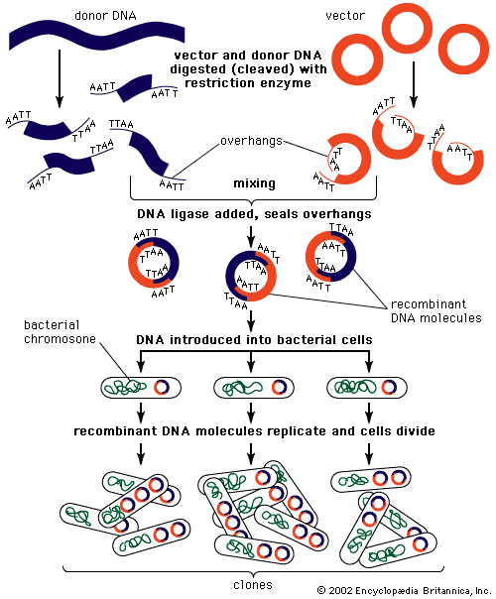

Slide 29
Notes:
Replicons used as carriers for foreign DNA fragments are termed vectors.
These include mainly plasmids from bacteria or
yeast, or DNA from bacteroviruses, animal , viruses or plant viruses.
Foreign DNA-isolated either from microbial, plant or animal cell with recognition site for the enzyme.
Restriction enzyme used to cut DNA at a specific site.
Recombinant DNA not covalently closed requires enzyme (ligase) to close circular DNA.

Slide 30
Recombinant DNA molecule is biologically of no interest as long as they reside in reaction tube.
Introduction of recombinant DNA into a host cell leads to form (transformant).
If the vector that served the construct is able to replicate in the host, all daughter cells will inherit a precise copy (a clone) of the recombinant DNA molecule.

Slide 31
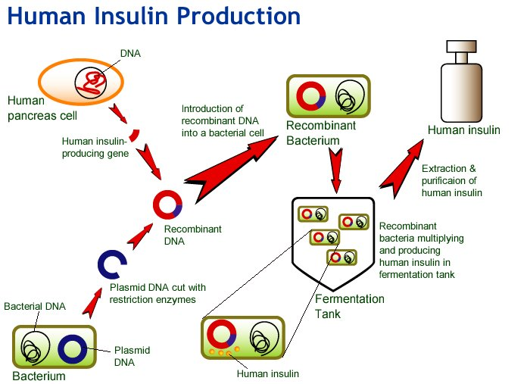
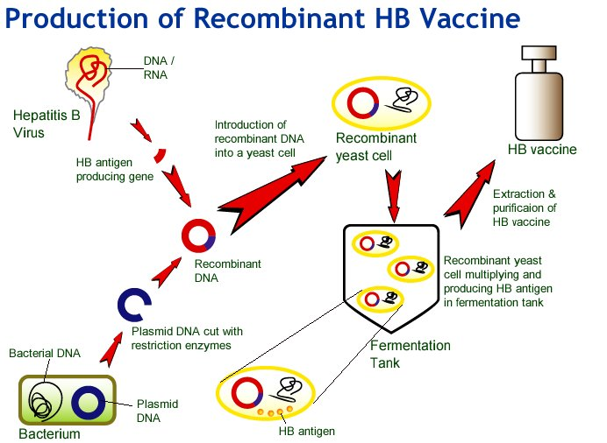

Slide 32


