Slide 2
Introduction
Protozoa are unicellular organisms, have all the essential organelles that help them in their essential activities, all of them are microscopic, most of them lives singly but many others are living in a colonies.
The main groups of parasitic protozoa are Amebae, the Flagellates and Ciliates.

Slide 3
I Amoeba
The member of amoeba group move by means of cytoplasmic extensions that are projected and retracted in response to external stimuli, it is called pseudopodia (the single pseudopodium).
All amebae have a trophozoite stage in which there is multiplication by binary fission as long a environmental conditions are favorable.
Many species also have an encysted stage that is more resistant to unfavorable conditions and that provides an opportunity for transfer from one host to the next.

Slide 4
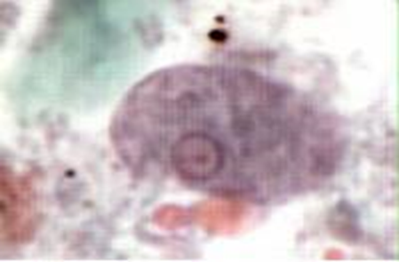
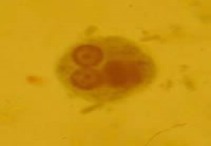
Amebiasis Amebic Dysentery
Causal agent: Entamoeba histolytica is well recognized as a pathogenic amoeba.
Morphology
trophozoite
cyst(1, 2, 4 nuclei)

Slide 5
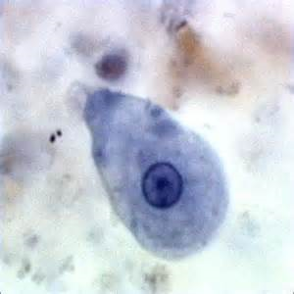
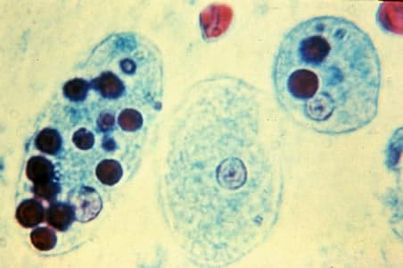
Trophozoite character :
The trophozoite lives in the last part of the small intestine and in the large intestine .
it varies from (12-30µ) in diameter
The nucleus rounded, viscular, surrounded by a delicate nuclear membrane which is studded on its inner surface with minute regular chromatin granules. In the center of the nucleus there is a single dense bead-like chromatin body called the karyosome or endosome (centric karyosome).
4-There are many food vacuoles containing parts of epithelial cells, Bacteria & some times many R.B.Cs

Slide 6
Entamoeba histolytica trophozoite

Slide 7
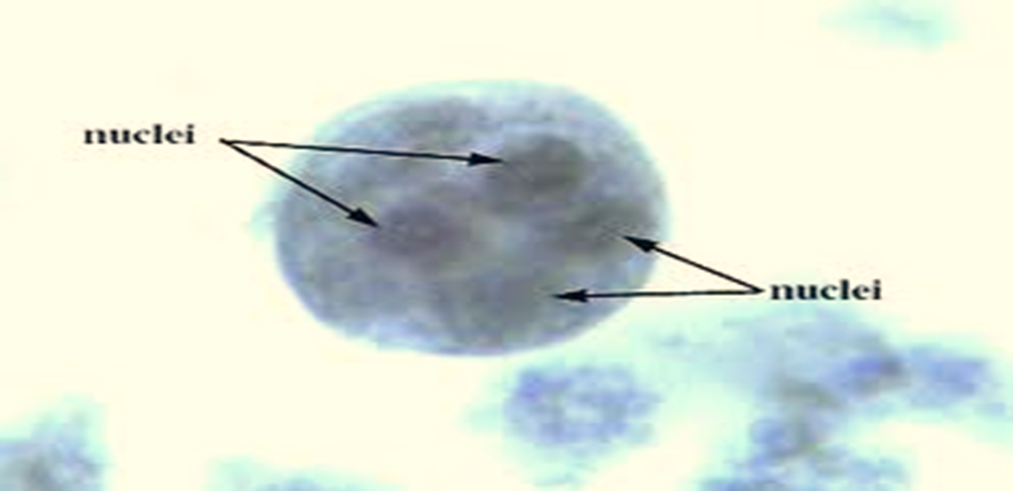
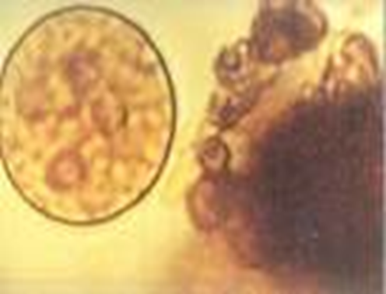
Cyst
The mature cyst typically has (4) nuclei. The cyst arrange between (5-10µ) in diameter, spherical or may has oval shape.

Slide 10
Pyogenic- Liver Abscess

Slide 11
Microscopic identification
This can be accomplished using:
Fresh stool: wet mounts and permanently stained preparations (e.g., trichrome).
Concentrates from fresh stool: wet mounts, with or without iodine stain, and permanently stained preparations (e.g., trichrome).

Slide 12
2-Entamoeba coli
It has cosmopolitan distribution (world-wide distribution).
It has (2) stages, trophozoite and cyst.
The diameter of the trophozoite is (15-50µ), it has spherical shape, the ectoplasm couldn’t recognize from the endoplasm, the food vacuoles contain bacteria and other enteric microbes.
The nuclear membrane studded from the inner surface with large irregular chromatin granules, (ecentric and large karyosome).
The trophozoite has a sluggish movement, short extended pseudopodia.

Slide 13
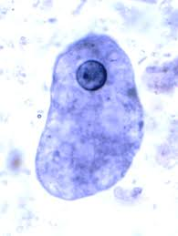
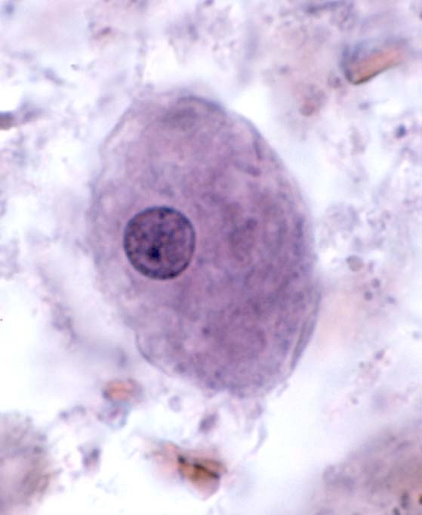
Entamoeba coli (trophozoite)

Slide 14
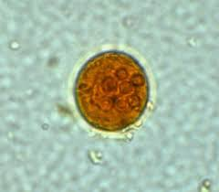
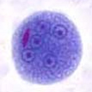
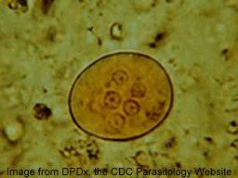
Cyst stage
The mature cyst has a diameter (10-35µ)
(8) nuclei
The chromatoid bodies have an irregular sharp ended (splinter-like)
Entamoeba coli (cyst)

Slide 15
General information
Definitive Host: Humans
Intermediate Host: None
Mode of transmission: Ingestion of contaminated food and water.

Slide 16
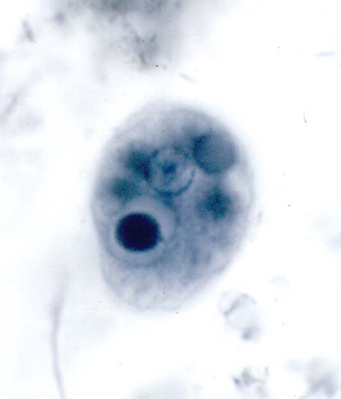
3-Entamoeba gingivalis
It is a parasite of the mouth of man and other mammals including (monkeys, dogs and cats).
Only the trophozoite stage.
It measures (5-35µ) in diameter.
Fingerlike pseudopodia , finely granular endoplasm, and clear ectoplasm.
Mode of transmission: Direct oral contact (kissing).

Slide 17
4- Endolimax nana
It has a world – wide distribution , commensal in the lumen of the caecum and lower level of the large intestine.
It is appear into (2) stages , trophozoite and cyst.
The trophozoite is (6-18µ) in diameter (the cause of the name).
The endoplasm finely granular .
Large karyosome (ecentric).
Short fingerlike pseudopodia.
The cyst (5-14µ) , it has (4) nuclei.

Slide 18
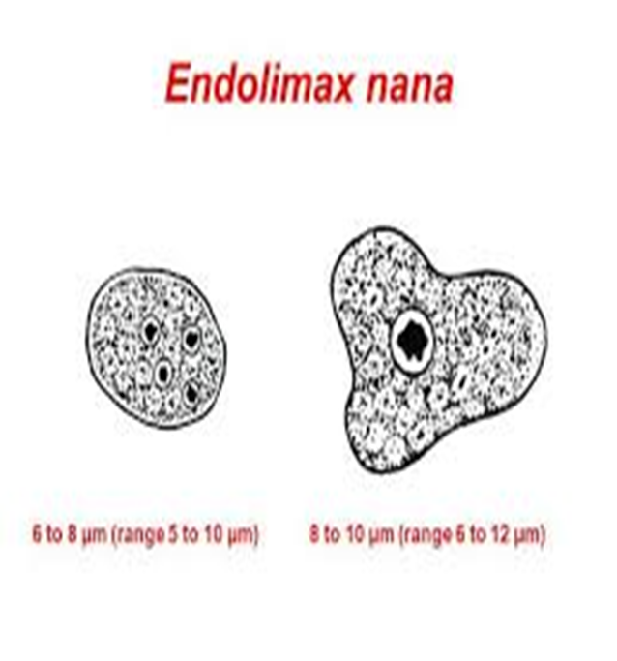

Slide 19
5-Iodamoeba butschlii
The parasite has cosmopolitan distribution, but it is seldom as common as E. coli & E. nana. It is commensal; living in the lumen of the large intestine especially the caecum.
It has (2) stages, trophozoite & cyst.
The trophozoite movement is sluggish; the ectoplasm is not easily distinguished from the endoplasm.
It is measures (8-20µ) in diameter, the vacuoles contain bacteria.
The nucleus spherical, vesicular and has rather thick membrane and large karyosome (centric or somewhat ecentric in position).

Slide 20
Iodamoeba butschlii ((trophozoite

Slide 21
The cyst is variable in shape, usually irregular rounded (ovoid), and (5-18µ) in diameter, usually contain one nucleus.
There is a relatively (big mass of glycogen that stains deep brown with iodine) [the cause of the name Iodo.], it is also help to differentiates this parasite from other intestinal amebae

Slide 22
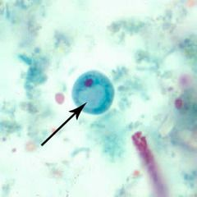
Iodamoeba butschlii (cyst)

