Slide 1
Medical Parasitology
lab. 3

Slide 2
II The flagellates
The flagellate protozoa that are parasites of man are conveniently discussed as:
(A) flagellates of the digestive tract and genital organs
(B) flagellates of the blood and tissues
Giardia lamblia
Trichomonas vaginalis
Leishmania ssp.
Trypanosoma ssp.
Classification
Kingdom : Protista
Phylum : Protozoa
Sub-phylum: Mastigophora
Class : Zoomastigophorea

Slide 3
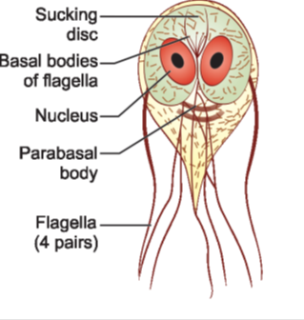
1- Giardia lamblia (It causes: Giardiasis)
This parasite infects the children more than the bigger people.
Morphology: It exists in 2 forms
Trophozoite (or vegetative form)
Cyst (or cystic form).
Trophozoite
The trophozoite is in the shape of a tennis racket (heartshaped or pyriform shaped) and is rounded anteriorly and pointed posteriorly.
measures 15 μm x 9 μm wide and 4 μm thick.
Dorsally, it is convex and ventrally, it has a concave sucking disc, which helps in its attachment to the intestinal mucosa.
It is bilaterally symmetrical and possesses.
 1 pair of nuclei
 4 pairs of flagella
Blepharoplast, from which the flagella arise (4 pairs)
 1 pair of axostyles, running along the midline
Two sausageshaped
parabasal or median bodies,
lying transversely posterior to the sucking disc.
The trophozoite is motile, with a slow oscillation about
its long axis, often resembling falling leaf.

Slide 4
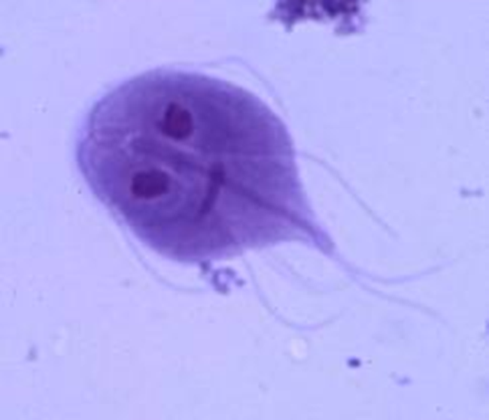
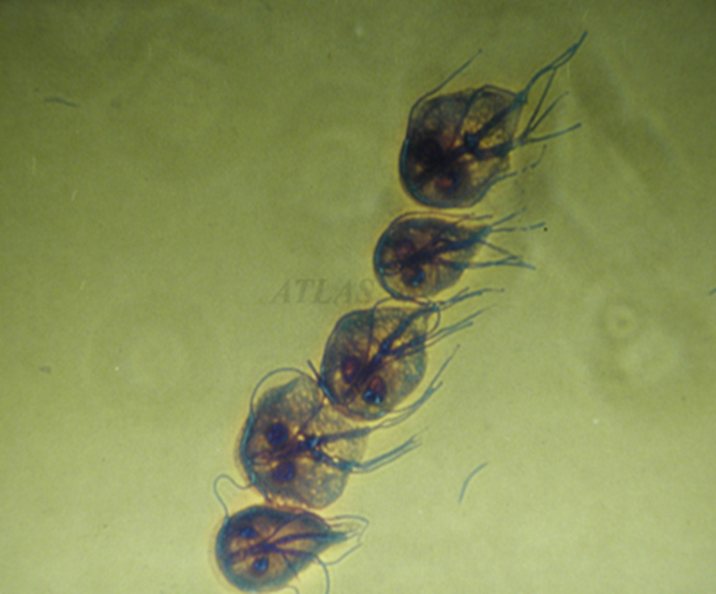
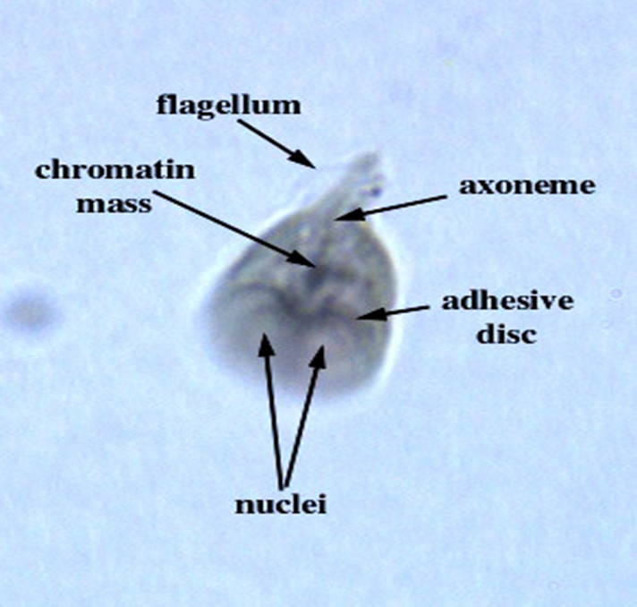
Giardia lamblia (Trophozoite) : Two symmetric nuclei, a median body, and 4 paired flagella are seen

Slide 5
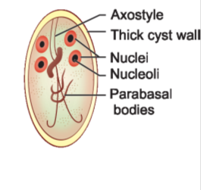
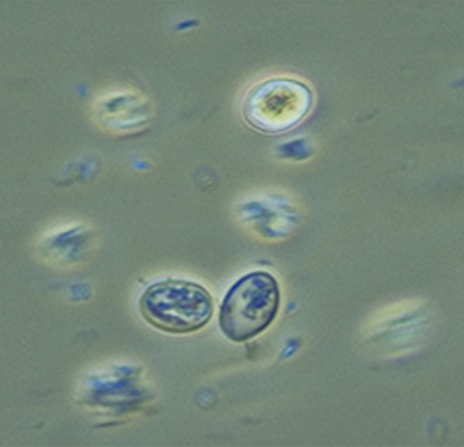
Cyst
It is the infective form of the parasite.
The cyst is small and oval, measuring 12 μm x 8 μm and is surrounded by a hyaline cyst wall.
Its internal structure includes 2 pairs of nuclei grouped at one end.
A young cyst contains 1 pair of nuclei.
The axostyle lies diagnonally, forming a dividing line within cyst wall.
Remnants of the flagella and the sucking disc may be seen in the young cyst.
Giardia lamblia (cyst)

Slide 6
Life Cycle
Giardia passes its life cycle in 1 host.
Infective form: Mature cyst.
Mode of transmission:
 Man acquires infection by ingestion of cysts in contaminated water and food.
 Direct persontoperson transmission may also occur in children, male homosexuals.
 Within half an hour of ingestion, the cyst hatches out into two trophozoites, which multiply successively by binary fission and colonize in the duodenum .
The trophozoites live in the duodenum and upper part of jejunum, feeding by pinocytosis.
During unfavorable conditions, encystment occurs usually in colon .
Cysts are passed in stool and remain viable in soil and water for several weeks.
There may be 200,000 cysts passed per gram of feces.
Infective dose is 10–100 cysts.

Slide 7
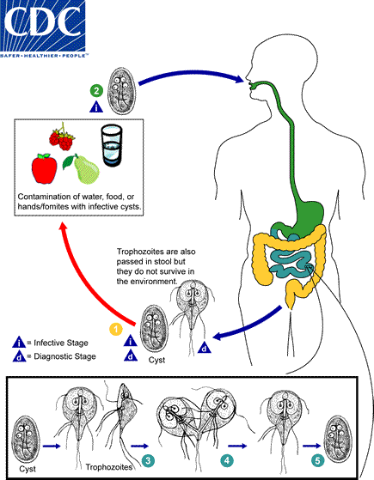
Life Cycle : Giardia lamblia

Slide 8
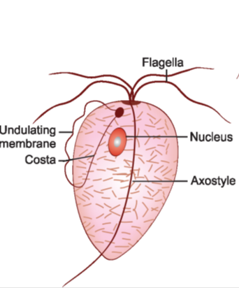
2-Trichomonas vaginalis (It causes: Trichomoniasis) or (Trichomonas vaginitis)
Morphology
It is pear-shaped or ovoid and measures 10–30 μm in length and 5–10 μm in breadth with a short undulating membrane reaching upto the middle of the body .
It has one nucleus(large in size).
It has four anterior free flagella with fifth one turn back to the half of the body forming undulating membrane.
A prominent axostyle runs throughout the length of the body and projects posteriorly like a tail.
The cytoplasm shows prominent siderophillic granules, which are most numerous alongside the axostyle and costa.
It is motile with a rapid jerky or twitching type movement.
It is found only in a trophozoite stage (There is no cyst stage).

Slide 9
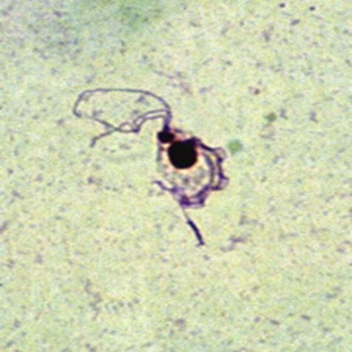
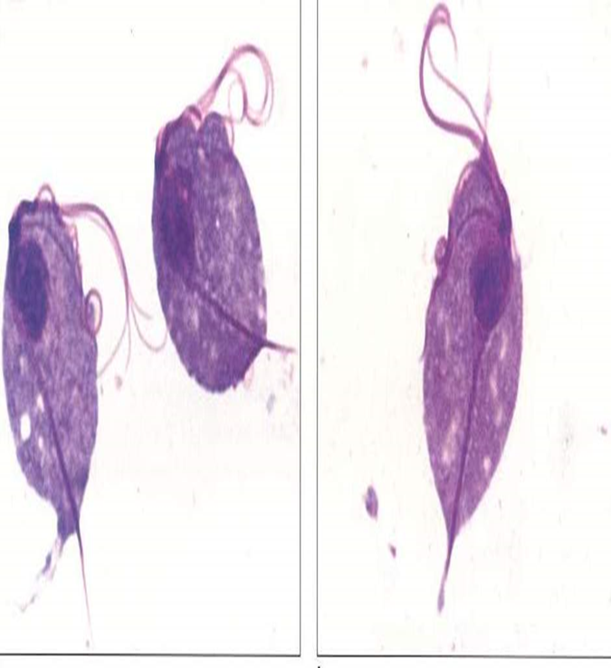
Trichomonas vaginalis (trophozoite stage )

Slide 10
Life Cycle
T. vaginalis is completed in a single host either male or female.
Its habitat is the human vagina (in females) and the genital tract (in males) and probably localized in the prostate gland and the urethra. Mostly non-pathogenic for male, but sometimes causes urethritis.
Mode of transmission:
The trophozoite cannot survive outside and so infection has to be transmitted directly from personto-person. Sexual transmission is the usual mode of infection.
Multiplication by longitudinal binary fission.
Incubation period is roughly 10 days.
Diagnosis
Microscopic examination
Vaginal or urethral discharge is examined microscopically in saline wet mount preparation for characteristic jerky and twitching motility and shape. In males, trophozoites may be found in urine or prostatic secretions.
Fixed smears may be stained with (Giemsa stains).

Slide 11
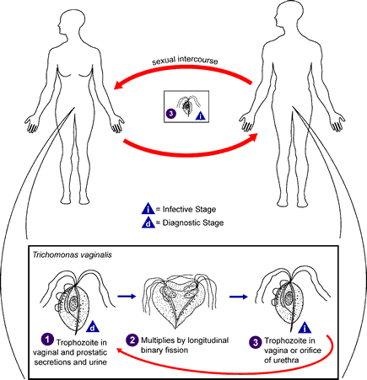
Life Cycle :Trichomonas vaginalis

Slide 12

III Ciliates
It constitutes a group characterized by numerous cilia.
Classification
Kingdom : Protista
Phylum : Protozoa
Sub-phylum: Ciliophora
Class : Ciliata

Slide 13
Morphologic
It has two stages trophozoite & cyst.
The trophozoite lives in the lumen of the cecum.
it is feeding on the host cells, bacteria,
the food substances in the tissue or the intestine contents.
Trophozoite
• Oval in shape.
• Has two nuclei macro-nucleus( is kidney-shap)
and micro-nucleus.
• Anterior end pointed with cytosome.
• Posterior end rounded.
Cyst
Spherical or oval shape .
• Two nuclei macro-nucleus (is kidney-shap )
and micro nucleus.
• Surrounded by thick layer.
Diagnosis of B. coli
By demonstration of trophozoites
and cysts in feces.
Morphology of Balantidium coli
A. Trophozoites B. Cyst

Slide 14
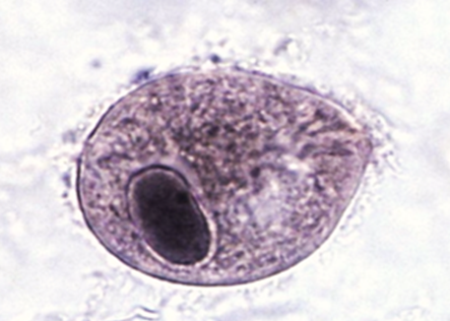
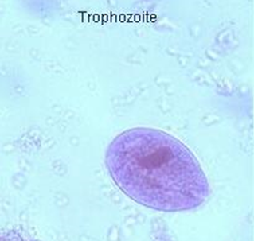
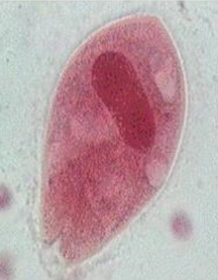
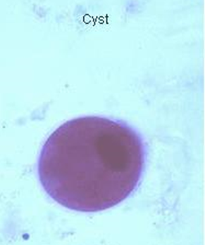
Balantidium coli ( Trophozoites)
Balantidium coli ( Cyst)

