Slide 1
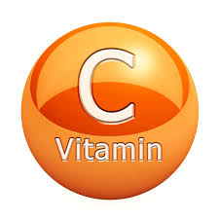
Ascorbic Acid (vitamin C)

Slide 2
What is vitamin C?
It is one of the most abundant vitamins that is required in large amounts by humans.
Dietary sources :
Vitamin C is found in a wide variety of fruits and vegetables.
Fats and meat are lacking of vit.C except liver

Slide 4
Vitamin C chemistry

Slide 5
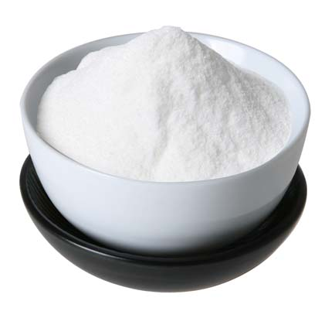
It forms white crystals which are stable in air

Slide 6
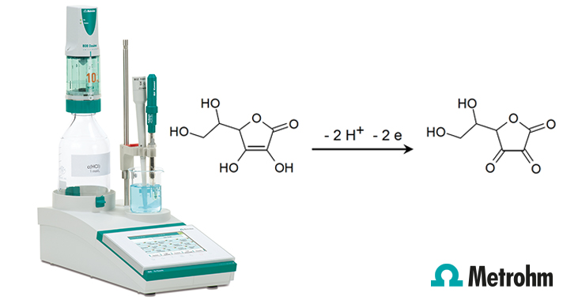
In solution, it is easily oxidized into dehydro ascorbic acid and this is the basis for analysis of vitamin C.

Slide 7
It is stable in acidic solutions
Both reduced and oxidized forms are biologically active
The only animals that can not synthasize ascorbic acid are:
Guinea pigs
Rare species of bats
Gorillas

Slide 8
Chimps
Monkeys
Humans
Recommended dietary requirements of vitamin C:
1-3 months infants: 30 mg/day
Growing boys: 80 mg/day
Pregnant and lactating women: 100 mg/day

Slide 9
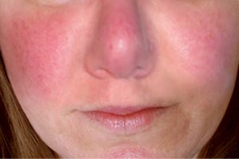
Side effects of Vitamin C over-dose:
Diarrhea
Redness of skin
Headache
Nausea
Side or lower back pain
Stomach cramps

Slide 10
Functions of ascorbic acid:
Collagen synthesis
Nor-epinephrine synthesis
Iron absorption
Steroid hormone synthesis
Antioxidant
Improves nitric oxide activity in blood vessels dilation
Reduce sorbitol accumulation in eyes, nerves and kidneys

Slide 11
Drug metabolism and detoxification
Carnitine synthesis
Increase macrophage activity
Cancer prevention
Formation of bile
Certain vitamin activation: folic acid
Vitamin E recycling
Antihistamine effect

