Slide 1
Synthesis of Hippuric Acid (Benzoyl Glycine)

Slide 2
Amino acids
Amino acids are organic compounds composed of carbon, hydrogen, oxygen, nitrogen, and occasionally sulfur. They serve as the fundamental building blocks of proteins, functioning in numerous biological processes within living organisms. Each amino acid contains both an amino group (-NH₂) and a carboxyl group (-COOH), allowing them to exhibit amphoteric properties. Under physiological pH (around 7.4), these groups become ionized, resulting in a zwitterionic form where the overall net charge is zero, thus making amino acids electrically neutral in biological systems.

Slide 3
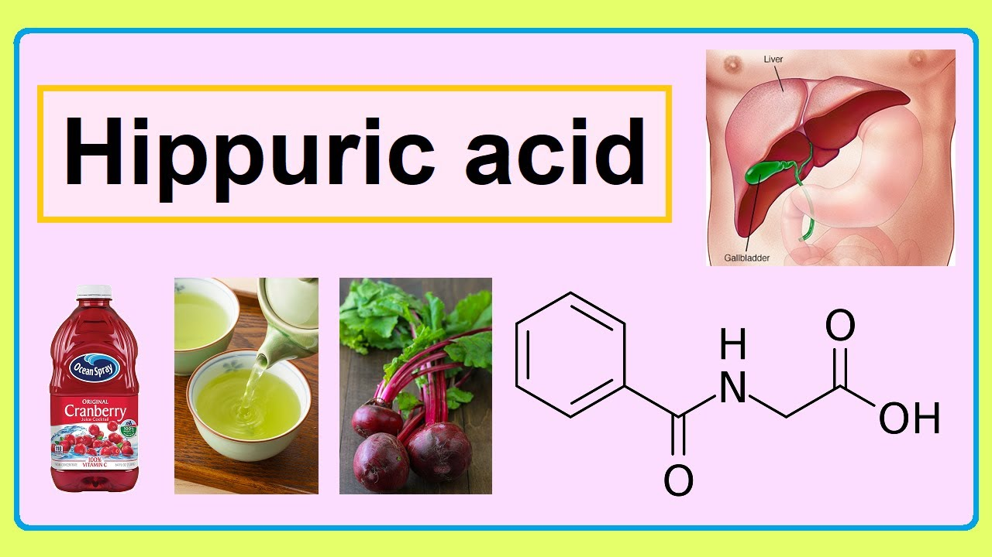
Hippuric Acid (Benzoyl Glycine)
Benzoyl glycine is an amide and amide contains a molecule of an organic acid linked to a molecule of an amine. A water molecule must be removed to make the new C–N bond. The –OH part comes from the –COOH group, while the –H from the –NH2 group.
This reaction cannot be completed by simple mixing of the acid and the amine compounds because the result of the reaction would be an acid-base neutralization reaction which occur much faster, and the –OH is a very poor leaving group.
Thus, the acid must be changed into a derivative first which is more reactive – most often an acid chloride, which has no acidic H and does have an excellent leaving group. Then the glycine (amine) can be mixed and it acts as a nucleophile instead of a base, now attacking the carbonyl carbon of –COCl group of benzoyl chloride

Slide 4
Steps Biosynthesis of Hippuric Acid in the Human Body
Hippuric acid is primarily synthesized in the human body through the conjugation of benzoic acid with glycine. This process mainly occurs in the liver, but it can also take place in the intestines and kidneys.
Here's a simplified overview of the biosynthesis process:
Benzoic Acid Formation: Benzoic acid can be derived from the metabolism of phenolic compounds found in foods like fruits, tea, and wine.
Conjugation with Glycine: In the liver, benzoic acid is converted to benzoyl-CoA, which then reacts with glycine to form hippuric acid.
Excretion: Hippuric acid is then excreted in the urine, serving as a detoxification mechanism for the body.
This process helps in detoxifying harmful substances and is a crucial part of the body's metabolic functions.

Slide 5
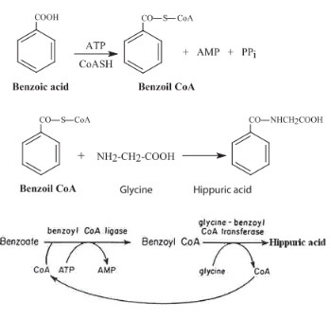
Biosynthesis of Hippuric Acid in the Human Body

Slide 6
Interaction Name :Schotten–Baumann reaction
Interaction Type : nucleophilic acyl substitution

Slide 7
These steps outline the nucleophilic acyl substitution mechanism involved in synthesizing hippuric acid.
Activation of Glycine in Basic Medium: In the presence of a base (such as NaOH), glycine is deprotonated. This increases the nucleophilicity of its amino group (–NH₂), making it more reactive toward electrophilic centers.
Nucleophilic Attack on Benzoyl Chloride: The lone pair of electrons on the nitrogen of the deprotonated glycine attacks the electrophilic carbonyl carbon of benzoyl chloride (C₆H₅–C(=O)–Cl). This attack breaks the carbonyl double bond, pushing the electrons onto the oxygen and forming a tetrahedral intermediate.
Formation of the Tetrahedral Intermediate: The resulting tetrahedral intermediate consists of:
A benzoyl group (C₆H₅)
A chloride ion (Cl) still attached to the carbon
The nucleophilic glycine moiety (–NH–CH₂–COOH)
An oxygen bearing a negative charge (O⁻)
Collapse of the Tetrahedral Intermediate: The negatively charged oxygen donates its electrons to re-establish the carbonyl double bond. This process causes the chloride ion (Cl⁻) to be expelled as the leaving group.
Formation of Hippuric Acid: The collapse of the intermediate results in the formation of N‑benzoylglycine (hippuric acid), where an amide bond is established between the benzoyl group and glycine. Any HCl produced during the reaction is neutralized by the base present, driving the reaction to completion.

Slide 9
Procedure:
Dissolve Glycine:
Dissolve 1 g of glycine in 10 ml of 10% NaOH solution in a flask.
Add Benzoyl Chloride:
Add 1.5 ml of benzoyl chloride to the flask containing the glycine solution.
Plug and Shake:
Plug the mouth of the flask with a cotton plug.
Shake the mixture vigorously until the smell of benzoyl chloride can no longer be detected.
Acidify the Mixture:
Add 1-2 drops of concentrated HCl to the mixture to make it acidic.
Filter the Product:
Filter the product to separate it from the mixture.
Wash with Water:
Wash the filtered product with water.
Recrystallize:
Recrystallize the dried product from boiling water (about 20 ml) with the addition of a little decolourising charcoal.
Filter Through Hot-Water Funnel (if necessary):
If necessary, filter the solution through a hot-water funnel.
Allow to Crystallize:
Allow the solution to crystallize.
Collect the Product:
Collect the benzoylglycine crystals using a Buchner funnel.
Dry the Product:
Dry the collected benzoylglycine in an oven.

Slide 10
The physical properties of hippuric acid (benzoyl glycine) include:
Molecular formula: C₉H₉NO₃
Molecular weight: 179.17 g/mol
Appearance: White crystalline solid
Melting point: Approximately 187–191°C
Solubility:
Soluble in hot water
Slightly soluble in cold water
Soluble in alcohol and ether
Odor: Odorless
Taste: Slightly bitter
Stability: Stable under normal conditions, but may decompose upon strong heating .

Slide 11
calculations
% Yield = (Practical Yield)/(Theoretical Yield) × 100

Slide 12
Note: A sacrificial base stronger than glycine’s N must be present to “soak up” protons formed. It is again important, to limit the amount of hydroxide to only what is needed to neutralize the released H+.

