Slide 1
Synthesis of benzoic acid from benzyl alcohol

Slide 2
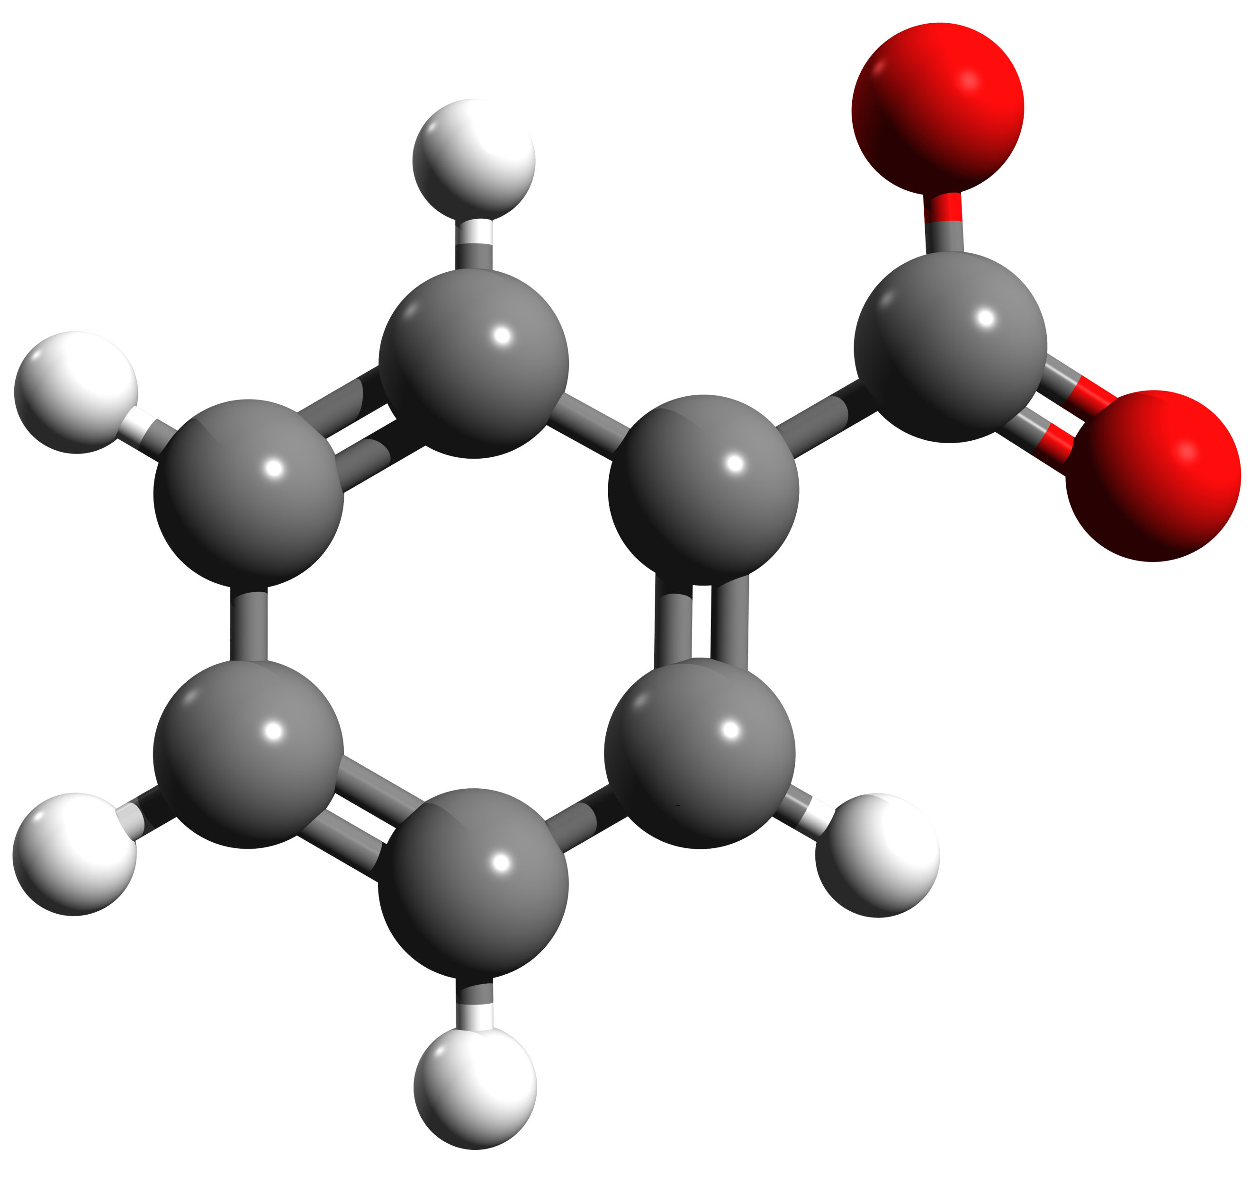
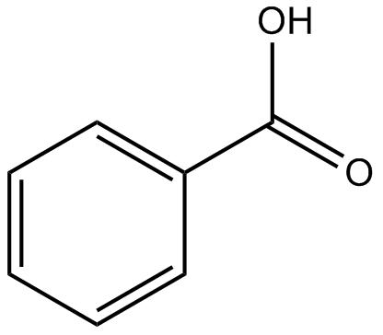
Benzoic acid
What is Benzoic Acid?
Benzoic acid is the simplest benzene ring containing carboxylic acid. Its most common natural source is gum benzoin. This gum benzoin is a resin found in the bark of trees of the genus Styrax. Benzoic acid is a commonly seen product in many industrial and household applications. It has a certain pleasant smell.
Benzoic Acid Structure?
It is an aromatic compound with molecular or structural benzoic acid formula C6H5COOH and an empirical benzoic acid formula C7H6O2. The structure consists of a carboxylic acid group connected to a benzene ring.
The benzoic acid structure comprises six hydrogen atoms, seven carbon atoms, and two oxygen atoms. Six carbon rings have alternate single and double covalent bonds and the -COOH group. The benzoic acid structure is given below:

Slide 3
Pharmaceutical Applications
Preservative in Formulations: Benzoic acid is widely used as an antimicrobial preservative in various pharmaceutical products, preventing the growth of bacteria and fungi.
Topical Preparations: Due to its antifungal and antibacterial properties, it is incorporated into creams, ointments, and other skin care products to help treat minor skin infections.
Antifungal Agents: Some antifungal medications include benzoic acid or its derivatives as an active ingredient to combat fungal infections.

Slide 4
Industrial Applications:
Food Preservation:
As a food preservative, benzoic acid helps extend the shelf life of products by inhibiting microbial growth.
It is used in the production of various cosmetics, shampoos, and personal care items to maintain product stability and prevent spoilage.
Benzoic acid serves as a building block in the synthesis of polymers, adhesives, and other chemical products, making it an important compound in industrial chemistry.

Slide 5
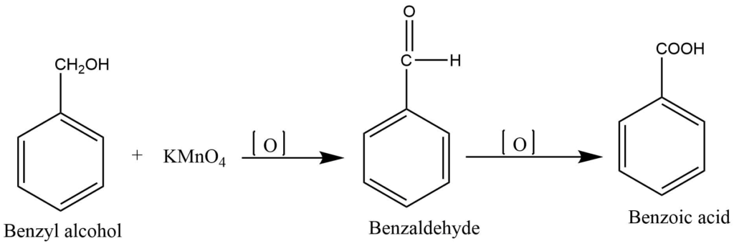
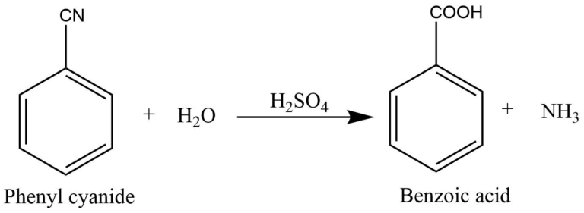
Laboratory preparation of Benzoic Acid
Oxidation of benzyl alcohol
Hydrolysis of phenyl cyanide with acid
The action of carbon dioxide with Grignard reagent

Slide 6
The mechanistic steps for the oxidation of benzyl alcohol to benzoic acid using potassium permanganate (KMnO₄):
Hydrogen Abstraction:
KMnO₄ initiates the reaction by abstracting a hydrogen atom from the methylene group (–CH₂OH) of benzyl alcohol, forming a benzyl alkoxide or radical intermediate.
Formation of Benzaldehyde:
The intermediate undergoes further oxidation, incorporating an oxygen atom from KMnO₄ to convert the –CH₂OH group into an aldehyde group (–CHO).
This step produces benzaldehyde (C₆H₅CHO) along with water as a byproduct.
Oxidation of Benzaldehyde to Benzoic Acid:
Under the strong oxidative conditions provided by KMnO₄, benzaldehyde is further oxidized.
The aldehyde group (–CHO) is transformed into a carboxylic acid group (–COOH), yielding benzoic acid (C₆H₅COOH).
Note: Although the reaction may involve several intermediate electron transfer steps and transient species, the overall transformation proceeds from benzyl alcohol to benzaldehyde and finally to benzoic acid.

Slide 7
procedure
1.5 g of potassium permanganate was accurately weighed and transferred into a conical flask. Subsequently, 30 mL of distilled water was added to the flask.
The conical flask was placed on a hotplate and heated at 60–70 °C for 3–5 minutes to dissolve the potassium permanganate.
1 mL of benzyl alcohol was gradually added to the mixture.
The solution was observed to change from purple to brown, indicating that an oxidation process is taking place. Then continue to react after the last drop for 5 minutes.
Filtration was performed using two filter papers, and the colorless filtrate, containing the acid salt, was collected. Subsequently, a few drops of concentrated hydrochloric acid were added until a white precipitate of benzoic acid formed.
The benzoic acid was recrystallized using hot water.
MnO4 MnO2

Slide 8
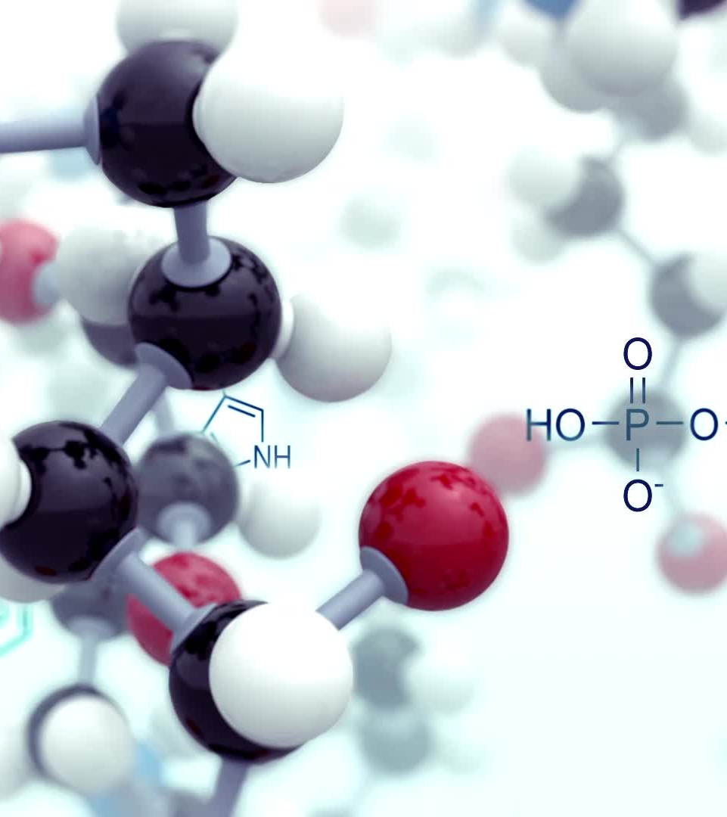
Physical Properties of Benzoic Acid
State: Benzoic acid is a white or colourless crystalline solid.
Solubility: Benzoic acid is slightly soluble in water, but it is highly soluble in organic solvents like ethanol and hot water.
Density: Benzoic acid has a density of around 1.27 grams per cubic centimeter.
Odor: Benzoic acid generally has a pleasant, fruity smell.
Molecular weight: The molecular weight of benzoic acid is 122.12 g/mol.
Melting Point of Benzoic Acid:The melting point of Benzoic acid is about 122° Celsius.

Slide 9
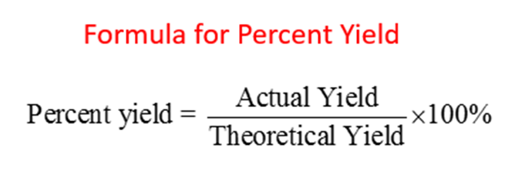
calculations

Slide 10
Notes:Using KMnO₄ provides strong oxidative conditions that convert the formed benzaldehyde directly into benzoic acid without isolating the aldehyde.This choice makes KMnO₄ the preferred oxidizing agent in this reaction compared to others, such as potassium dichromate (K₂Cr₂O₇), which might stop the reaction at the aldehyde stage.In this way, benzoic acid is obtained as the final product from the oxidation of benzyl alcohol using potassium permanganate.

