Slide 1

Non- steroidal anti inflammatory drugs (NSAID)
م.م سرى عباس
م.م نور وفاء

Slide 2
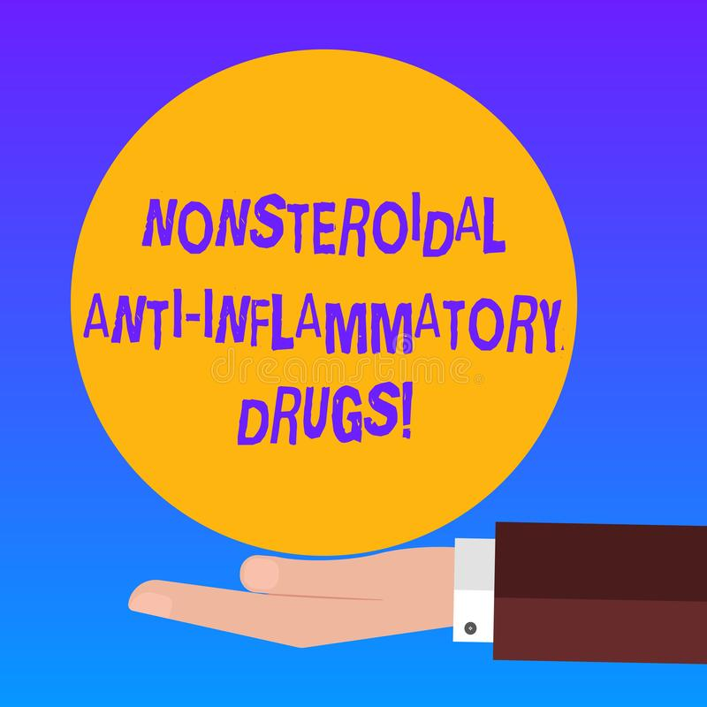
objectives
by the end of the lab you will be able to know the followings about NSAID:
Indications
Classifications of NSAID
Side effect
Dose
Caution and contra-indications

Slide 3
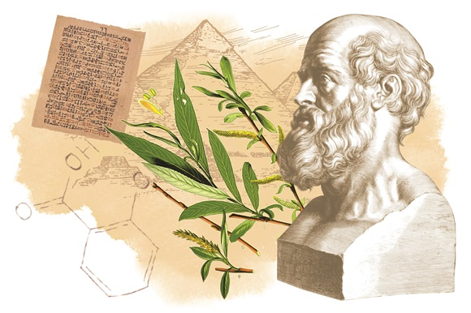

Slide 4
NSAID according to chemical structure

Slide 5

Mechanism of action
NSAIDs reduce the production of prostaglandins by inhibiting the enzyme cyclo-oxygenase.
COX-1( constitutive enzyme )( protective role) (gastric mucosa, kidney, and platelets).
COX-2 (inducible enzyme) (inflammation and local tissue injury

Slide 6
Cox-2
Cox-1
Cox-1

Slide 7
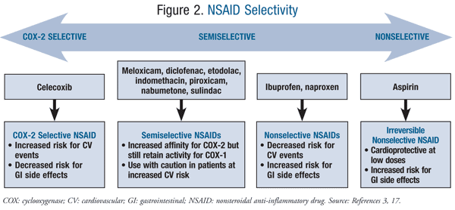
selectivity

Slide 8

INDICATIONS
Pain
Inflammation
Fever
Pain relief occurs rapidly (within hours) with these agents after single dose while full analgesic effect require 1 week. the anti-inflammatory benefits are not realized until after 2 to 3 weeks of continuous therapy.

Slide 9
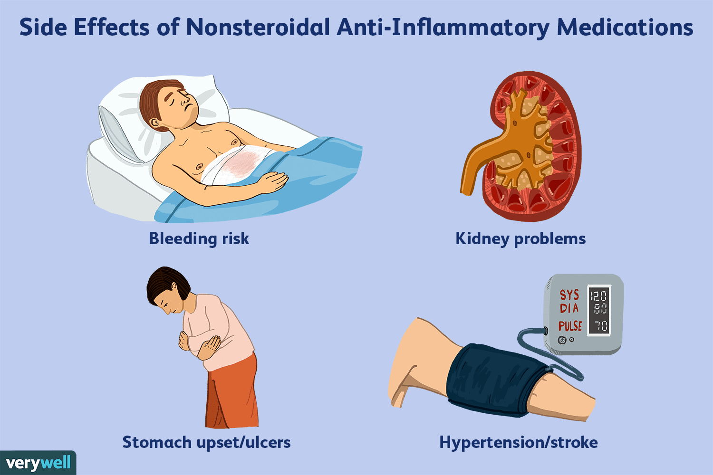

Slide 10
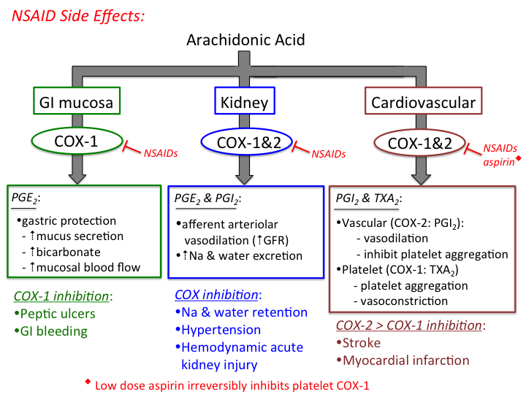

Slide 11
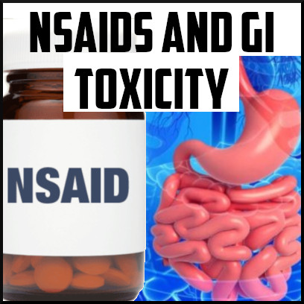
Nsaid effect on GIT
NSAID-induced gastroduodenal mucosal damage primarily results from inhibition of COX-1 in the mucosal lining.
This inhibition of COX-1 decreases bicarbonate secretion, mucosal blood flow, formation of protective mucus, proliferation of gastric epithelium, and the ability of the mucosa to resist injury.

Slide 12
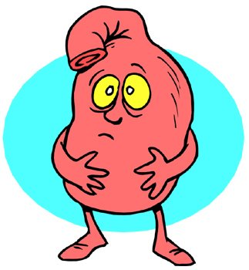
Nsaid effect on GIT
Gastro-intestinal discomfort, nausea, diarrhoea, and occasionally bleeding and ulceration occur.
Systemic as well as local effects of NSAIDs contribute to gastro-intestinal damage.

Slide 13
NSAID and GIT side effects
piroxicam, ketoprofen, and ketorolac trometamol
Indomethacin, diclofenac, and naproxen
Ibuprofen\ selective cox2 inhibitors

Slide 14
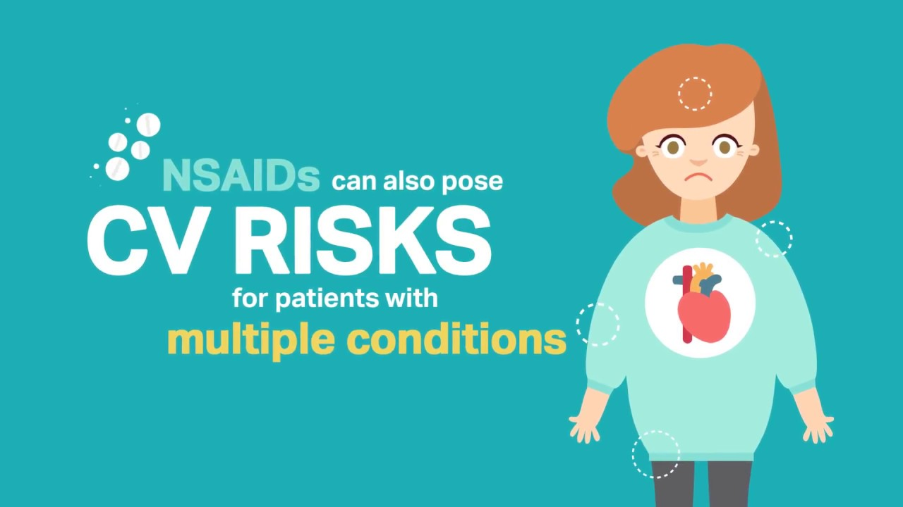

Slide 15
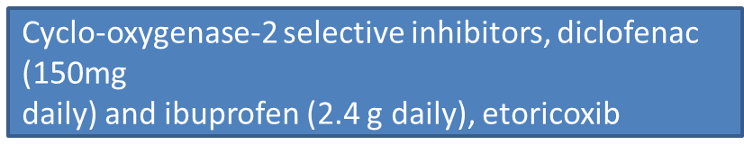
All NSAID use can, to varying degrees, be associated with a small increased risk of thrombotic events (e.g. myocardial infarction and stroke) independent of baseline
cardiovascular risk factors or duration of NSAID use
Naproxen (1 g daily) is associated with a lower thrombotic risk, and low doses of ibuprofen (1.2 g daily or less)

Slide 16
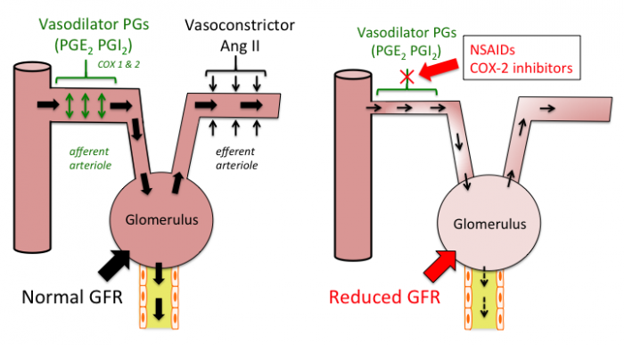
Renal effects

Slide 17
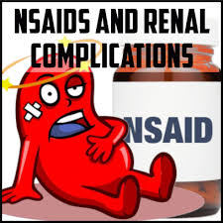
Renal effects
Fluid retention may occur (rarely precipitating congestive heart failure); blood pressure may be raised.
Renal failure may be provoked by NSAIDs, especially in patients with renal impairment. Rarely, papillary necrosis or interstitial fibrosis associated with NSAIDs can lead to renal failure.
some NSAIDs have been associated with sustained mean arterial pressure increases of 5 to 6 mm Hg, presumably the result of COX-2 inhibition and sodium/water retention

Slide 18
Prolongation of bleeding time
Non-aspirin NSAIDs also can prolong bleeding times by inhibiting platelet aggregation, but these drugs bind reversibly to COX resulting in reversible platelet inhibition.
Therefore, non-aspirin NSAIDs should be discontinued about 5 half-lives before surgical procedures. Generally, the impairment of platelet aggregations is reversed within 2 days after the discontinuation of nonaspirin NSAIDs.
Likewise, COX-2 inhibitors are not expected to alter platelet function because COX-2 is not found in platelets

Slide 19
Prolongation of Bleeding Time\ aspirin
Low doses of aspirin irreversibly impair platelet aggregation throughout the life of the platelet by irreversible binding to COX and, thereby, prolong bleeding time for several days because new platelets must be released into the circulation before the bleeding time normalizes
Bleeding times normalize within 3 to 6 days after discontinuation of aspirin. Therefore, aspirin should be discontinued about 7 days before surgery.

Slide 20
asthma
COX-2 inhibitors also have been used safely in aspirin-sensitive asthmatics.
In theory, these agents might be safer because they allow COX-1 to continue producing prostaglandin E₂.
Prostaglandin E₂ is an important mediator of multiple physiological processes, including reduction of leukotriene synthesis, suppression of the release of inflammatory mediators from mast cells, and prevention of aspirin-induced bronchoconstriction.

Slide 21
CONCEPTION AND CONTRACEPTION
Caution—long-term use of some NSAIDs is associated with reduced female fertility, which is reversible on stopping treatment.
PREGNANCY Most manufacturers advise avoiding the use
of NSAIDs during pregnancy or avoiding them unless the
potential benefit outweighs the risk.
NSAIDs should be avoided during the third trimester because use is associated with a risk of closure of fetal ductus arteriosus in utero and possibly persistent pulmonary hypertension of the newborn. In addition, the onset of labor may be delayed and its duration may be increased

Slide 22
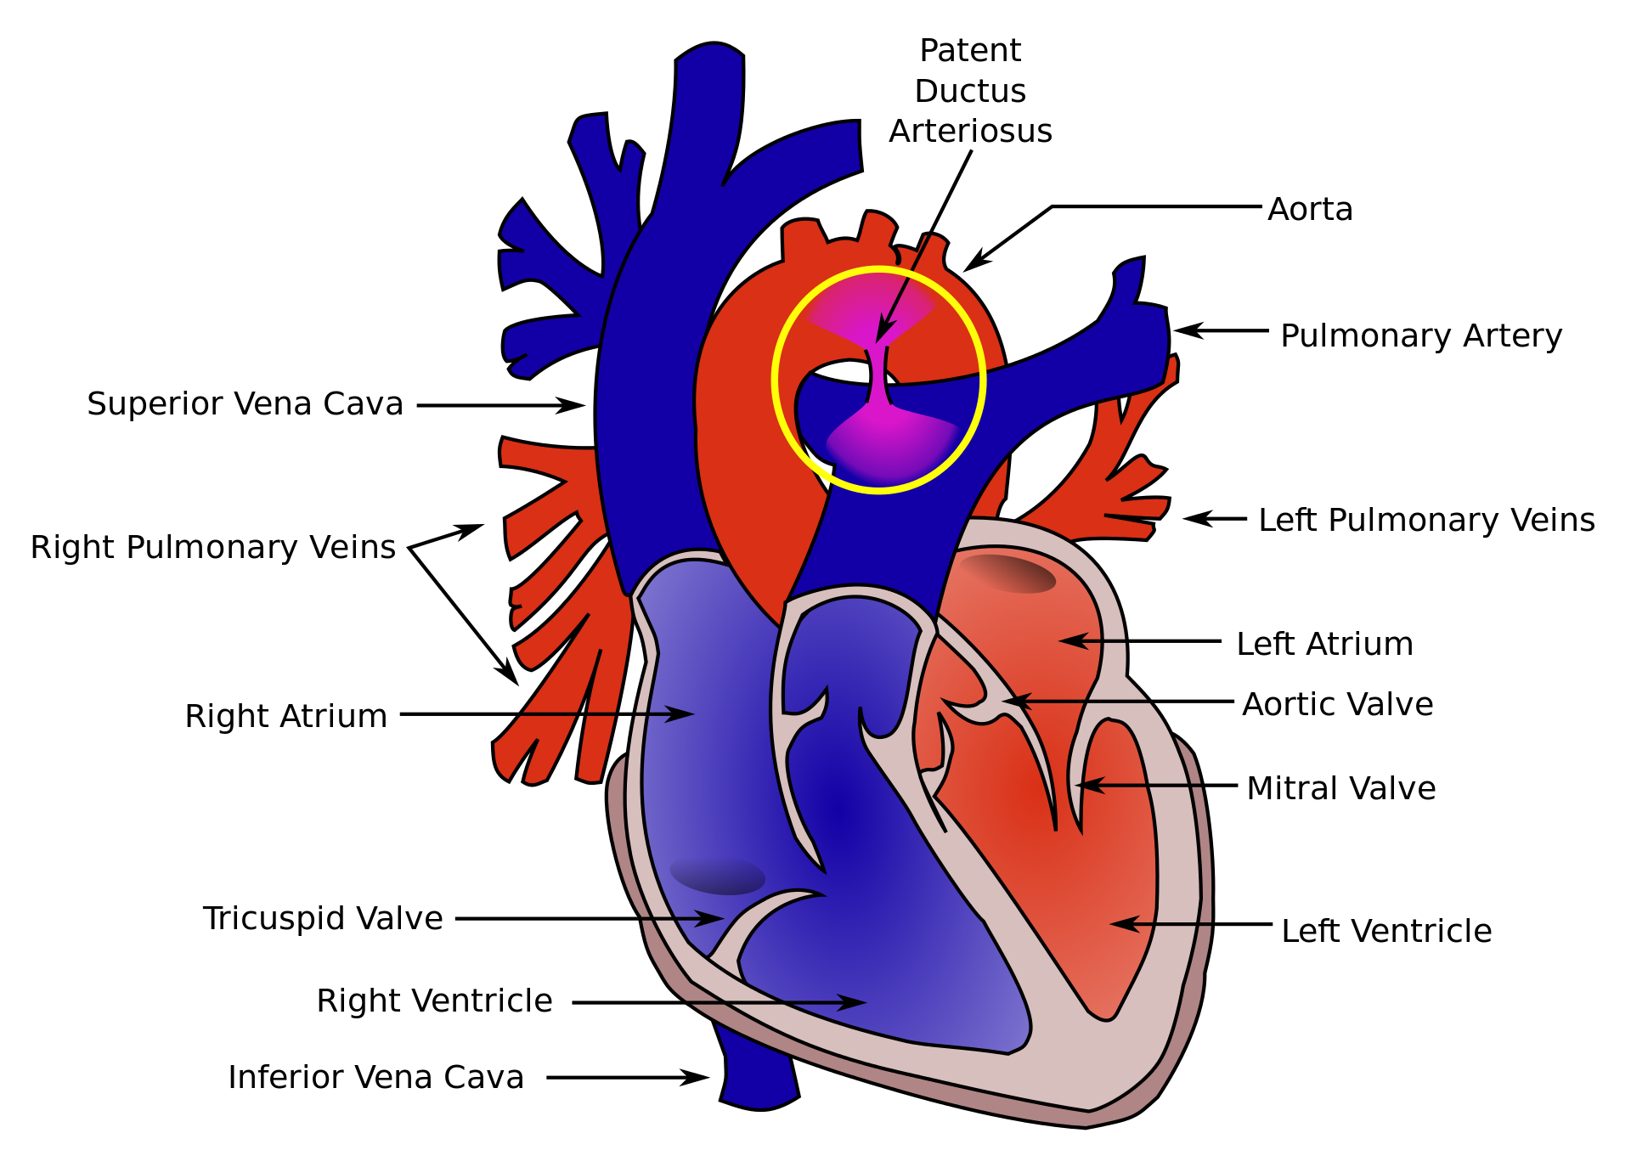

Slide 23
Aspirin classification
Acetylsalicylic acid (ASA; aspirin) is a nonselective COX inhibitor with all the key
features of other NSAIDs (antipyretic, analgesic, antiinflammatory activity), but it is
often classified separately. Reasons include the fact that it irreversibly inhibits the
COX enzyme and as a result has prolonged antiplatelet activity.
The antiplatelet effects of ASA are observed at doses much lower than required for
antiinflammatory or other activities. This is thought to be the case because the
antiplatelet effects are mediated by the irreversible inhibition of COX-1 by the parent
ASA. Salicylic acid, the metabolite of ASA, is a reversible inhibitor of COX, just like
the other NSAIDs. Because the antiplatelet effects of ASA are not affected by first
pass, a much lower dose can be used to achieve platelet inhibition.

Slide 24
Patients instructions
Patients should be taught to recognize the signs and symptoms of GI bleeding (e.g., nausea, vomiting, anorexia, gastric pain), GI bleeding as manifested by melena (described to the patient as “dark, tarry stool”), or emesis of coagulated blood (described to the patient as, “coughing or vomiting up what seems to be coffee grounds”).
It should be emphasized that GI bleeding can occur without gastric pain. The patient should be instructed to contact their health care provider immediately for further instructions if any of these signs or symptoms occur.

Slide 25
CONTRAINDICATIONS AND CAUTIONS
NSAIDs should be used with caution in the elderly (risk of serious side effects and fatalities),
In allergic disorders (they are contra-indicated in patients with a history of hypersensitivity to aspirin or any other NSAID—which includes those in whom attacks of asthma, angioedema, urticaria or rhinitis have been precipitated by aspirin or any other NSAID).
During pregnancy and breast-feeding .

Slide 26
CONTRAINDICATIONS AND CAUTIONS
In coagulation defects.
Long-term use of some NSAIDs is associated with reduced female fertility, which is reversible on stopping treatment.
In patients with renal, cardiac, or hepatic impairment caution is required since NSAIDs may impair renal function ,the dose should be kept as low as possible and renal function should be monitored.
All NSAIDs are contra-indicated in severe heart failure.

Slide 27
CONTRAINDICATIONS AND CAUTIONS
The selective inhibitors of cyclo-oxygenase-2 (celecoxib, etoricoxib, and parecoxib) are contra-indicated in ischaemic heart disease, cerebrovascular disease, peripheral arterial disease, and moderate or severe heart failure.
The selective inhibitors of cyclo-oxygenase-2 should be used with caution in patients with a history of cardiac failure, left ventricular dysfunction, hypertension, in patients with oedema for any other reason, and in patients with risk factors for heart disease.

Slide 28
Non-steroidal anti-inflammatory drugs Salicylates: Aspirin ,Propionic acid derivatives * Ibuprofen, * Naproxen Acetic acid derivatives : * Diclofenac (sodium, potassium salts) *Indomethacin* Oxicam derivatives : *Meloxicam*Piroxicam COX-2 inhibitors: Eterocoxib

Slide 29
Aspirin
Mild to moderate pain | Pyrexia
▶ BY MOUTH
▶ Adult: 300–900 mg every 4–6 hours as required; maximum 4 g per day
▶ BY RECTUM
▶ Adult: 450–900 mg every 4 hours; maximum 3.6 g per day

Slide 30
CONTRA-INDICATIONS Active peptic ulceration . Bleeding disorders (antiplatelet dose) . children under 16 years (risk of Reye’s syndrome) . haemophilia . previous peptic ulceration (analgesic dose) . severe cardiac failure (analgesic dose)
CONTRA-INDICATIONS, FURTHER INFORMATION
▶ Reye’s syndrome Owing to an association with Reye’s syndrome, aspirin-containing preparations should not be given to children under 16 years, unless specifically indicated, e.g. for Kawasaki disease.

Slide 31
CAUTIONS Allergic disease . anemia . Asthma dehydration . elderly . G6PD deficiency . preferably avoid during fever or viral infection in children (risk of Reye’s syndrome) . previous peptic ulceration (but manufacturers may advise avoidance of low-dose aspirin in history of peptic ulceration) . thyrotoxicosis . Uncontrolled hypertension

Slide 32
PREGNANCY Use antiplatelet doses with caution during third trimester; impaired platelet function and risk of hemorrhage; delayed onset and increased duration of labor with increased blood loss; avoid analgesic doses if possible in last few weeks (low doses probably not harmful); high doses may be related to intra-uterine growth restriction, teratogenic effects, closure of fetal ductus arteriosus in utero and possibly persistent pulmonary hypertension of newborn; kernicterus may occur in jaundiced neonates.
BREAST FEEDING Avoid—possible risk of Reye’s syndrome; regular use of high doses could impair platelet function and produce hypoprothrombinemia in infant if neonatal vitamin K stores low.

Slide 33
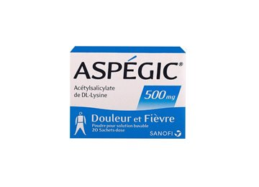
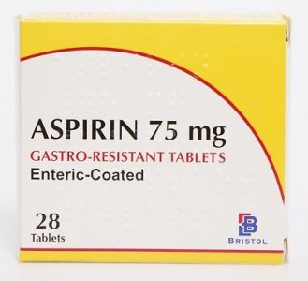
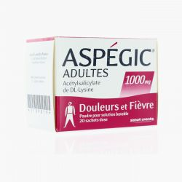
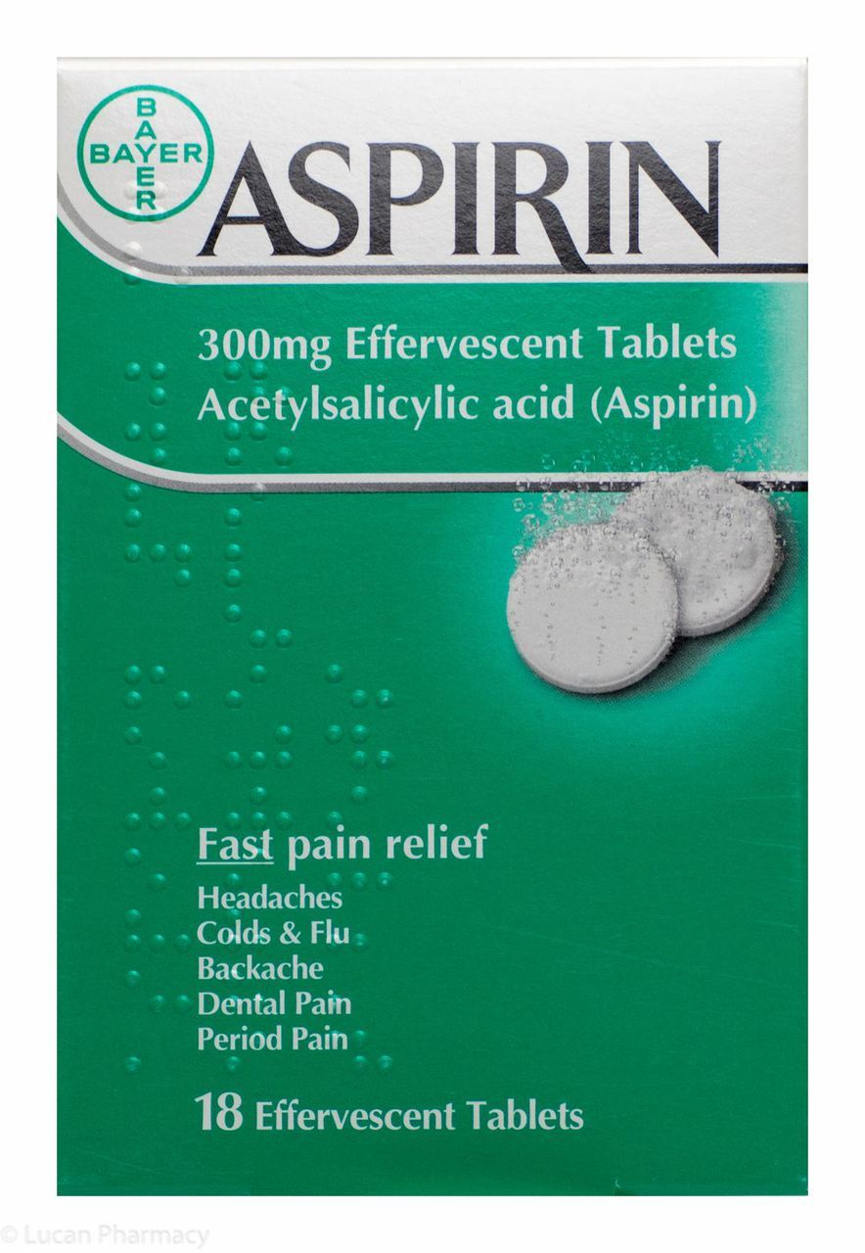
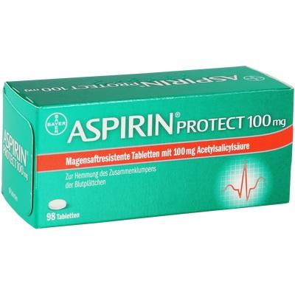

Slide 34
ibuprofen
Max dose in adult
Age of child
Dose of ibuprofen in child

Slide 35
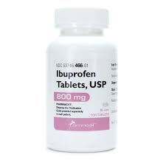
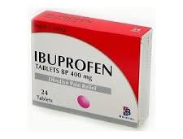
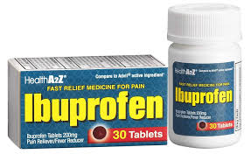
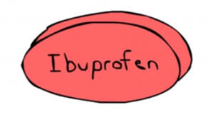

Slide 36
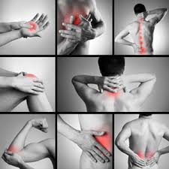
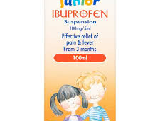
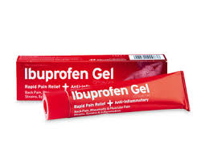

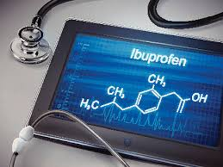

Slide 37
naproxen
INDICATIONS AND DOSE
Pain and inflammation in rheumatic disease
▶ BY MOUTH
▶ Adult: 0.5–1 g daily in 1–2 divided doses
Pain and inflammation in musculoskeletal disorders |Dysmenorrhoea
▶ BY MOUTH
▶ Adult: Initially 500 mg, then 250 mg every 6–8 hours as
required, maximum dose after the first day 1.25 g daily
Acute gout
▶ BY MOUTH
▶ Adult: Initially 750 mg, then 250 mg every 8 hours until attack has passed

Slide 38

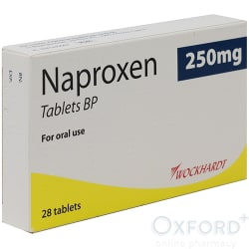

Slide 39
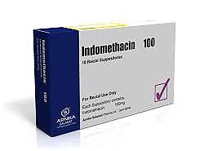
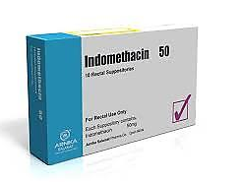
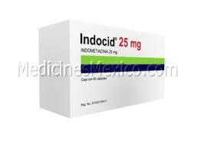
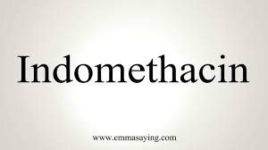
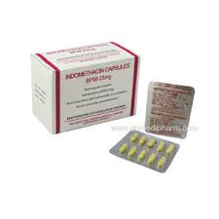

Slide 40
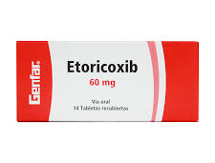
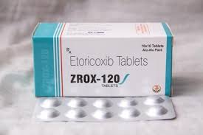

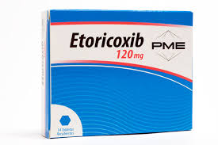

Slide 41
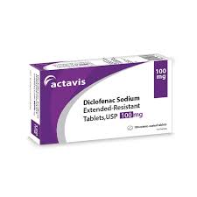
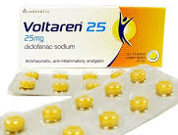
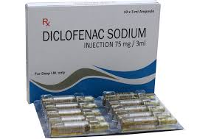

Slide 42
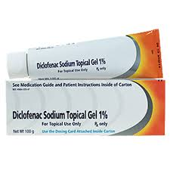
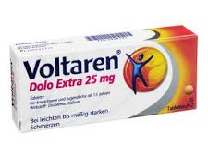
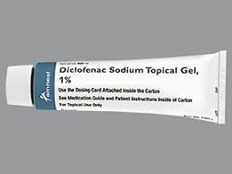
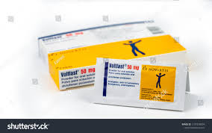

Slide 43
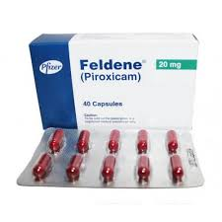
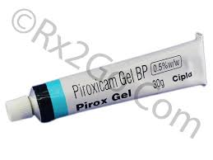
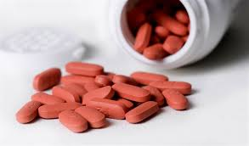

Slide 44
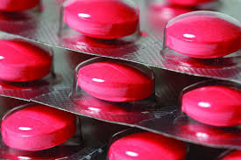
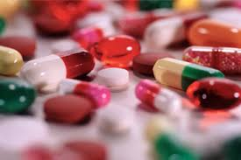
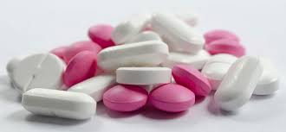
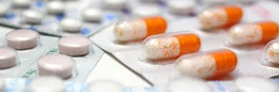
Thank you

