Slide 1
Insomnia
Done by assist. Lec. Shaymaa Hasan Abbas

Slide 3
Management

Slide 4
Antihistamines

Slide 5
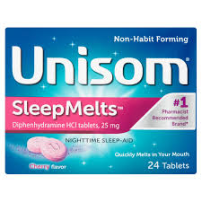
diphenhydramine

Slide 6
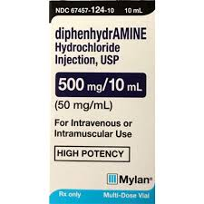

Slide 7
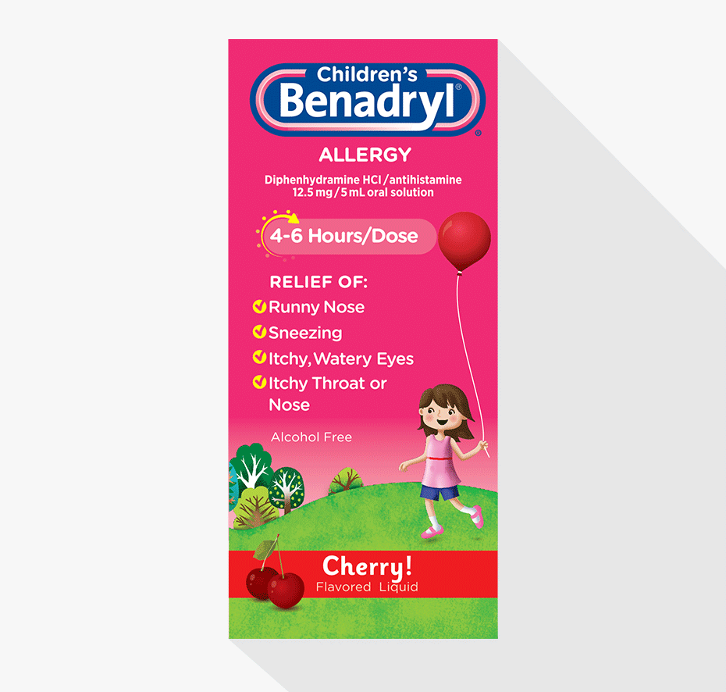

Slide 8
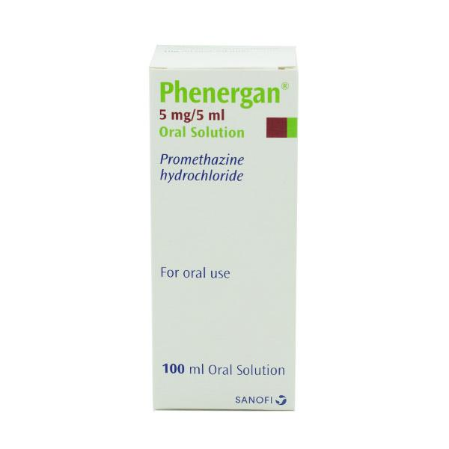
Promethazine

Slide 10
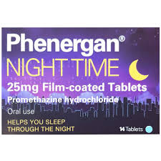

Slide 11
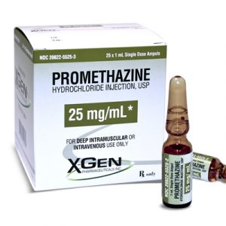

Slide 12
Benzodiazepines

Slide 13
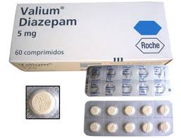
Diazepam ( Valium ®)

Slide 14
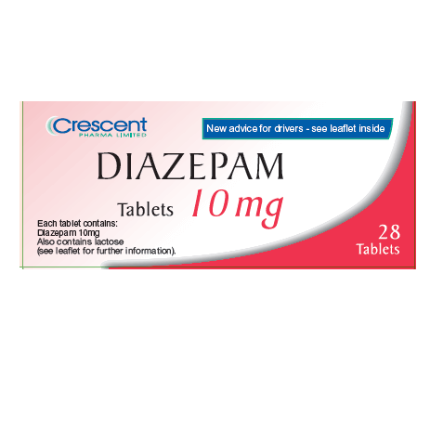

Slide 15
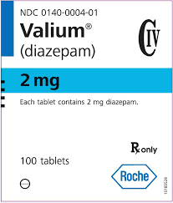

Slide 16
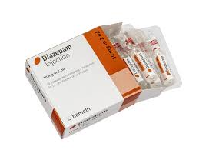

Slide 17
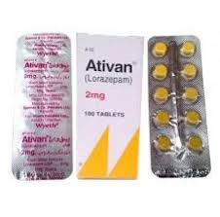
Lorazepam (Ativan®)

Slide 18
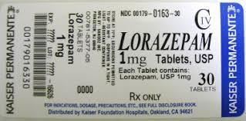

Slide 19
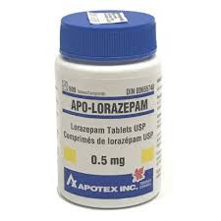

Slide 20
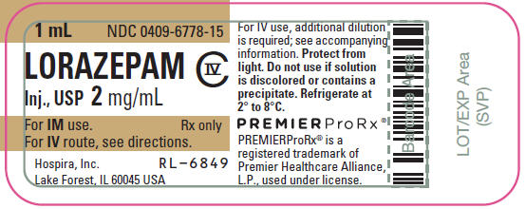

Slide 21
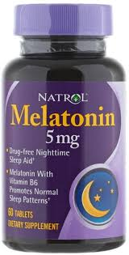
Melatonin

Slide 22
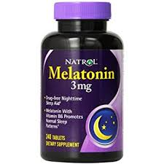

Slide 23
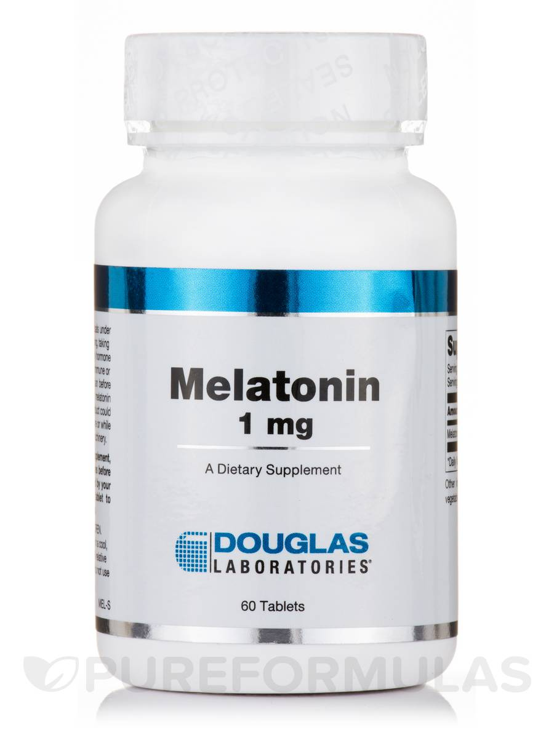

Slide 24
St John’s wort (hypericum)
St. John's wort is a plant with yellow, star-shaped flowers and five petals that grows in Europe, North and South America, Australia, New Zealand, and Eastern Asia. The plant grows in sunny, well-drained areas. It grows to be 50-100 cm tall. St. John's wort might cause serious interactions with some medications. Because of this, France has banned the use of St. John's wort in products. In other countries St. John's wort is only available with a prescription. St. John's wort is most commonly used for "the blues" or depression and symptoms that sometimes go along with mood such as nervousness, tiredness, poor appetite, and trouble sleeping. There is some strong scientific evidence that it is effective for mild to moderate depression. St. John's wort is also used for symptoms of menopause such as hot flashes and mood changes

Slide 25
Aromatherapy
Aromatherapy uses aromatic essential oils medicinally to improve the health of the body, mind, and spirit. It enhances both physical and emotional health.

Slide 26
THANK YOU

