Slide 1
General Urine Examination (Urinalysis)
By:
MSc. Huda Raad
1
.

Slide 2
Urine Formation & Composition
Urine is an excretory product (fluid ) of the body .
kidneys continuously form urine as an ultra filtrate of plasma. Reabsorption of water and essential filtered substances converts approximately 170,000 mL of this filtrate to the average daily urine output of 1200 mL.
2

Slide 3
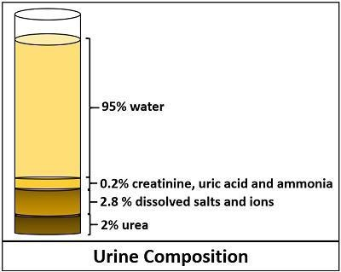
Urine Composition
Urine is normally 95% water and 5% solutes ( urea and other organic and inorganic chemicals dissolved in water)

Slide 4
Urea, a metabolic waste product, accounts for nearly half of the total dissolved solids in urine. Other organic substances include primarily creatinine and uric acid.
The major inorganic solid dissolved in urine is chloride, followed by sodium and potassium.

Slide 5
substances such as hormones, vitamins, and drugs also found in urine.
Although not a part of the original plasma filtrate, the urine also may contain formed elements, such as cells, casts, crystals, mucus, and bacteria.

Slide 6
Variations in the concentrations of these solutes can occur owing to the influence of factors such as :
Dietary intake
Physical activity
Body metabolism
Endocrine functions.

Slide 7
Specimen Collection
Specimens must be collected in clean, dry, leak-proof , disposable
containers.
Containers are available in a variety of sizes and shapes, including bags with adhesive for the collection of pediatric specimens and large containers for 24-hour samples.
8

Slide 8
Specimen Integrity
Following collection, specimens should be delivered to the laboratory promptly and tested within 2 hours, otherwise sample should be refrigerated or have an appropriate chemical preservative added.

Slide 9
Types of Specimens
1-Random Sample
Most commonly used because of its ease of collection & convenience for the patient (can be collected at any time of the day).
However, it may also show erroneous results resulting from dietary intake or physical activity just before collection. The patient will then be requested to collect an additional specimen under more controlled conditions.

Slide 10
2-First Morning Specimen
This is a concentrated specimen, thereby assuring detection of chemicals and formed elements that may not be present in a dilute random specimen.
The patient should be instructed to collect the specimen immediately on awaking and to deliver it to the laboratory within 2 hours or keep it refrigerated.

Slide 11
3- 24-Hour (or Timed) Specimen
Measuring the exact amount of a urine chemical is often necessary instead of just reporting its presence or absence. A carefully timed specimen must be used to produce accurate quantitative results
All specimens should be refrigerated or kept on ice during the collection period and may also require addition of a chemical preservative.

Slide 12
General Urine examination consist of 3 parts :
Physical examination
Chemical examination
Microscopic examination

Slide 13
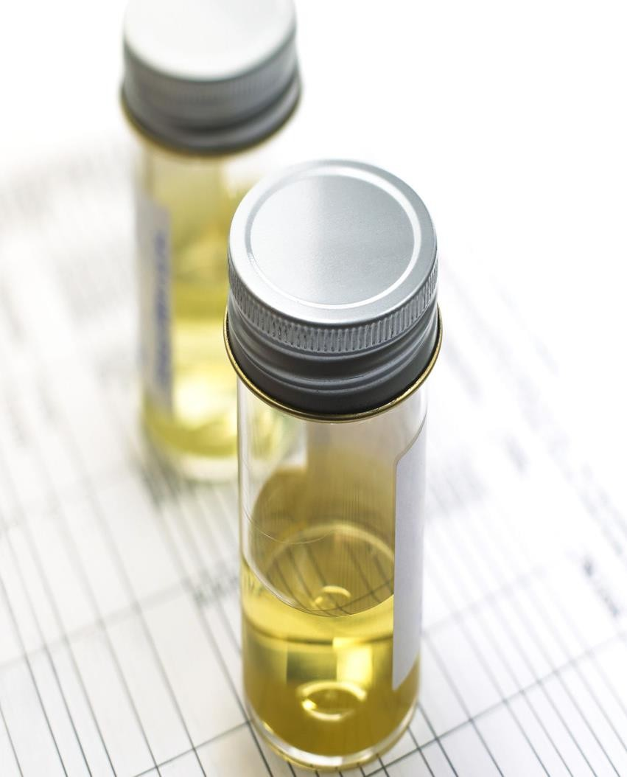
Physical Examination
Urine color
Appearance
Volume
Oder

Slide 14
Urine color & Appearance
Common descriptions include pale yellow, yellow, and dark yellow.
This is attributed to the presence of pigments, such as urochrome (a product of endogenous metabolism),and Urobilin ( an oxidation product of the normal urinary constituent urobilinogen) the later imparts an orange-brown color to urine that is not fresh.
Freshly voided normal urine is usually clear, turbidity in a fresh specimen caused by RBCs, WBCs, bacteria, epithelial cells and mucus.

Slide 15
Laboratory Correlation of Urine Color
color | Cause
Pale yellow | polyuria : diabetes insipidus ,diabetes mellitus dilute random specimen (recent fluid consumption)
Dark yellow | concentrated specimen , increase Bilirubin, increase urobilinogen
Pink -Red | RBCs, Hemoglobin, Myoglobin beets , rifampin ,menstrual contamination
Brown -Black | Homogentisic acid (alkaptonuria)

Slide 16
Urine Volume
normal daily urine output 600 to 2000 mL.
Factors that influence urine volume include :
fluid intake
fluid loss from non-renal sources
variations in the secretion of antidiuretic hormone
Increased amounts of dissolved solids, such as glucose in urine.

Slide 17
Oliguria : a decrease in urine output ( less than 400 mL/day), occur during dehydration as a result of excessive water loss from vomiting, diarrhea, or severe burns.
Oliguria may result from acute kidneys injury (AKI) .
Polyuria: an increase in daily urine volume (greater than 2.5 L/day), is often associated with diabetes mellitus , diabetes insipidus and diuretics use.

Slide 18
Oder
Freshly voided urine has a faint aromatic odor. As the specimen stands, the odor of ammonia becomes more prominent (the breakdown of urea is responsible for the characteristic ammonia odor).
Causes of unusual odors include
Bacterial infections, which cause a strong, unpleasant odor.
Diabetic ketoacidosis , which produce a sweet or fruity odor.
Maple syrup urine disease: metabolic defect results in urine with a strong odor of maple syrup

Slide 19
Chemical Examination
Routine examination of urine has changed dramatically by the development of the
Protein
Glucose
Ketones
Blood
Bilirubin
Urobilinogen
Nitrite
Leukocytes esterase
PH
Specific gravity.
reagent
simple,
strip method, providing a rapid means for performing
medically significant chemical analysis of urine, including:

Slide 20
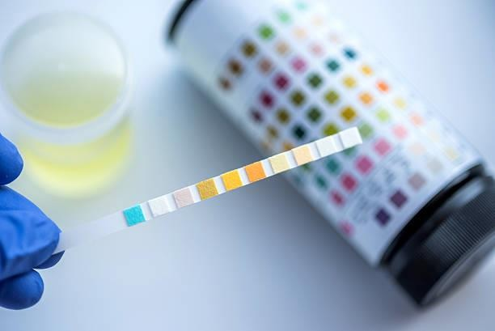
A reagent strip, also called a dipstick, is a narrow strip of plastic with small pads attached to it. Each pad contains reagents for a different chemical reaction, thus allowing for the simultaneous determination of several tests.
The color intensity generated on each reagent pad vary according to the concentration of the analyte present.

Slide 21
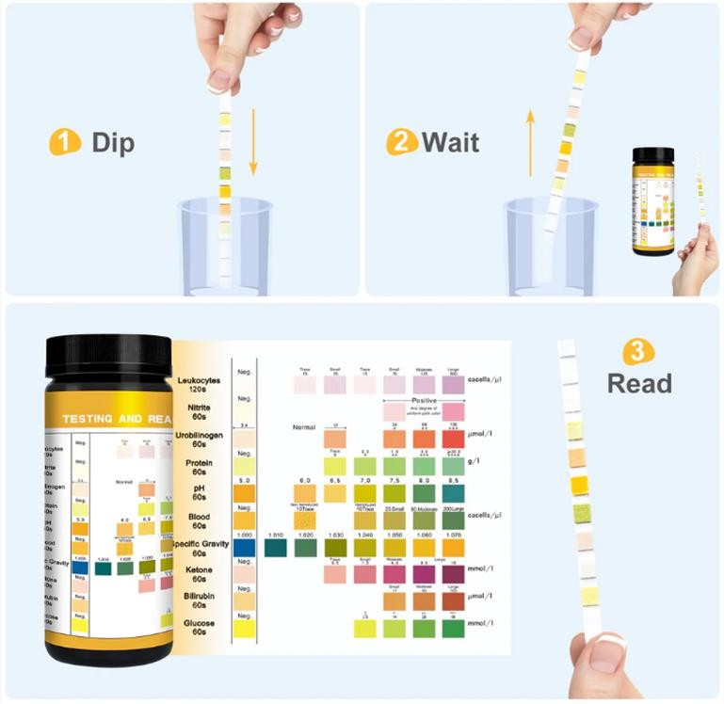
The reactions are then interpreted by comparing the color produced on the pad within the required time frame with a chart supplied by the manufacturer.
By careful comparison of the colors on the chart and the strip, a semi quantitative value of trace, 1+, 2+, 3+, or 4+ can be reported

Slide 22
Protein
Of the routine chemical tests performed on urine, the most indicative of renal disease is the protein determination. Proteinuria is often developed in the early stage renal disease.
The loss of plasma proteins through the glomeruli is restricted by the size of the pores and by a negative charge on, the basement membrane that repel negatively charged protein molecules.
less than 200 mg of protein is normally excreted in the urine each day (half of which is Tamm–Horsfall protein, secreted by tubular cells).

Slide 23
Causes of proteinuria:
Nephrotic Syndrome is a clinical condition caused by increased glomerular permeability, resulting in a daily urinary protein loss of more than 3 g with hypoalbuminemia, edema, hyperlipidemia.
Microalbuminuria: urinary albumin loss at a range of 30-300 mg per 24 hours, which usually undetected by reagent strip and required quantitative determination using more sensitive immunoassays. Microalbuminuria is shown to precede the overt renal disease and is an indicative of increased risk for development of diabetic nephropathy.
Blood and pus in the urine also give positive tests for protein.

Slide 24
Glucose
Under normal circumstances, almost all the filtered glucose is actively reabsorbed in the proximal convoluted tubule.
The quantity of glucose that appears in the urine is dependent upon the blood glucose level, the rate of glomerular filtration, and the degree of tubular reabsorption.

Slide 25
The blood level at which tubular reabsorption stops (renal threshold) for glucose is approximately 160 to 180 mg/dL, when the blood glucose exceeds the renal threshold, the tubules cannot reabsorb all of the filtered glucose, and glycosuria occurs.
Glycosuria may be due to:
Diabetes mellitus.
Renal glycosuria: in which the renal threshold for glucose decreases so that glucose is present in urine despite of normal blood sugar level.
Pregnancy

Slide 26
Blood
blood may be present in the urine either in the form of intact red blood cells (hematuria) or as the product of red blood cell destruction, hemoglobin (hemoglobinuria).
hematuria produces a cloudy red urine, and hemoglobinuria appears as a clear red specimen

Slide 27
Major causes of hematuria include
renal calculi
glomerular diseases
tumors
trauma
pyelonephritis
exposure to toxic chemicals and anticoagulant therapy

Slide 28
Haemoglobinuria: (Presence of free Hb in urine), seen in intravascular hemolysis when the binding capacity of Haptoglobin is exceeded.
Myoglobinuria: presence of myoglobin in urine( seen in crush injuries and muscular disorders) also give positive test for blood .

Slide 29
Microscopic Examination of Urine
Microscopic examination of the sediment obtained from the centrifugation of a fresh urine sample shows the presence of :
Few cells (erythrocytes, leukocytes, and cells derived from the kidney and urinary tract)
Casts (composed predominantly of Tamm-Horsfall glycoprotein, other proteins present in the urinary filtrate, such as albumin and immunoglobulins, are also incorporated into the cast matrix)

Slide 30
Casts are the only elements found in the urinary sediment that are unique to the kidney.
They are formed within the lumens of the distal convoluted tubules and collecting ducts, providing a microscopic view of conditions within the nephron. Their shape is representative of the tubular lumen.
The most frequently seen cast is the hyaline type, which consists almost entirely of Tamm-Horsfall glycoprotein .

Slide 31
