Slide 1
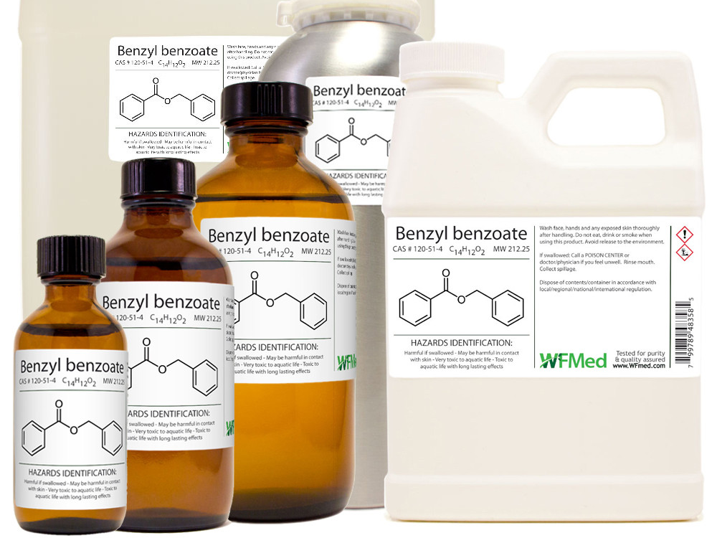

Synthesis of benzyl benzoate
MSC. MOHAMMED AL-DAHLAKI

Slide 2
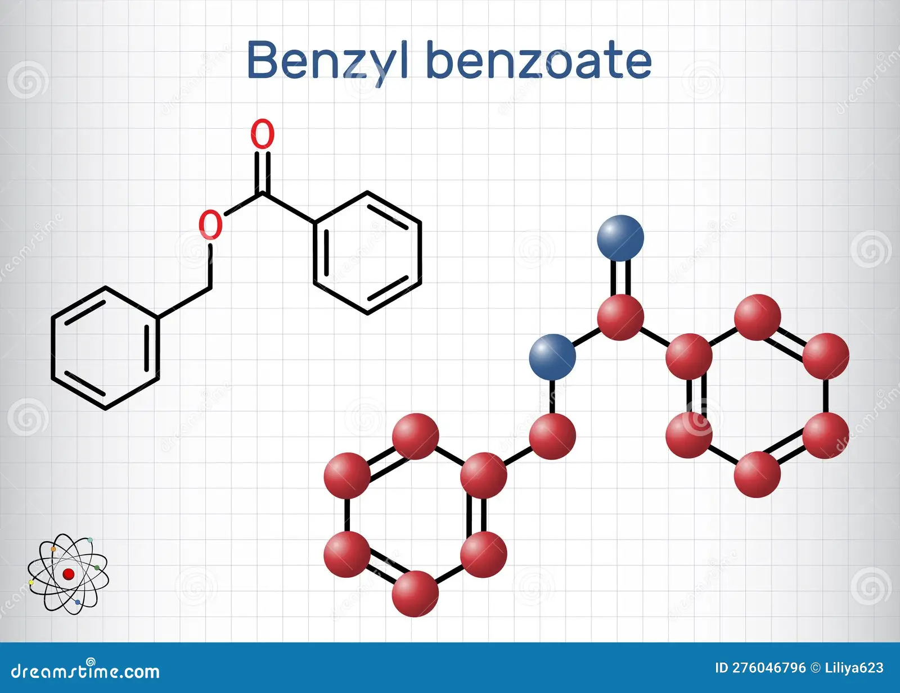
Benzyl benzoate
Benzyl benzoate (C₁₄H₁₂O₂) is an organic aromatic ester, structurally comprising a benzyl group attached to the ester functional group of benzoic acid. Pure benzyl benzoate is typically a clear, nearly colorless liquid with a mild, aromatic odor. Chemically, it demonstrates low solubility in water but is readily miscible with organic solvents such as alcohol, ether, and aromatic hydrocarbons. Due to its aromatic nature and excellent solvation properties, benzyl benzoate finds extensive use as a solvent, fixative, and carrier agent in various chemical and industrial processes, particularly in fragrance manufacturing, chemical synthesis, and as an intermediate in organic synthesis.
*Benzyl benzoate is sold under the brand name Scabanca among others and is available as a generic medication.
*Side effects may include irritation of the skin.
*It is not recommended in children.
*t is also used in other animals; however, it is considered toxic to cats.

Slide 3
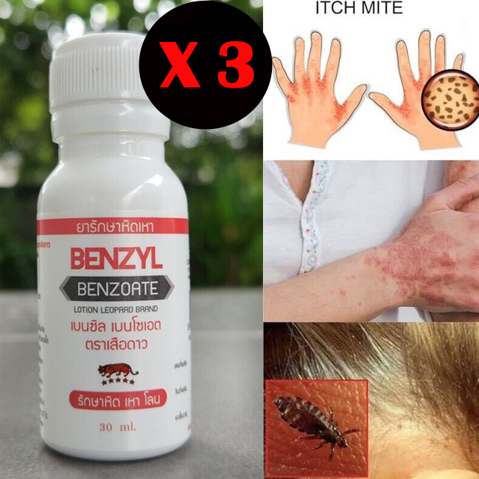
pharmaceutical applications of Benzyl Benzoate
Scabicide and Pediculicide: Benzyl benzoate is primarily used in pharmaceutical formulations as a topical treatment against infestations of scabies mites and lice due to its potent insecticidal and acaricidal properties, For scabies either permethrin or malathion is typically preferred.
Solvent and Penetration Enhancer: It serves as a solvent and penetration enhancer in topical pharmaceutical preparations, improving the skin absorption of active compounds, particularly those with low solubility.
Stabilizer and Solubilizer: Benzyl benzoate is included in various topical and injectable pharmaceutical preparations to stabilize formulations, maintain consistency, and enhance the solubility of active pharmaceutical ingredients
.Antimicrobial Agent and Preservative: Due to its antimicrobial properties, benzyl benzoate may function as a preservative to prevent microbial contamination in some pharmaceutical formulations, prolonging shelf life.
Carrier in Dermatological Formulations: It is utilized as a carrier or excipient in dermatological preparations, facilitating the penetration of active substances into the skin, thereby improving therapeutic efficacy.

Slide 4
Reaction Name:
Schotten-Baumann
Benzoylation Reaction
Reaction Type:
✅ Nucleophilic Acyl Substitution

Slide 5
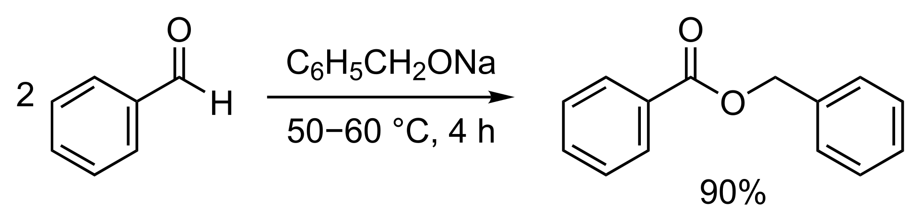
Methodes of synthesis the benzyl benzoate
synthesized by the Tishchenko reaction, using benzaldehyde with sodium benzyloxide (generated from sodium and benzyl alcohol) as catalyst.(condensation reaction)
2. Esterification Method (Direct Esterification):
3. Reaction using Benzoyl Chloride (Acyl Chloride method):

Slide 6

Step-by-Step Mechanism
Step 1: Formation of Sodium Benzyloxide (Activation of the Alcohol)
Initially, benzyl alcohol is treated with sodium hydroxide (NaOH), a strong base. Sodium hydroxide deprotonates the hydroxyl group of benzyl alcohol, converting it into sodium benzyloxide. This transformation significantly enhances the nucleophilicity of the alcohol, making it more reactive and better able to attack electrophilic centers.
Step 2: Nucleophilic Attack on Benzoyl Chloride.
The activated form of benzyl alcohol (sodium benzyloxide) acts as a powerful nucleophile. It attacks the electrophilic carbonyl carbon atom in benzoyl chloride, forming a transient tetrahedral intermediate. This intermediate is negatively charged and contains both benzyl and chloride substituents attached to the carbonyl carbon.
Step 3: Collapse of the Intermediate and Departure of Chloride Ion.
The tetrahedral intermediate formed in the previous step is unstable and rapidly collapses. In this step, the chloride ion, acting as a good leaving group, departs from the intermediate structure. This departure regenerates the carbonyl functionality and results in the formation of benzyl benzoate.
Step 4: Neutralization and By-product Formation.
Simultaneously, the chloride ion released from the intermediate combines with sodium ions (Na⁺) from the base, forming sodium chloride (NaCl). Additionally, water is produced in the initial step during the deprotonation of benzyl alcohol by sodium hydroxide.

Slide 8
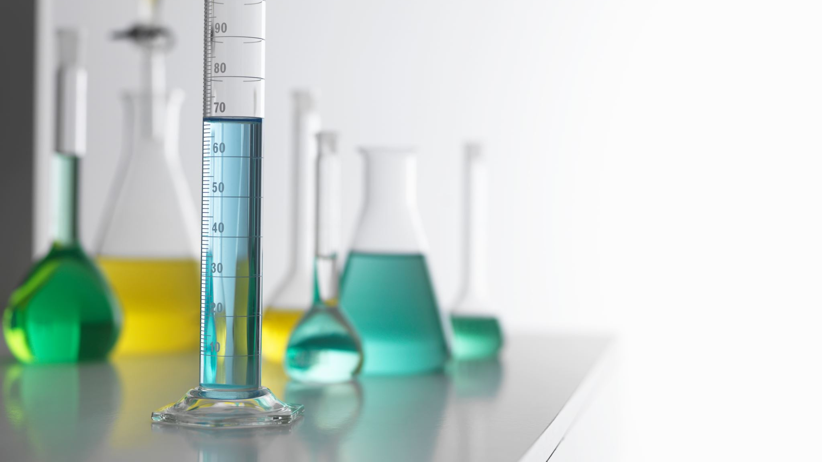
Proceduer
Place 1 ml of benzyl alcohol into a 100 ml round-bottom flask.
Add 8 ml of 10% sodium hydroxide solution to the flask containing benzyl alcohol. Shake vigorously until a temporary white emulsion forms.
Add 1 ml of benzoyl chloride to the mixture, then heat the reaction gently at approximately 50–60 °C for 20–30 minutes, until clear, oily droplets form, indicating the formation of benzyl benzoate.
Add 10 ml of ether(Diethyl ether)to the mixture to facilitate phase separation.
Transfer the mixture into a separatory funnel and shake vigorously for 5–10 minutes to ensure the complete dissolution of the oily layer into the organic phase.
Open the stopcock and carefully drain the lower aqueous layer. Then, collect the upper organic layer (ether layer) in a beaker. Allow the ether to evaporate naturally, leaving behind the oily residue of the desired product.
Steps 4, 5, and 6 are repeated on the remaining aqueous layer to ensure the complete extraction of any residual organic phase.

Slide 9
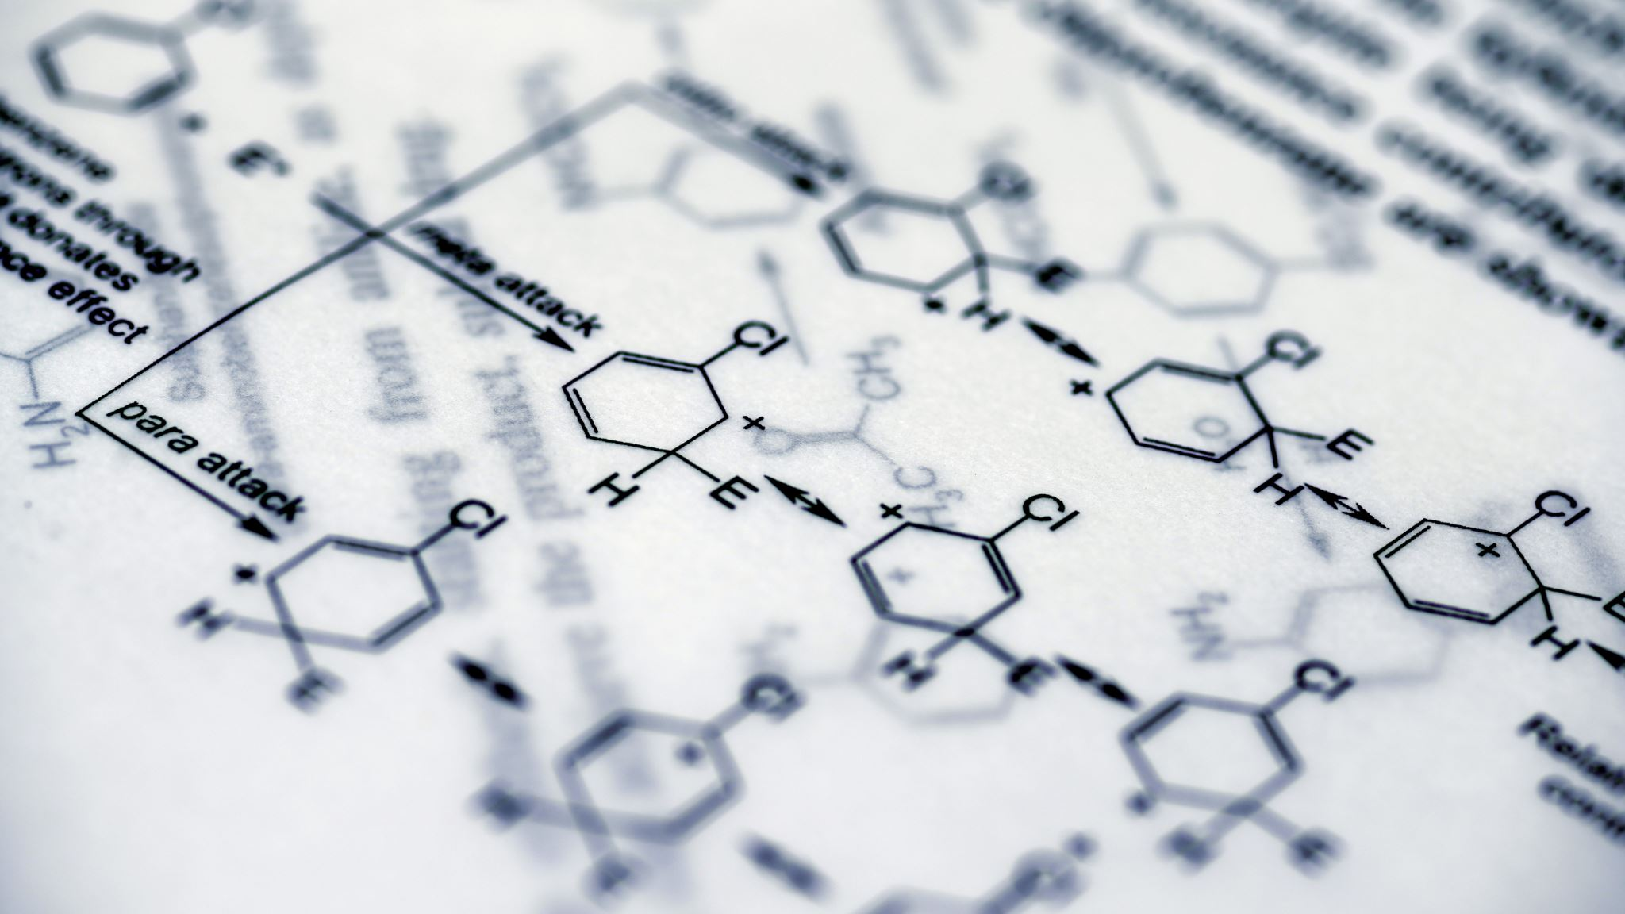
Physical Properties of Benzyl Benzoate
Chemical Formula: C₁₄H₁₂O₂
Molecular Weight: 212.25 g/mol
Appearance: Colorless to pale yellow oily liquid
Odor: Faint balsamic aroma
Density: 1.118 g/cm³ at 20°C
Boiling Point: 323-324°C
Melting Point: 18-20°C (solidifies at lower temperatures)
Solubility:
Slightly soluble in water
Soluble in ethanol, chloroform, ether, and benzene
Refractive Index: 1.568 (at 20°C)
Viscosity: Moderate viscosity, non-volatile at room temperature

Slide 10
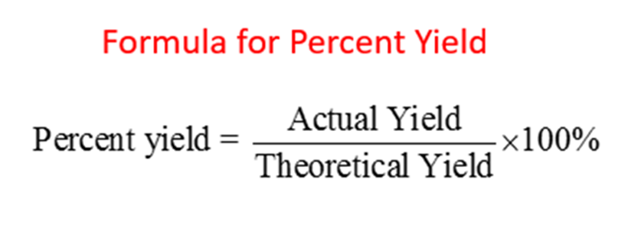
calculations

