Slide 1
Malaria

Slide 2
Plasmodium
commonly known as the malaria parasite, this species of the genus are known as plasmodia. Infection with plasmodia is known as malaria, a deadly disease widespread in the tropics
Species infecting humans
The most common forms of human malaria are caused by
Plasmodium falciparum (the cause of malignant tertian malaria, Blackwater Fever )
P. vivax (the most frequent cause of benign tertian malaria)
P. ovale (the other, less frequent, cause of benign tertian malaria)
P. malariae (the cause of benign quartan malaria)
Blackwater Fever - a complication of P. falciparum malaria. Hemolysis and hematuria are due to a severe immune reaction.

Slide 3
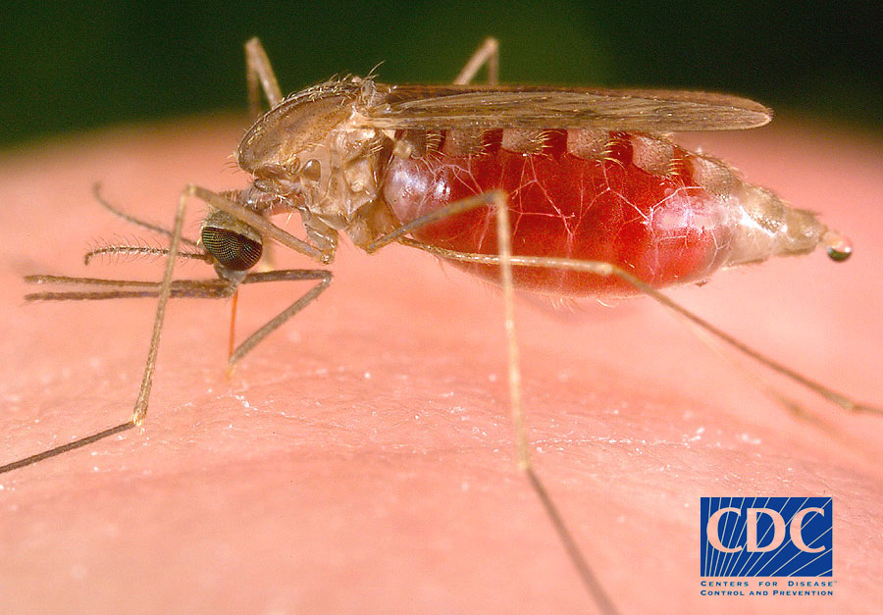
Anopheles Mosquito
The vector of malaria Anopheles
Notes:
the Anopheles sp. vector ingests the gametocytes, microgametocytes develop into microgametes, which are able to fertilize gametes.

Slide 4
Life cycle:
In human body
Exoerythrocytic stage
bite/inject into
sporozoites exoerythrocytic schizonts
(mosquito blood) (hepatic cell)
rupture/release
exoerythrocytic sporozoites
( blood)

Slide 5




2. Erythrocytic stage
early trophozoite later trophozoite
P.f/36-48hrs
P.v/48hrs
merozoite immature schizont
Mature schizont
*the process from trphozoite to merozoite is called schizogony.

Slide 6


3-In mosquito (final host)
Gametocytes(♀♂) gametes (♀♂)
(blood—stomach) (stomach of insect)
union of
zygote
rupture/release rounds up into
sporozoites oocyst motile ookinete
(Salivary glands) ( the body cavity side

Slide 7
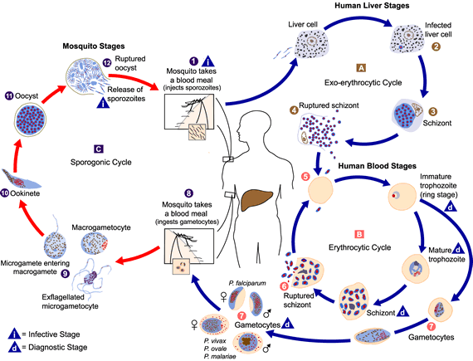
Note: P. vivax and P. ovale can lie dormant in
liver for weeks or even years.

Slide 8
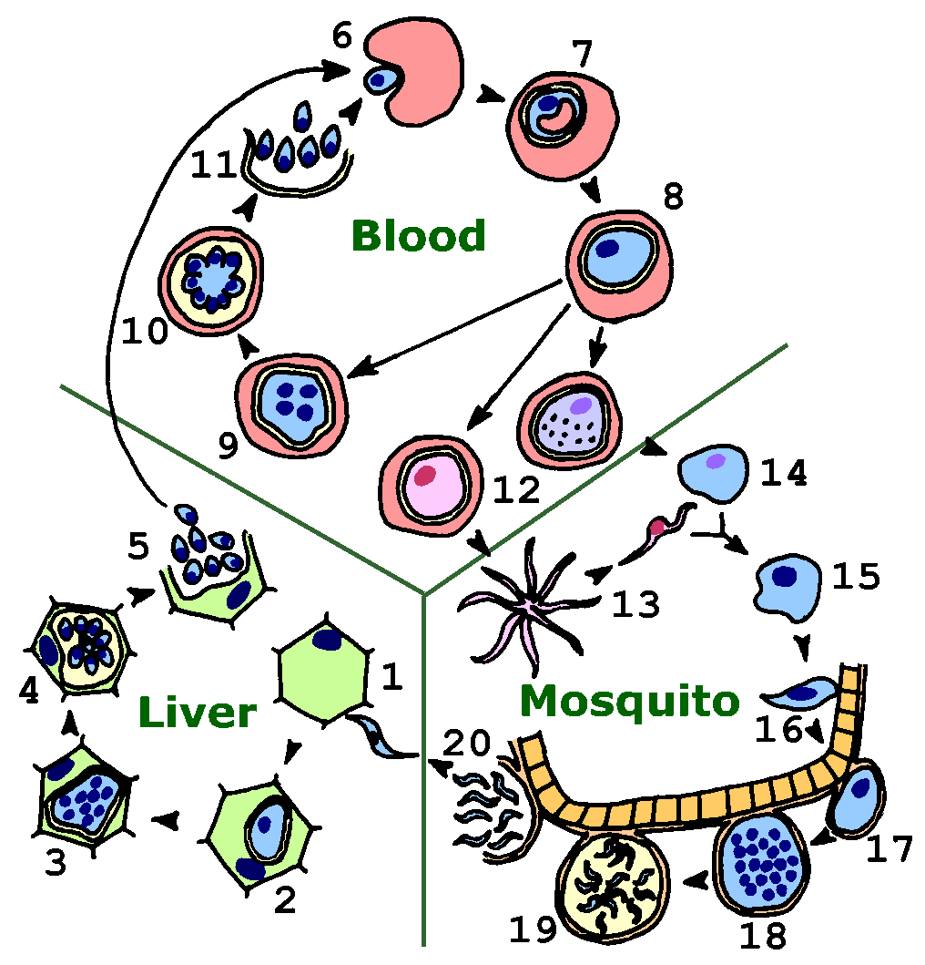
Invasive Stages
Merozoite
erythrocytes
Sporozoite
salivary glands
hepatocytes
Ookinete
epithelium

Slide 9
Specimen collection
Ideally, blood can be collected by finger prick
  If other tests being performed, can use venipuncture
  EDTA is preferred as the anticoagulant as heparin may lead to morphological distortion
Smears should be prepared and stained within an hour of drawing the specimen.
  Alterations in morphology may occur if delayed.
Notes:
Manual of Clinical Microbiology “Diagnosis” pg. 2041

Slide 10
Microscopy
Thick film considered “gold standard” for detection of parasites due to being able to use larger volume (10µl of blood)
Thin film considered “gold standard” in species identification
Smear examinations should be under oil immersion
  Negatives should not be reported until 200 oil immersion fields have been examined
  Additional specimens should be examined at 12-hour intervals for a subsequent 36 hours.

Slide 11
Preparing thick and thin films
1.
Touch one drop of blood to a clean slide.
4.
Carry the drop of blood to the first slide and hold at 45 degree angle.
2.
Spread the first drop to make a 1 cm circle.
5.
Pull the drop of blood across the first slide in one motion.
3.
Touch a fresh drop of blood to the edge of another slide.
6.
Wait for both to dry before fixing and staining.

Slide 12
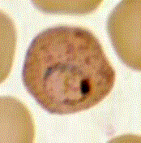
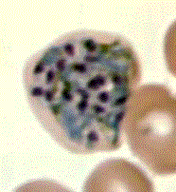
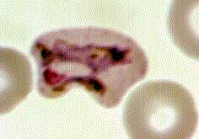
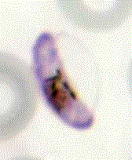
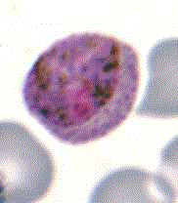
Malaria Parasite Erythrocytic Stages
Ring form
Trophozoite
Schizont
Gametocytes

Slide 13
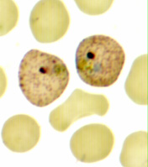
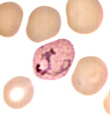
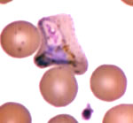
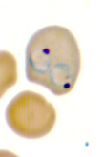
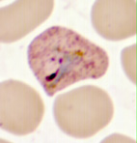
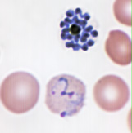
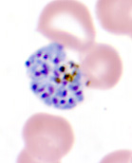
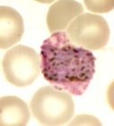
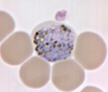
Plasmodium vivax
Infected erythrocytes: enlarged up to 2X; deformed; (Schüffner’s dots)
Rings
Trophozoites: ameboid; deforms the erythrocyte
Schizonts: 12-24 merozoites
Gametocytes: round-oval

Slide 14
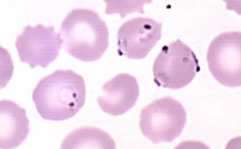
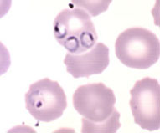
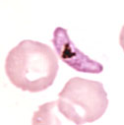
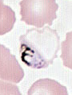
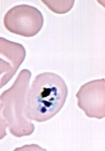
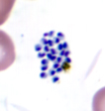


Plasmodium falciparum
Infected erythrocytes: normal size
M
I
Gametocytes: mature (M)and
immature (I) forms (I is rarely
seen in peripheral blood)
Rings: double chromatin dots; appliqué forms;
multiple infections in same red cell
Schizonts: 8-24 merozoites
(rarely seen in peripheral blood)
Trophozoites: compact
(rarely seen in
peripheral blood)

Slide 15
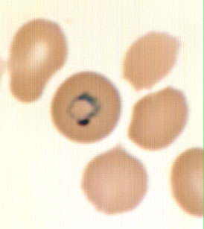
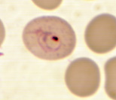

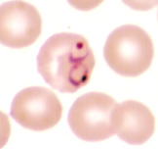

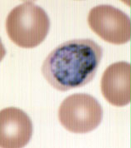
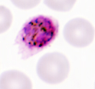
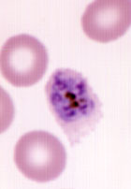
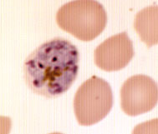
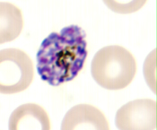
Plasmodium ovale
Infected erythrocytes: moderately enlarged (11/4 X); fimbriated; oval; (Schüffner’s dots)
“malariae - like parasite in vivax - like erythrocyte”
Trophozoites: compact
Rings
Schizonts: 6-14 merozoites;
dark pigment; (“rosettes”)
Gametocytes: round-oval

Slide 16
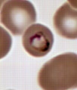
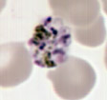
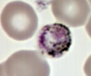

Plasmodium malariae
    Infected erythrocytes: size normal to decreased (3/4X)
Trophozoite:
compact
Trophozoite:
typical
band form
Schizont:
6-12 merozoites;
coarse, dark pigment
Gametocyte:
round; coarse,
dark pigment

Slide 17

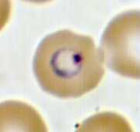
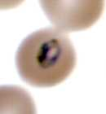
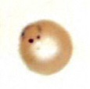
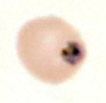
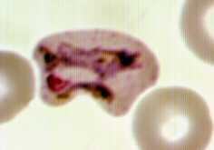
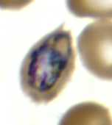
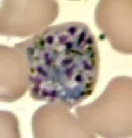
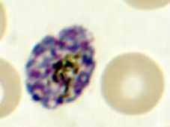
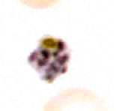
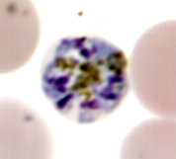
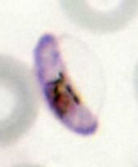
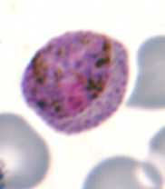
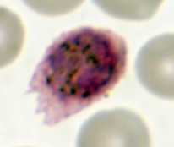
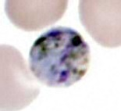
Species Differentiation on Thin Films

