Slide 1
RHEOLOGY
Lecture by
Assistant Prof. Anas Tarik Nafei
Mustansiriyah University/ College of pharmacy/ Pharmaceutics Department

Slide 2
The term rheology, comes from the Greek rheo ("to flow") and logos ("science").
Rheology is the flow of liquids and the deformation of solids.
Viscosity is the resistance of a fluid to flow; the higher the viscosity, the greater is the resistance.
Note:
Simple liquids described in terms of absolute viscosity (single value).
Heterogeneous dispersions rheologic properties are more complex, however, and cannot be expressed by a single value.

Slide 3
Manufacturers of medicinal and cosmetic creams, pastes, and lotions must be capable of producing products with acceptable consistency and smoothness.
The rheology of product can affect patient acceptability, physical stability, and even biologic availability.
Rheologic properties of a pharmaceutical system can influence the selection of processing equipment.

Slide 4
Classes of materials according to types of flow:
Newtonian systems.
2. Non-Newtonian systems.

Slide 5
NEWTONIAN SYSTEMS
Newton's Law of Flow
The higher the viscosity of a liquid, the greater is the force per unit area (shearing stress) required to produce a certain rate of shear.
Shearing force
• Is the force that is applied to the top of the rectangle while the bottom is held in place.
The resulting shear stress, F, deforms the rectangle into a parallelogram. The area, A, involved would be the top of the parallelogram.

Slide 6
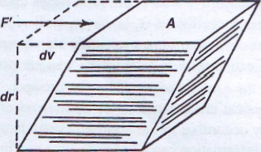
Rate of shear or the velocity gradient: ($\frac{dv}{dr}$) = G
Is the difference of velocity, dv, between two planes of liquid separated by an infinitesimal distance, dr.
Shearing stress : ($\frac{F′}{A}$) = F
Is the force per unit area required to bring about flow.

Slide 7
According to Newton system: rate of shear is directly proportional to shearing stress
$$\frac{F′}{A}=ƞ \frac{dv}{dr}$$
Where, is the coefficient of viscosity, usually prepared as simply as viscosity.
Above equation is frequently written as
Ƞ = $\frac{F}{G}$
Where, F= F’/A and G = dv/dr
The unit of viscosity is the poise, The units for poise are dyne.sec.cm⁻² (i.e., dyne.sec/cm²) or g cm⁻¹ sec⁻¹ (i.e., g/cm.sec). A more convenient unit for most work is the centipoise (cp), 1 cp being equal to 0.01 poise.

Slide 8
Fluidity, φ, a term sometimes used, is defined as the reciprocal of viscosity (The ability to flow)
φ = $\frac{1}{ƞ}$
Kinematic Viscosity
Is the absolute viscosity divided by the density of the liquid at a specific temperature (measure of a fluid's resistance to flow under the influence of gravity):
Kinematic viscosity = $\frac{ƞ}{ρ}$
The units are the stoke (s) and the centistoke (cs).

Slide 9
Absolute viscosities of some Newtonian liquids at 20 C° commonly used in pharmacy are given in this table:
Liquid | Viscosity (cp)
Castor oil | 1000
Olive oil | 100
Water | 1.0019
Note: water is ordinarily used as a standard for viscosity of liquids. Its viscosity at 25°C is 0.8904 cp.
Temperature Dependence and the Theory of Viscosity
The viscosity of liquid decreases as temperature is raised, and the fluidity of a liquid (the reciprocal of viscosity) increases with temperature. This can be expressed by an equation analogous to the Arrhenius equation of chemical kinetics:
Ƞ = A$e^{EvRT}$
Where A is a constant depending on the molecular weight and molar volume of the liquid and Ev, is the activation energyreuired to intitate flow between molecules.

Slide 10
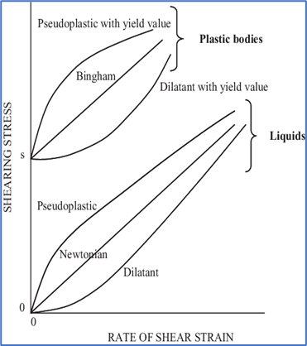
NON-NEWTONIAN SYSTEMS
Most fluid pharmaceutical products are not simple liquids and do not follow Newton's law of flow. These systems are referred to as non-Newtonian.
Non-Newtonian behavior is generally exhibited by liquid and solid heterogeneous dispersions such as colloidal solutions, emulsions, liquid suspensions, and ointments.
In a non-Newtonian fluid, the relation between the shear stress and the strain rate is non-linear and can even be time-dependent. Therefore, a constant coefficient of viscosity cannot be defined.

Slide 11
When non-Newtonian materials are analyzed in a rotational viscometer and results are plotted, various consistency curves, representing three classes of flow, are recognized:
1- Plastic
2- Pseudoplastic
3- Dilatant.

Slide 12
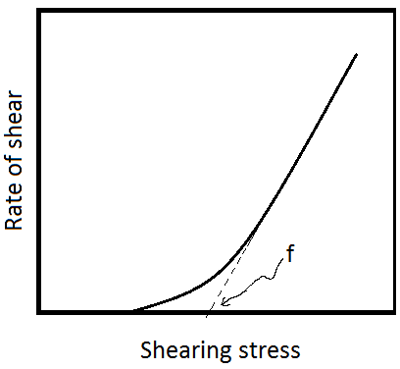
Plastic Flow
In Figure below, the curve represents a body that exhibits plastic flow; such materials are known as Bingham bodies (like clay suspensions, drilling mud, toothpaste, mayonnaise, chocolate, and mustard).
The classic case is ketchup which will not come out of the bottle until you stress it by shaking.
Plastic flow curves do not pass through the origin but rather intersect the shearing stress axis (or will if the straight part of the curve is extrapolated to the axis) at a particular point referred to as the yield value.

Slide 13
A Bingham body does not begin to flow until a shearing stress corresponding to the yield value is exceeded. At stresses below the yield value, the substance acts as an elastic material.
The slope of the rheogram in the Figure is termed the mobility, analogous to fluidity in Newtonian systems, and its reciprocal is known as the plastic viscosity, U. The equation describing plastic flow is:
U = $\frac{F−f}{G}$
Where f is the yield value (dynes/${cm}^{2}$)

Slide 14
In practice, deformation and flow usually occurs at a lower shear stress value and this accounts for the curved portion of the curve.
• The viscosity decreases initially and then remains constant.
• In a highly flocculated system, there is interaction between flocs which results in a structured system and plastic flow that is associated with these systems e.g highly flocculated suspensions.
• The yield value is present because of the contacts between adjacent particles to form network (flocculation caused by van der Waals forces which may be capable of withstanding weak stresses) which must be broken down before flow can occur.
• The yield value is an indication of the degree of flocculation; the more flocculated the suspension, the higher will be the yield value (keep flocculated particles suspended, preventing sedimentation. If the yield value is too low, flocs can break apart and settle over time).
• This type of behaviour is also exhibited by creams and ointments.

Slide 15
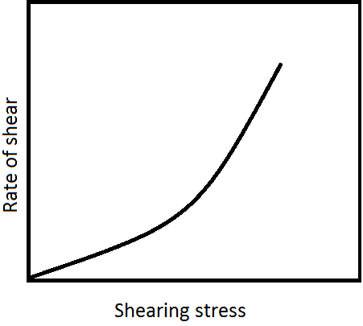
Pseudoplastic Flow
Many pharmaceutical products exhibit pseudoplastic flow include natural and synthetic gums e.g. liquid dispersions of tragacanth, sodium alginate, methylcellulose, sodium carboxymethylcellulose.
Pseudoplastic flow is typically exhibited by polymers in solution, in contrast to plastic systems, which are composed of flocculated particles in suspension. As seen in this Figure, the consistency curve for a pseudoplastic material begins at the origin. Therefore, there is no yield value as there is in a plastic system.

Slide 16
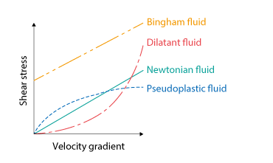
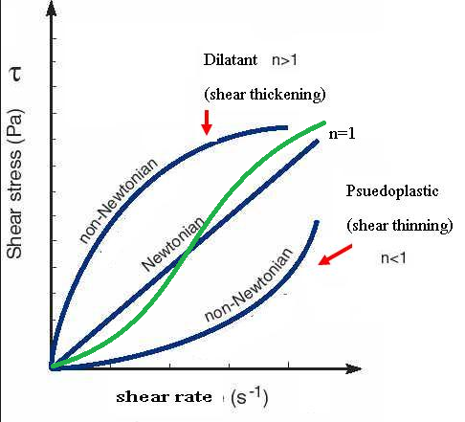
Furthermore, because no part of the curve is linear, the viscosity of a pseudoplastic material cannot be expressed by any single value.
The viscosity of a pseudoplastic substance decreases with increasing rate of shear (shear-thinning systems).
An apparent viscosity can be obtained at any rate of shear from the slope of the tangent to the curve at the specified point.

Slide 17
At the Particulate level:
• The curved rheogram for pseudoplastic materials results from a shearing action on the long-chain molecules which become entangled and associated with immobilized solvent.
• As the shearing stress is increased, the randomly arranged particles tend to become disentangled and align their long axes in the direction of flow.
• This orientation reduces the internal resistance of the material and offers less resistance to flow. Some of the entrapped water will also be released.
• Both of these account for the lower viscosity. Once stress is removed, the structures reform spontaneously.
Increasing rate of shear
Coiled polymer at rest
Linear polymer at increased shear stress

Slide 18
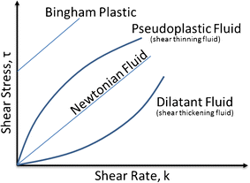
Dilatant Flow
If suspensions with a high percentage of dispersed solids (>50%)
Exhibit an increase in resistance to flow with increasing rates of shear.
Such systems increase in volume when sheared and are hence termed dilatant.
Figures illustrates their flow properties:

Slide 19
Dilatant flow is the inverse of that possessed by pseudoplastic systems.
Pseudoplastic materials are termed "shear-thinning systems ".
Dilatant materials are termed "shear-thickening systems ".
When stress is removed, a dilatant system returns to its original state of fluidity.

Slide 20
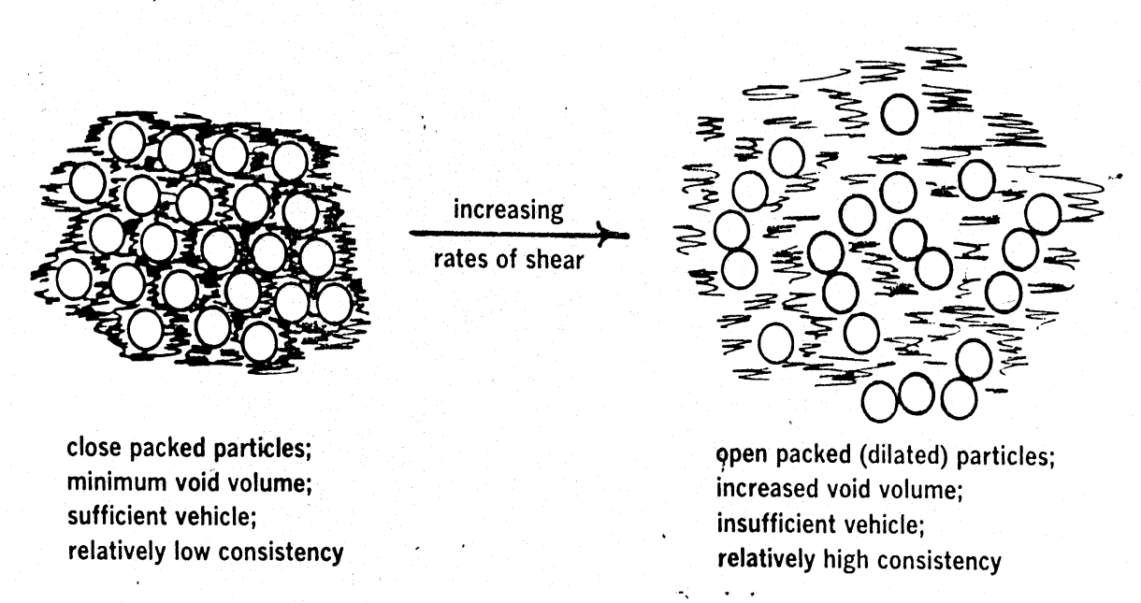
At the particulate level:
At rest:
Particles:
- closely packed
- voids at a minimum.
Vehicle:
- sufficient to fill this volume
- allows the particles to move relative to one another at low rates of shear.
Can pour a dilatant suspension from a bottle without shaking as it is relatively fluid without shear stress applied.
At stress:
If the shear stress is increased by shaking
Bulk expands or dilates
Particles move quickly past each other and take an open form of packing.

Slide 21
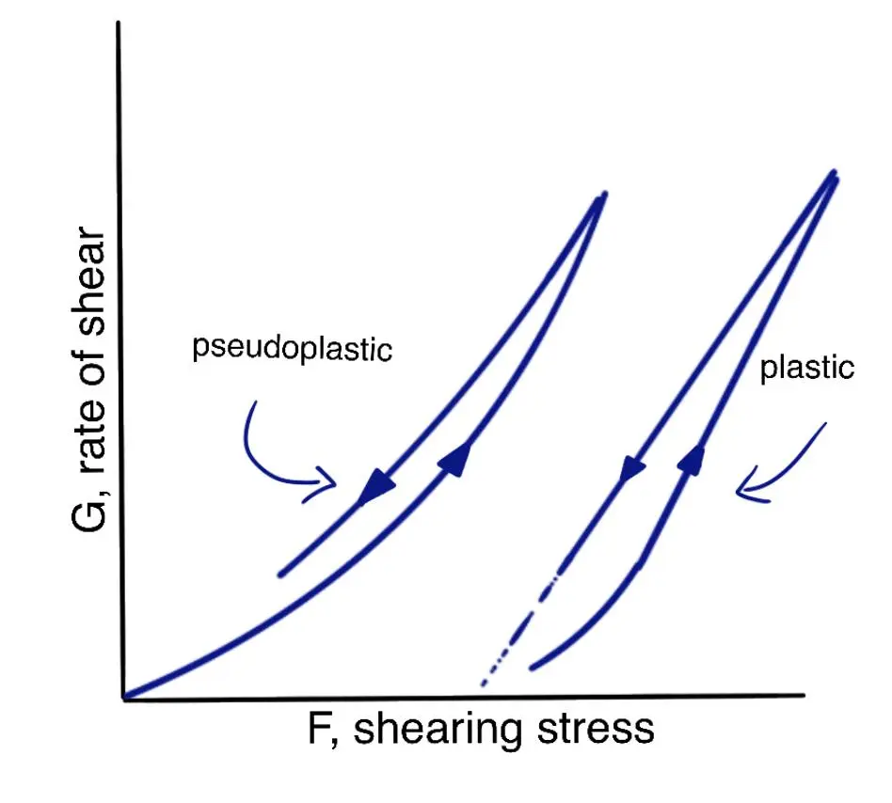
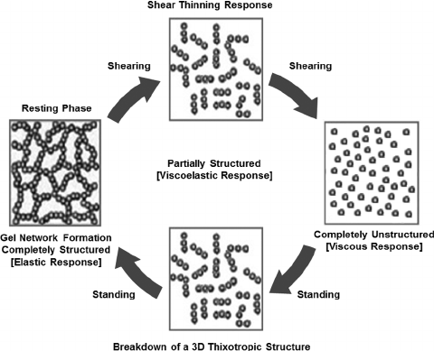
THIXOTROPY
Several types of behavior are observed when rate of shear is progressively increased and plotted against resulting shear stress.
If shear stress had been reached, and rate of shear were reduced when the maximum the resulted down curve is identical with the upcurve, this system is Newtonian systems.
With shear-thinning systems (i.e., pseudoplastic), the downcurve is frequently displaced to the left of the upcurve (Figure), showing that the material has a lower consistency at the downcurve than at upcurve.
This phenomenon, known as thixotropy, can be defined as "an isothermal (constant temp.) and comparatively slow recovery, on standing of a material, of a consistency lost through shearing.“

Slide 22
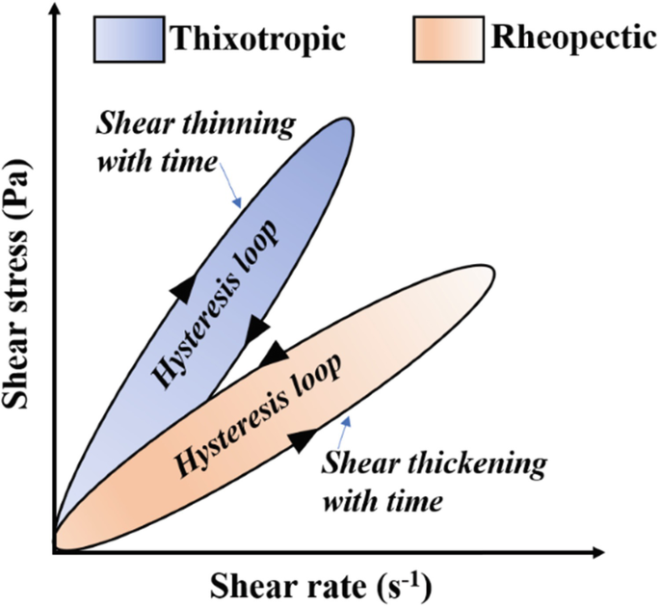
An important point to obtain a quantitative measure of thixotropy:
Rheograms obtained with thixotropic materials (same product) is different and highly dependent on:
1- shear rate (increased or decreased)
2- length of time a sample is subjected to rate of shear.
3- degree of structure in the sample.
Hysteresis loop: Is the area between the upcurve and downcurve of rheogram.
A thixotropic hysteresis loop can be obtained by measuring the non-equilibrium shear stress as a shear rate is first increased and then decreased in standard way.

Slide 23
Examples:
Solutions of high polymers (thixotropic to a certain extent) intermolecular attractions.
e.g. sols of iron(111)oxide , alumina and many clay.
In paint industry [the paint should flow only when being brushed on to appropriate surface (high rate of shear)] and immediately after brushing.
Properties of thixotropic systems: usually contain a symmetric particles that through numerous point of contact, set up a loose 3D network throughout the sample.
Mechanism:
At rest: this structure confers some degree of rigidity on the system, and it resemble a gel.
As shear is applied: flow starts structure beings to break down, are disrupted and particles become a ligned. The material undergoes a gel-to-sol transformation and exhibits shear thinning.
On removal of stress: the structure starts to reform.

Slide 24
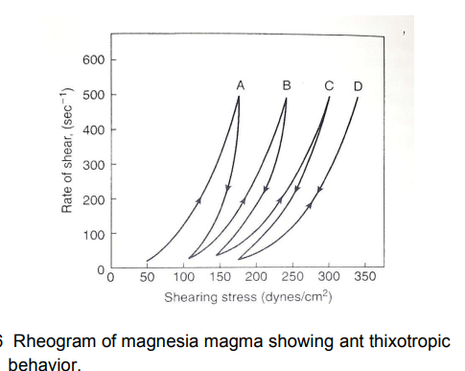
Negative Thixotropy or Antithixotropy
It is phenomenon represents an increase rather than a decrease in consistency on the downcurve (formation of internal structure under stress).
This increase in thickness with increased time of shear (shear thickening) in the rheologic analysis: e.g. magnesia magma (shear rates of greater than 30 sec⁻¹)
While (below 30 sec⁻¹) the magma showed normal thixotropy, the downcurve appearing to the left of the upcurve.

Slide 25
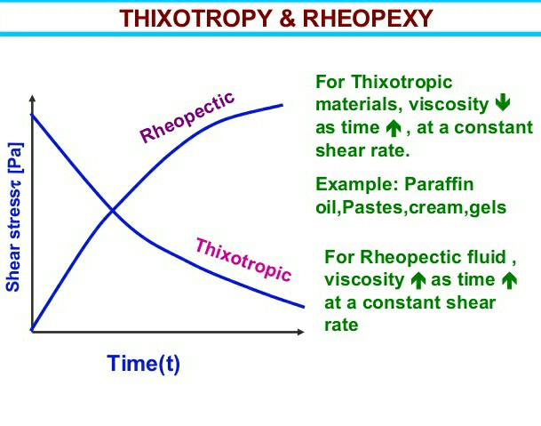
Negative thixotropy or antithixotropy should not be confused with dilatancy or rheopexy:
Rheopexy is a phenomenon in which solid forms a gel more readily when gently shaken (rolling and rocking motion so particles acquire random orientation and network established) than when allowed to form the gel while the material is kept at rest.
In a rheopectic system, the gel is the equilibrium form, whereas in antithixotropy, the equilibrium state is the sol.
Property | Dilatancy | Antithixotropy
Definition | A shear-thickening behavior where viscosity increases instantly when shear is applied and returns to normal immediately when shear stops. | A time-dependent shear-thickening behavior where viscosity gradually increases under shear and gradually decreases after shear is removed.
Type of system | Deflocculated (Starch in water) | Flocculated (clay suspensions, some gels)
Content | Greater than 50% by volume of solid dispersed phase | Low solids content (1%-10%)
Cause | Increased particle interactions in highly concentrated suspensions (particles move apart, increasing resistance). | Formation of a network structure over time under shear, leading to thickening.
Hysteresis Loop | No hysteresis loop (instantaneous response). | Counterclockwise hysteresis loop (time-dependent response).

Slide 26
DETERMINATION OF RHEOLOGIC PROPERTIES
Choice of Viscometer
Newtonian system: shear rate is directly proportional to shearing stress, instruments that operate at a single shear rate can be used. These "single-point instruments" provide a single point on the rheogram; extrapolation of a line through this point to the origin will result in a complete rheogram.
For Non-Newtonian: a single-point determination is virtually useless in characterizing its flow properties. It is therefore essential that, with non-Newtonian systems, the instrument can operate at a variety of shear rates. Such " multipoint instruments " are capable of producing a complete rheogram for non-Newtonian systems.

Slide 27
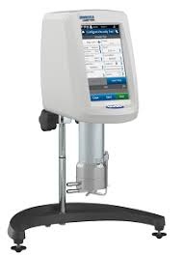
The main instruments used for determination of rheological properties:
1- Capillary
2- Falling-sphere
3- Cup-and-bob
4- Cone-and-plate viscometers.
single-shear-rate instruments suitable for use only with Newtonian materials
(multipoint, rotational instruments) can be used with both Newtonian and non-Newtonian systems.

Slide 28
Pharmaceutical areas in which rheology is significant
1. Fluids
a. Mixing
b. Particle-size reduction of disperse systems with shear.
c. Passage through orifices (pouring, packaging in bottles, and passage through hypodermic needles).
d. Fluid transfer (pumping and flow through pipes e. Physical stability of disperse systems).

Slide 29
2. Quasisolids (semisolids)
a. Spreading and adherence on the skin.
b. Removal from jars or extrusion from tubes.
c. Capacity of solids to mix with miscible liquids.
d. Release of the drug from the base.
3. Solids
a. Flow of powders from hoppers and into die cavities in tabletting or into capsules during encapsulation.
b. Packageability of powdered or granular solids.
4. Processing
a. Production capacity of the equipment.
b. Processing efficiency.

