Slide 1
Acute Decompensated Heart Failure: Treatment Approach
Acute decompensated heart failure (ADHF) is a serious condition requiring immediate medical attention.
By: Assist. Prof. Abeer Aljuburi

Slide 2
Acute Decompensated Heart Failure: Treatment Approach
Acute decompensated heart failure involves patients with new or worsening signs or symptoms [often resulting from volume overload and/or low cardiac output (CO)] requiring medical intervention, such as emergency department visit or hospitalization.
Admission to an intensive care unit (ICU) may be required for some cases.

Slide 3
Recognizing ADHF: Signs and Symptoms
Volume Overload
Low Output
Symptoms include dyspnea, orthopnea, paroxysmal nocturnal dyspnea, ascites, GI symptoms, peripheral edema, and weight gain.
Symptoms include altered mental status, tachycardia, hypotension or hypertension, cool extremities, pallor, and decreased urine output.

Slide 4
Initial Management: Diuresis and GDMT
Aggressive Diuresis
GDMT Continuation
Initiate aggressive diuresis with IV diuretics, particularly if fluid retention is evident on physical exam.
ACE inhibitors, ARBs, ARNI, and aldosterone antagonists) may also need to be temporarily withheld in the presence of renal dysfunction, with close monitoring of serum potassium.
Temporary Adjustments
Temporarily hold or reduce β-blockers if recent changes are responsible for acute decompensation.

Slide 5
Sodium and Fluid Restriction: Managing Congestive Symptoms
Sodium Restriction
Fluid Restriction
Place all patients with congestive symptoms on a strict sodium restriction (<2 g daily).
Consider fluid restriction for patients with refractory symptoms, as it can help reduce fluid overload.

Slide 6
Respiratory Support: Noninvasive Ventilation
Noninvasive Ventilation
Respiratory Support
Consider noninvasive ventilation for patients in respiratory distress due to acute pulmonary edema.
This intervention can help improve oxygenation and reduce the need for mechanical ventilation.

Slide 7
Thromboprophylaxis: Preventing Blood Clots
1
Pharmacologic
Provide pharmacologic thromboprophylaxis with unfractionated heparin or low-molecular-weight heparin for most patients with limited mobility.
2
Mechanical
Consider mechanical thromboprophylaxis with intermittent pneumatic compression devices in patients at high risk for bleeding.

Slide 8
Mechanical Circulatory Support: Bridge to Recovery
Hemodynamic Stabilization
Definitive Therapy
Temporary mechanical circulatory support may be considered for hemodynamic stabilization until the underlying etiology is corrected.
This support can bridge patients to definitive therapy, such as cardiac transplantation.

Slide 9
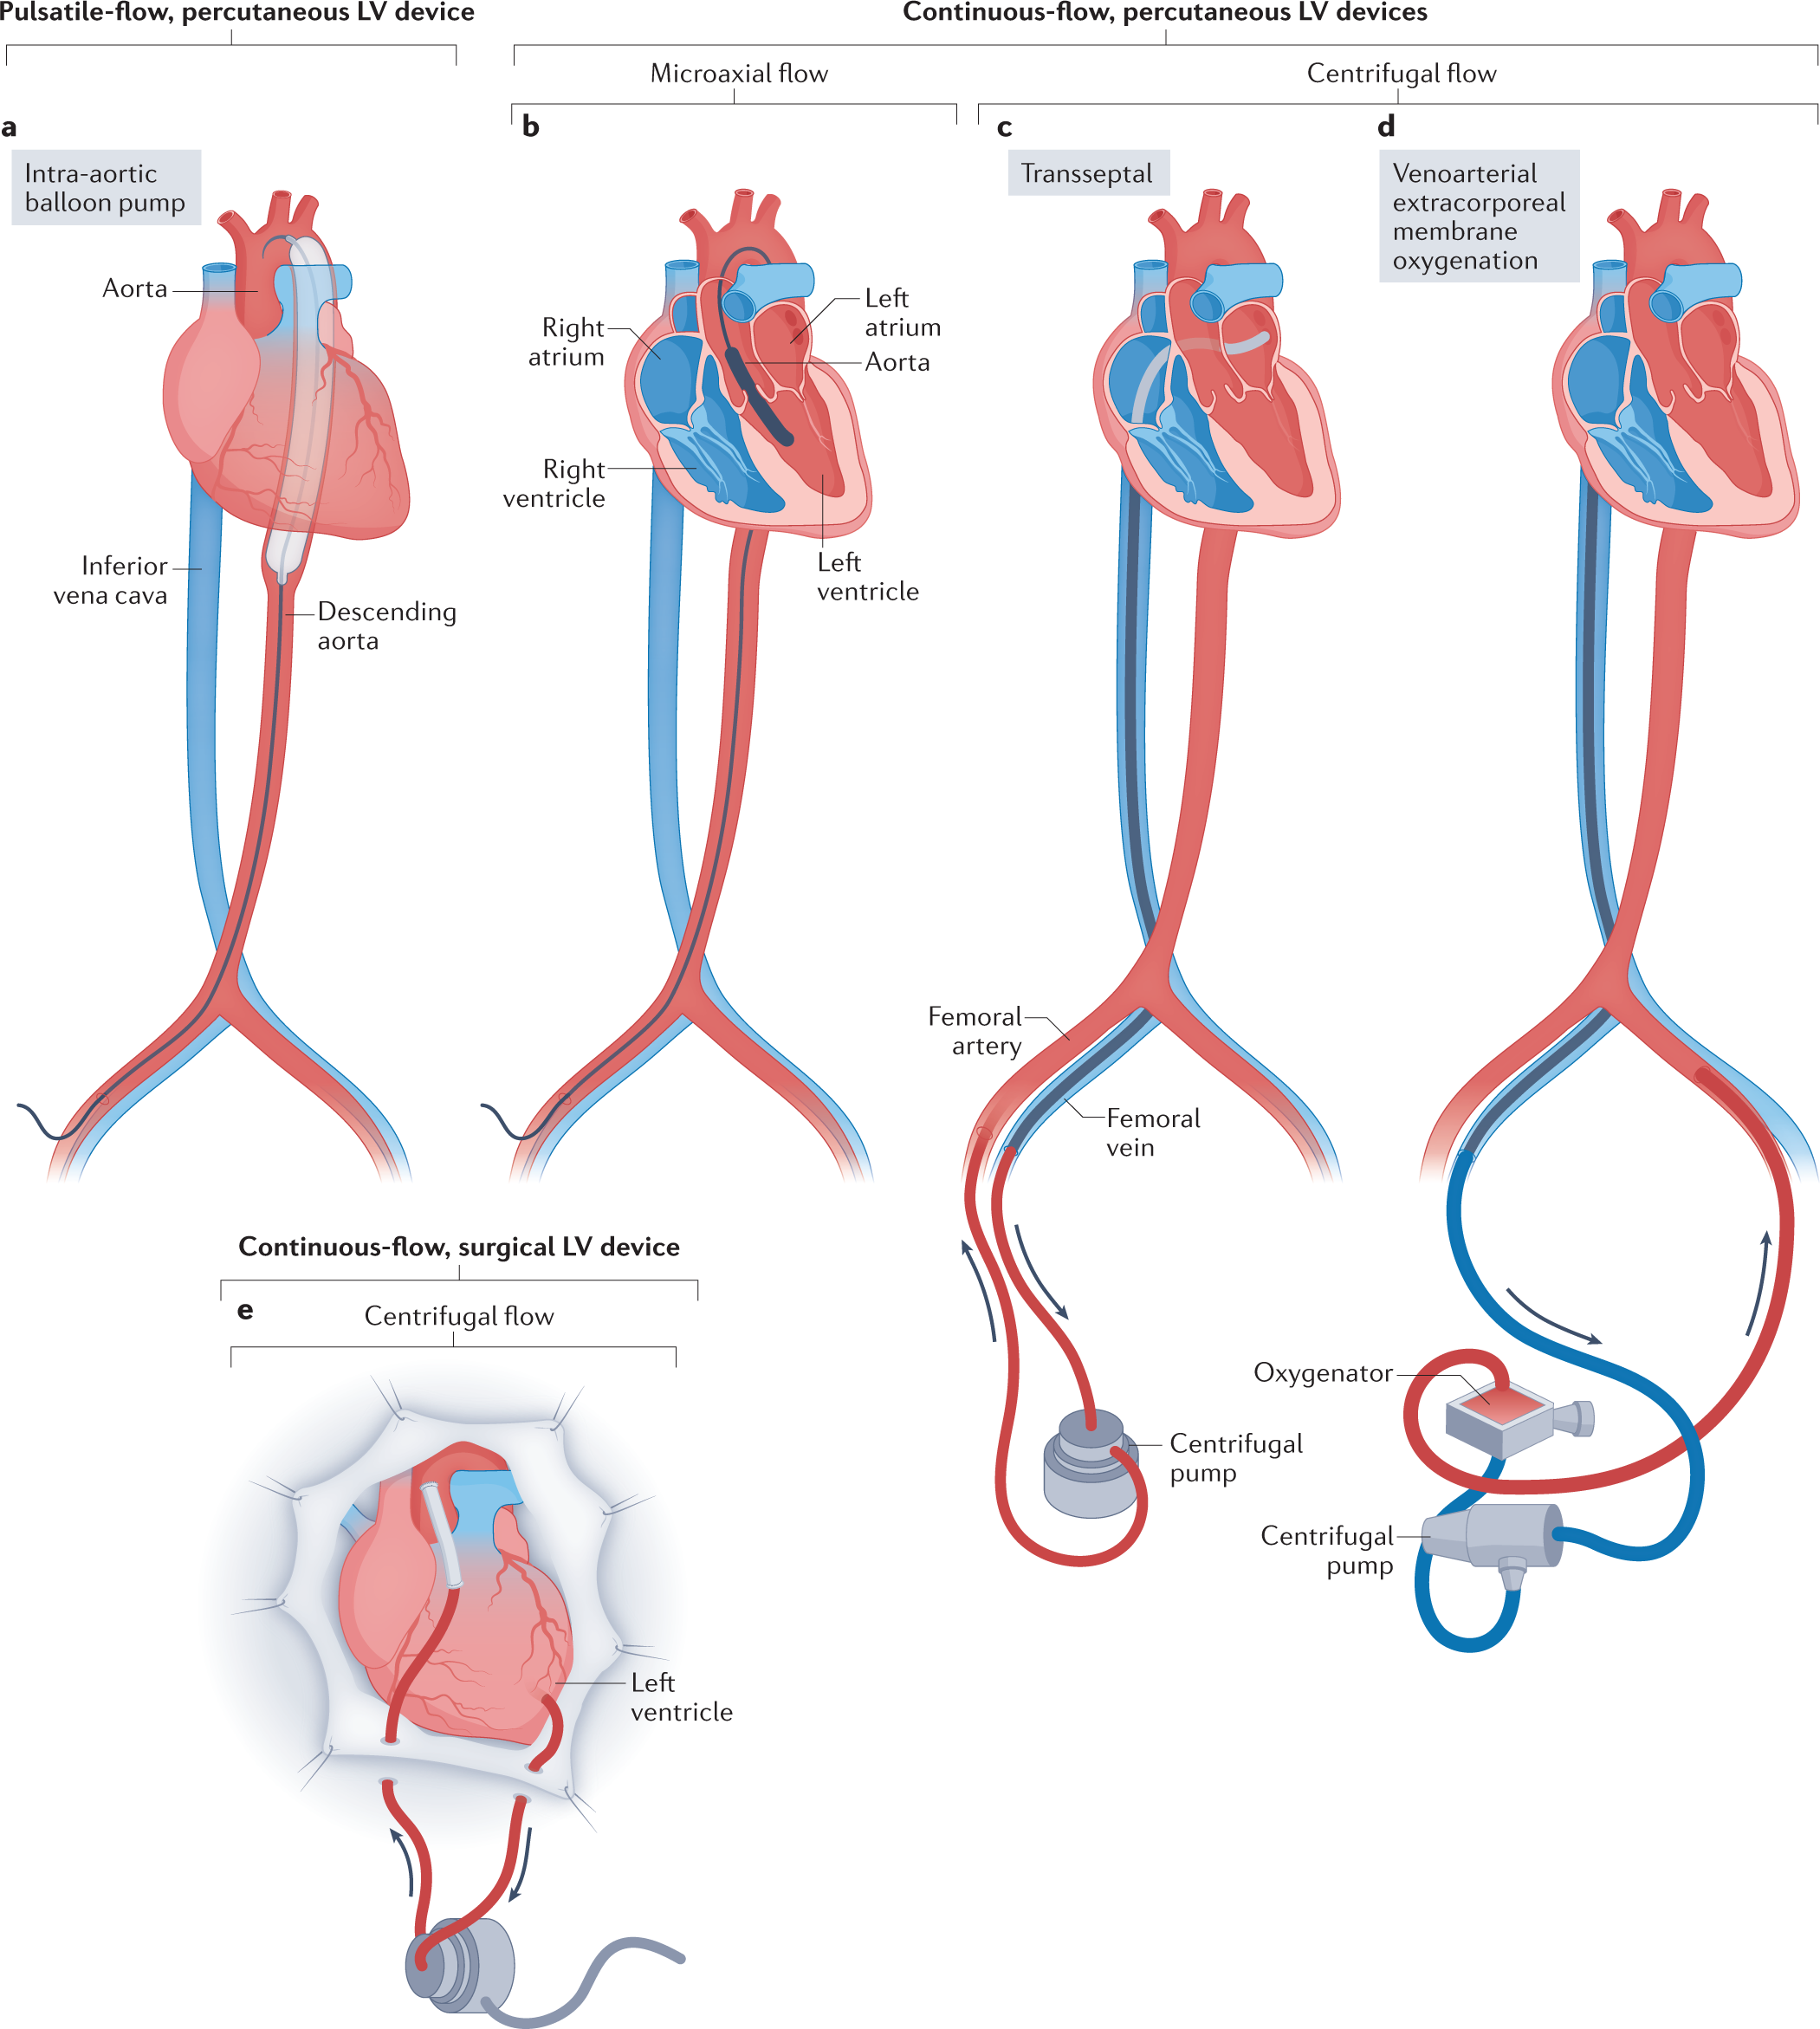

Slide 10
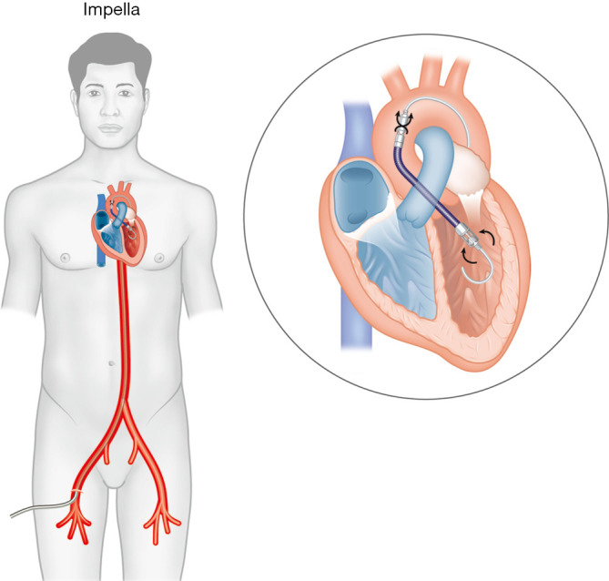

Slide 11
Advanced Therapies: Transplantation and Beyond
Cardiac Transplantation
1
The best option for patients with irreversible
advanced heart failure.
Myocardial Cell Transplantation
2
New surgical strategies offer options for patients ineligible for device implantation or heart transplantation.

Slide 12
Diuretics: Addressing Volume Overload
Loop Diuretics
IV loop diuretics like furosemide and bumetanide are first-line therapy for ADHF patients with volume overload.
Bolus administration reduces preload within 5-15 minutes by functional venodilation and later via sodium and water excretion, improving pulmonary congestion.
Diuretic resistance may be addressed with larger bolus doses, continuous infusions, or adding a second diuretic with a different mechanism of action, such as a distal tubule blocker (eg, oral metolazone, oral hydrochlorothiazide, or IV chlorothiazide).

Slide 13
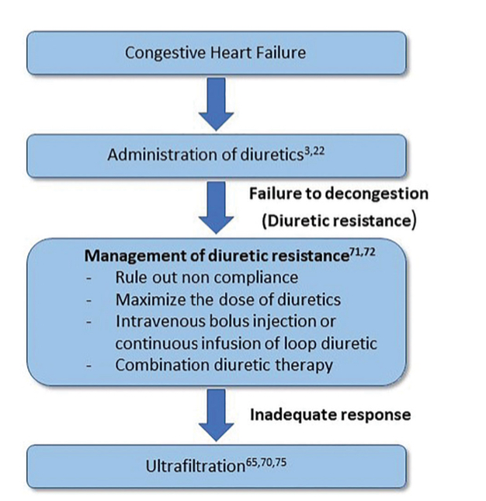

Slide 14
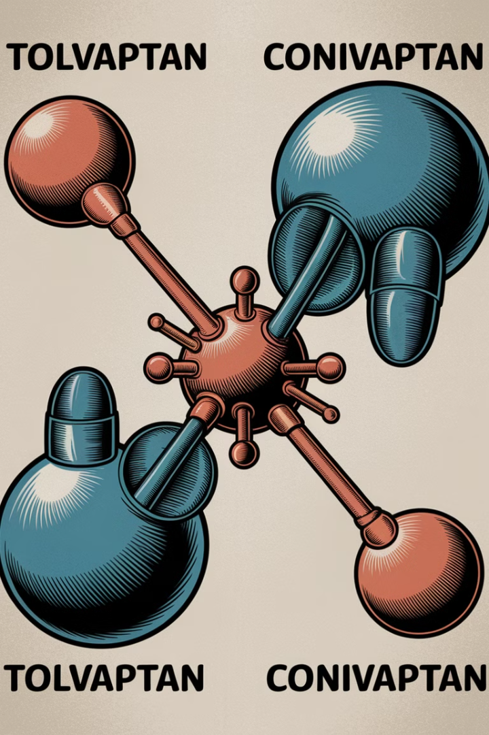
Vasopressin Antagonists: Targeting Hormone Imbalance
1
V1A and V2 Receptors
2
Tolvaptan and Conivaptan
Vasopressin receptor antagonists affect one or both V1A and V2 receptors of antidiuretic hormone (AVP).
V1A receptors in vascular smooth muscle cause vasoconstriction and positive inotropic effects.
V2 receptors in renal tubules regulate water reabsorption.
Tolvaptan selectively inhibits the V2 receptor, orally for hypervolemic and euvolemic hyponatremia in patients with HF. Conivaptan nonselectively inhibits V1A and V2, intravenously for hypervolemic and euvolemic hyponatremia, but is not indicated for HF.

Slide 15
Vasopressin Antagonists: Targeting Hormone Imbalance
Close Monitoring
Monitor patients closely to avoid excessively rapid rises in serum sodium, which might require drug discontinuation.

Slide 16
Vasodilators: Relaxing Vessels, Reducing Congestion
Venodilators
Considerations for IV Vasodilators
Venodilators, such as nitroglycerin, reduce preload by increasing venous capacitance, improving pulmonary congestion. Arterial vasodilators, decrease afterload, increasing cardiac output. Mixed vasodilators, like nitroprusside, act on both venous capacitance and arterial resistance vessels.
IV vasodilators are considered before inotropes for patients with low cardiac output and elevated systemic vascular resistance (SVR).
However, hypotension may preclude their use in patients with preexisting low blood pressure or SVR.

Slide 17
Vasodilators: Relaxing Vessels, Reducing Congestion
Nitroglycerin: Preferred for
Preload Reduction
Sodium Nitroprusside: Mixed Arteriovenous Vasodilator
IV nitroglycerin is often preferred for preload reduction in ADHF due to its potent coronary vasodilating properties. It is the vasodilator of choice for patients with severe HF and ischemic heart disease.
Sodium nitroprusside is a mixed arteriovenous vasodilator. Hypotension is an important dose-limiting adverse effect, and its use should be primarily reserved for patients with elevated SVR.

Slide 18
Inotropes: Enhancing Cardiac Contractility
Dobutamine
Milrinone
Dobutamine increases cardiac contractility, improving heart function. It is typically used in patients with low cardiac output and a need for short-term support.
Milrinone is a phosphodiesterase inhibitor that enhances cardiac contractility and reduces preload and afterload, improving heart function. It is often used in patients with severe heart failure.
Norepinephrine
and Dopamine
Norepinephrine and dopamine are potent vasopressors that increase blood pressure and improve cardiac output. They are typically used in patients with severe shock and low blood pressure.

Slide 19
Key Considerations for Inotrope Use
1
Prompt correction of low cardiac output in patients with hypoperfusion is crucial to restore peripheral tissue perfusion and preserve end-organ function. Inotropes are a temporizing measure to maintain end-organ perfusion.
2
Inotropes are considered for patients with cardiogenic shock or severely depressed cardiac output and low systolic blood pressure. These patients are often ineligible for IV vasodilators due to the risk of hypotension.
3
Inotropes are not a substitute for long-term management of heart failure. They are typically used for short-term support until other therapies, such as diuretics or vasodilators, can be optimized.

Slide 20
Evaluation of therapeutic outcomes
Ask patients about the presence and severity of symptoms and how symptoms affect daily activities.
Evaluate efficacy of diuretic treatment by disappearance of the signs and symptoms of excess fluid retention
Body weight is a sensitive marker of fluid loss or retention, and patients should weigh themselves daily and report changes of (1.4–2.3 kg) to their healthcare provider so adjustments can be made in diuretic doses.
Symptoms may worsen initially on β-blocker therapy, and it may take weeks to months before patients notice symptomatic improvement.

Slide 21
Evaluation of therapeutic outcomes
Routine monitoring of serum electrolytes (especially potassium and magnesium) and renal function (BUN, serum creatinine, eGFR) is mandatory in patients with HF.

Slide 22
Acute Decompensated Heart Failure
Assess the efficacy of drug therapy with daily monitoring of weight, strict fluid intake and output measurements, and HF signs/symptoms.
Monitor frequently for electrolyte depletion, symptomatic hypotension, and renal dysfunction. Assess vital signs frequently throughout the day.

Slide 23
Q1/ A 55 years old smoker presented to the ER with sever HF a main symptom of dyspnea due to pulmonary congestion. What is the drugs of choice in this case?
Digoxin
Spironolactone
Nitroglycerin
Enalapril
Q2/ which of the following group of drugs are the 1st line treatment in both hypertension and HF?
ACEI
Cardiac glycosides
Both A and B

Slide 24
Q1/ A 55 years old smoker presented to the ER with sever HF a main symptom of dyspnea due to pulmonary congestion. What is the drugs of choice in this case?
Digoxin
Spironolactone
Nitroglycerin
Enalapril
Q2/ which of the following group of drugs are the 1st line treatment in both hypertension and HF?
ACEI
Cardiac glycosides
Both A and B

Slide 25
Q3/ AHA/ACC stage B correlates to which of the below answers?
At high risk of heart failure without structural damage
Structural heart disease but without signs and symptoms of heart failure
Structural heart disease but with symptoms
Heart failure requiring interventions

Slide 26
Q3/ AHA/ACC stage B correlates to which of the below answers?
At high risk of heart failure without structural damage
Structural heart disease but without signs and symptoms of heart failure
Structural heart disease but with symptoms
Heart failure requiring interventions

