Slide 1
Denaturation of proteins and protein sequencing
MOHAMMED AL-ZUBAIDI, PhD

Slide 2
Determination of primary structure:
The primary structure comprises the identification of component amino acids with regard to their quality, quantity and sequence in a protein structure. A pure sample of a protein or a polypeptide is essential for the determination of primary structure which involves 4 steps :
Determination of amino acid composition.
Identification of N-terminal and C-terminal amino acids
Degradation of protein or polypeptide into smaller fragments.
Determination of the amino acid sequence.

Slide 3
1- Determination of amino acid composition:
In a protein: The protein or polypeptide is completely hydrolysed to liberate the amino acids which are quantitatively estimated. The hydrolysis may be carried out either by acid or alkali treatment or by enzyme hydrolysis. Treatment with enzymes, however results in smaller peptides rather than amino acids.
Pronase is a mixture of non-specific proteolytic enzymes that causes complete hydrolysis of proteins.
Separation and estimation of amino acids :
The mixture of amino acids liberated by protein hydrolysis can be determined by chromatographic techniques.

Slide 4
2- Degradation of protein into smaller fragments :
Protein is a large molecule which is sometimes composed of individual polypeptide chains. Separation of polypeptides is essential before degradation.
Liberation of polypeptides: Treatment with urea or guanidine hydrochloride disrupts the non-covalent bonds and dissociates the protein into polypeptide units. For cleaving the disulfide linkages between the polypeptide units, treatment with performic acid is necessary.
Number of polypeptides: The number of polypeptide chains can be identified by treatment of protein with dansyl chloride. It specifically binds with N-terminal amino acids to form dansyl polypeptides which on hydrolysis yield N-terminal dansyl amino acid. The number of dansyl amino acids produced is equal to the number of polypeptide chains in a protein.
Breakdown of polypeptides into fragments: Polypeptides are degraded into smaller peptides by enzymatic or chemical methods.

Slide 5
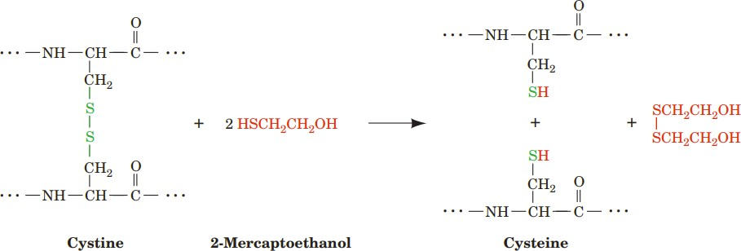

Disulfide bonds can be reductively cleaved by treating them with 2-mercaptoethanol or another mercaptan (compounds that contain an ¬SH group):
The resulting free sulfhydryl groups are then alkylated, usually by treatment with iodoacetate, to prevent the re-formation of disulfide bonds through oxidation by O₂.

Slide 6
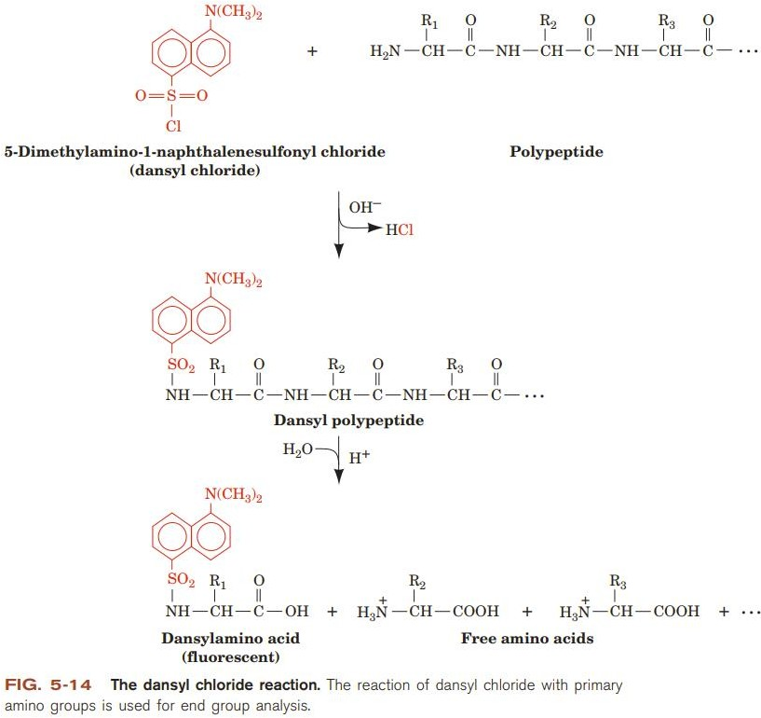

Slide 7
Large Polypeptides Are First Cleaved Into Smaller Segments
While the first 20–30 residues of a peptide can readily be determined by the Edman method, most polypeptides contain several hundred amino acids. Consequently, most polypeptides must first be cleaved into smaller peptides prior to Edman sequencing. Cleavage also may be necessary to circumvent posttranslational modifications that render a protein’s α-amino group “blocked”, or unreactive with the Edman reagent.

Slide 8
It usually is necessary to generate several peptides using more than one method of cleavage. This reflects both inconsistency in the spacing of chemically or enzymatically susceptible cleavage sites and the need for sets of peptides whose sequences overlap so one can infer the sequence of the polypeptide from which they derive. Following cleavage, the resulting peptides are purified by reversed-phase HPLC—or occasionally by SDS-PAGE—and sequenced.

Slide 9
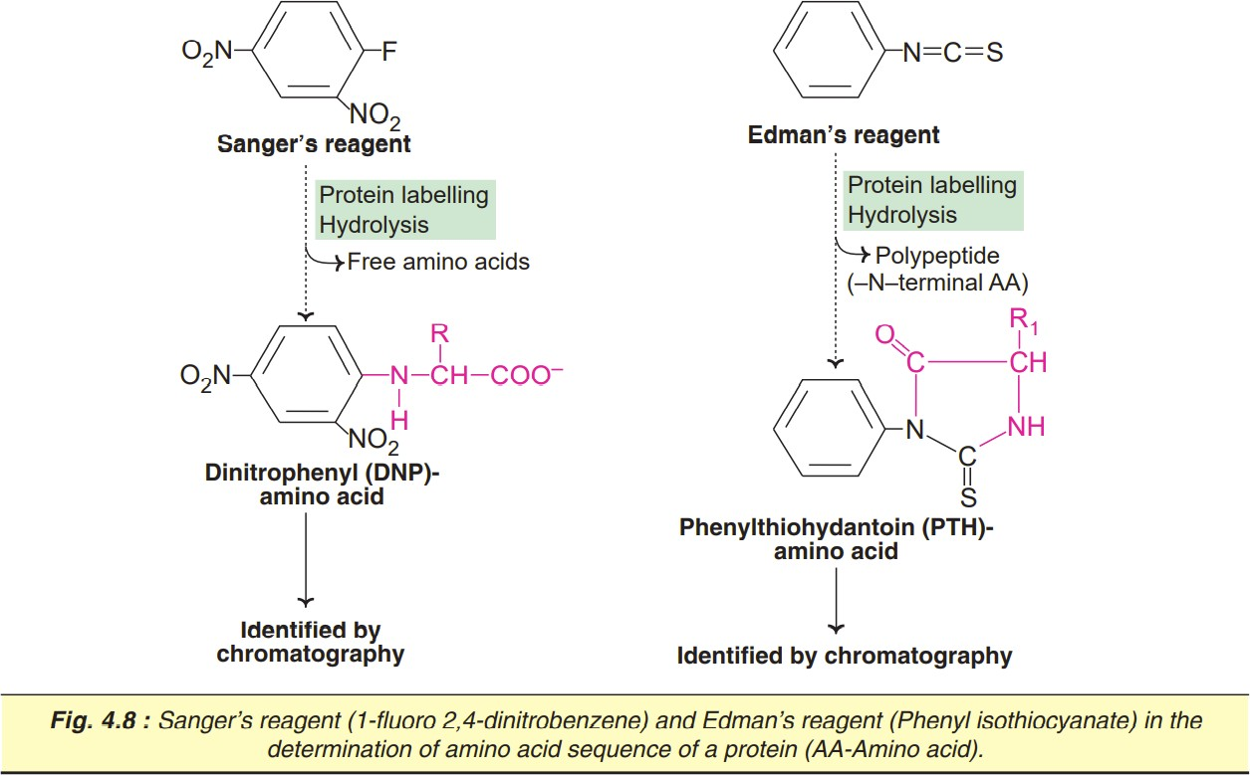
Breakdown of polypeptides by chemical methods

Slide 10
THE EDMAN REACTION ENABLES PEPTIDES & PROTEINS TO BE SEQUENCED
Pehr Edman introduced phenylisothiocyanate (Edman’s reagent) to selectively label the amino-terminal residue of a peptide. In contrast to Sanger’s reagent, the phenylthiohydantoin (PTH) derivative can be removed under mild conditions to generate a new amino terminal residue.
Successive rounds of derivatization with Edman’s reagent can therefore be used to sequence many residues of a single sample of peptide. Edman sequencing has been automated, using a thin film or solid matrix to immobilize the peptide and HPLC to identify PTH amino acids. Modern gas-phase sequencers can analyze as little as a few picomoles of peptide.

Slide 11
This technique involves the selective cleavage of the N-terminal amino acid from a protein, allowing for the determination of the C-terminal amino acid by inference.
PITC Derivatization: The protein is derivatized with phenyl isothiocyanate (PITC), which reacts specifically with the N-terminal amino group of the protein, forming a stable derivative.
Cleavage: Under mildly acidic conditions, the N-terminal amino acid is cleaved from the protein, resulting in the formation of a cyclic derivative known as a phenylthiohydantoin (PTH) amino acid.
Identification: The PTH amino acid is then analyzed using techniques like high-performance liquid chromatography (HPLC) or mass spectrometry to determine its identity. This process is repeated iteratively for each N-terminal amino acid.

Slide 12
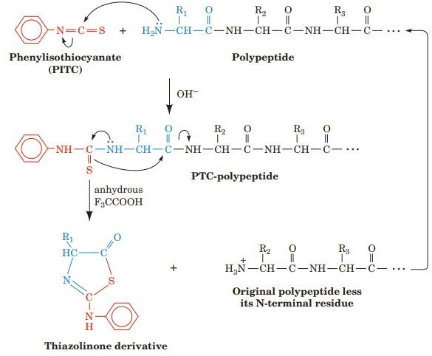
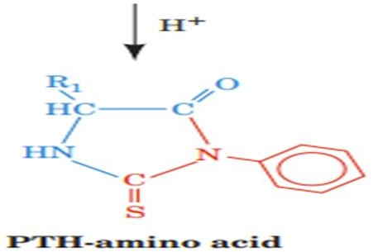

Slide 13
Advantages of Edman Degradation:
Precise determination of N-terminal amino acids.
Suitable for relatively small proteins.
High purity of sequenced peptides.
Limitations of Edman Degradation:
Limited scalability: Not well-suited for large-scale protein sequencing.
Degradation can damage the protein, making it unsuitable for subsequent analysis.
The method is time-consuming and labor-intensive.

Slide 14
SANGER WAS THE FIRST TO DETERMINE THE SEQUENCE OF A POLYPEPTIDE
E.g. mature insulin consists of the 21-residue A chain and the 30-residue B chain linked by disulfide bonds. Frederick Sanger reduced the disulfide bonds, separated the A and B chains, and cleaved each chain into smaller peptides using trypsin, chymotrypsin, and pepsin. The resulting peptides were then isolated and treated with acid to hydrolyze peptide bonds and generate peptides with as few as two or three amino acids.

Slide 15
Each peptide was reacted with 1-fluoro-2,4-dinitrobenzene (Sanger’s reagent), which derivatizes the exposed α-amino group of amino terminal residues. The amino acid content of each peptide was then determined. While the ε-amino group of lysine also reacts with Sanger’s reagent, amino-terminal lysines can be distinguished from those at other positions because they react with 2 mol of Sanger’s reagent. Working backwards to larger fragments enabled Sanger to determine the complete sequence of insulin

Slide 16
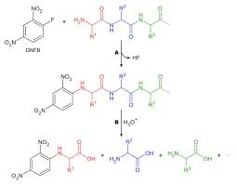

Slide 17
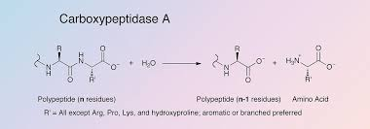
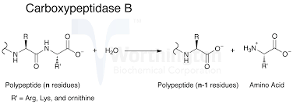
Identification of C-terminal amino acids

Slide 18
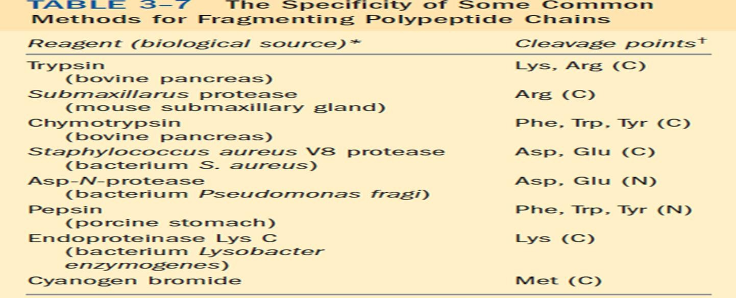
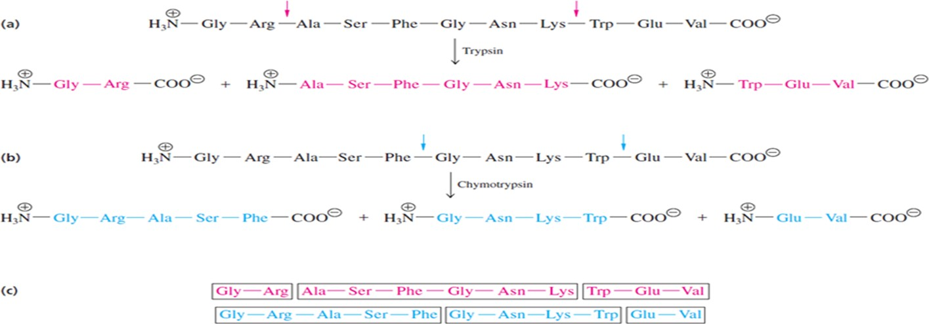
Breakdown of polypeptides enzymatic

Slide 19
Protein Sequencing Strategy
1 If the protein contains more than one polypeptide chain, the chains are separated and purified.
2 Intrachain S-S (disulfide) cross-bridges between cysteine residues in the polypeptide chain are cleaved.
The amino acid composition of each polypeptide chain is determined.
The N-terminal and C-terminal residues are identified.
Each polypeptide chain is cleaved into smaller fragments, and the amino acid composition and sequence of each fragment are determined.
Step 5 is repeated, using a different cleavage procedure to generate a different and therefore overlapping set of peptide fragments .
The overall amino acid sequence of the protein is reconstructed from the sequences in overlapping fragments.
The positions of S-S cross-bridges formed between cysteine residues are located.

Slide 20
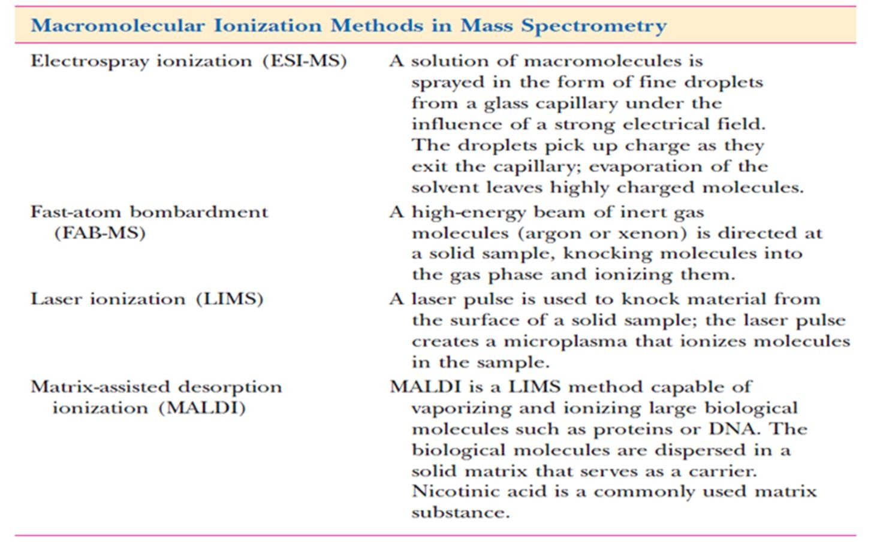
Sequence Determination by Mass Spectrometry (MS):
Mass spectrometers exploit the difference in the mass-to-charge (m/z) ratio of ionized atoms or molecules to separate them from each other.

Slide 21
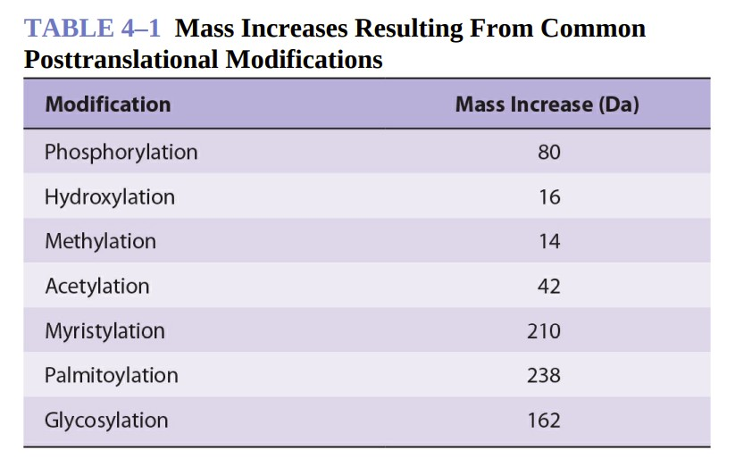
MASS SPECTROMETRY CAN DETECT COVALENT MODIFICATIONS
MS is significantly more sensitive and tolerant of variations in sample quality. Moreover, since mass and charge are common properties of a wide range of biomolecules, MS can be used to analyze metabolites, carbohydrates, and lipids, and to detect posttranslational modifications such as phosphorylation or hydroxylation that add readily identified increments of mass to a protein

Slide 22
GENOMICS ENABLES PROTEINS TO BE IDENTIFIED FROM SMALL AMOUNTS OF SEQUENCE DATA
Primary structure analysis has been revolutionized by genomics, the application of automated oligonucleotide sequencing and computerized data retrieval and analysis to sequence an organism’s entire genetic complement.
Where genome sequence is known, the task of determining a protein’s DNA-derived primary sequence is materially simplified. In essence, the second half of the hybrid approach has already been completed. All that remains is to acquire sufficient information to permit the open reading frame (ORF) that encodes the protein to be retrieved from an Internet accessible genome database and identified. In some cases, a segment of amino acid sequence only four or five residues in length may be sufficient to identify the correct ORF.

Slide 23
Computerized search algorithms assist the identification of the gene encoding a given protein and clarify uncertainties that arise from Edman sequencing and mass spectrometry.
The spectrum of information suitable for identification of the ORF that encodes a particular polypeptide is greatly expanded. In peptide mass profiling, for example, a peptide digest is introduced into the mass spectrometer and the sizes of the peptides are determined. A computer is then used to find an ORF whose predicted protein product would, if broken down into peptides by the cleavage method selected, produce a set of peptides whose masses match those observed by mass spectrometry.

Slide 24
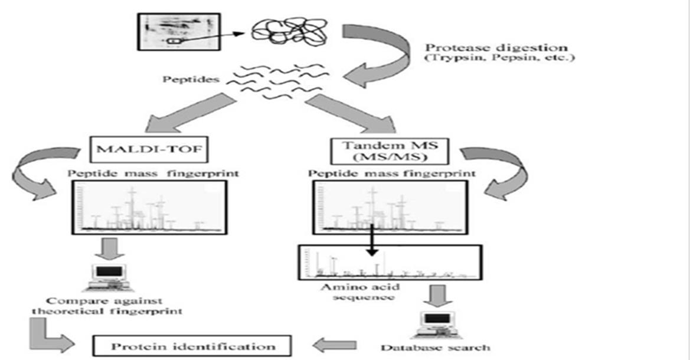
Proteomic:
The term proteomics was introduced in 1995 for analysis of the complete protein complements expressed by a genome in a cell or a tissue type. By analogy with genomics, the term proteomics refers to studies of a gene’s function at the protein level.
Proteomics is the study of these proteins their identity, their biochemical properties and functional roles, and how their quantities, modifications, and structures change during development and in response to internal and external stimuli.

Slide 25
Proteome for drugs design and other application:
There are several theoretical differences studying the human proteome as compared with human genome and they all analytical challenges in proteome.
There is not a one relationship between the number of gens and the number of protein as proteins come in different splice variants and in addition undergo post-translational modification, where sugars, phosphates, and other molecules are added to the protein structure.

Slide 26
The process of drug discovery and development ,it has been postulated that scientists could use genome information to identify and validate a host of new drug targets and specific drugs based on an individual's detailed genetic makeup.
The broad field of proteomics has as its primary goal the understanding of structure, function, expression cellular localization interaction partners, biomarkers, and regulation of every protein produced from a complete genome . For drugs design of specific protein modifying reagents that can be used for functional.

Slide 27
Bioinformatics Assists Identification of Protein Functions
Bioinformatics is the application of computer technology to the management and analysis of biological data. The result is that computers are being used to gather, store, analyze and merge biological data.
Data mining through bioinformatics permits researchers to compare amino acid sequences of unknown proteins with those whose functions have been determined. This provides a means to uncover clues to their potential properties, physiologic roles, and mechanisms of action.
There are three central biological processes around which bioinformatics tools must be developed:
1-DNA sequence determines protein sequence
2-Protein sequence determines protein structure
3-Protein structure determines protein function

Slide 28
THE END

