Slide 1
Proteins
MOHAMMEDAL-ZUBAIDI, PhD

Slide 2
CONFORMATION VERSUS
CONFIGURATION
Configuration refers to the geometric relationship between a given set of atoms, for example, those that distinguish L- from D-amino acids. Interconversion of configurational alternatives requires breaking covalent bonds.
Conformation refers to the spatial relationship of every atom in a molecule. Interconversion between conformers occurs without covalent bond rupture, with retention of configuration, and typically via rotation about single bonds.

Slide 3
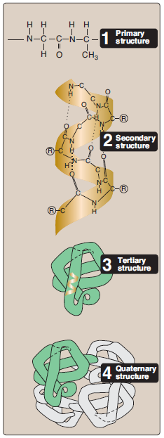
Protein Structures
Primary structure: the amino acid sequence of a protein.
Secondary structure: a specific local structure that is produced by hydrogen bonding within the backbone.
Tertiary structure: the three dimensional structure of a single amino acid chain which is produced by interactions of secondary structures.
Quaternary structure: the three dimensional structure of protein that is resulted from intermolecular interaction within two or more protein units.

Slide 4
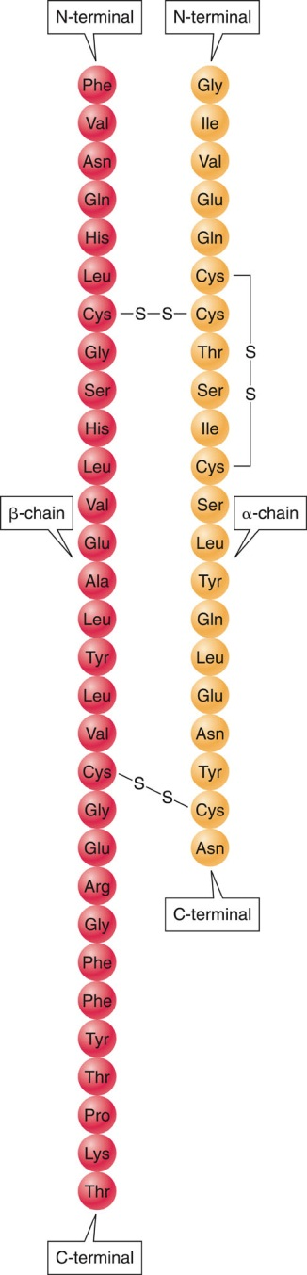
PRIMARY PROTEIN STRUCTURE
Primary protein structure:
  Is the linear sequence of amino acids in a protein chain.
  Determines secondary and tertiary structures.
  Is important for the functioning of proteins; small variations in the primary structure can cause profound differences in the functioning of proteins.

Slide 5
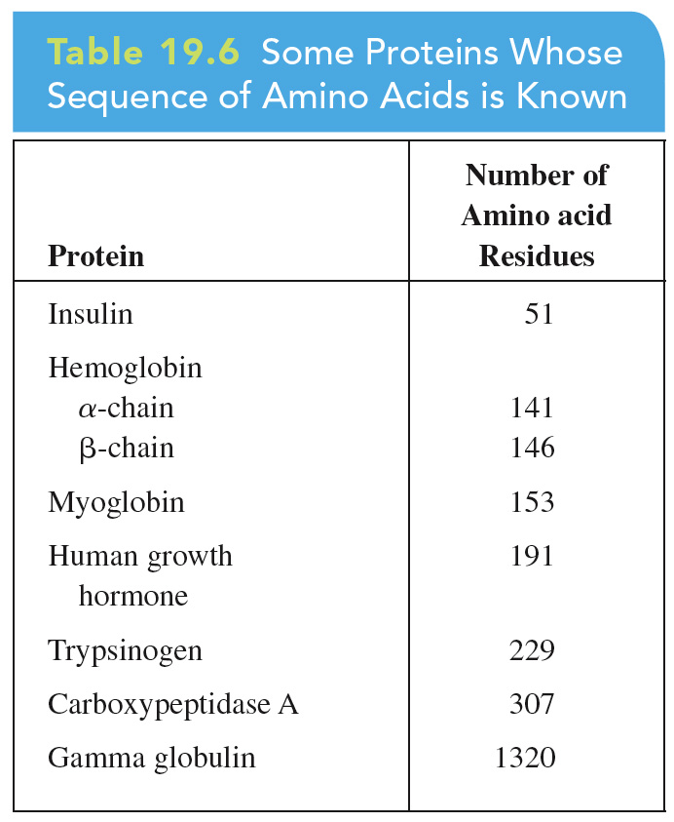
PRIMARY PROTEIN STRUCTURE

Slide 6
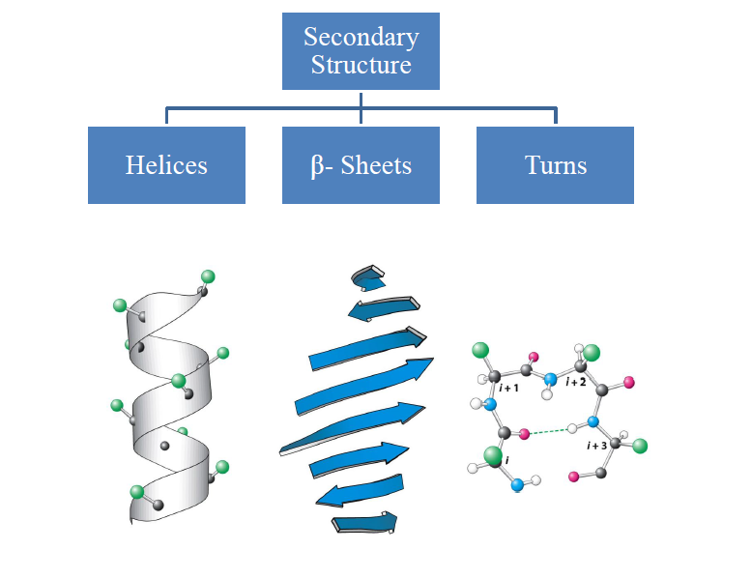
Secondary Structure

Slide 7
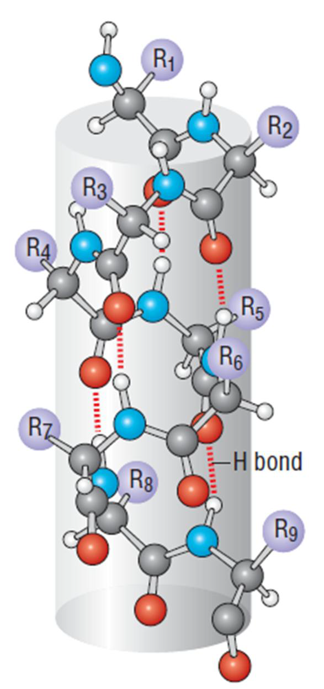
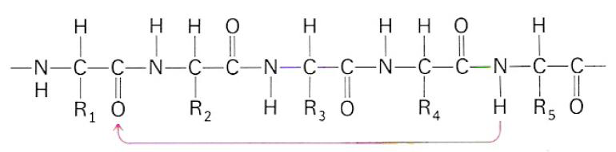
α- Helices
Alpha helices are versatile cylindrical structures stabilized by a network of backbone hydrogen bonds between C=O and N–H groups close together in the sequence.
In an alpha helix, the carbonyl oxygen atom of each residue (n) accepts a hydrogen bond from the amide nitrogen four residues further along (n+4) in the sequence, so that all of the polar amide groups in the helix are hydrogen bonded to one another.
At the start of an α-helix, four amide groups are always free, and at the end of an α-helix, four carbonyl groups are also free. As a result, both ends of an α-helix are highly polar.

Slide 8
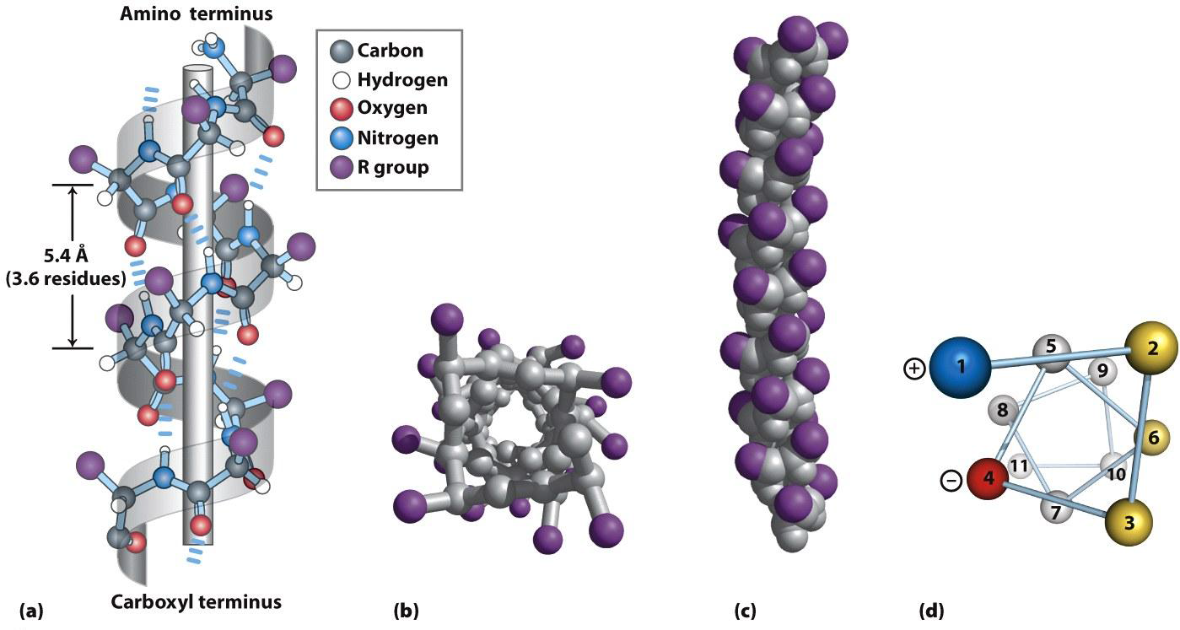
The result is a cylindrical structure where the wall of the cylinder is formed by the hydrogen-bonded backbone, and the outside is studded with side chains. The protruding side chains determine the interactions of the alpha helix both with other parts of a folded protein chain and with other protein molecules.
Often an α-helix serves as a building block for the three-dimensional structure of globular proteins by bringing hydrophobic side chains to one side of a helix and hydrophilic side chains to the opposite side of the same helix.
Not all polypeptide sequences adopt α-helical structures. Small hydrophobic residues such as Ala and Leu are strong helix formers. Pro acts as a helix breaker because the rotation around the N-Cα bond is impossible (the peptide bond nitrogen of proline lacks a hydrogen atom to contribute to a hydrogen bond, proline can only be stably accommodated within the first turn of an α helix. When present elsewhere, proline disrupts the conformation of the helix, producing a bend). Gly acts as a helix breaker because the tiny R-group supports other conformations (Because of its small size, glycine also often induces bends in α helices).

Slide 9
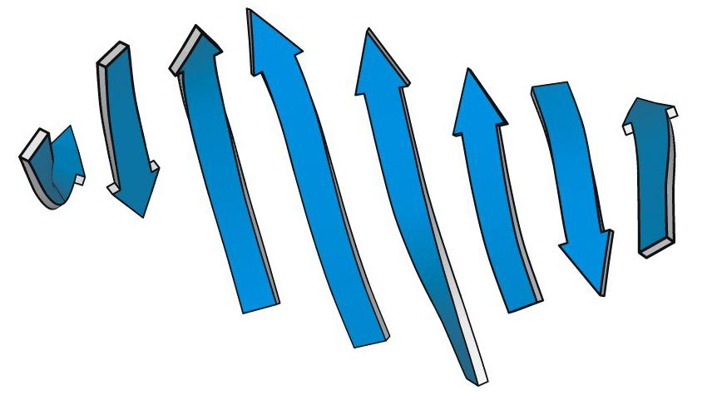
β- Sheets
In contrast to the α-helix, which is built up from a continuous region with a peptide hydrogen bond linking every fourth amino acid, the β-sheet is comprised of peptide hydrogen bonds between different regions of the polypeptide that may be far apart in sequence.
β-sheets can interact with each other in two ways, either parallel or antiparallel. Mixed sheets with both parallel and antiparallel strands are also possible.
Because the polypeptide chain in a beta sheet is extended, amino-acid side chains such as those of valine and isoleucine, which branch at the beta carbon, can be accommodated more easily in a beta structure than in a tightly coiled alpha helix where side chains are crowded more closely together. Although unbranched side chains can fit in beta structures as well, branched side chains appear to provide closer packing so they are found more frequently in sheets than other residues.

Slide 10
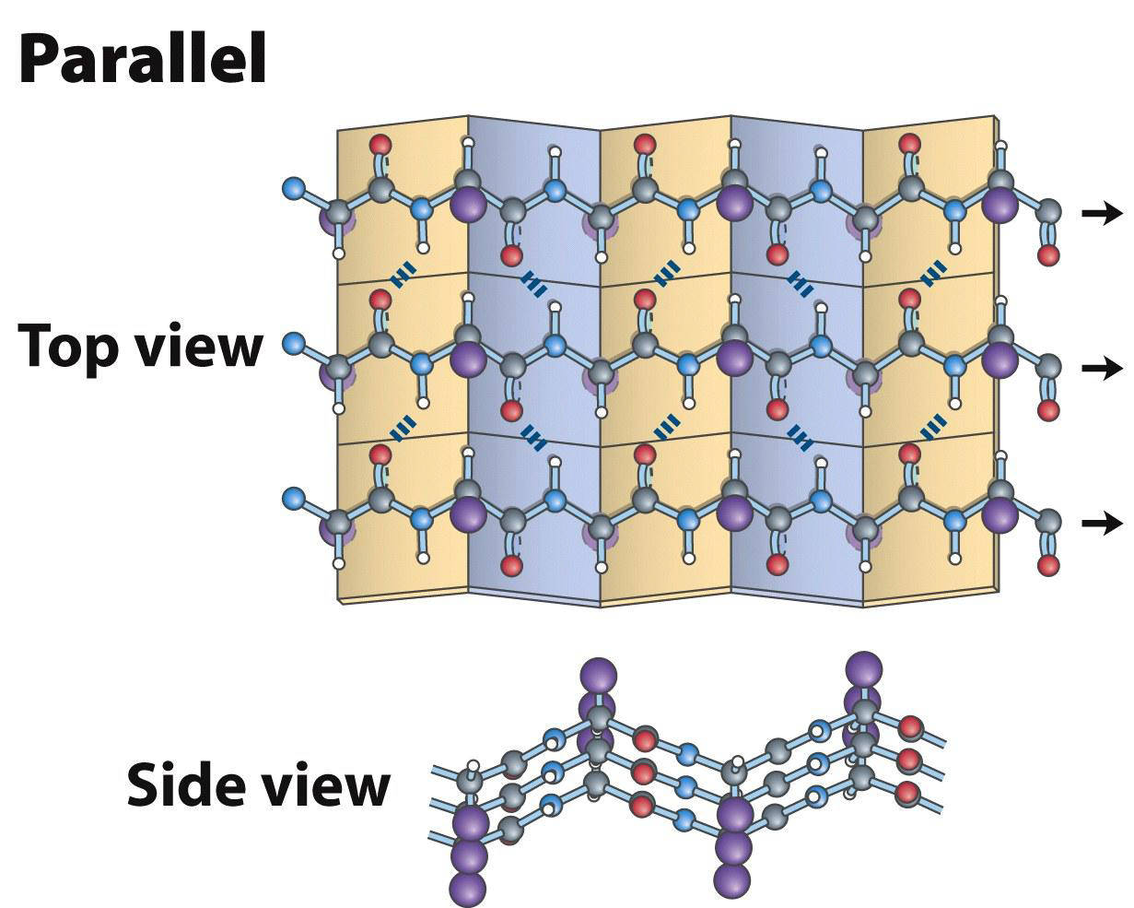
In parallel β-sheets, each strand is oriented in the same direction with peptide hydrogen bonds formed between the strands.
Antiparallel sheets are more stable, which is consistent with their hydrogen bonds being more linear.
Side chains protrude from the sheet alternating in up and down direction projecting perpendicularly to the plane.

Slide 11
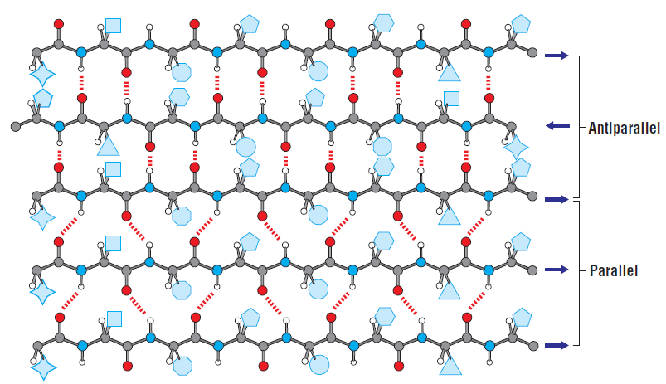
Mixed Sheets

Slide 12
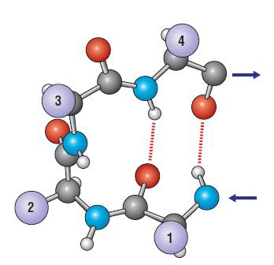
Turns
The simplest secondary structure element.
Usually involves four residues but sometimes requires only three. It consists of a hydrogen bond between the carbonyl oxygen of one residue (n) and the amide N–H of residue n+3, reversing the direction of the chain.
They are comprised of an amino acid sequence which is usually hydrophilic and exposed to the solvent.
It usually consists of Pro at the second position of the turn and a Gly at the third/fourth position.
Turns occur frequently whenever strands in β-sheets change direction.

Slide 13
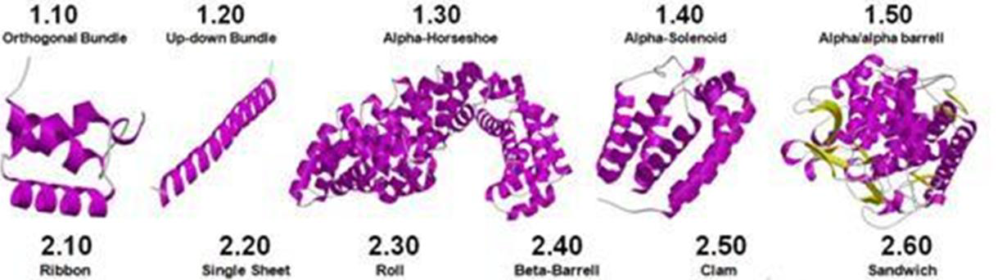
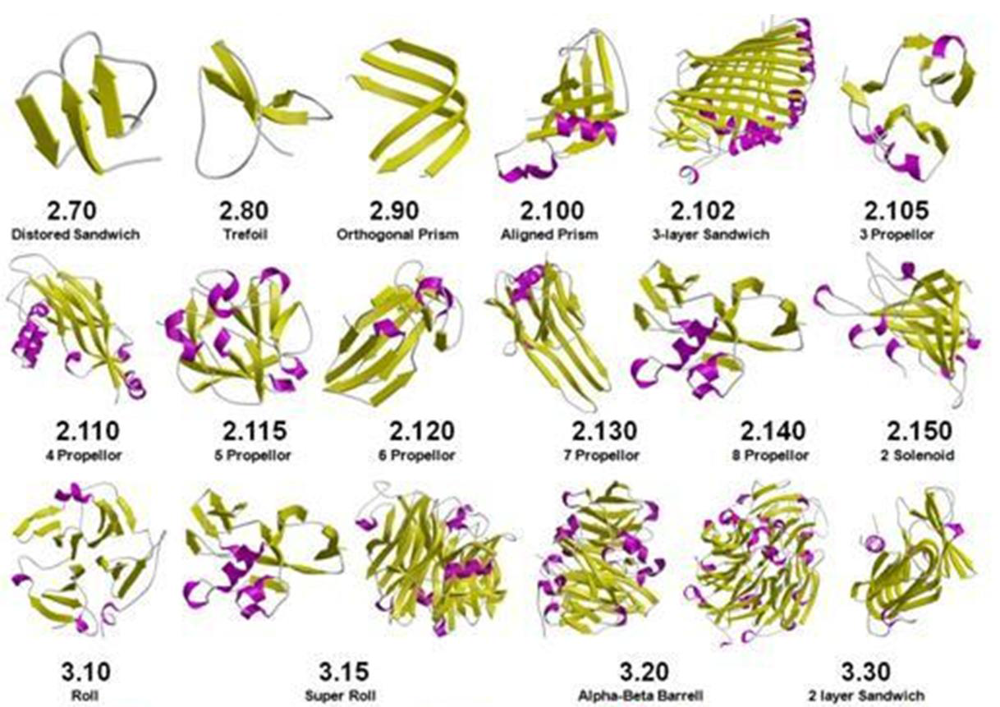
Tertiary Structure
Combination of various secondary structures in a protein results in its three-dimensional structure.
The folding of a protein molecule into a distinct three-dimensional structure determines its function.

Slide 14
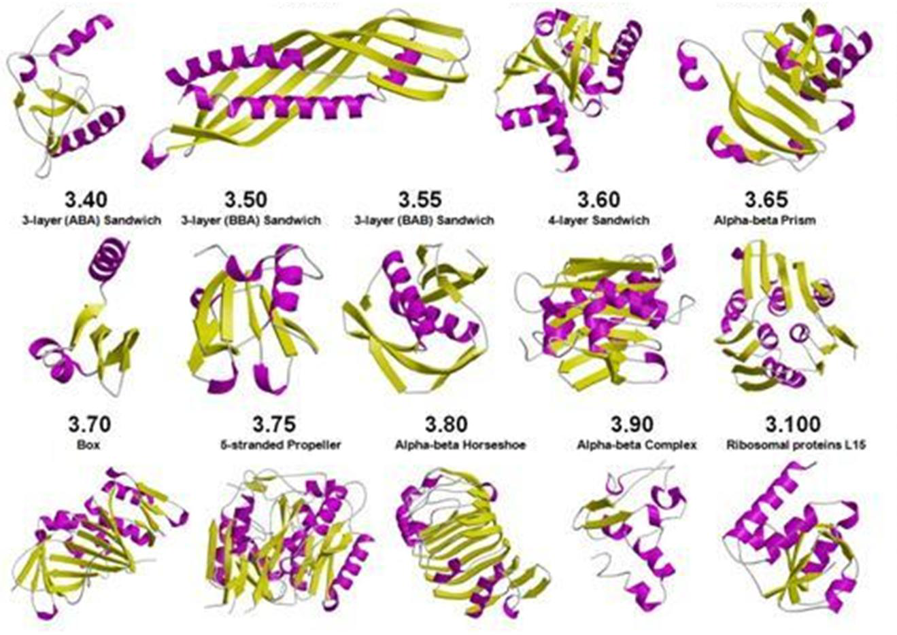

Slide 15
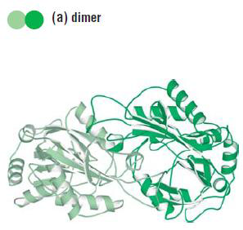
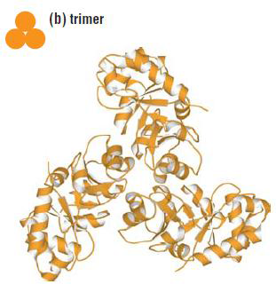
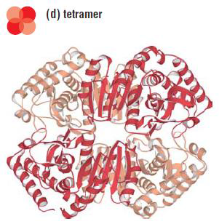
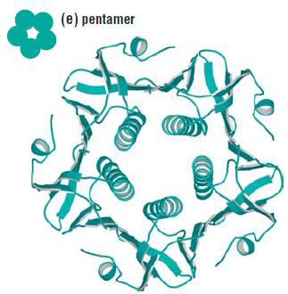
Quaternary Structure
A unique tertiary structure of a protein can often result in the assembly of the protein into a distinct quaternary structure consisting of a fixed stoichiometry of protein chains within the complex.
Assembly can occur between the same proteins or between different polypeptide chains.
Each molecule in the complex is called a subunit.
The formation of quaternary structure occurs via non-covalent interactions or through disulfide bonds between the subunits.

Slide 16
Functions and Classification of Proteins
Functions / importance of Proteins
Type Examples
Structural tendons, cartilage, hair, nails
Contractile muscles
Transport hemoglobin, albumin
Storage ferritin
Hormonal eg. insulin, growth hormone
Enzyme eg. hydroxylases
Protection immunoglobulins
Energy 4.1 k.cal/g

Slide 17
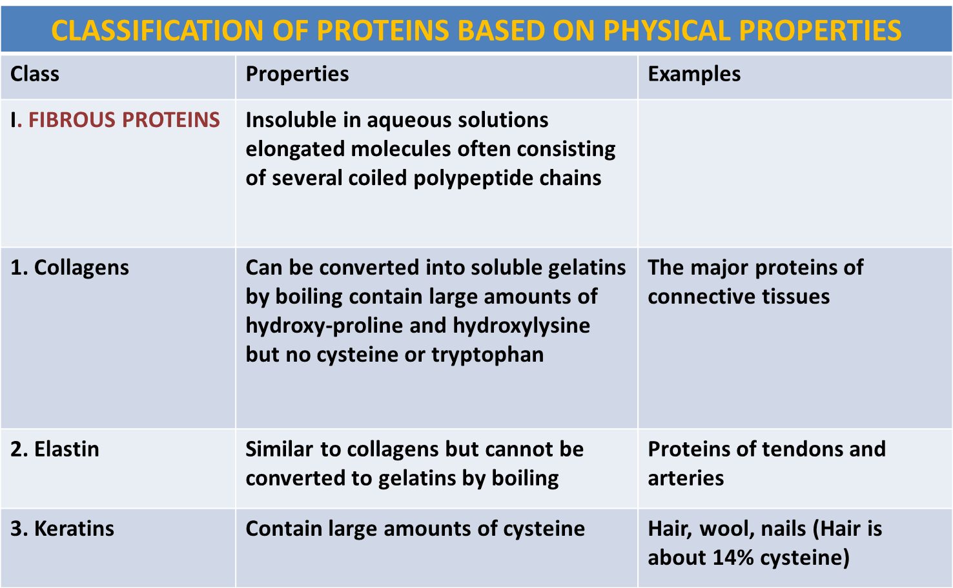
Classification of proteins based on physical properties (Shape)

Slide 18
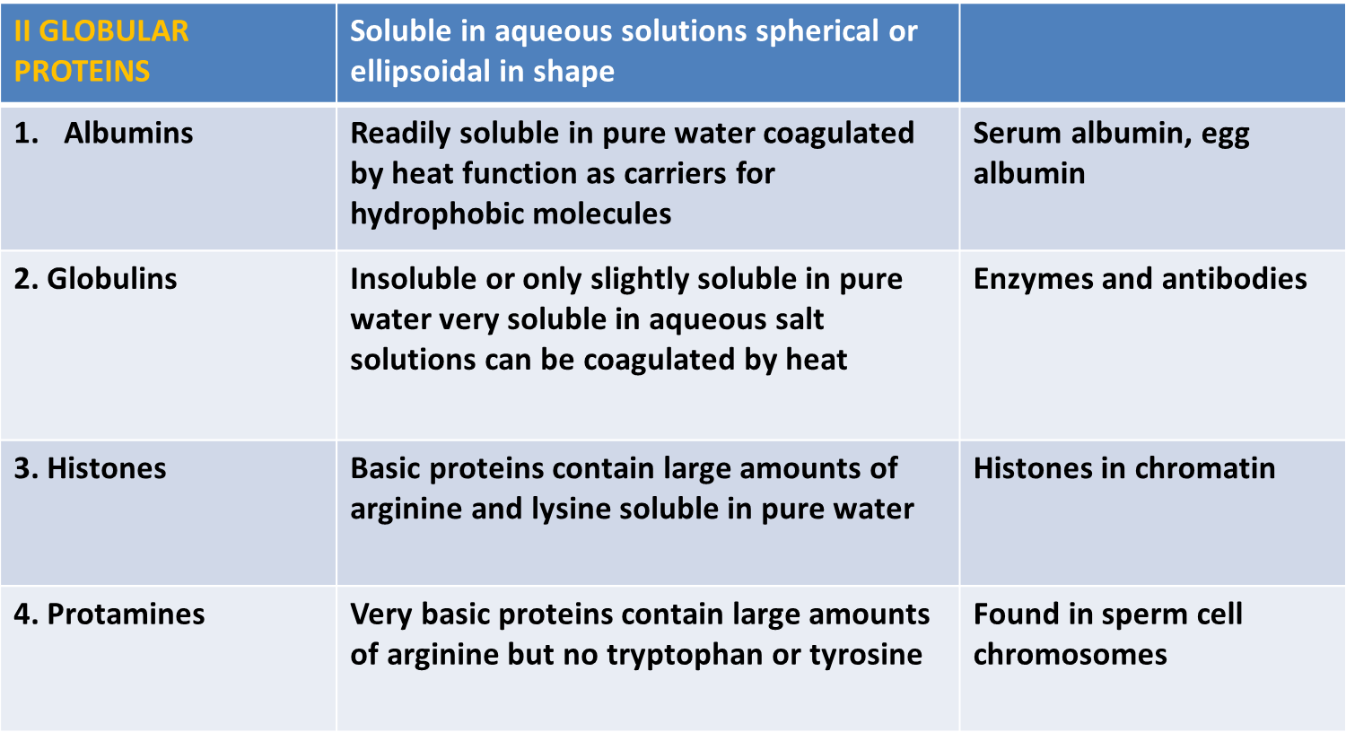

Slide 19
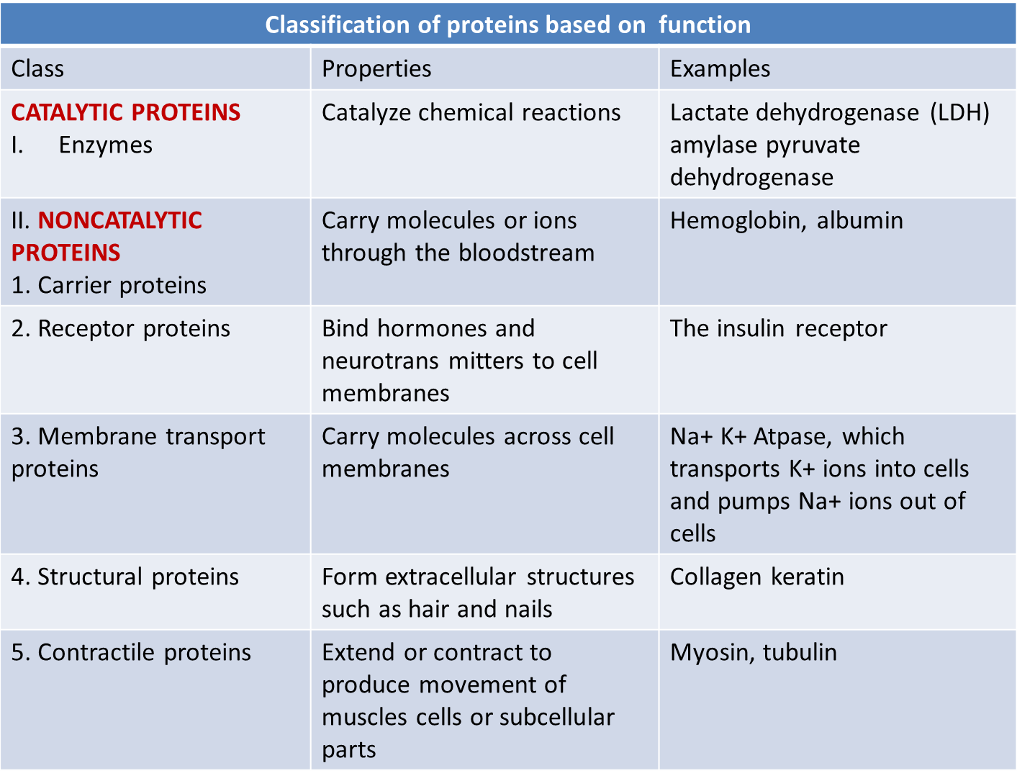
Classification of proteins based on function

Slide 20
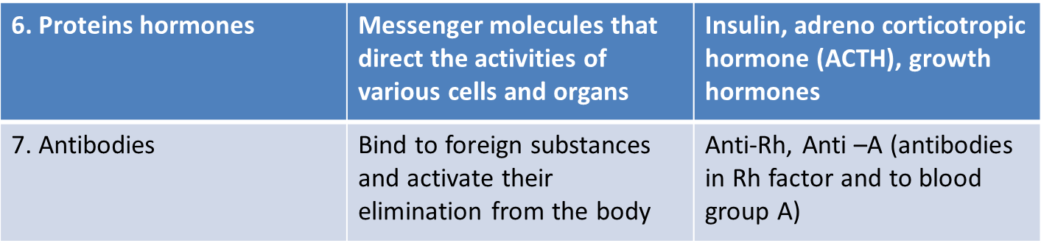

Slide 21
Another Classification (composition)
I: Simple, contain only amino acid residues
II: Conjugated, contain amino acid residues and other organic or inorganic components (prosthetic groups).
III. Derived

Slide 22
I: SIMPLE PROTEINS
Albumin
Globulin
Globin
Prolamines
Histones
Protamines
Albuminoids
Water soluble , coagulated by heat eg. albumin, lactalbumin, ovalbumin
Insoluble in water, soluble in dilute salt solutions. Heat coagulable to variable extent eg lact globulins, immune globulins, myosine
Rich in histidine. Unite with heme to form hemoglobin
Soluble in 70-80% ethanol and insoluble in water eg. gliadin of wheat and zein of maize
Soluble in water but not in ammonium hydroxide. Present in nucleus
Like histones but present in sperm cells. Soluble in ammonium hydroxide.
Also called scleroproteins eg. collagen , elastin and keratin

Slide 23
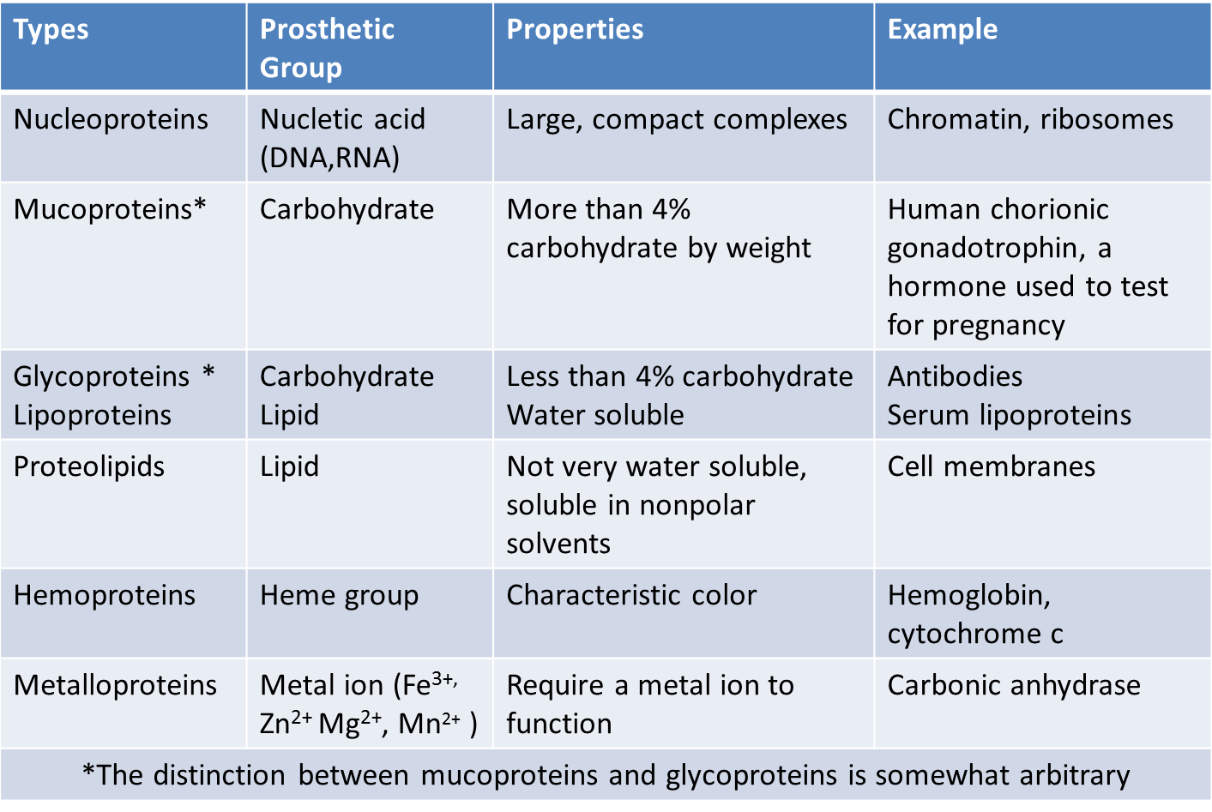
II: CONGUGATED PROTEINS

Slide 24
III: Derived Proteins
Are degradation products obtained by the action of acids, alkalies, and enzymes on protein.
Primary Derived (insoluble in water but soluble in acids and alkalis)
Secondary Derived (soluble in water and coagulated by heat)
e.g. denatured proteins
Polypeptides, oligopeptides, proteoses, peptones

Slide 25
The End

