Slide 1
The Diversity of the Endocrine System /
Hormone Action and Signal Transduction
MOHAMMED AL-ZUBAIDI, PhD

Slide 2
Introduction
Survival of a multicellular organism depends on their ability to adapt to the constantly changing environment.
Intercellular communication mechanisms are necessary for this adaptation.
Nervous system and endocrine system provide this intercellular, organism- wide communication.

Slide 3
Introduction
Word hormone is a Greek term that means to arouse to activity.
Hormone is defined as a substance that is synthesized in one organ and transported by the circulatory system to act on another tissue.

Slide 4
Hormones are chemically diverse
Cholesterol derived Hormones- Glucocorticoids, mineralocorticoids, estrogens, Progestins, 1,25 (OH)₂-D₃ .
Steroid hormone can be the precursor of another hormone e.g. Progesterone is the precursor of Mineralocorticoids, Glucocorticoids, and androgens.
Testosterone is then an obligatory intermediate in the biosynthesis of estradiol and dihydrotestosterone.
The final product is determined by the cell type and set of enzymes that present.

Slide 5
Hormones are chemically diverse
The amino acid tyrosine is the precursor of catecholamines and of thyroid hormones.
Thyroid hormones require Iodine addition for their bioactivity.
Many hormones are polypeptides e.g. ACTH (39 AA), TRH (tripeptide), PTH (84 AA) and growth hormone (191 AA).
Insulin has AB chains formed from 21 and 30 amino acids.
FSH,LH,TSH,CG are glycoproteins. The alpha chain is identical in all these hormones and the beta chain is specific.

Slide 6
Hormones Are Synthesized & Modified
For Full Activity in a Variety of Ways
Some hormones are synthesized in the final form and secreted immediately. e.g. Cholesterol derived hormones.
Other hormones are synthesized in the final form and stored in the producing cells e.g. Catecholamines.
Some hormones are synthesized from their precursor molecules, processed and then secreted upon a physiologic response e.g. Insulin.
Others are converted to active forms from precursor molecules in the periphery e.g. T₃ and DHT.

Slide 7
Target cells Concept
Specific cells are affected by hormone and respond in unique fashion:
Cells have specific receptors on membrane or in cell that respond to hormone
Can have receptors for several different hormones
Number of active receptors can change
  Down-regulation - number of receptors decreases & target is less sensitive
  Up-regulation - number increases & target is more sensitive

Slide 8
Target cells Concept
Several factors determine the response of a target cell to a hormone. These can be thought of in two general ways:
As factors that affect the concentration of the hormone at the target cell and
As factors that affect the actual response of the target cell to the hormone

Slide 9
Determinants of the Concentration of a Hormone at the Target Cell
The rate of synthesis and secretion of the hormones.
The proximity of the target cell to the hormone source (dilution effect).
The dissociation constants of the hormone with specific plasma transport proteins (if any).
The conversion of inactive or suboptimally active forms of the hormone into the fully active form.
The rate of clearance from plasma by other tissues or by digestion, metabolism, or excretion

Slide 10
Determinants of the Target Cell Response
The number, relative activity, and state of occupancy of the specific receptors on the plasma membrane or in the cytoplasm or nucleus.
The metabolism (activation or inactivation) of the hormone in the target cell.
The presence of other factors within the cell that are necessary for the hormone response.
Up- or down-regulation of the receptor consequent to the interaction with the ligand.
Post receptor desensitization of the cell, including down-regulation of the receptor.

Slide 11
Target cells Concept
Hormones are present at very low concentrations in the extracellular fluid
This concentration is much lower than that of the many structurally similar molecules (sterols, amino acids, peptides, proteins)
High degree of discrimination is provided by cell-associated recognition molecules called receptors

Slide 12
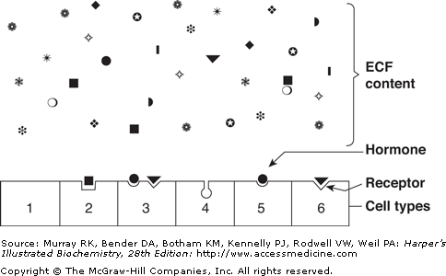

Slide 13
Target cells Concept
A target cell is defined by its ability to selectively bind a given hormone to its cognate receptor.
Several biochemical features of this interaction are important in order for hormone-receptor interactions to be physiologically relevant:
1) binding should be specific i.e. displaceable by agonist or antagonist.
2) binding should be saturable.
3) binding should occur within the concentration range of the expected biologic response.

Slide 14
How does a cell receive a signal?
Some small molecules are capable of entering the cell through the plasma membrane.
Some small hormones also enter the cell directly, by passing through the membrane. Examples are steroid hormones and thyroid hormones.

Slide 15
BIOMEDICAL IMPORTANCE
Homeostatic adaptations by an organism are in large part accomplished through alterations of the activity and amount of proteins.
Hormones provide a major means of facilitating these changes.
Hormone –receptor interaction occurs that results in the generation of an intracellular signal.

Slide 16
BIOMEDICAL IMPORTANCE
Intracellular signal can either regulate the activity of a select set of genes, leading to alteration in the amount of certain proteins in the target cell.
Or this signal affect the activity of specific proteins including enzymes, transporter or channel proteins.

Slide 17
BIOMEDICAL IMPORTANCE
The signal can influence the location of proteins in the cell and can affect their general processes such as: Protein synthesis, cell growth and replication through effects on gene expression.
Other signaling molecules e.g. interleukins, growth factors, cytokines and metabolites use some of the general mechanisms and signaling pathways.

Slide 18
BIOMEDICAL IMPORTANCE
Excess, deficiency or inappropriate production and release of these hormones and regulatory molecules are major causes of disease.
Many pharmcotherapeutic agents are aimed at influencing these pathways.

Slide 19
Biomedical Importance
So, the functions:
  Stimulate synthesis of enzymes or structural proteins.
  Change rate of synthesis.
  Inactivate or activate existing enzymes or protein channels.

Slide 20
General Properties Of Hormones
Hormone receptors
Half life (mins/ days)
Onset of action(immediate/ delayed)
Types of Action (specific/general)
Storage
6. Release of Hormones:
a. Insoluble to soluble (T3-T4)
b. Storage granules (insulin, glucagon)
c. Passive diffusion down their concentration gradient. (steroid hormones)

Slide 21
General Properties Of Hormones
7. Regulation of secretion:
a. Hypothalamus / anterior pituitary
b. Negative feedback mechanism
c. Concentration of ions (Ca)
d. Changes in environment (melatonin- light, cold-thyroxine)
e. stimulation of sympathetic nervous system (adrenal medullary)
f. Afferent nerve impulses (oxytocin)
g. Cyclic rhythms of release- ultradian (mins-hrs), circadian(24hrs), infradian (months –years)

Slide 22
General Properties Of Hormones
8. PreProhormones/ Pro hormones
9. Production of abnormal hormones
10. Ectopic production of Hormones
11. Hormonal Assays (radioimmunoassays, chemiluminescent methods)
12. Interactive effects

Slide 23
Target cells sensitive to several hormones may show interactive effects
1. Permissive effects - first hormone enhances the effect of a later hormone action: example:
Estrogen up-regulates progesterone receptors in uterus
Thyroid hormone increases the effect of epinephrine on breakdown of triglycerides in adipocytes.
2. Integrative effects - hormones produce complementary effects on different tissues: Example:
PTH and calcitriol increase ECF calcium.

Slide 24
Target cells sensitive to several hormones may show interactive effects
3. Synergistic effects - two hormones acting together have a greater effect than the sum of the effects of each hormone acting independently. Example:
Both FSH and estrogen necessary for normal oocyte development.
FSH and testosterone together increase spermatogenesis than alone.
4. Antagonistic effects - one hormone opposes the action of the other hormone. Example:
Insulin and glucagon.

Slide 25
Hormone Receptors
Hormones are present in very low concentrations in the extracellular fluid, generally in the range (10ˉ¹⁵ ) and (10^{ˉ9} ) mol/L .
Other molecules are present in range (10ˉ⁵ ) and (10^{ˉ3} ) mol/L.
The cells have to distinguish between hormones and other substances.
This high degree of recognition is provided by cell associated recognition molecules called Receptors.

Slide 26
Hormone Receptors
Hormones initiate their biologic effects by binding to specific receptors.
A target cell is defined by its ability to selectively bind a given hormone to its cognate receptor.

Slide 27
Hormone Receptors
Receptors have at least two functional domains:
A recognition domain – it binds to the hormone ligand.
Coupling domain (Second region) –that generates a signal when the hormone binds to it.
The dual function of binding and coupling (signal generation) ultimately defines a receptor.
It is the coupling of hormone binding to signal transduction called, receptor – effector coupling.
This is the first step in the amplification of hormonal response.
This dual purpose also distinguishes the receptor from the plasma carrier protein that also bind hormone but do not generate signal.

Slide 28
Interactions with receptors
Hormone-receptor complex concentrations are effectively determined by three factors:
1-The number of hormone molecules available for complex formation.
2-The number of receptor molecules available for complex formation.
3-The binding affinity between hormone and receptor

Slide 29
The factors that regulate hormone action
Action of a hormone at a target organ regulated by four factors: _
1- Rate of synthesis and secretion of hormone.
2- Specific transport systems in plasma.
3- Hormone-specific receptors in target cell membrane which differ from tissue to Tissue.
4- Ultimate degradation of the hormone usually by the liver or kidneys.

Slide 30
Classification of Hormones
Hormones can be classified according to:
Chemical composition
Solubility properties
Location of receptors
Nature of signal used to mediate hormonal action within the cell.

Slide 31
HORMONES MADE
FROM CHOLESTEROL
Adrenal Steroidogenesis
ADRENAL CORTEX produces steroid hormones (corticosteroids) subdivided in:
Glucocorticosteroids – affecting the carbohydrate metabolism
  cortisol
  corticosterone
Mineralocorticosteroids -affecting the mineral metabolism
  aldosterone
Sex hormones (androgens, estrogens) in small amounts

Slide 32
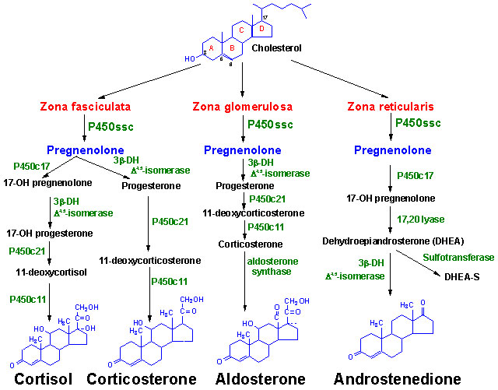

Slide 33
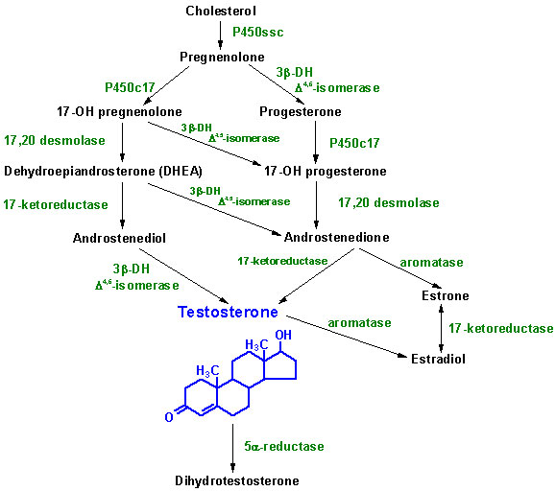
Synthesis of the male sex hormones

Slide 34
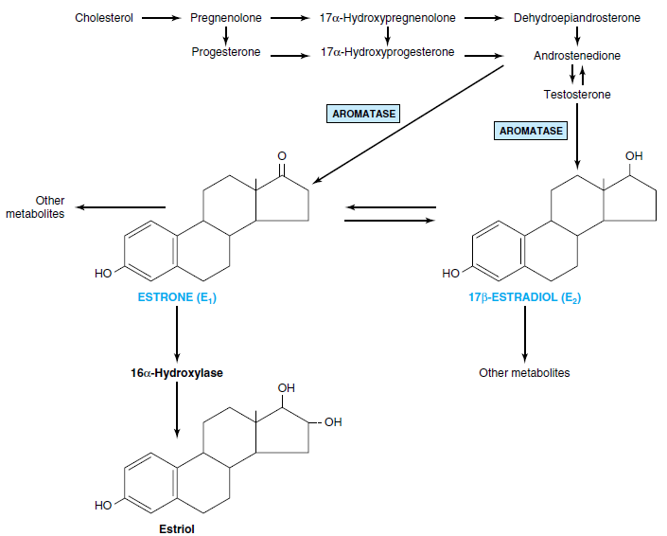
Synthesis of the female sex hormones

Slide 35
Synthesis of Vitamin D
They are sterol hormones and have much in common to other steroid hormones
Its precursor, cholecalciferol, is obtained from diet or synthesized by the ultraviolet irradiation of provitamin D in the skin
Cholecalciferol, by a series of enzymes in the liver and kidney, is hydroxylated to the active hormone, calcitriol

Slide 36
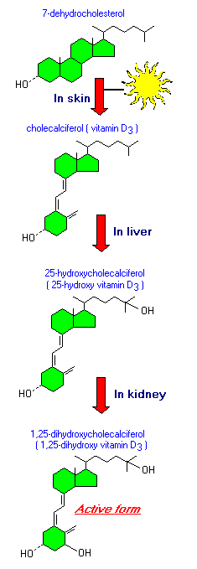
Vitamin D

Slide 37
Synthesis of Tyrosine-derived hormones
I.Thyroid hormones: is a unique process
  Thyroid cells concentrate iodine
  Thyroid cells synthesize a glycoprotein, thyroglobulin
  Iodine is oxidized
  Iodine is oxidized, then coupled to iodotyrosine within thyroglobulin (organification process) by thyroid peroxidase enzyme
  Reuptake of thyroglobulin by endocytosis
  Proteolytic digestion by lysosomal enzymes (hydrolyases) → T­3+ T4 (iodothyronines) and MIT+ DIT (iodotyrosines)
II. Catecholamines: They are synthesized from tyrosine by a number of enzymes in the cytoplasm and chromaffin granules

Slide 38
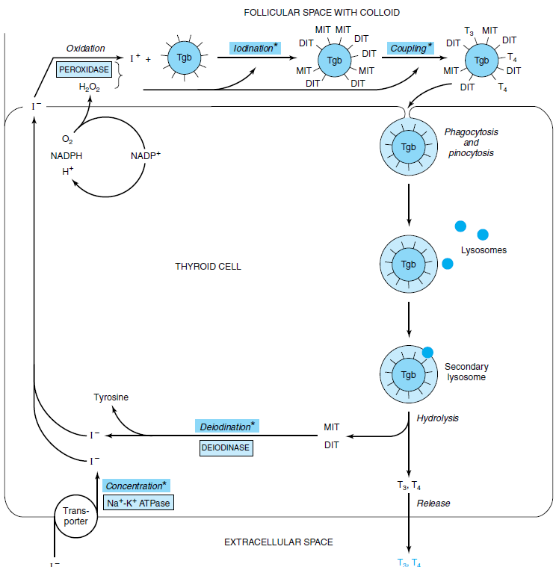
T3 & T4 Illustrate the Diversity in Hormone Synthesis

Slide 39


Slide 40
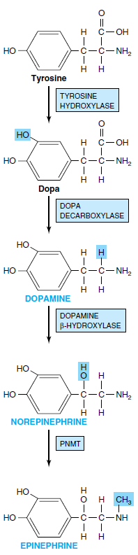
(PNMT, phenylethanolamine-N-methyltransferase.)

Slide 41
Storage
Protein hormones: In secretory granules within the cytoplasm
Steroid hormones: Are not stored. The hormones precursor, cholesterol esters, is the storage form
Tyrosine-derived hormones
Thyroid hormones: in the thyroglobulin
Catecholamines: in secretory chromaffin granules in the cytoplasm + ATP + chromogranin
  Vitamin D: Cholecalciferol is stored in adipose tissue. Liver stores its metabolite

Slide 42
Release
Protein hormones: By exocytosis
Steroid hormones: By diffusion immediately upon synthesis
Vitamin D: By diffusion immediately upon synthesis
Tyrosine – derived hormones:
Thyroid hormones: fusion of lysosomes with colloid droplets, the hormones are released by exocytosis from the basement membrane
Catecholamines: stimulus-secretion coupling requiring Ca, vesicular exocytosis

Slide 43
Transport
Protein hormones: mostly unbound, free in the blood
Steroid hormones: Bound to a plasma protein (high- affinity binding to globulin and low-affinity to albumin). Cortisol to transcortin, sex hormones to sex-hormone-binding globulin (SHBG).
Vitamin D: Bound to a globulin (transcalciferin)
Tyrosine-derived hormone:
  Thyroid hormones: Mostly bound to thyronine-binding globulin (TBG) or prealbumin (transthyretin)
  Catecholamines: Bound to albumin.

Slide 44
Purpose of binding of hormones to proteins
The hormone is protected from the inactivating systems present in the blood.
The hormone is maintained in a “stored” circulating form to be readily available to its target tissues.
Ensure ubiquitous distribution of the water-insoluble hormones.

Slide 45
Peripheral Conversion
Some biologically active hormones are converted to other equally active hormones in peripheral tissues such as liver, breast adipose tissue, brain etc.
Example:
Testosterone dihydrotestosterone
Thyroxine (T₄) triiodothyronine (T₃)

Slide 46
Different effects/several hormones
Single hormone, different effects.
Example:
Estradiol acts on ovarian follicles to promote granulosa cell differentiation, on uterus to stimulate its growth and maintain the cyclic change of uterine mucosa, on mammary gland to stimulate ductal growth, on bone to promote linear growth and closure of epiphyseal plates, on HPA to regulate secretion of gonadotropins and prolactin, on metabolic processes to affect adipose tissue distribution, volume of ECF, etc
Several hormones, single function.
Example:
Release of fatty acids (lipolysis) from adipose tissue stimulated by catecholamines, glucagon, secretin, prolactin and B-lipotropin

Slide 47
Hormone Action and Signal Transduction

Slide 48
Classification of Hormones by Mechanism of Action
The following classification is based on the location of receptors and the nature of signal produced.
Hormones that bind to intracellular receptors:
Androgens
Calcitriol
Estrogens
Progestins
Retinoic acid
Glucocorticoids
Mineralocorticoids
Thyroid hormones

Slide 49
Classification of Hormones by Mechanism of Action
II. Hormones that bind to cell surface receptors
Second messenger is cAMP:
α₂ adrenergic catecholamines
β- adrenergic catecholamines
ACTH
ADH
Calcitonin
FSH
LH
PTH
TSH
Glucagon
Somatostatin

Slide 50
Classification of Hormones by Mechanism of Action
B. Second messenger is cGMP:
Atrial natriuretic factor
Nitric oxide
C. Second messenger is calcium or phosphatidylinositol:
Acetylcholine
Angiotensin
Gastrin
TRH
Oxytocin
ADH
PDGF

Slide 51
Classification of Hormones by Mechanism of Action
D. Second messenger is a Kinase or Phosphatese cascade:
Erythropoietin
GH
IGF I-II
PDGF
Prolactin
EGF

Slide 52
GENERAL FEATURES OF HORMONE CLASSES
GROUP I
GROUP II
TYPES
Steroids
2. Solubility
Lipophilic
3. Transport proteins
Yes
Polypeptides
Proteins
Glycoproteins
Catecholamines
Hydrophilic
No

Slide 53
GENERAL FEATURES OF HORMONE CLASSES
GROUP I
GROUP II
4. Plasma half life
Long(hrs-days)
5. Receptor
Intracellular
6.Mediators
Receptor -hormone complex
Short(mins)
Plasma membrane
cAMP,
cGMP,
Ca/phosphoinositol
Kinase cascade

Slide 54
HORMONES TRANSDUCE SIGNALS TO
AFFECT HOMEOSTATIC MECHANISMS
General steps involved in producing a coordinated response to a particular stimulus are:
Recognition
Hormone release
Signal generation
Effects

Slide 55
HORMONES TRANSDUCE SIGNALS TO
AFFECT HOMEOSTATIC MECHANISMS
Recognition - of stimulus
Release of hormones- group I or group II
Signal generation – Group I(hormone- receptor complex)
Group II (many different signals)
Effects- Group I (Gene transcription)
Group II ( gene transcription, channels & transporters, Protein translocation, Protein modification)

Slide 56
HORMONES TRANSDUCE SIGNALS TO
AFFECT HOMEOSTATIC MECHANISMS
At the organismic level the recognition involves the nervous system and the special senses.
At the cellular level it involves physiochemical factors such as: pH, O₂ tension, temperature, nutrient supply, noxious metabolites and osmolarity.

Slide 57
SIGNAL GENERATION
GROUP I HORMONES:
Group I hormones are lipophilic.
They diffuse through the plasma membrane of all cells and they encounter their receptors intracellularly.
These receptors can be located in the cytoplasm or in the nucleus of target cells.

Slide 58
SIGNAL GENERATION
Hormone –receptor complex first undergoes activation reaction.
Activation reaction occurs by at least two mechanisms:
For example:
1. Glucocorticoids diffuse across the plasma membrane and encounter their cognate receptors in the cytoplasm of target cells.

Slide 59
SIGNAL GENERATION
In the cytoplasm these receptors are attached to heat shock proteins 90 (hsp90).
Ligand (hormone) –receptor binding results in the conformational change in the receptor.
This binding of hormone results in the dissociation of hsp90.
This step is necessary for the nuclear localization of the receptor.
The activated receptor moves into the nucleus.
There it binds with high affinity to specific DNA sequence called hormone response element(HRE).

Slide 60
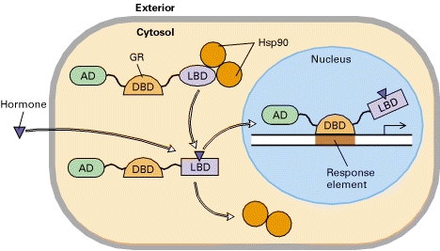

Slide 61
SIGNAL GENERATION
This DNA bound liganded receptor serves as a high affinity binding site for co-activator proteins.
This leads to accelerated gene transcription.

Slide 62
SIGNAL GENERATION
2. On the other hand hormones such as the thyroids and retinoids diffuse from the extracellular fluid across the membrane and go directly into the nucleus.
In this case the cognate receptor is already bound to HRE, in this case called TRE.
But this DNA bound receptor fails to activate transcription because it exists in complex with a co-repressor.
This receptor – co-repressor complex serves as an active repressor of gene transcription.
The association of ligand with these receptors result in the dissociation of the co-repressor.

Slide 63
SIGNAL GENERATION
When the ligand binds to the receptor it results in the dissociation of co repressor.
The liganded receptor is now capable of binding co activators, leading to gene transcription.
The liganded receptor is now capable of binding one or more co activators, and this causes activation of gene transcription.

Slide 64
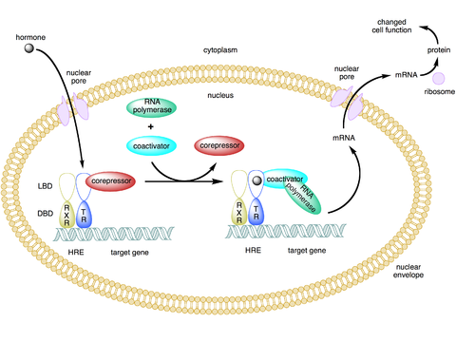

Slide 65
SIGNAL GENERATION
GROUP II HORMONES:
Many hormones are water soluble, have no transport proteins and therefore has got a short plasma half life, and they initiate a response by binding to a receptor located in the plasma membrane.
Their mechanism of action is described in terms of intracellular signal they generate.

Slide 66
SIGNAL GENERATION
These signals include cAMP, cGMP, Ca and phosphatidylinositides.
These molecules are termed as second messengers and their synthesis is triggered by the presence of primary hormone binding to its receptor.
These messengers may affect gene transcription and other biologic processes.

Slide 67
G-Protein Coupled Receptors
Many of the group II hormones bind to receptors that couple to effectors through a GTP- binding protein intermediary.
Belong to a very large superfamily of proteins that couple with Guanosine nucleotide binding proteins (G-proteins) to communicate with intracellular effector molecules
These receptors have seven membrane spanning domains.
Members of this class which signal through G- proteins are called, G-protein-coupled receptors.
It is the largest family of cell surface receptors.

Slide 68
G-Protein Coupled Receptors
Components:
Seven membrane spaning domains
G- protein complex has α, β, γ subunits.
In inactive form is GDP bound form and is not associated with the receptor.
This group is attached to the plasma membrane through Prenylation on the β, γ subunits.

Slide 69
G-Protein Coupled Receptors
On binding of the hormone to the receptor, a conformational change in the receptor occurs.
G-protein complex is activated.
This cause the binding of GTP in exchange of GDP.
This binding occurs on the α subunit and, β γ subunits dissociate from it.
α subunit binds to and activate the effector.
Effector can be adenylyl cyclase, Ca, Na, or Cl or K channels, Phospholipase, or cGMP phosphodiestrase.
Termination of Signal:
Dissociation of hormone from its receptor
G-protein coupled receptors may be inactivated by phosphorylation

Slide 70
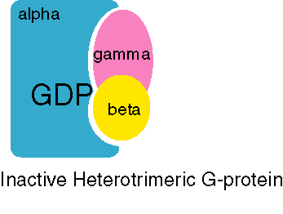
G- protein receptors
Shape change allows receptor to bind inactive G-protein
Inactive G-protein = G-alpha + GDP + G-beta + G-gamma

Slide 71
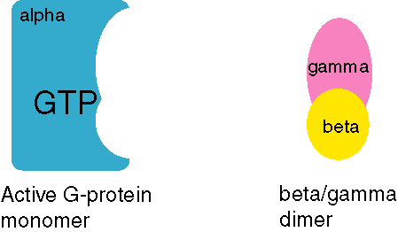

Slide 72
G proteins may either stimulate or inhibit an effector.
In the case of adenylyl cyclase, the stimulatory G protein is known as G_{s} and the inhibitory G protein is known as G_{i}
G_{i} may act either by the G_{iα} subunit binding to AC or by the G_{iβγ} complex complexing all the G_{iα} and preventing it from binding to AC

Slide 73
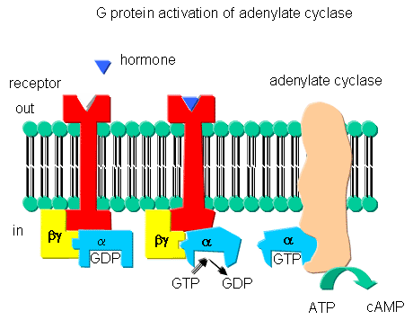
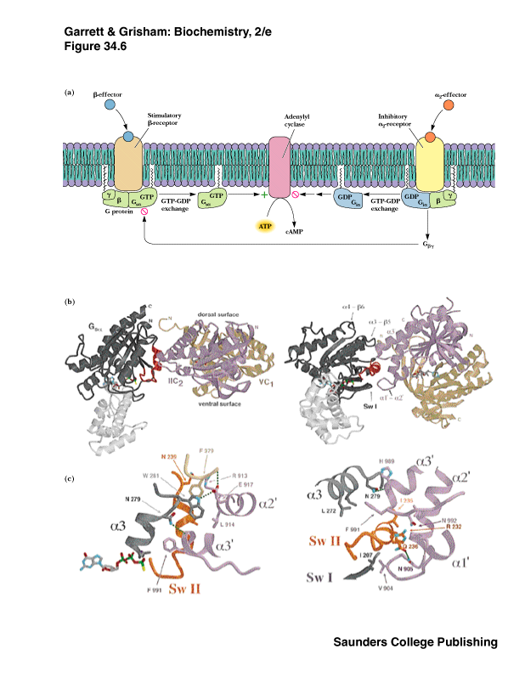

Slide 74
cAMP Intracellular Signal
cAMP was the first signal that was identified in mammalian cells.
Different Peptide hormones can either stimulate or inhibit the production of cAMP from adenylyl cyclase.
It has got a Catalytic molecule.
Each consists of a receptor R (Rs & Ri).
And a regulatory molecule G (Gs & Gi)
The regulatory complex(G) is composed of αβγ subunit.
α subunit differs in both Gs & Gi.

Slide 75
cAMP Intracellular Signal
The hormone binds to Rs or Ri and results in receptor mediated activation of G, which entails the binding of GTP on α subunit.
αs protein has intrinsic GTPase activity.
So the active form αs – GTP is inactivated .
Again the trimeric Gs complex(αβγ) is formed.

Slide 76
cAMP Intracellular Signal
On the other hand αi-GTP inhibit adenylyl cyclase by binding it.
This lowers the concentration of cAMP.
The action of cAMP is to mainly activate some of the protein kinases.
In eukaryotic cells cAMP binds to a protein kinase called Protein Kinase A.

Slide 77
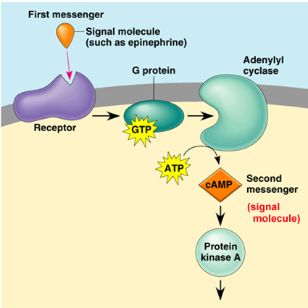

Slide 78
cAMP Intracellular Signal
PROTEIN KINASE A (PKA) is a heterotetrameric molecule and consists of two regulatory subunits (R) and two catalytic subunits (C).
4cAMP+ R₂C₂↔ R₂.(4cAMP)+ 2C
R₂C₂ is not active catalytically, but the C unit is active.
The active C unit catalyzes the transfer of γ phosphate of ATP to a serine or threonine residue in a variety of proteins.

Slide 79
cAMP Intracellular Signal
Phosphatases remove this phosphate and terminate the physiologic response.
Phosphodiestrase can also terminate this action by converting cAMP to 5’-AMP.
Inhibitors of phosphodiesterase like caffeine, which is a methylated xanthine derivative, increase the concentration of cAMP and prolongs the action of hormones.

Slide 80
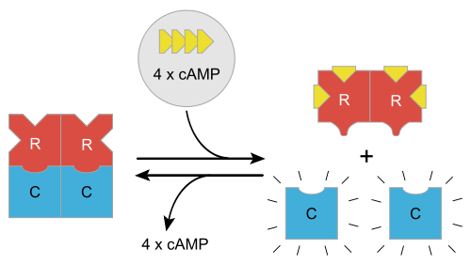

Slide 81
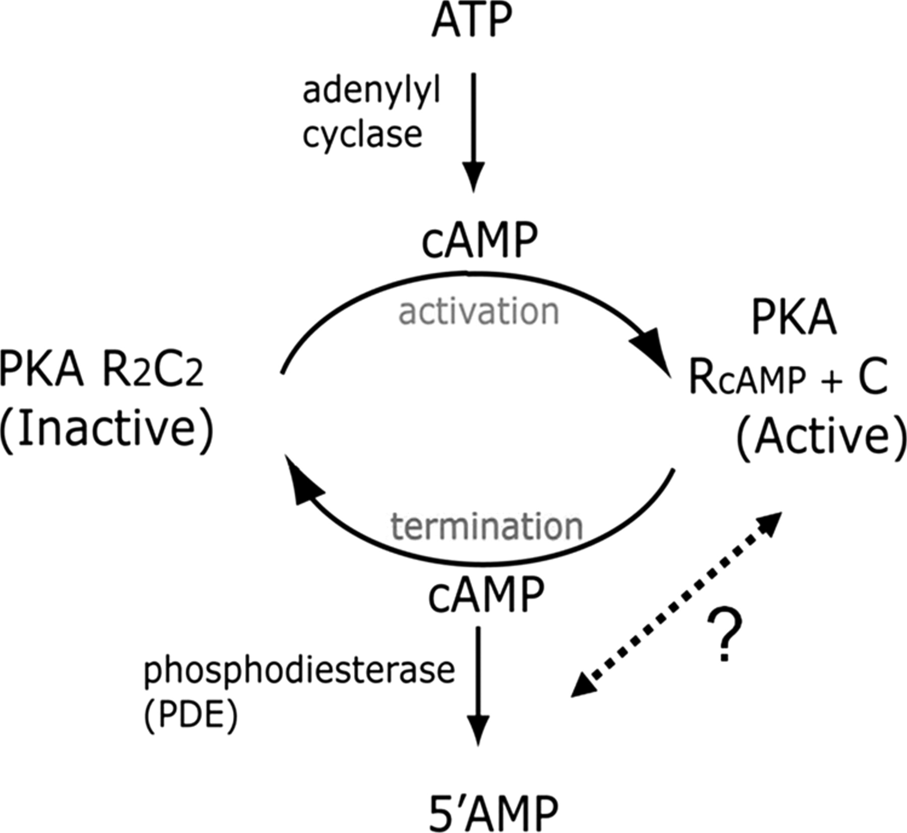

Slide 82
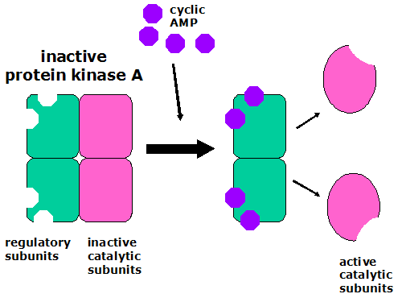

Slide 83
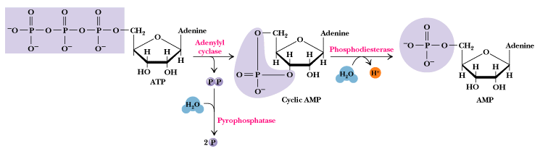
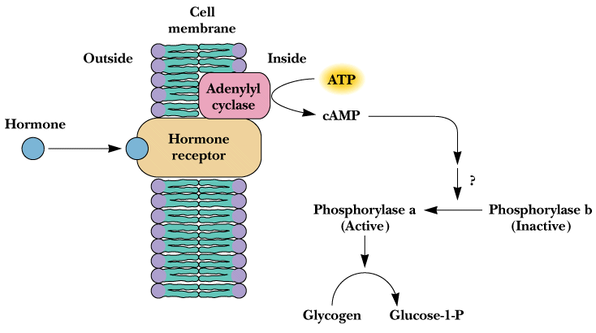
cAMP is synthesized by adenylyl cyclase and degraded by phosphodiesterase

Slide 84
cGMP Intracellular Signal
cGMP is made from GTP by the enzyme gaunylyl cyclase.
Atrial natriuretic peptide and nitric oxide function through this Signal.
These are potent vasodilators.
nitroprusside, nitroglycerin, nitric oxide, sodium nitrite, and sodium azide increase cGMP by activating the soluble form of guanylyl cyclase, (the increased cGMP activates cGMP-dependent protein kinase (PKG), which in turn phosphorylates a number of smooth muscle proteins).
Inhibitors of cGMP phosphodiestrase is sildenafil.

Slide 85
Phosphatidylinositol or Calcium Second Messenger
Certain hormone receptor interaction result in the activation of the enzyme phospholipase C attached to the inside projections of the receptors. The receptor binding and activation of phospholipase C are coupled by a specific G – protein
Certain hormones enhance membrane permeability to Ca²⁺ influx, this is probably accomplished by:-
Na¹⁺ - Ca ²⁺ exchange mechanism.
Ca ²⁺ – 2H ATPase – dependent pump..

Slide 86
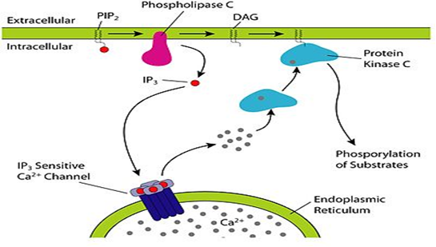

Slide 87
Calcium Calmodulin Second Messenger
It is the calcium – dependent regulatory protein, which is homologous to the muscle protein troponin C in structure and function.
It has four Ca²⁺ binding sites, and full occupancy of these sites leads to a marked conformational change.
This conformational change is presumably linked to calmodulins ability to activate or inactivate enzymes.

Slide 88
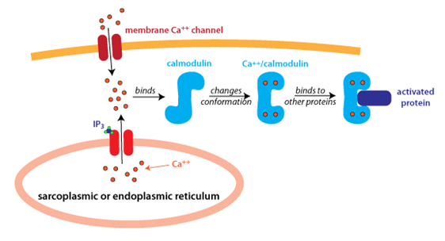

Slide 89
The hypothetical sequence of interactions between Ca²⁺, calmodulin and target enzyme as follows:-
Calomdulin binds 2Ca²⁺ at the high- affinity sites.
Conformational change in calmodulin
Calmodulin / 2Ca²⁺ complex binds to target enzyme
Conformational change in enzyme.
Second change in calmodulin conformation consequent upon change in enzyme conformation increase in Ca²⁺ affinity of site 3 and 4.
Association of 2 further Ca²⁺.

Slide 90
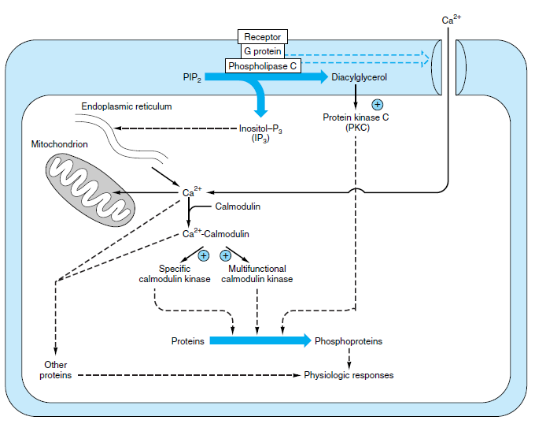

Slide 91
Clinical applications of hormones
Distribution of estrogens and progesterone in contraceptives pills is world-wide. Estrogens are widely used to relieve postmenopausal discomfort.
Females with osteoporosis are treated with calcitonin, because calcitonin inhibits osteoclastic bone resorption.
Insulin is a lifesaver for diabetics, and it is produced and distributed as pure human insulin.

Slide 92
Clinical applications of hormones
In the affluent areas of the world many women deliver their babies following an oxytocin infusion.
Estrogens and gonadotropins are used in treatment of sterility and menstrual disturbances.
Huggins received the Nobel Prize in 1966 for the introduction of a new form of cancer therapy in which sex hormones are used to retard their growth. He used androgens for breast cancer and estrogens for prostate cancer.

Slide 93
THE END

