Slide 1
Peptides
MOHAMMED AL-ZUBAIDI, PhD

Slide 2
Peptides
Peptide:
Peptides are polymers of amino acids , that are made up of a number of amino acids linked together through a peptide bond.
Two amino acid molecules can be covalently joined by peptide bond to yield dipeptide.
This linkage is formed by removal of the element of H₂O from the α-carboxyl group of one amino acid and the α-amino group of the other by the action of strong reducing agents.

Slide 3
Peptides

Slide 4
Peptides
- Three amino acids can be joined by two peptide bonds to form a tripeptide.
- Similarly we have tetrapeptides and pentapeptides.
- When there are many amino acids joined in the same way
the structure is called a polypeptide.
When the peptide molecule is made up of 2-10 amino acids it is called an oligopeptide .
When the peptide molecule is made up of 11-50 amino acids it is called a polypeptide.

Slide 5
Peptides
Amino acids in a peptide are called amino acid residues.
In a peptide the amino acid residue at the end with the free α-amino group is the amino terminal (or N-terminal) residue, the residue at the other end with the free α-carboxyl group is the carboxyl terminal (or C-terminal) residue.
Peptides contain only one free α-amino group and one free α-carboxyl group, one at each end of the chain.
The α-amino and α-carboxyl group of all the other non-terminal residues are covalently joined in the forming of the peptide bond.
The peptide is numbered and named starting from the N-terminal residue.
When a polypeptide is named, either using full amino acid name [all amino acid residues have their suffixes (-ine, -an, -ic, or -ate) changed to -yl, with the exception of the C-terminal amino acid], or using three-letter code abbreviation.

Slide 6
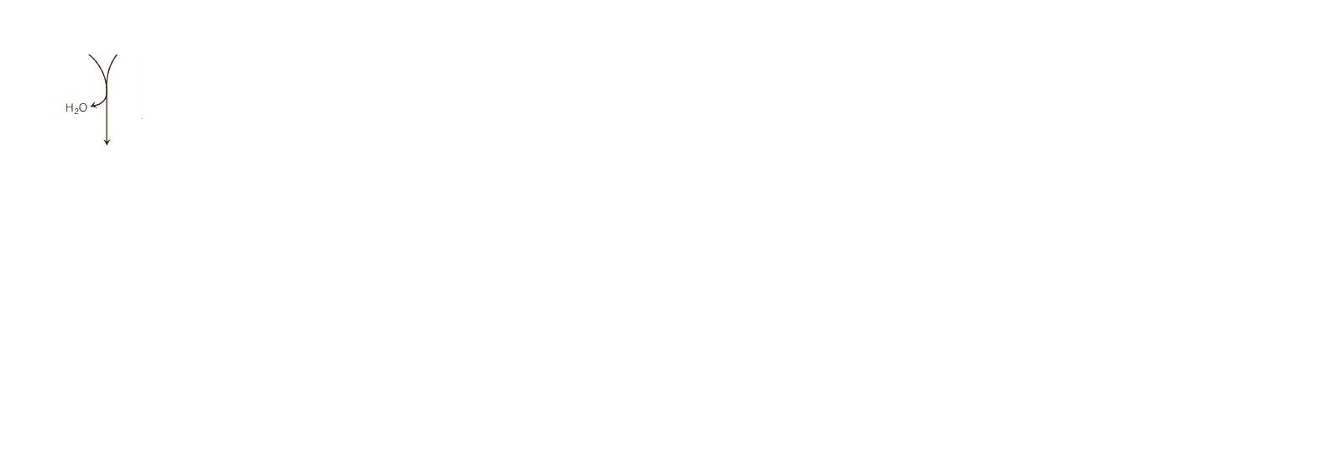
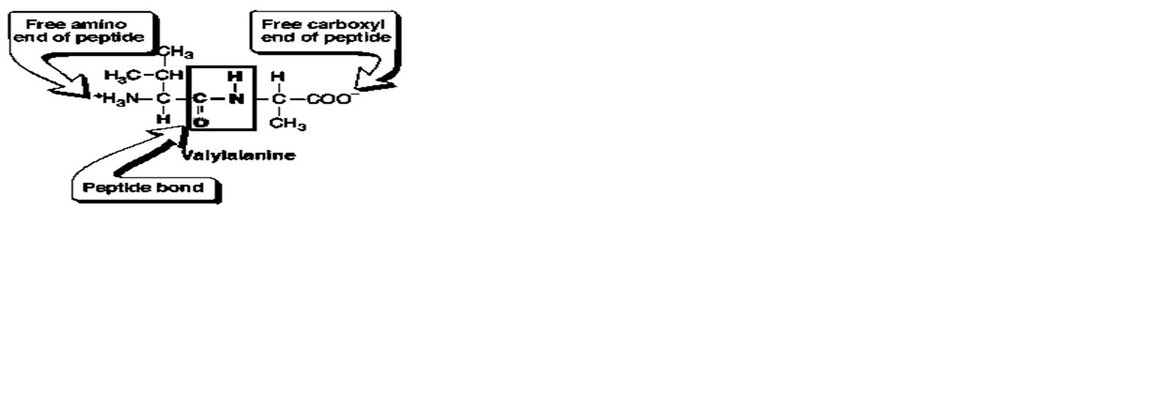
Peptides

Slide 7
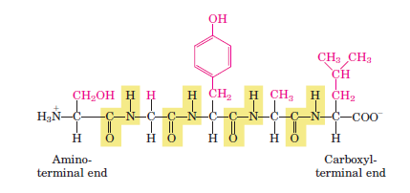
Peptides
- This is the pentapeptide serylglycyltyrosylalanylleucine. Or Ser-Gly-Tyr-Ala-Leu.
Peptides are named beginning with the amino-terminal residue, which is placed at the left.
The peptide bonds are shaded in yellow; the R groups are in red.

Slide 8
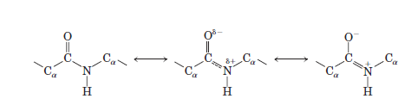
Peptide Bond
Properties of a peptide bond;
The peptide C-N bond is shorter than the single C-N bond in a simple amine , and longer than the C=N bond which indicated a resonance or partial sharing of two pairs of electrons between the carbonyl oxygen and the amide nitrogen (thus the peptide bond has a partial double bond character).

Slide 9
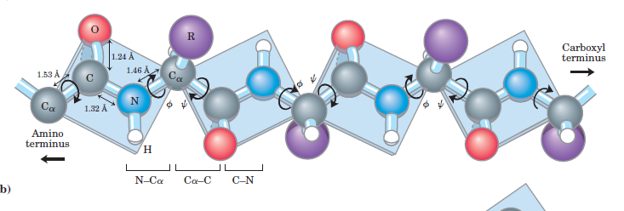
Peptide Bond
The peptide bond is unable to rotate freely because of its partial double-bond character, thus the peptide bond is rigid.
Virtually all peptide bonds in proteins occur in the trans configuration .

Slide 10
Peptide Bond
The peptide bond can be cleaved (hydrlolyzed) by:
1- Chemically; by the addition of strong acids or strong bases with high temperatures.
2- Enzymatically; by specific enzymes called the proteases.

Slide 11
Properties of peptides
1 . Acid – base properties:
The total acid-base behavior of a peptide can be predicted
from :
- its single free α-amino group at the end of the chain.
- and its single free α-carboxyl group at the end of the chain.
- and the nature and number of its ionizing
R-groups.

Slide 12
Properties of peptides
Peptide molecules contain only one free α-amino group and one free α-carboxyl group at the terminals, all the other α-amino α-carboxyl groups of the non-terminal amino acids are involved in the peptide bond so they cannot ionize nor contribute to the acid –base behavior of the peptide molecule.
However the R-group when containing an ionizable group (additional carboxyl or amino group) will contribute to the overall acid-base behavior of peptides.
Thus the acid-base behavior of a peptide can be predicted from its free α-amino , α- carboxyl group and as well as the ionizable groups of its side chains.

Slide 13
Properties of peptides
The net charge on the peptide molecule is determined by the ionizable groups of the N-terminal, C-terminal residues and the ionizable groups of the side chain and the pH of the media.
2. Peptides have a characteristic isoelectric pH (pI values).
3. Peptides have characteristic titration curves similar to those of amino acids.
4. Peptides have a high melting point.
5. Complex mixtures of peptides can be separated from each
other by ion exchange chromatography or electrophoresis.

Slide 14
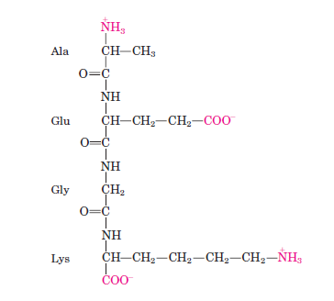
Properties of peptides
Alanylglutamylglycyllysine. This tetrapeptide has one:
free -amino group, one free -carboxyl group, and two ionizable R groups.
The groups ionized at pH 7.0 are in red.
Net charge on this tetrapeptide is (0).

Slide 15
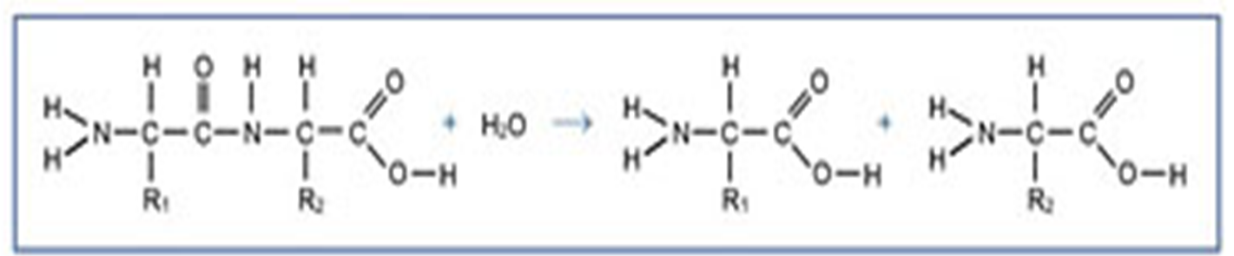
Peptides have characteristic chemical reactions
These reactions are characteristic for functional groups
(free α-amino group, free α-carboxyl group, R-groups).
Two very useful reactions of peptides:
A)
1) Their peptide bonds can be hydrolyzed by boiling with either strong acid or base to yield the constituent amino acids in free form.

Slide 16
Peptides have characteristic chemical reactions
2) Peptide bonds can also be hydrolyzed by proteolytic
enzymes secreted into the intestine for protein digestion
(Trypsin and chymotrypsin).
Trypsin: cleaves the peptide bond on the carbonyl
side of Arg and Lys.
Trypsin
Ala – Ser – Lys – Asp – val

Slide 17
Peptides have characteristic chemical reactions
Chymotrypsin: cleaves the peptide bond on the
carbonyl side of Phe, Trp, Tyr.
Chymotrypsin
Gly – Val – Tyr – Ala

Slide 18
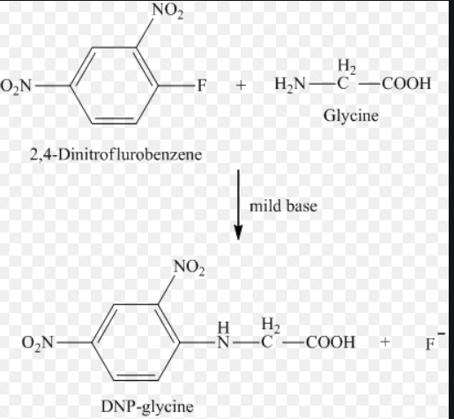
Peptides have characteristic chemical reactions
B) Reaction with 1-fluoro – 2,4 dinitrobenzene: FDNB (sanger’s reagent)
This reagent reacts with α-amino group of a free amino acid to
yield a 2,4 dinitrophenyl amino acid.

Slide 19
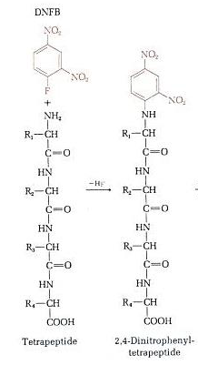
Peptides have characteristic chemical reactions
It also reacts with the α-amino group of the amino terminal residue of peptide.

Slide 20
Peptides: A Variety of Functions
Hormones and pheromones
  insulin
  oxytocin
  sex-peptide (sex pheromone)
Neuropeptides
  substance P (pain mediator) (acts as a mediator of pain transmission in the central nervous system and during neurogenic inflammation in the periphery)
Antibiotics
  polymyxin B (for Gram – bacteria)
  bacitracin (for Gram + bacteria)
Protection, e.g. toxins
  amanitin (mushrooms)
  conotoxin (cone snails)
  chlorotoxin (scorpions)

Slide 21
Essential poly peptides in the human body and its structures
Peptides found in nature are either products of protein hydrolysis, or biologically active peptides
Example of some peptides have intense biological activity:
Insulin (51 amino acid residues)
- Is secreted by beta cells, it promoting the absorption of glucose from the blood into cells
Oxytocin ( 9 amino acid residues)
- Is secreted by the posterior pituitary and stimulates uterine contractions.
Thyrotropin releasing factor ( 3 amino acid residues) TRF
- Is formed in the hypothalamus and stimulates the release of another hormone, thyrotropin, from the anterior pituitary gland.

Slide 22
Essential poly peptides in the human body and its structures
Bradykinin ( 9 amino acid residues)
- Inhibits inflammation of tissues.
Glucagon another hormone made up of 29 amino acid residues
Glutathione which is a very important antioxidant made up of 3 amino acid residues.

Slide 23
The End

