Slide 1
The Review of Literature
MOHAMMED AL-ZUBAIDI, PhD

Slide 2
Definition of a Literature Review
A literature review
  Surveys scholarly articles, books and other sources (e.g. dissertations, conference proceedings) relevant to a particular issue, area of research, or theory.
  Provides a short description and critical evaluation of work critical to the topic.
  Offers an overview of significant literature published on a topic.

Slide 3
A Hermeneutic Approach for Conducting
Literature Reviews and Literature Searches
  Engagement with the literature is an intellectual development process
  Conducting a literature review is not a linear process
  An interactive and iterative process that aims for saturation in understanding
  An important aspect of creating good literature reviews is re-writing
  Importance of (ongoing) reading

Slide 4
Literature Reviews are Conducted For
Various Reasons:
For a review paper
2. For the introduction (and discussion) of a research paper, masters dissertation or thesis (provides a rationale for your research question, provides a frame of reference for your research project)
3. To embark on a new area of research
4. For a research proposal

Slide 5
Conducting a literature review will help you:
Determine if proposed research is actually needed.
  Even if similar research published, researchers might suggest a need for similar studies or replication.
Narrow down a problem.
  It can be overwhelming getting into the literature of a field of study. A literature review can help you understand where you need to focus your efforts.
Generate hypotheses or questions for further studies.

Slide 6
Conducting a literature review will give you:
Background knowledge of the field of inquiry
  Facts
  Eminent scholars
  Parameters of the field
  The most important ideas, theories, questions and hypotheses.
Knowledge of the methodologies common to the field and a feeling for their usefulness and appropriateness in various settings.

Slide 7
More specifically…
A literature review should answer the following questions:
  What is known/understood?
  What are the strengths and weaknesses of present knowledge and understanding?
  What is not known?
  Where are the gaps in knowledge?
  What is needed to be studied to improve knowledge and understanding?
  What theories can frame the approach to study of the topic?

Slide 8
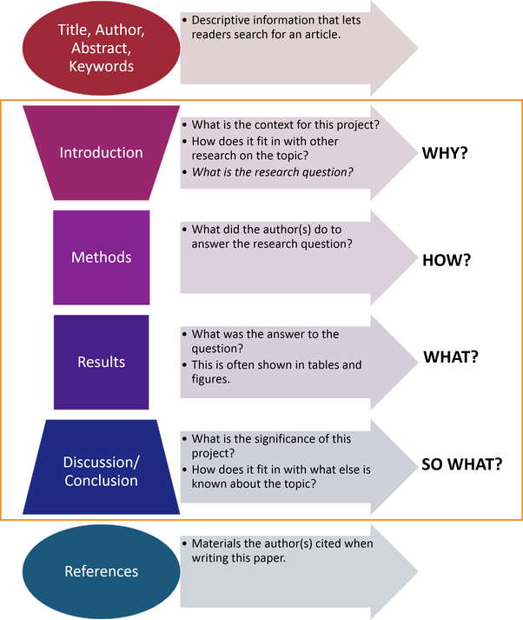
Lit. review vs. essay
Essay
An essay focuses on a topic and uses the literature as a support for the arguments.

Slide 9
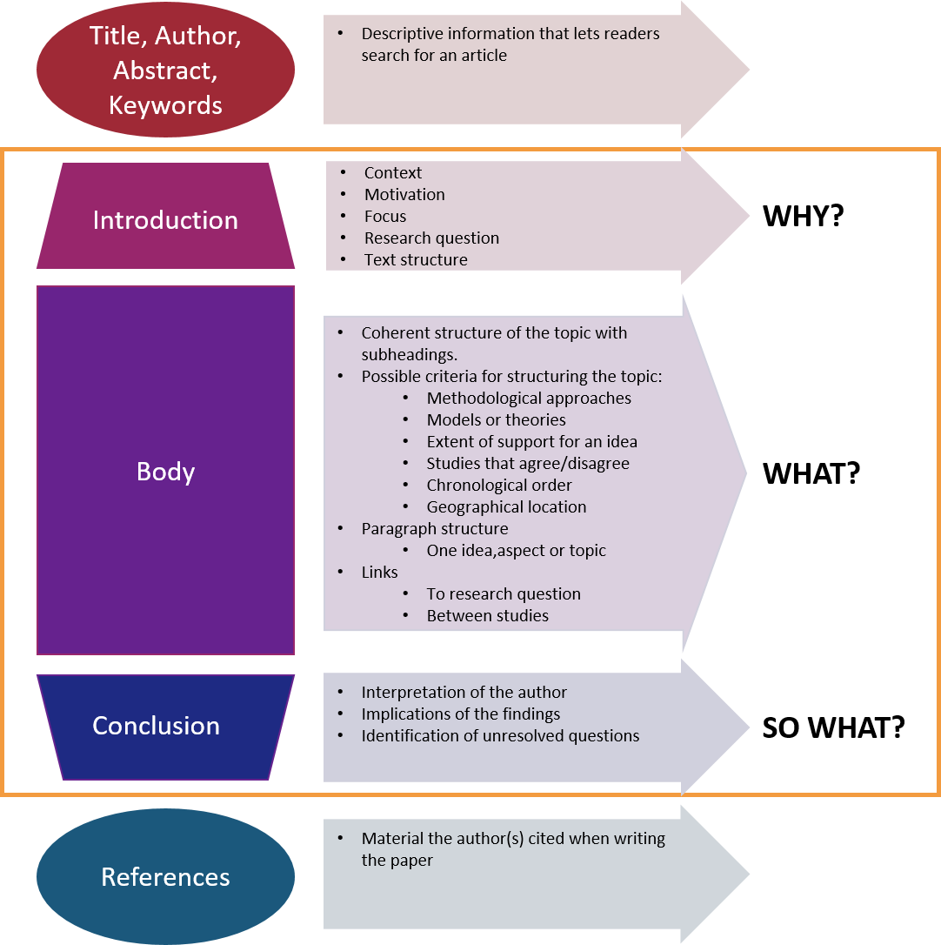
Lit. review vs. essay
Literature Review
In a standalone literature review, the literature itself is the topic of discussion and evaluation. You draw connections and comparisons of the included studies. You evaluate and discuss not only the informational content, but the quality and limitations of the content.

Slide 10
Outline of Review Process
    Formulate a problem - which topic or field is being
    examined and what are its component issues?
    Search the literature for materials relevant to the
    subject being explored.
      searching the literature involves reading and
      refining your problem
    Evaluate the data - determine which literature makes a
    significant contribution to the understanding of the topic
    Analyze and interpret - discuss the findings and
    conclusions of pertinent literature
    Format and create bibliography

Slide 11
Research Process (in theory)
Research Process Reality

Slide 12
Formulate a problem, Choosing a topic
Select a topic you are interested in
  You want to be fascinated throughout the process and less likely to lose motivation.
Choose a topic with a feasible focus.
  Keep the focus clear and defined and it will be easier to complete than something huge like "headaches“
Look at key journal editorials/news
  Journal Citation Reports
    Medicine, General
    Multidisciplinary Sciences
  Web of Science
    Hot Topics
    Highly Cited

Slide 13
Formulate a problem, Choosing a topic
Get Help - get it early and often.
  Solicit opinions before you begin, review drafts once start them
You may want to start out with a general idea, review the literature of that area, and then refine your problem based on what you have found.

Slide 14
Getting Started
Find out what information is available
  OMNI
  PubMed
  Your favourite search tool
Do some background reading
  Find a review article
    Use a database filter (Pubmed, Scopus, WoS)
    Use review as a search term
  Find a book
    Look at the Table of Contents
  Find an encyclopedia entry
    Often provide background readings

Slide 15
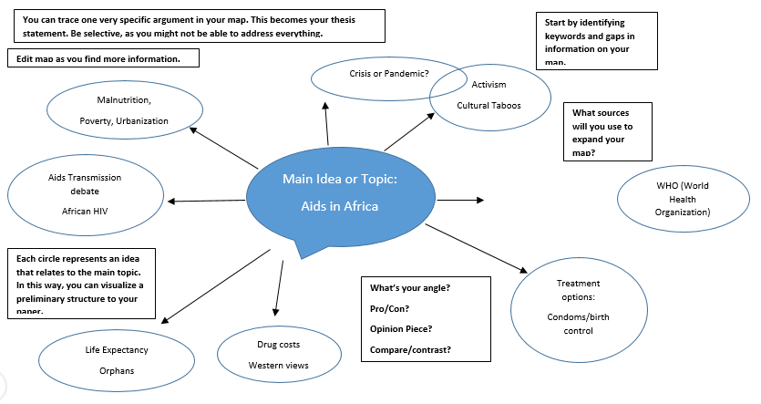
Example: AIDS in Africa

Slide 16
Narrowing your topic
Pick one or two aspects to focus on
Go deeper into these areas
Think of questions about these aspects
  What population do you want to study?
  What is the relationship between an issue/intervention and a particular outcome?
  What is the relationship between an independent variable and a particular dependent variable?

Slide 17
Example: AIDS in Africa
Malnutrition
  What impact does AIDS have on malnutrition?
  What is being done to combat this issue?
  Are theses interventions effective?
  What more can be done?
Poverty
  What is the relationship between AIDS and poverty?
  What other factors are involved?
  What programs exist to tackle this problem?
  Why do certain programs/interventions work and others not?
Orphans
  How has AIDS affected children of parents with AIDS in Africa?

Slide 18
Identify Search Terms
Concepts/main ideas
PICO
  Population
  Intervention
  Comparison
  Outcome
Related terms
Controlled vocabulary

Slide 19
Combining Search Terms
Boolean operators – AND, OR, NOT
Phrase searching – “…”
Truncation - *
Proximity operators – N/x, NEARx

Slide 20
Example: AIDS in Africa
AIDS in Africa
  (AIDS or “acquired immune deficiency syndrome” or HIV)
  (Africa or Sub-sahara* or Burundi or Malawi or ….)
  (Child* or youth)
  orphan*
  (Malnutrition or “nutritional deficiency” or malnourishment)
  (Poverty or “low income” or poor)
You may need to do separate searches for different aspects of your topic

Slide 21
Where to look
Think about who/what is interested in the topic
Think about what subject area might cover this topic

Slide 22
Example: AIDS in Africa
African governments
NGOs
AIDs researchers
Economists
Nutritionists

Slide 23
The “Literature” in the Review
The literature included can be any format appropriate to your topic.
Don’t restrict yourself to journal articles.
  Look in books – you’ll need to know and cite the work of major contributors to the field. A lot of this in books, especially annual reviews
  Important Information can be found in reports, conference proceedings, and other non-journal sources. Search government websites and associations related to your topic.
Look at library subject guides in your area to find the key databases additional resources

Slide 24
Literature Search
Perform a preliminary search of the literature.
  Search lit to see what other work in the area of interest has already been published.
    Gives a preview of the number of articles available on the topic.
    If your topic is already written about, select a slightly different topic or modify the focus of the objective.
  Recent journal issues in areas central to the topic may provide leads to content that should be in the review.
    Consult Web of Science’s Journal Citation Index for an idea of the most important journals in the field
  Develop a list of subject headings that relate to themes of interest

Slide 25
Literature Search
  Search across multiple databases and information resources.
    It’s not adequate to use Medline as your one and only resource
    Example: AIDS in Africa
WHO
  IRIS Digital Library
  Health Topics
PubMed
CINAHL
Worldwide Political Science Abstracts
World Bank
Government Info
  Read the literature throughout the search process.
    What you read will guide your subsequent searches and refine your topic.
  Your search should help refine the topic and objective of the overview being written.

Slide 26
Think ahead
The more one learns about a subject, the more questions come to mind.
Keep a list of questions and hypotheses that come to your mind or that are mentioned in what you read.
    Have I answered my question without any obvious gaps?
    Are no new related issues coming up as I search the literature?
    Have I found multiple references which cover the same material or just enough to prove agreement?
    These questions will help guide you when you are constructing your review
    The questions will also guide you in discussing the implications of your own findings and the additional research directions your work supports or suggests.
For key articles
  Look at the references to see who has been cited (backward)
  Find who has cited these articles (forward)

Slide 27
Save your references
Keep a record of the literature you collect
Record where and when you retrieved the information
Use a citation manager program like RefWorks or EndNote
Better to record too many references than have to return a few weeks or months hence and spend hours trying to relocate documents

Slide 28
Data Evaluation: Selecting literature
Read widely
When you read for your literature review, you are actually doing two things at the same time:
Trying to define your research problem: finding a gap (What is missing? What can be studied next?), asking a question, continuing previous research, counter-claiming
Trying to read every source relevant to your research problem
It is usually impossible to do the latter (need Note Taking)
  you will need to identify the most relevant and significant works and focus on them.

Slide 29
Data Evaluation: Selecting literature
How to read the material
Reading for the big picture
  Read the easier works first
  Skim the document and identify major concepts
  After you have a broad understanding of the 10 to 15 papers, you can start to see patterns:
    Groups of scientists argue or disagree with other groups. For example, Some researchers think x causes y, others that x is only a moderating variable

Slide 30
Data Evaluation: Selecting literature
As you define your problem you will more easily be able to decide what to read and what to ignore.
  Before you define your problem, hundreds of sources will seem relevant.
  However, you cannot define your problem until you read around your research area.
  This seems a vicious circle, but what should happen is that as you read you define your problem, and as you define your problem you will more easily be able to decide what to read and what to ignore.

Slide 31
Narrow your focus
Start from new material to old, general to specific
  starting with general topic will provide leads to specific areas of interest and help develop understanding for the interrelationships of research
  Note quality of journal, output of author
As you read and become more informed on the topic, you will probably need to go back and do more focused searches
Think, analyze, and weed out
Arrange to spend some review time with an experienced researcher in the field of study to get feedback and to talk through any problems encountered

Slide 32
Read the Material Closer
Step 1: read the abstract
  Decide whether to read the article in detail
Step 2: read introduction
  It explains why the study is important
  It provides review and evaluation of relevant literature
Step 3: read Method with a close, critical eye
  Focus on participants, measures, procedures
Step 4: Evaluate results
  Do the conclusions seem logical
  Can you detect any bias on the part of the researcher?
Step 5: Take discussion with a grain of salt
  Edges are smoothed out
  Pay attention to limitations

Slide 33
Critical Analysis
Significance
  Your interpretation of the impact of this study
Evaluation
  Is the study design suitable?
  Was the sample size/population appropriate?
  Do the results support the conclusions?
  Has the study cited the appropriate literature?
  What are the limitations of the study?
Relevance
  How is this relevant to your research?
  Does this agree/disagree with other sources?
  Does this add something new to your research?

Slide 34
Identify Common Themes
Hypotheses
Populations studied
Theories
Methods
Outcomes

Slide 35
Questions To Consider In Your Review
What do we already know in the immediate area concerned?
What are the characteristics of the key concepts or the main factors or variables?
What are the relationships between these key concepts, factors or variables?
What are the existing theories?
Where are the inconsistencies or other shortcomings in our knowledge and understanding?
What views need to be (further) tested?
What evidence is lacking, inconclusive, contradictory or too limited?
Why study (further) the research problem?
What contribution can the present study be expected to make?
What research designs or methods seem unsatisfactory?

Slide 36
Construct the Literature Review
In the introduction, explain why the topic is important and give the reader an idea of where you are going in your paper.
Group research studies and other types of literature according to common denominators.
  If you’ve taken notes before, the common themes are more easily identifiable.
  Some factors used to organize reviews are:
    Conclusions of authors
    Specific purpose
    Objective
    Chronology (this method will give the worst impression, use only if it really makes sense to your topic!)

Slide 37
Construct the Literature Review
  Summarize individual studies or articles
    Use as much or as little detail as each merits according to its comparative importance in the literature
    Space (length) denotes significance.
    Don’t need to provide a lot of detail about the procedures used in other studies.
    Most literature reviews only describe the main findings, relevant methodological issues, and/or major conclusions of other research.
  Discuss major areas of agreement or disagreement
  Tie the study into the current body of lit, make logical interpretations from the lit reviewed.
    If there is no discussion of the relevance of the overview to other work in the field, or if there is no interpretation of the literature, it may signal the author has not thoroughly investigated the topic.

Slide 38
Organization of the Review
Introduction to the lit review
Content - what is covered
Structure - how it is organized
Boundaries - what is outside of its scope
Body of the Lit Review
SECTION 1
The most important topic or a key concept
discussed and evaluated
summarized and related to your research project
Conclusion
From each of the section summaries,
highlight the most relevant points
relate these back to the need for research
reiterate what these mean for the research design
SECTION 2
The next most important
topic or a key concept
discussed and evaluated
summarized and related to your research project
ADDITIONAL SECTIONS
Follow the same pattern

Slide 39
Writing and Reading
‘Writing while you collect and collecting while you write.’
The writing stage is part of the research process, not something that happens after you have finished reading the literature.
Once you are part way through your reading you can have a go at writing the literature review.
It is often not until you start explaining something in writing that you find you need to collect more information.

Slide 40
An Effective Literature Review
Places each work in the context of its contribution to the understanding of the subject under review
Describes the relationship of each work to the others under consideration
Identifies new ways to interpret, and shed light on any gaps in, previous research
Resolves conflicts amongst seemingly contradictory previous studies
Identifies areas of prior scholarship to prevent duplication of effort
Points the way forward for further research
Places one's original work (in the case of theses or dissertations) in the context of existing literature

Slide 41
Be accurate and thorough
Your review acts as a guide of your topic for others.
Take care to make your review:
  Accurate: e.g., Citations correct, findings attributed to authors correct.
    Make sure someone can track down the article and that you have provided a reliable representation
  Complete: i.e., include all important papers (not every paper written on the topic).

Slide 42
The End

