Slide 1
Fundamental of Scientific Researches
Mohammed Al-zubaidi, PhD

Slide 2
Learning Objectives
You will know by the end of this session:
What is ‘research’, types and importance?
Steps for scientific researching

Slide 3
What is scientific research
Research is the physical process of gathering information and the mental process of deriving the answer to your question from the information you gathered.
A tool used to find evidence.
Research writing is the process of sharing the answer to your research question along with the evidence on which your answer is based, the sources you used, and your own reasoning

Slide 4
Research Purpose
To advance one’s knowledge about a topic
To replicate, examine and extend previous knowledge claims
To develop new knowledge for humankind
To create new interventions, new applications.

Slide 5
Types of researches

Slide 6


Slide 7

Problem-Oriented research: These are to understand the exact nature of a problem & to find out relevant solutions.

Slide 8
Qualitative research:
It helps create in-depth understanding of problems or issues.
This is a non-statistical method.

Slide 9
Quantitative research:
Is a structured way of collecting data and analyzing it to draw conclusions.
Statistical (all about numbers).

Slide 10
What Is the Purpose of a Research?
1. Exploratory:
It is conducted to handle new problem areas which haven’t been explored before.
To explore a group of questions. The answers & analytics may not offer a final conclusion to the perceived problem.
Example: The survey poll that can be send to students to understand their opinions about the timing of a weekly conference. Based on such information, decision is taken.

Slide 11
What Is the Purpose of a Research?
2. Descriptive:
Three main purposes of descriptive research: describing, explaining & validating the findings.
Focuses on expanding knowledge on current issues through a process of data collection.
To describe the behavior of a sample population.
Example: Across-section study planned to include a questionnaire form among medical students in order to know their opinions about continuous medical education.

Slide 12
What Is the Purpose of a Research?
3. Explanatory:
Can be conducted for a problem that was not well researched before, demands priorities, generates operational definitions.
They are not used to give us some conclusive evidence but helps us in understanding the problem more efficiently.
Examples: Literature Research, In-depth study of every single problem & a Case Analysis Research.

Slide 13
Steps for a Research Process?

Slide 14
Steps of Research Process
1- Define research problem
2- Review of literature
3- Formulate hypotheses
4- preparing the research design
5- Data collection
6- Data analysis interpretation and report writing

Slide 15
Step 1: Define Research Problem
“Research Question & Topic”
Begin from a question to which you don’t know the answer & that can’t be answered just by going to the appropriate reference source.
That is, begin from a research question, not a homework question.

Slide 16
Step 2: Review of Literature
“Gathering information”
Decide what kind of information or data will be needed in order to build the answer to the question.
Gather information &/or collect data.
Work with the information/data to derive or construct your answer.

Slide 17
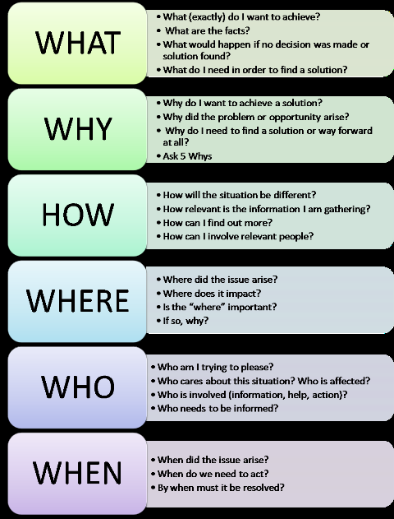
Getting Started:
Step 1+2
How to select Research topic?
5Ws & 1H

Slide 18
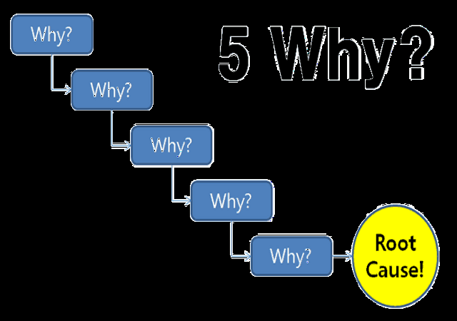

Slide 19
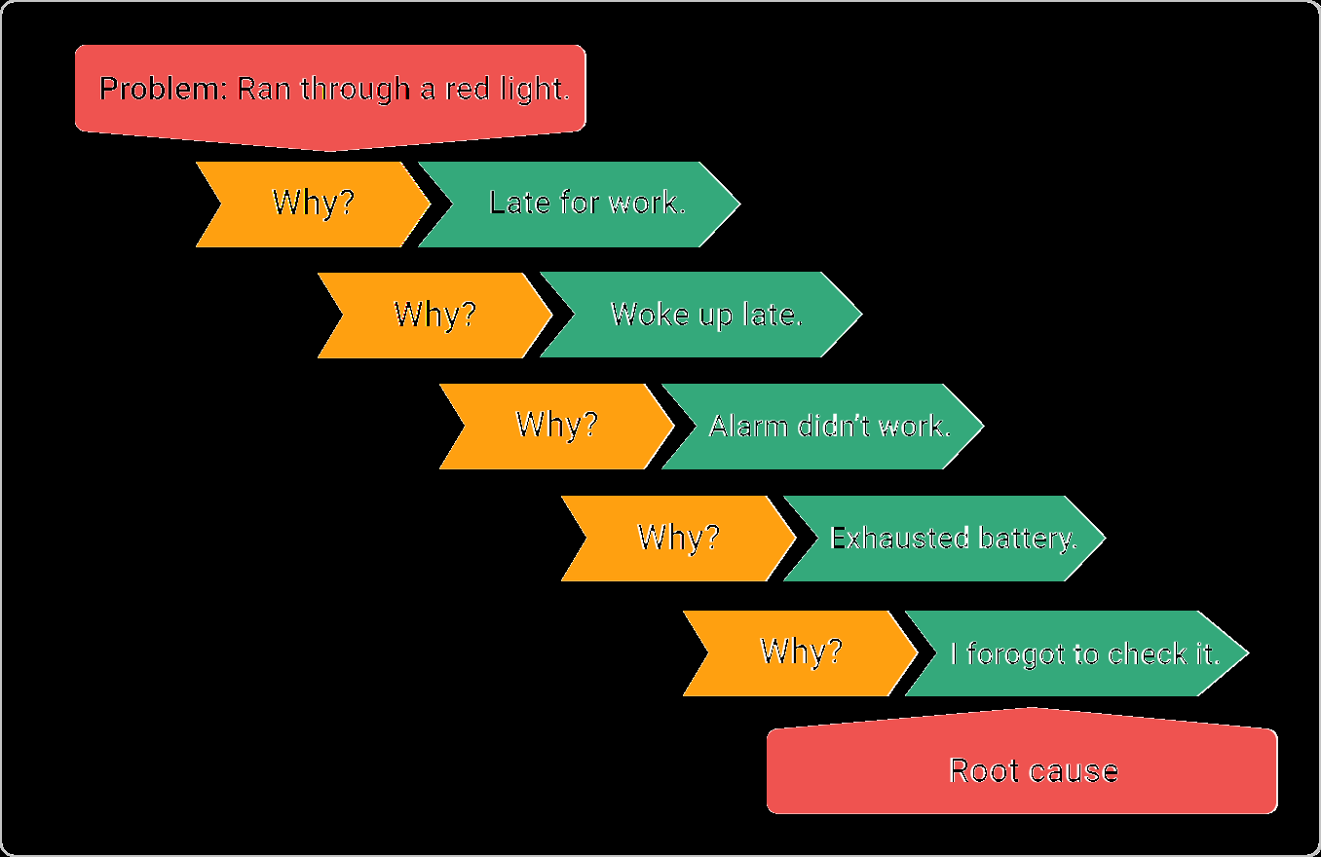
Example

Slide 20
Examples of a Research Topic?

Slide 21
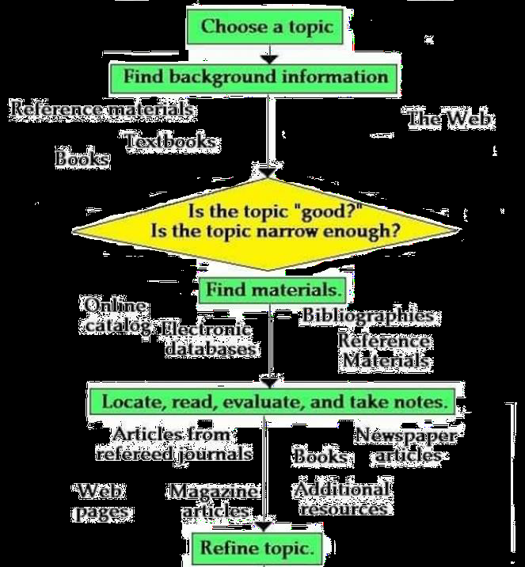
Getting Started: Step 1+2

Slide 22
Step 3: Formulate hypothesis
A hypothesis is a statement about the relationship between two or more variables.
It is a specific, testable prediction about what you expect to happen in a study.

Slide 23
Examples
Example 1
A study designed to look at the relationship between sleep deprivation and test performance
Hypothesis : ?

Slide 24
Examples
Hypothesis :
"This study is designed to assess the hypothesis that sleep-deprived people will perform worse on a test than individuals who are not sleep deprived."

Slide 25
Examples
Example 2:
A researcher might be interested in the relationship between study habits and test anxiety.
Hypothesis?
"Test anxiety decreases as a result of effective study habits."

Slide 26
Step 4: Preparing the study Design
Introduce the overall methodological approach for investigating your research problem.
Is your study qualitative or quantitative or a combination of both (mixed method)?

Slide 27
Step 5: Data Collection
Describe the specific methods of data collection you are going to use, such as:
Surveys
Interviews
Questionnaires
Observation
Archival research.

Slide 28
Step 6: Data Analysis
Explain how you intend to analyze your results. Will you use statistical analysis?
Describe how you plan to obtain an accurate assessment of relationships, patterns, trends, distributions, ..etc.

Slide 29
Step 7: Data Interpretation & Research writing
Simply state what you found.
Presented in a logical order.
Use the past tense to describe your results.

Slide 30
To Sum Up
Research is a systematic inquiry to describe, explain, predict & control an observed phenomenon.
The research purpose can be either Exploratory, descriptive or explanatory.
Research can be: Basic, applied, problem oriented/solving, quantitative or qualitative.
There are 7 Steps for Scientific Researching.

