Slide 1
Methods and Techniques of Data Collection
MOHAMMED AL-ZUBAIDI, PhD

Slide 2
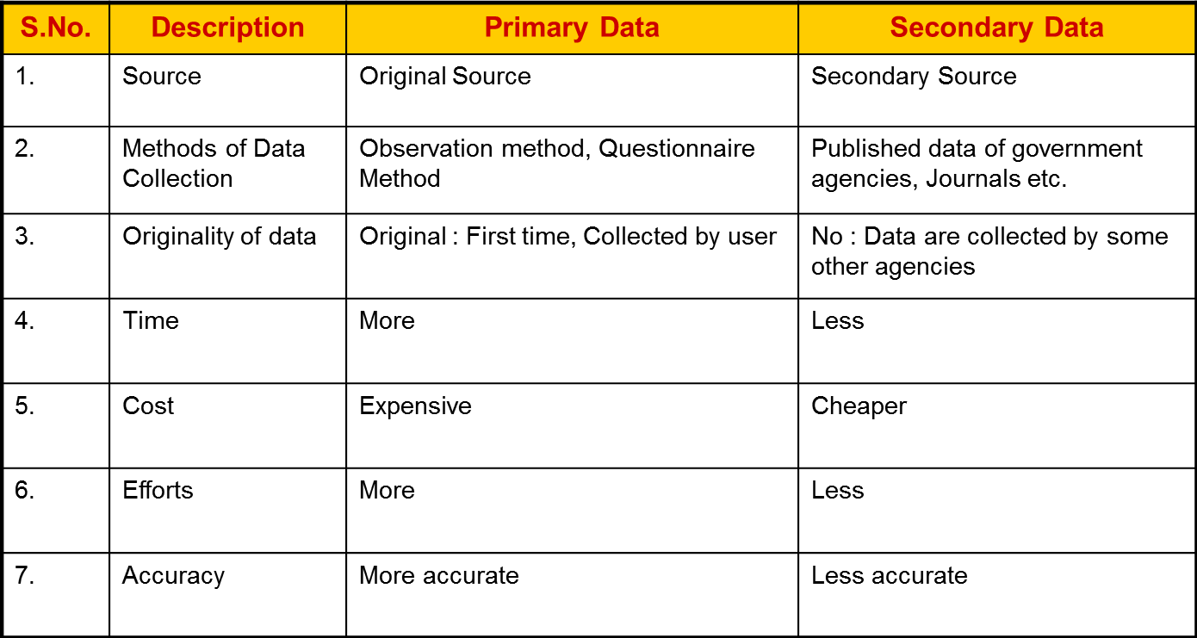
Classification of Data
Primary Data
Secondary Data
Distinction Between Primary Data and Secondary Data

Slide 3
Primary Data
Collected by investigator himself for the purpose of a specific inquiry or study. The data is original in character and highly representative and unbiased.
Methods of Primary Data Collection
Observation
Interviewing: a) Personal interviews b) Telephonic Interview
Questionnaires/Surveys
Schedules

Slide 4
Observation Method
Advantages:
Observation is planned and recorded. Information is collected by the investigator’s own direct observation (by observing the process at work) without asking from the respondent. This method is independent of respondents’ willingness to respond.
Subjective/response bias can be eliminated if observation is done accurately.
Information obtained relates to what is currently happening, it is not complicated by either the past behaviour or future attitudes.
This method is independent of respondents’ willingness to respond .

Slide 5
Limitations
Although this method can be used to study sales techniques, customer movements, customer response, etc, but this method has certain limitations.
The information provided by this method is very limited (we can not see motivations for actions). Customer’s state of mind, their buying motives, their income and education are not revealed.
The method is time consuming.
Factors may interfere with the observations. Some people (or actions) are rarely accessible to direct observation
Person being observed may change behavior because of the observation

Slide 6
Defining Observations
Structured observation - Time is selected, and particular actions counted.
Unstructured observation – no advanced characteristics sought
Participant observation – observer makes himself part of the group
Non-participant observation – observer not part of group
Disguised observation – observer not visible to group
Uncontrolled – observation done in natural setting
Controlled – special environment created

Slide 7
Interview Method
a) Personal Interviews : Personal Interview method
requires a person known as the interviewer asking
questions in a face-to-face contact to the other
person.
This sort of interview may be in the form of direct
personal investigation or indirect oral investigation.

Slide 8
The method of collecting information through personal interviews is carried out as the following:
Structured Framework: Such interviews involves use of a set of predetermined questions which enables researcher to standardize the response with some fixed alternatives. Thus, the interviewer in a structured interview follows a rigid procedure laid down, asking questions in a form and order prescribed.
Unstructured Framework: Unstructured interviews do not follow a system of predetermined questions. Here the interviewer is allowed much greater freedom to ask questions (supplementary questions, omit certain questions, or change the sequence of questions).

Slide 9
Focused interview: generally unstructured but meant to focus on respondent experience. Can discuss reasons and motives.
Clinical interview: concerned with broad underlying feelings or motivations or with the course of individual’s life experience.
Non-directive interview: the interviewer’s function is simply to encourage the respondent to talk about the given topic with a bare minimum of direct questioning.

Slide 10
Advantages of Personal Interviews Method
More information and that too in greater depth can be obtained.
The interviewer can simplify the language of the questions (if required) on the basis of ability and education level of the interviewee and thus misinterpretations or confusions regarding questions can be avoided.
Observations can be made during the interview.
The interviewer can usually control which person(s) will answer the questions. (This is not possible in mailed questionnaires)
Group discussions can be held.
The interviewer may observe spontaneous reactions.

Slide 11
Disadvantages of Personal Interviews Method
i) It is very expensive method, specially when large and widely spread geographical sample is taken.
ii) This method is relatively more time-consuming specially when the sample is large.
iii) Under the interview method, the organisation has to select, train and supervise the field –staff which is time consuming and difficult task.
iv) Certain type of respondents such as important officials or executives or people in high income groups may not be easily approachable under this method.
v) There remains the possibility of biasness of the interviewer as well as of the respondents.
vi) Effective interviews require proper rapport with respondents. This requires particular interviewer skill.

Slide 12
Interview Techniques
Every effort should be made to create friendly atmosphere of trust and confidence, so that respondents may feel at ease
The interviewer must ask questions properly and must record the responses accurately and completely.
The interviewer must answer legitimate question(s), if any, asked by the respondent and must clear any doubt that the latter has.
The interviewer should not show surprise or disapproval of a respondent’s answer
The interviewer must discourage irrelevant conversation and keep the respondent on the subject.

Slide 13
b) Telephonic Interviews : In this method information is collected by contacting respondents on telephone itself.
It is not very widely used method, but plays important part in industrial surveys, particularly in developed regions.

Slide 14
Advantages of such a system are:
It is a quick way of obtaining information.
It is cheaper than personal interviewing method; here the cost per response is relatively low.
Replies can be recorded without causing embarrassment to respondents.
No field staff is required.
v) Wider sample can be covered.
vi) Certain type of respondents such as important officials or executives or people in high income groups who are not be easily approachable can be contacted over telephone.

Slide 15
Disadvantages
This method is restricted to those respondents who have telephone facilities.
Questions have to short and to the point.

Slide 16
Questionnaire/Surveys Technique
Gather data by asking questions from people who are thought to have the desired information.
When information is to be collected by asking questions to people who may have the desired data, a standardized form called questionnaire is prepared.
The questionnaire has a list of questions to be asked in a desired sequence and spaces in which the respondents record the answers.

Slide 17
Usefulness of Questionnaire/Surveys
Technique
This method of data collection is quite popular,
particularly in case of big enquires. It is being adopted by private individuals, research workers, private and public organisations .

Slide 18
Advantages
Yield broaden range of information compared with direct observation. One can not know by observation why buyer makes particular purchases or what is his opinion about a product.
Fast
Economical/low cost than observation method.
By mailing or sending questionnaire by post the respondents who are not approachable can also be reached conveniently.

Slide 19
Limitations
Unwillingness of respondent to provide information. This requires salesmanship on the part of the interviewer. The interviewer may assure that the information will be kept secret. Motivating respondents with some token gifts often yield result.
Inability of respondents due to lack of knowledge.

Slide 20
Essentials of a good questionnaire
To be successful, questionnaire should be comparatively short and simple i.e. the size of the questionnaire should be kept as minimum.
Questions should proceed in logical sequence from easy to more difficult questions.
Personal and intimate questions should be left to the end.
Technical terms and vague expressions capable of different interpretations should be avoided.

Slide 21
5. Questions may be dichotomous (Yes or No answers), multiple choice (alternative answers listed) or open-ended. The latter type of questions are often difficult to analyse and hence should be avoided in a questionnaire to the extent possible.
6. Questions affecting the sentiments of respondents should be avoided.
Adequate space for answers should be provided in the questionnaire to help editing and tabulation.
8. There should always be provision for indications of uncertainty, e.g. ‘do not know’, “no preference” and so on.

Slide 22
9. Brief directions with regard to filling up the questionnaire should invariably be given in the questionnaire itself.
10. Finally, the physical appearance of the questionnaire affects the cooperation the researcher receives from the recipients. Therefore, attractive looking questionnaire particularly in mail surveys, is a plus point for getting cooperation. The quality of the paper, along with its colour, must be good so that it may attract the attention of the recipients.

Slide 23
Construction of a Questionnaire
Decide what information is wanted
Decide the type of questions
Decide the content of individual questions
Decide the wording of questions
Decide the sequence of questions
Decide the lay out and method of reproduction
Make a preliminary draft and pretest it
Revise and prepare the final draft

Slide 24
Schedule Method
A Performa that contains a set of questions which are asked and filled by an interviewer in a face to face interaction.
Purpose/objectives of the schedule
Delimitation of the topic
Aids to memorize
Aids to classification and analysis

Slide 25
Types of Schedule
Observation schedule
Rating schedule
Document schedule
Institution survey schedule
Interview schedule

Slide 26
Advantages of the Schedule Method
Higher response
Saving of time
Personal contact
Human touch
Deeper probe
Defects in sampling are detected
Removal of doubts
More reliable and dependable

Slide 27
Limitations of the Schedule Method
Costly and time consuming
Need of trained field workers
Adverse effects of personal presence
Organizational difficulties

Slide 28
Organization of Schedule
Selection of respondents
Selection and training of the field workers
Interviews and correct replies

Slide 29
Characteristics of a Good Schedule
Accurate Communication
Accurate response
Precise size
Clear and unambiguous
Free from subjectivity
Inter-linked question

Slide 30
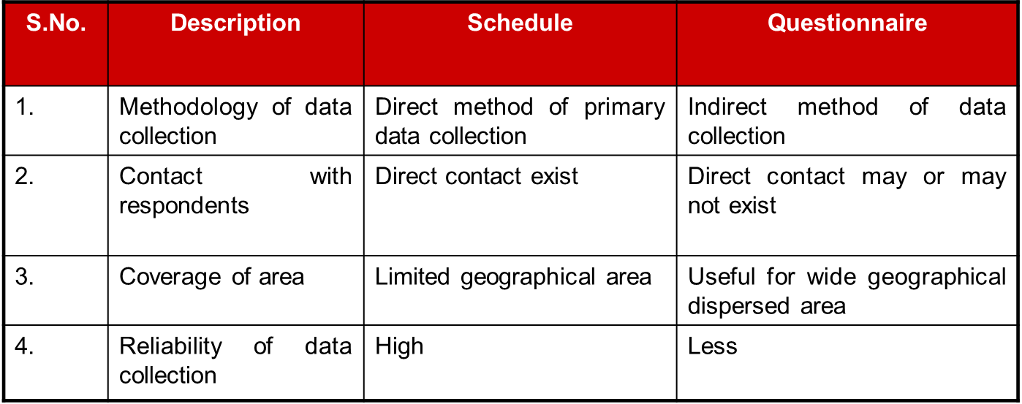
Distinction Between Schedule and Questionnaire

Slide 31
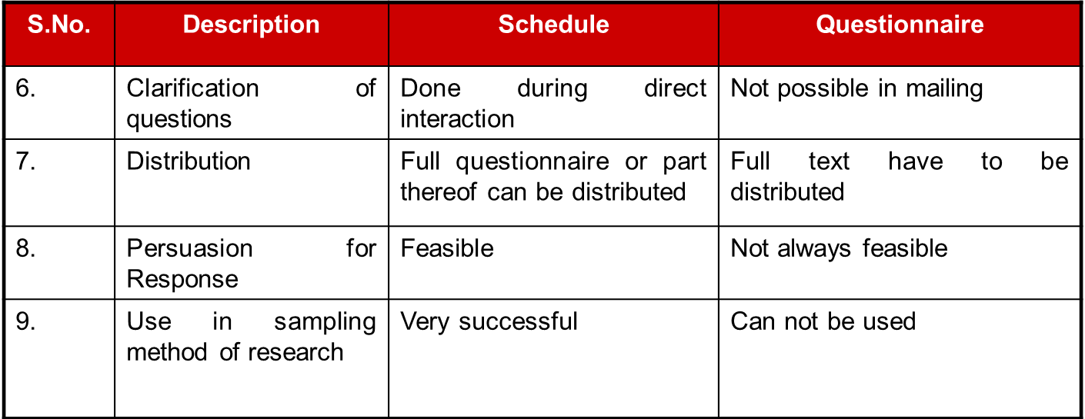

Slide 32
Secondary Data
It is the data already been collected by others which may be published or unpublished. This data is primary data for the agency that collects it and becomes secondary data for someone else who uses this data for his own purpose.

Slide 33
Methods of Secondary Data Collection
Various publications of the central and state government.
Various publication of foreign governments/institutions.
Technical & trade journals.
Book, magazines and news-paper.
Reports and publications of universities/institutions.
Census reports.
Reports prepared by research scholars.
Researcher must ensure the reliability, suitability and adequacy of secondary data.

Slide 34
THE END

