Slide 1
General urine examination
&
General Stool examination
Lab. Training
Lab 2
Lect. Zainab farooq shafeeq

Slide 2
Urine (from Latin Urina), is normally sterile liquid by-product of the body secreted by the kidneys and excreted through the urethra through a process called urination. The specifications of urine and its contents are an important indicators reflects the normal or pathological of physiological state of the body.
Normal urine is sterile and contains no bacteria, viruses, or fungi. Urine is a mixture of water and chemicals, proteins, or electrolytes such as:
sodium
potassium
urea, which is formed when protein breaks down
creatinine, which is formed when muscles break down
other chemical compounds

Slide 3
Urine analysis include many laboratory test, and the most common are:
1- General Urine Examination (GUE).
2- Urine for Culture and Sensitivity test (urine for c/s).
3- Urine biochemical tests.
4- Urine cytology and may other special tests.

Slide 4
General Urine Examination (G.U.E):
It includes two basic tests:
A-Macroscopic examination
B-Microscopic examination

Slide 5
A-Macroscopic examination of the urine
(physical examination) :
1. Volume
2. Specific gravity
3. Color,
4. Appearance.
5. Odor
6. Reaction (pH)
7. Sugar
8. Ketone bodies
9. Protein (Albumin)
10. Bilirubin
11. Urobilinogen.
12. Bile Salt

Slide 6
1. Volume:
The normal range of urine output is 800 to 2,000 milliliters per day if you have a normal fluid intake of about 2 liters per day.
Abnormal volumes which are:
a) Polyuria >2000 mls./day, an abnormally high urine volume may indicate:
Diabetes mellitus
Renal diabetes insipidus
Some forms of kidney failure
Unusually large fluid intake
Use of diuretic medications

Slide 7
b) Oliguria <400 mls. /day, An abnormally low urine volume may indicate:
• Inadequate fluid intake
• Diarrhea
• Dehydration
• Renal insufficiency
• Renal failure
c) Dysuria: is any discomfort or painful associated with urination which often signifies an infection of the lower urinary tract.
d) Anuria: complete cessation of urine caused by presence of tumor or large renal stone (Calculus)

Slide 8
2. Specific gravity:
It is a test that shows the concentration of all chemical particles in the urine that compares the density of urine to the density of water, depends on the concentration of various solutes in urine like salt, Albumins, Sager.
Test is made by using
Hydrometer (Urinometer),
Refractometer
Reagent strip
Normal value of S.G. (1008-1030), Increased S.G. concentration of solutes in the urine called (Hyperosthenuria) reach at 1060 this case is associated with chronic renal disease when kidney has lost the ability to reabsorb the solid material, low S.G. called (Hyposthenuria) reach to 1001 because the kidney lost the ability to concentrate the urine so it is secretion a dilute urine.

Slide 9
How the test is performed using Urinometer?
1. Fill 2/3 of urinometer's container with urine.
2. Allow the urinometer to float into the urine.
3. Read the graduation at the lowest level of urine.
NOTE: If the amount received is insufficient urine we were wrights Quantity Not Sufficient (Q.N.S).

Slide 10

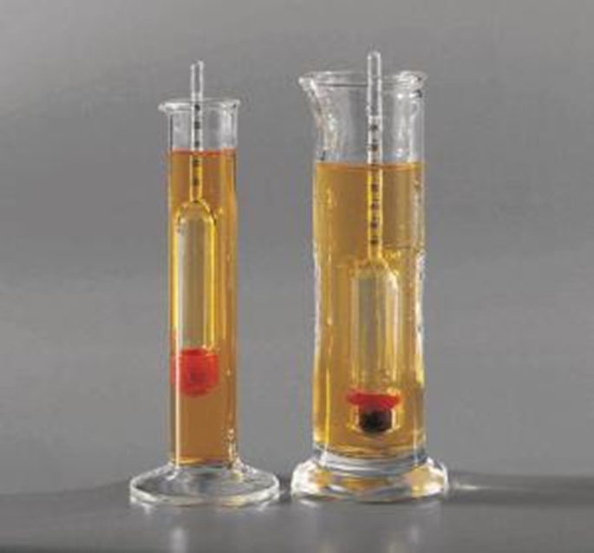

Slide 11
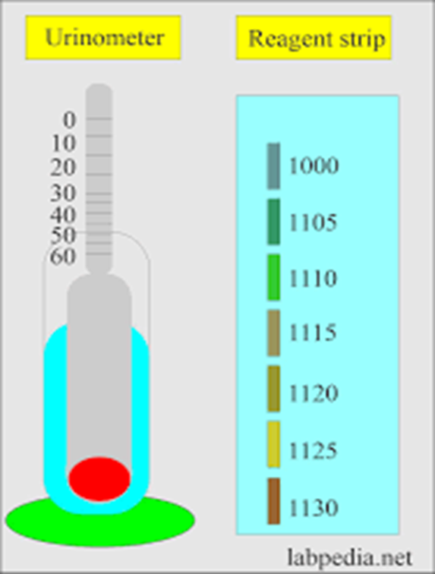

Slide 12
3- colour
1- Transparent: sign of over hydration .A person has been drinking a little too much water.
2- Pale Yellow: mean a person is healthy and hydrated.
3-Transparent Yellow: Normal.
4- Dark Yellow : Normal but needs to drink more water .
4- Brownish orange : sign of dehydration or a possible sign of liver disease .
5- Pinkish red possibly a sign of kidney disease .UTI or tumor .
6-Blue or Green : sign of a rare genetic disease.
7- Foamy : sign of kidney disease .

Slide 13
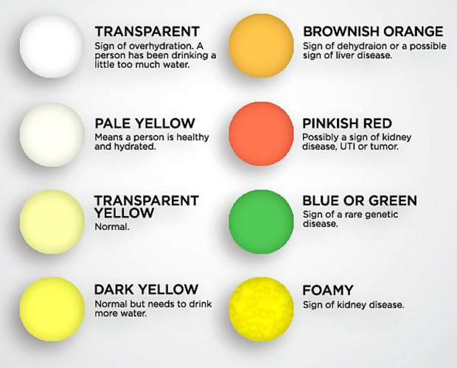

Slide 14
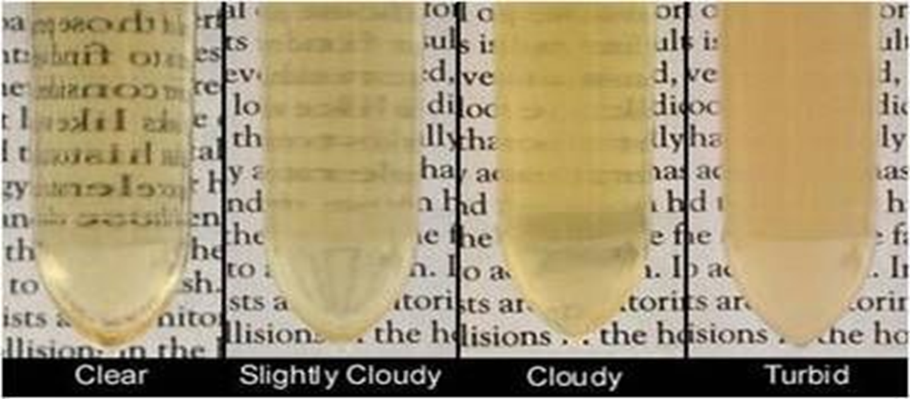
4. Appearance (Transparency and Turbidity ):
Normal appearance of urine is clear and abnormal cloudy or turbid implying to presence salt, albumin and pus cells.

Slide 15
5- Odor:
Fresh normal urine has a faint aromatic odor and leaving it for a long time leads to convert urea into ammonia which has foul odor.
In some pathological conditions, certain metabolites may be produced to give a specific odor called Fruity odor caused by the presence of ketone bodies and acetic acid in Diabetic patient's urine, however:
Ammonia odor urine standing for a long time.
Offensive or bad odor caused by Bacterial action of pus cells in urine (UTI).

Slide 16
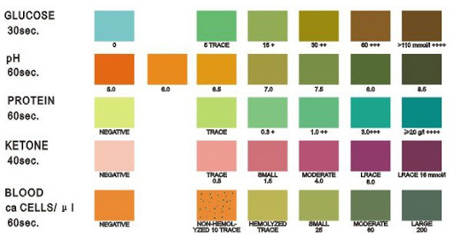
6- Reaction (pH):
Normal: 5-7
Acidic: 4.5-5 (Diabetes , precipitation of uric acid and oxalate crystals)
Basic : 7.8-8 (UTI ,plant nutrition ,precipitation of phosphate crystals)

Slide 17
7. Sugar:
The normal level of Random blood sugar is
(80-180 mg/dl), and insulin and kidney threshold is responsible for blood level control, but when blood sugar is elevated above 180 mg./dl.(Kidney threshold) the kidney plays an important role by excreting excess sugar in urine this case is associated with Diabetes Mellitus patients, urine sugar can be measured by using:
• Benedict's Reagent
• Fehling’s Reagent
Principle: Benedict’s reagent contains CuSo4 in the presence of reducing sugars cupric ions are converted to cuprous oxide which is hastened or hurry by heating, to give the color in urine.
Method: Takes 5ml of Benedict's reagent in a test tube, add 1 ml of urine.
Boil the mixture and the color of urine will change as follows:

Slide 18
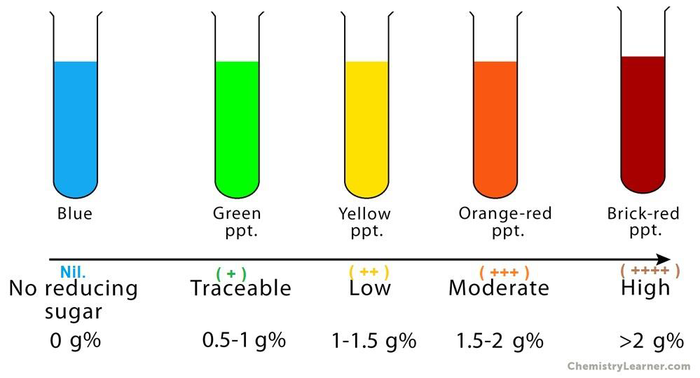

Slide 19
8. Keton bodies:
Normally, your body burns sugar for energy. But if you don't have enough sugar in cases of extreme fasting in your body for energy and people with (type 1 or type 2 diabetes) often have high ketone levels because they don't make enough insulin. Or their body doesn't respond well to insulin, and they can't use the sugar in the blood for energy.
The body burns fat instead and produces substances called ketones. The ketones end up in your blood and urine.
Test is made by using:
Detect by strip
Rotheras test Appear in sever diabetes ,dehydration ,bad nutrition, vomiting

Slide 20
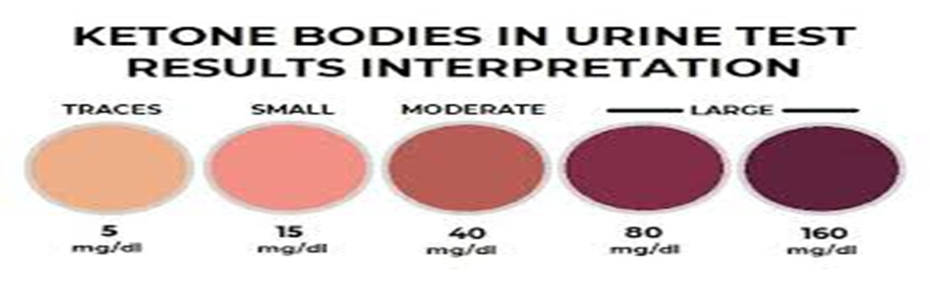


Slide 21
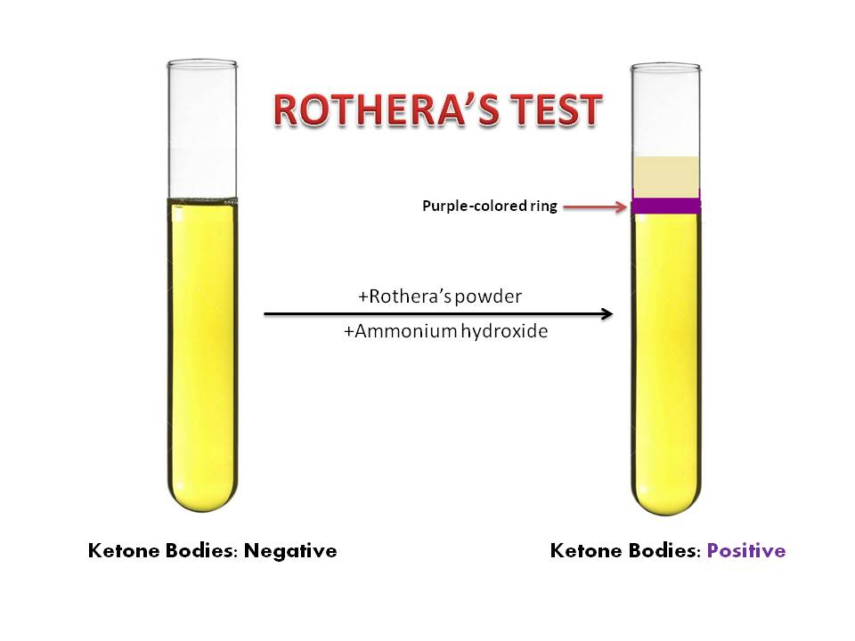

Slide 22
9. Protein (Albumin):
Proteinuria is: The presence of protein in the urine and include these five types of protein:
1-Albumine
2-Globuline
3-Mucine
4-Haemoglobin
5-Bence-Jones protein (It appears only in people with bone cancer)

Slide 23
Proteinuria is classified into three types according to origin of protein in urine:
1- Accidental proteinuria: It is found in contaminated urine with other condition such as hemorrhage in the urinary tract (menses), Vaginal or urethral secretions. This type of proteinuria is not due to kidney disease.
2- Functional proteinuria any proteinuria that is not due to renal disease, such as orthostatic proteinuria, or the transient proteinuria of pregnancy, or produced by eating of certain foods, or occurring as a result of vigorous and prolonged exercise of the lower limbs also called athletic proteinuria.
3- Organic Proteinuria (Glomerular proteinuria) the most common kind of proteinuria, being due to Kidney disease and abnormal permeability of the glomerular capillaries to protein.

Slide 24
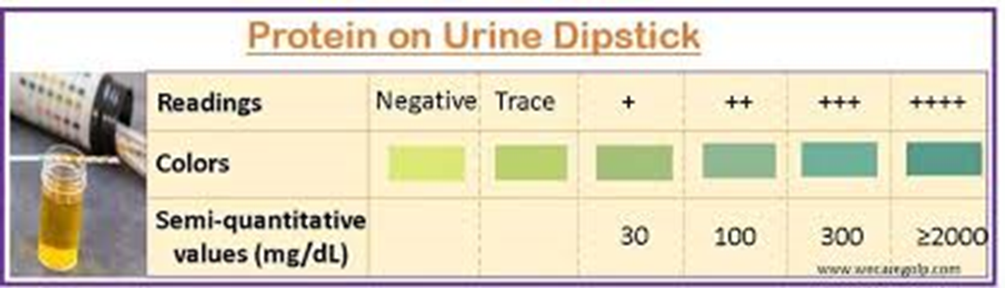
Test is made by using:
By sinking strip (change in color )
Or by adding 3 drop of sulphosalicylic acid to 5 ml of urine (precipitate)

Slide 25
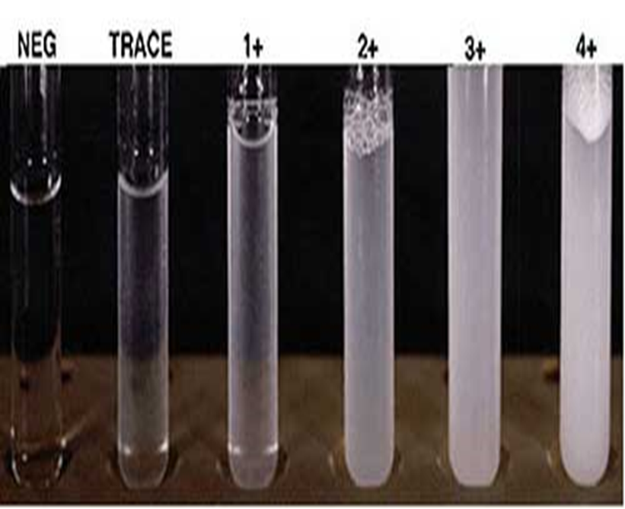

Slide 26


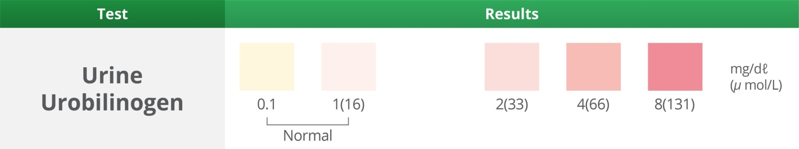
10- Bilirubin and Bilirubinuria:
It is the presence of bile pigments (Bilirubin and Urubilinogen) in the urine.
Causes: Liver diseases or injury, viral hepatitis and Obstruction to biliary duct.
Test Method Detect by the same strip

Slide 27
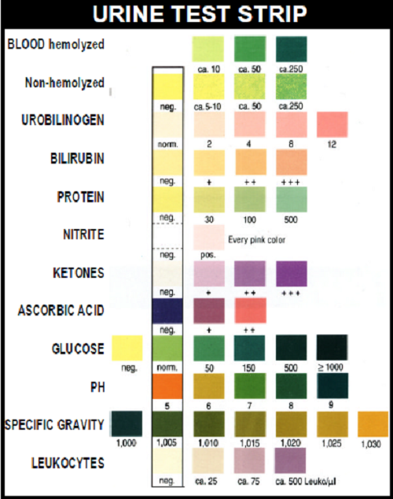

Slide 28
General Stool examination
General Stool Examination (GSE) is carried out in laboratories for various diagnostic purposes.
Examination of stool is very helpful in the diagnosis of disease of the gastrointestinal tract.
Mostly a clean container which does not contain any detergent or disinfectant is sufficient for all types of stool examinations including stool culture. It consist the following tests

Slide 29
A- PHYSICAL EXAMINATION OF STOOL:
Sample should be examined immediately after collection. Samples left standing prolonged will deteriorate helminthes, Ovum, other parasites and increase the numbers of monilia and bacteria which gives wrong results, however the following aspects of stool should be examined:

Slide 30
1- Quantity: the adult person excretions about 150-250 gm. /day of feces, about (1/3- 1/2) of feces dry weight is bacteria.
2- Consistency and form: Normal stool is well formed. But in constipation (Dehydration) the stool is solid (Hard) and the semi-solid (soft or loose) seen when taking certain medications and laxatives. In abnormal cases such as diarrhea and dysentery the stool appear liquid, or watery in nature. In cholera the stools have a rice water appearance. In cases of malabsorption of fats the stools are pale bulky and semi-solid.

Slide 31
3- Colour:
Normal colours of stools are light to dark brown due to the Presence of bile pigments.
Abnormal types of feces color :
1-Watery (like rice water) :the patient infected with
cholera (Vibrio cholerae)
2- Dark black: In cases with bleeding into the intestinal tract the stools become dark tarry in nature due to the formation of acid hematin , if the bleeding is in the small intestines. In case of bleeding in large intestines or rectum stool color may be bright red due to fresh blood.
3- Red color: Resulted from eating certain colorful foods such as red beets.
4- Clay colour: The stool may be clay coloured due to absence of stercobilinogen in biliary tract obstruction.

Slide 32
4- Odor:
The normal fecal odor of stool resulted from Indole and Skatol.
Odor of stools may become offensive in conditions like, Intestinal amoebiasis.
In cases of bacillary dysentery and cholera the stools are not foul smelling due to the absence of fecal matter.
5- Blood:
The blood is present on the outer surface of the feces and this caused either by contamination from menstrual cycle blood in women or bleeding hemorrhoids from the blood vessels.
Blood should be noted in stools if present as it is indicative of Ulceration or presence of any other pathology like malignancy.

Slide 33
B. MICROSCOPIC EXAMINATION OF STOOL:
The laboratory diagnosis of most parasitic infections is by the demonstration of ova of the parasite in the stools of the infected person. The stool is collected in a clean container. The stool can be examined by the following techniques.
(a) Wet mounts examination. (b) Iodine examination.

Slide 34
a) Saline wet mount examination: The stool is emulsified in normal saline and a large drop is placed on a glass slide and is then covered with a cover slide. Then examined under a light microscope, it is important to examine specimen under 10X objective lens at first to observe large molecules, cells, ova and helminthes, then to the 40X objective to complete the test. It is preferable to keep the condenser down and the intensity of the light low for proper visualization of the ova and cysts. The thickness of the film should be such that one is able to see the printed letters of the newspaper through it.

Slide 35
b) Iodine examination: Iodine preparation leads to better visualization of morphological details of ova and cysts as it stains the glycogen in them. However it has the disadvantage that the live trophozoites of Entamoeba histolytica and other live parasites cannot be seen as the iodine kills them. The examination instructions in normal saline must be followed the same in iodine test.

Slide 36
Microscopic examination include the following:
(1) Pus cells: Observed in stool the same procedure as in urine.
(2) RBCs: Observed in stool the same procedure as in urine.
(3) Monilia: Observed in stool the same procedure as in urine.
(4) Protozoa: (a) Entamoeba histolytica: To investigate the vegetative phase (trophozoite) and cyst, causing amoebic dysentery disease. (b) Entamoeba coli: trophozoite + cyst Note: - most of children diarrhea less than 2 years cause by Entamoeba coli. (c) Giardia lamblia, trophozoite + cyst, Cause watery diarrhea disease in children, especially. (d) Balantidium coli, trophozoite + cyst, causing Balantidiasis in colon.

Slide 37
5) Worms :
(a) Enterobius vermicularis (pinworm): investigating the eggs that are of convex and flat surface and a pointed end.
(b) Ascaris lumbricoides: investigating for eggs which characterized by the content of granular yellow to Brown irregular albumin membrane.
(c) Hookworm (Ancylostoma duodenale): investigating the eggs where the egg yolk is divided and surrounded by a thin membrane.
(d) Tapeworms, (Taenia solium): investigating the worm pieces called (gravid segments or Proglottids) that comes out with the feces.
(e) Schistosoma mansoni: Investigating the eggs distinct by lateral spin.

Slide 38
STOOL CULTURE
Stool is cultured by taking a sample by loop and cultured on different types of culture media according to the type of bacteria or diagnosis of case investigated as follows:
1- It is cultured on Thiosulfate citrate bile salts sucrose (TCBS) agar media if the patient is suspected of cholera infection.
2- It is cultured on Xylose lysine deoxycholate (XLD) agar: This selective medium has been recommended for the isolation of Salmonella and particularly Shigella from fecal samples
3- It is cultured on Lowenstein–Jensen medium for Mycobacterium tuberculosis if the person suspected of gastrointestinal tuberculosis.

Slide 39
4- It is cultured on blood agar if suspected of infection with Staphylococcus aureus which it is blood hemolytic
5- It is cultured on MacConkey agar medium to detect lactose fermentation bacteria in pink color colonies include (E .coli, Klebsiella and Enterobacter). But if it's not lactose fermenter, it is either Proteus which is identified by (diffusion phenomenon), or pseudomonas which is identified by (pyocynin test). And to distinguish between Shigella and Salmonella, by using serological and biochemical test.

Slide 40
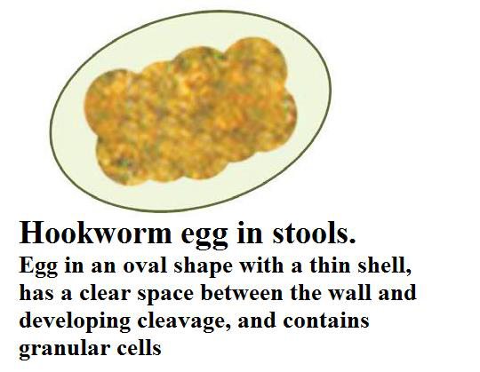

Slide 42
Salmonella typhimurium.
(XLD) agar
Vibrio cholerae
(TCBS)agar

