Slide 1
Bacterial Smear Preparation & Bacterial staining

Slide 2
Smear preparation
It is a preparation that includes a small amount of biological sample or culture spreadin a very thin film on the surface of the slide.
•Smear preparation is a step before staining.
•A good bacterial smear preparation is the key for good stain.
Materials
•Bacterial culture (whether on plate or broth)
•Glass slide
•Bunsen burner.
•Inoculating loop
•Permanent marker

Slide 3
Method
Step I:Properly label a new microscope slide
Step II: Sterilize an inoculating loop by burning it and let it cool
Step III: Remove bacteria from plate or broth sample
A: From plate (solid media)
1.Place a drop of water on the slide
2.Using a sterilized and cooled inoculation loop to obtain a very small sample of a bacterial colony from a culture plate
3.Gently mix the bacteria with the water drop.
4.Spread the mixture in a circular motion, this will avoid cell clumping.

Slide 4
B. From broth (liquid media)
1.Gently tapping the broth tube by the finger to re-suspense the bacteria
2. Using a sterilized and cooled inoculation loop to obtain broth (one or two loopfuls taken according to the size of the loop)
3. Apply the broth on the center of the slide and spread it evenly.
Step IV: Allow the smear to dry completely by air at room temperature
Step V:Heat fixation
i.After smear is dried completely by air, rapidly pass it 3-4 times through flame of Bunsen burner
ii.Avoid too much heating
iii.Allow smear to cool before staining

Slide 5
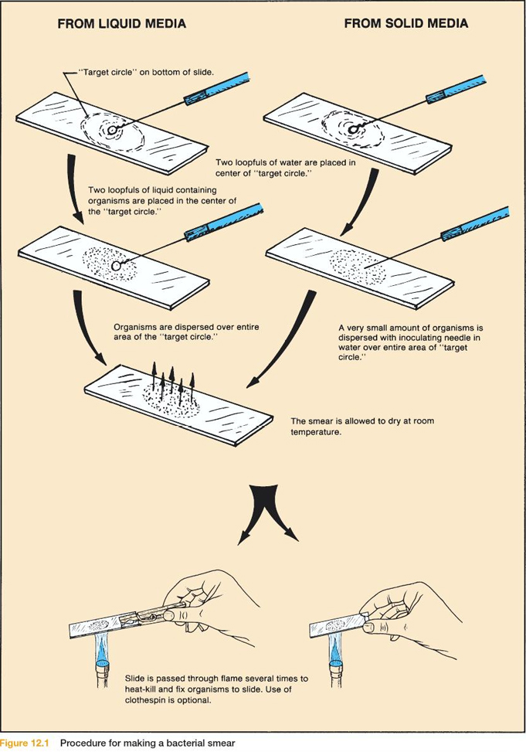

Slide 6
The importance of heat fixation is:
1) Kill the M.O.
2) Make the M.O. stuck to the surface of the slide.
3) Make the M.O. more permeable to the stain.
4) Prevent the M.O. from going autolytic changes

Slide 7
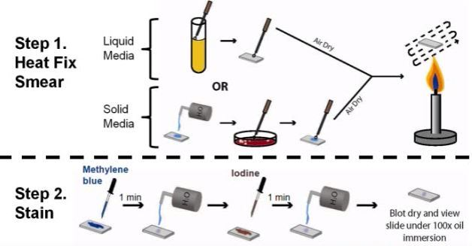

Slide 8
An ideal bacterial smear should be thin, semi-transparent, whitish layer or film, circular or oval with
2 cm diameter
“A good smear preparation is the key to a good stain”.

Slide 9
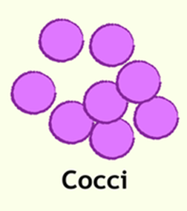

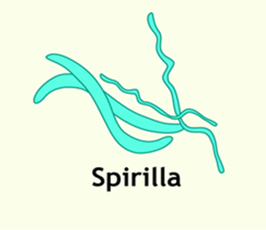
Bacterial morphology
Can be grouped into three types
1- Spherical (cocci)
2- Rod – shaped
(bacili)
3 – Helical
(spirilla)

Slide 10

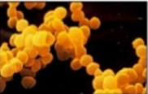
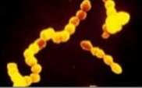
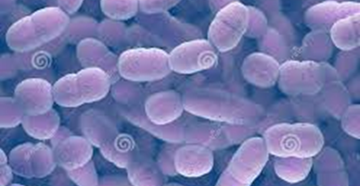
1- Spherical ( cocci) : bacteria may occur single , in pairs ,
in tetrads , in chain and in irregular masses.
Staphylococcus aureus
(in clusters)
Streptococcus pyogenes
(in chain)
Streptococcus pneumoniae
(in pairs)

Slide 11
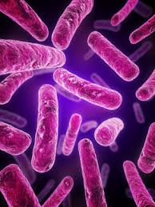
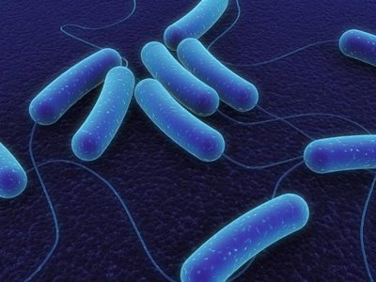
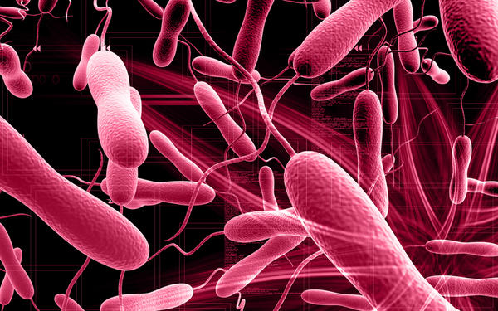
2- Rod – shaped(bacilli): bacteria may vary considerably in length may have square , round , or pointed end and may be motile or non-motile
Bacillus subtilis
Escherichia coli
3- Helical and curved bacteria : exite as slender spirochaetes , spirillum and bent rods (vibrios).

Slide 12
Stain is a substance that adheres to a cell giving the cell color.
Staining is a technique used to enhance contrast in samples, generally at the microscopic level. Staining means coloring microorganism with a dye that emphasizes a certain structure.

Slide 13
Bacterial Staining
• Bacteria are colorless (transparent)
• Staining is a process by which we use different dyes to visualize
• By staining we can study size, shape (cocci, bacilli, coccobacilli) and arrangment (single, pairs, clusters or chains )

Slide 14
Types of stains
: 1. Basic (+ve stains)
2. Acidic (-ve stains)
3. Neutral stains

Slide 15
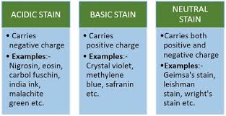

Slide 16
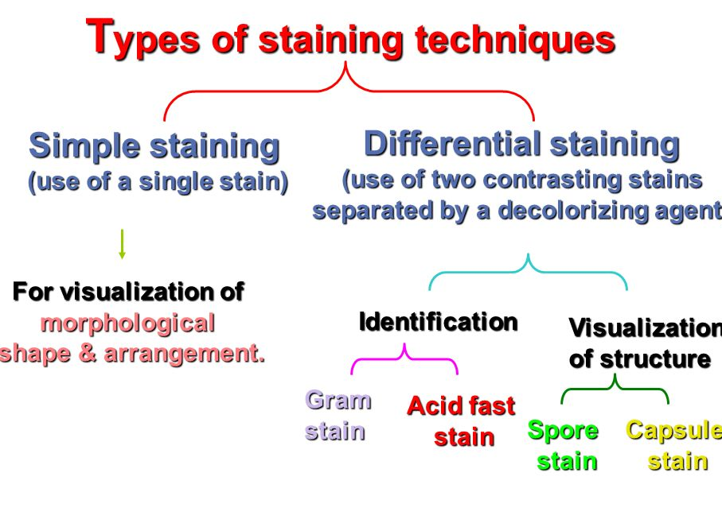

Slide 17
Simple stain
Principles
It is the using of ONE STAIN (Basic stain) only to stain microorganisms, so MO that present in the slide appears in ONE COLOR.
It used to get information about bacterial size, shape (cocci, bacilli, cocco-bacilli) and arrangement(single, pairs, clusters or chains )
Crystal violet (20-30 sec. staining time).
Methylene blue (60 sec. staining time).
Carbolfuchsin (5-10 sec. staining time).

Slide 18
Procedure
This procedure is simple , easy, time saving and economic.
It is applied by using only a single stain and all bacteria in the specimen will be stained by one color.
1-Use a clean slide, mark it and fellow the steps of smear preparation
2-Flood smear with simple stain , basic stains, suchas ;
Crystal violet , methyl violet
3-Wash with tap water, drain excess water & dry in air.
4-Examine under microscope using the low , high and oil immersion lens.

Slide 19
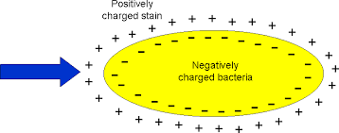
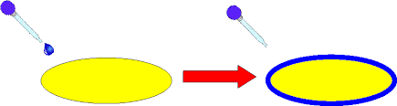

Slide 20
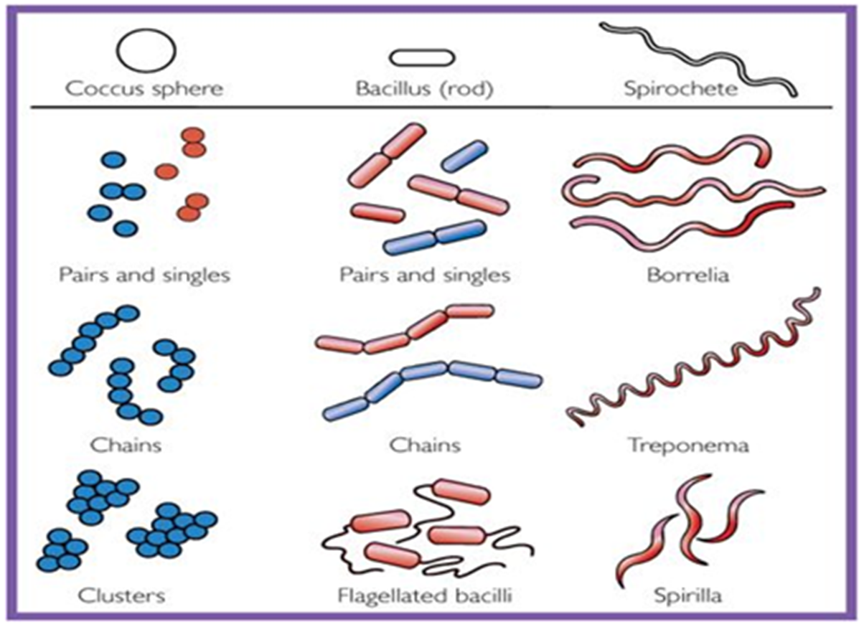

Slide 21
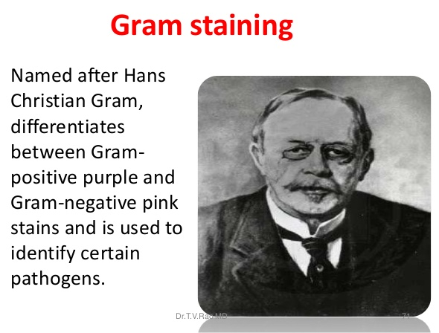

Slide 22
Principle
The Gram stain is the most useful and widely employed differential stain in bacteriology.
It divides bacteria in to two groups (Gram positive and Gram negative bacteria.
The primary stain is crystal violet. It is followed by treatment with an iodine solution , which function as a mordant , that is , it increase the interaction between the bacterial cell and the dye .

Slide 23
The smear than decolorized by washing with an agent such as 95% ethanol.
Gram positive bacteria retain the crystal violet-iodine complex when washed with the decolorize where as gram negative bacteria lose their crystal violet-iodine complex and become colorless.
Finally , the smear is counter stained with a basic dye, different in color than crystal violet.
This is safranin, the safranin will stain the colorless gram negative bacteria pink but does not alter the dark purple color of gram positive bacteria.

Slide 24
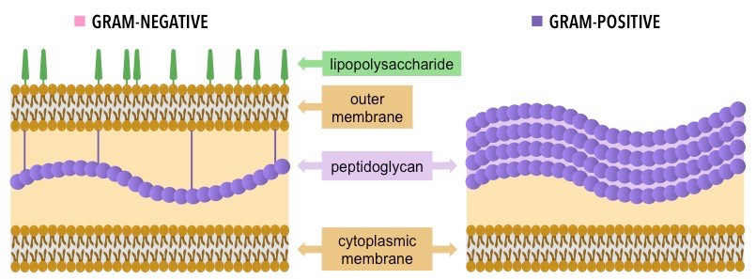

Slide 25
Difference between Gram positive and Gram negative bacteria
Gram positive bacteria | Gram negative bacteria
Simple cell wall | More complex cell wall
Thick peptidoglycan cell wall layer | Thin peptidoglycan cell wall layer
No outer lipopolysaccharide wall layer | outer lipopolysaccharide wall layer
Retain crystal violat/iodine | Retain safranin
Appear (Blue/Purple) | Appear (Pink/Red)
Teichoic acid | absent

Slide 26
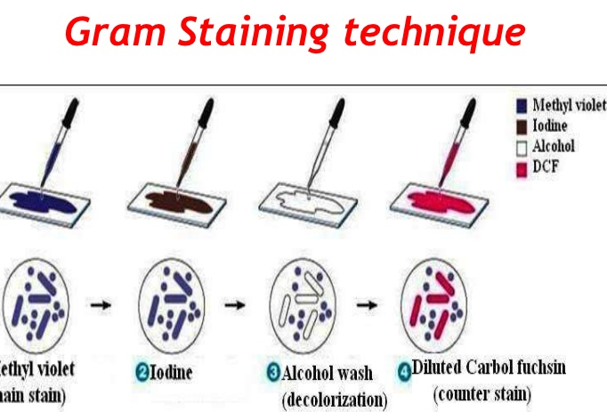

Slide 27
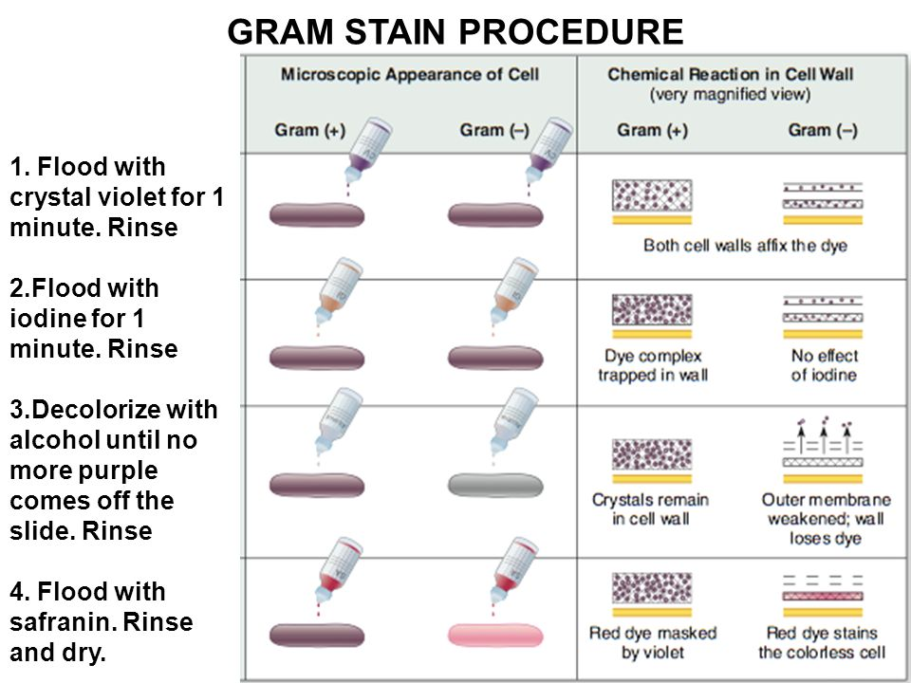

Slide 28
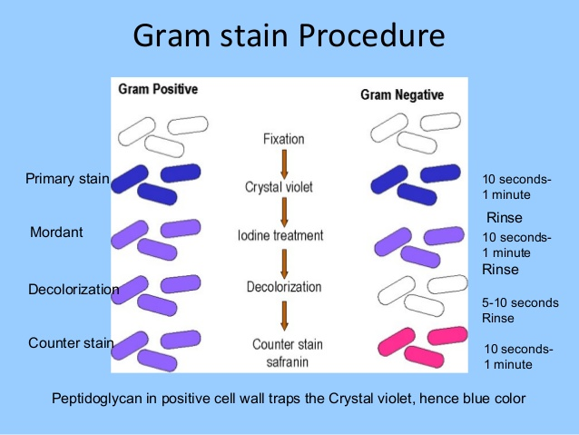

Slide 29
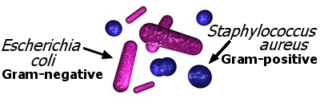
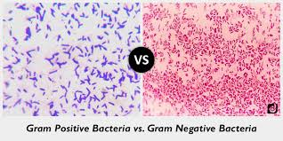
Staphylococcus aureus
Escherichia coli

Slide 30
Spore staining
(Schaeffer-Fulton method)
Principle
Bacteria in genera such as Bacillus and Clostridium produce a quite resistant structure capable of surviving for long periods in an unfavorable environment and then giving rise to new bacterial cell.
This structure is called an endospore since it develops within the bacterial cell.
The location and size of endospore vary with the species

Slide 31
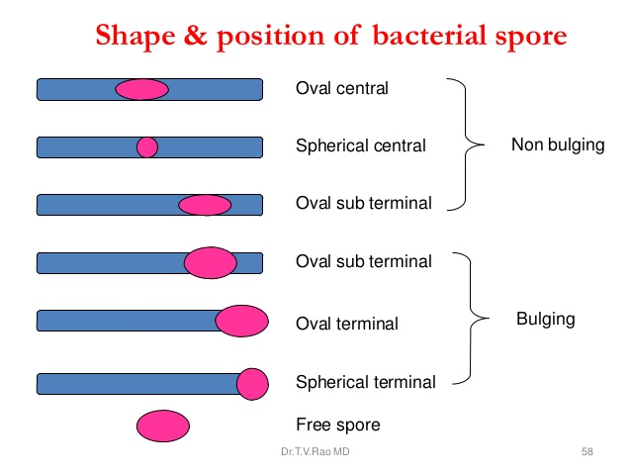

Slide 32
Endospore do not stain easily but , once stained they strongly resist decolorization .
The endospore are stained with malachite green , heat is used to provide stain penetration .
The rest of the cell is then decolorized and counter stained a light red safranin.

Slide 33

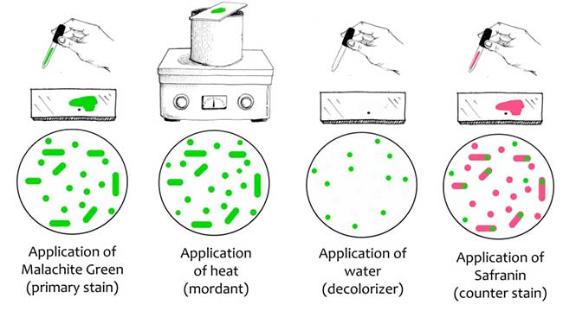

Slide 34
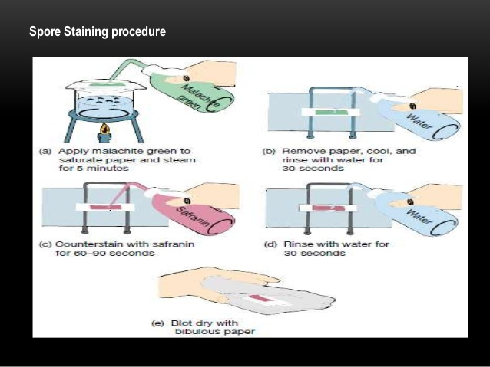

Slide 35
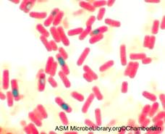
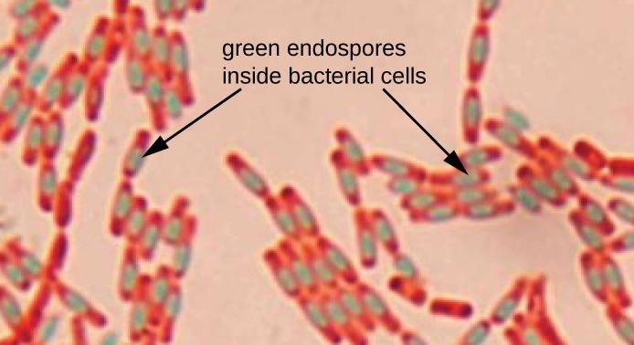
Bacillus subtilus

Slide 36
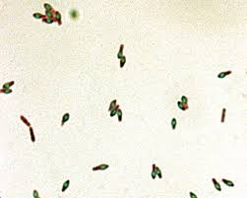
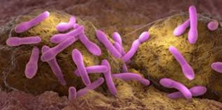
Clostridium botulinum

Slide 37
Acid fast staining
(Ziehl-Neelson stain)
Principle
A few species of bacteria in the genera Mycobacteria and Nocardia do not readily stain with simple stain ,however these microorganisms can be stained by heating them with carbolfuchsin .
The heat drives the stain in to the cell once the microorganisms have taken up the carbolfuchsin , they are not easily decolorized by acid-alcohol and hence are termed acid fast .
This acid fasten is due to the high lipid content (mycolic acid) in the cell wall these microorganisms.

Slide 38
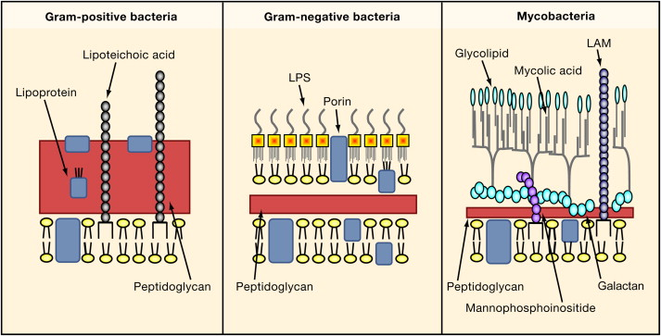

Slide 39
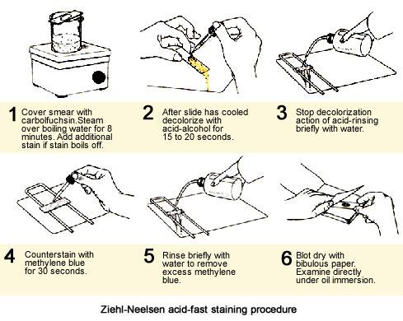

Slide 40
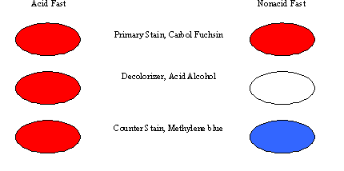
Microorganisms that are not acid fast , termed non acid fast appear (Blue due) staining with methylene blue after they have been decolorized by the acid alcohol.

Slide 41
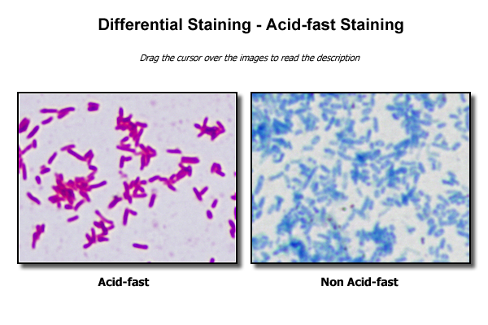
Mycobacterium tuberculosis
Escherichia coli

