Slide 1
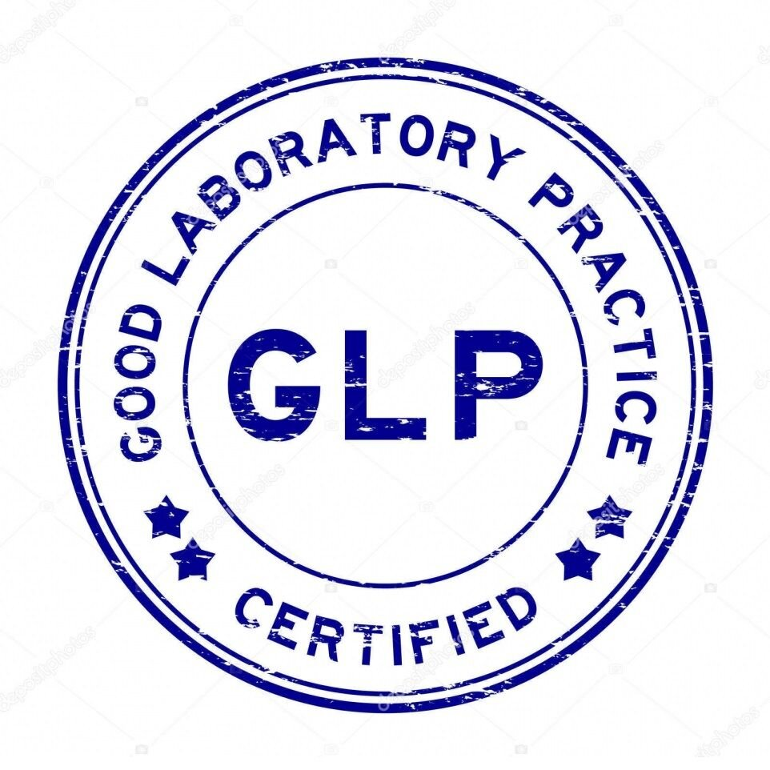
Introduction to Laboratory Safety
and Good Laboratory Practice (GLP)
L:Zahraa A.
A.L.Mustafa M. Nouri
A.L.Lamyaa Gh. Fejer

Slide 2
What is Laboratory Safety?
Laboratory safety and Good Laboratory Practice (GLP) are essential to ensuring the integrity, reliability, and reproducibility of scientific research, particularly in regulated non-clinical studies involving pharmaceuticals, chemicals, pesticides, and other products that affect human health and the environment.
Laboratory safety encompasses the policies, procedures, and practices designed to protect personnel, equipment, and the environment from hazards associated with laboratory work.

Slide 3
Key elements of Laboratory Safety
Personal Protective Equipment (PPE): Use of lab coats, gloves, safety glasses, and other gear to minimize exposure to hazardous materials.·
Chemical Safety: Proper handling, storage, and disposal of chemicals, including the use of Safety Data Sheets (SDS).·
Equipment Safety: Regular maintenance, calibration, and validation of laboratory equipment to prevent accidents and ensure accurate results.·

Slide 4
Key elements of Laboratory Safety
Emergency Preparedness: Availability of eyewash stations, showers, fire extinguishers, and clear evacuation procedures.
Training: Ongoing education for laboratory personnel on safety protocols, hazard communication, and emergency response.

Slide 5
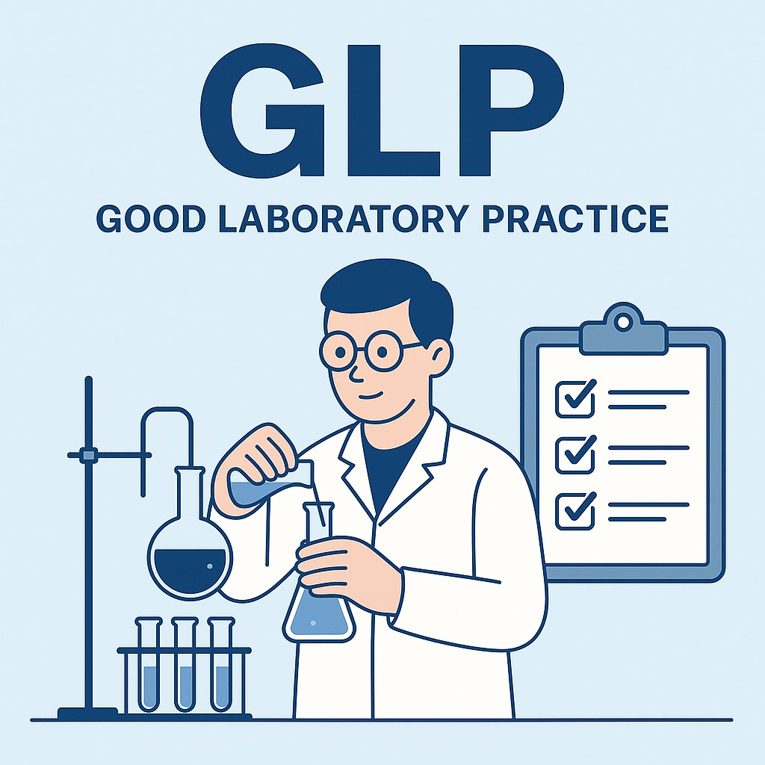
Good Laboratory Practice (GLP)
GLP (Good Laboratory Practice) is a system that ensures the accuracy, reliability, and quality of data in laboratories through standardized procedures and proper documentation.

Slide 6
Key principles of GLP
Organization and Personnel: Clear roles and responsibilities, adequate training, and defined management structure.
Quality Assurance (QA): Independent monitoring of studies and facilities to ensure compliance with GLP.
Facilities: Suitable size, design, and location to prevent cross-contamination and ensure study integrity.

Slide 7
Key principles of GLP
Apparatus and Materials: Proper calibration, maintenance, and validation of equipment and reagents.
Test and Reference Items: Proper receipt, identification, storage, and handling.
Standard Operating Procedures (SOPs): Documented procedures for all critical activities.

Slide 8
Key principles of GLP
Performance of the Study: Adherence to study plans, accurate data recording, and management of deviations., Reporting of Results and Archiving.

Slide 9
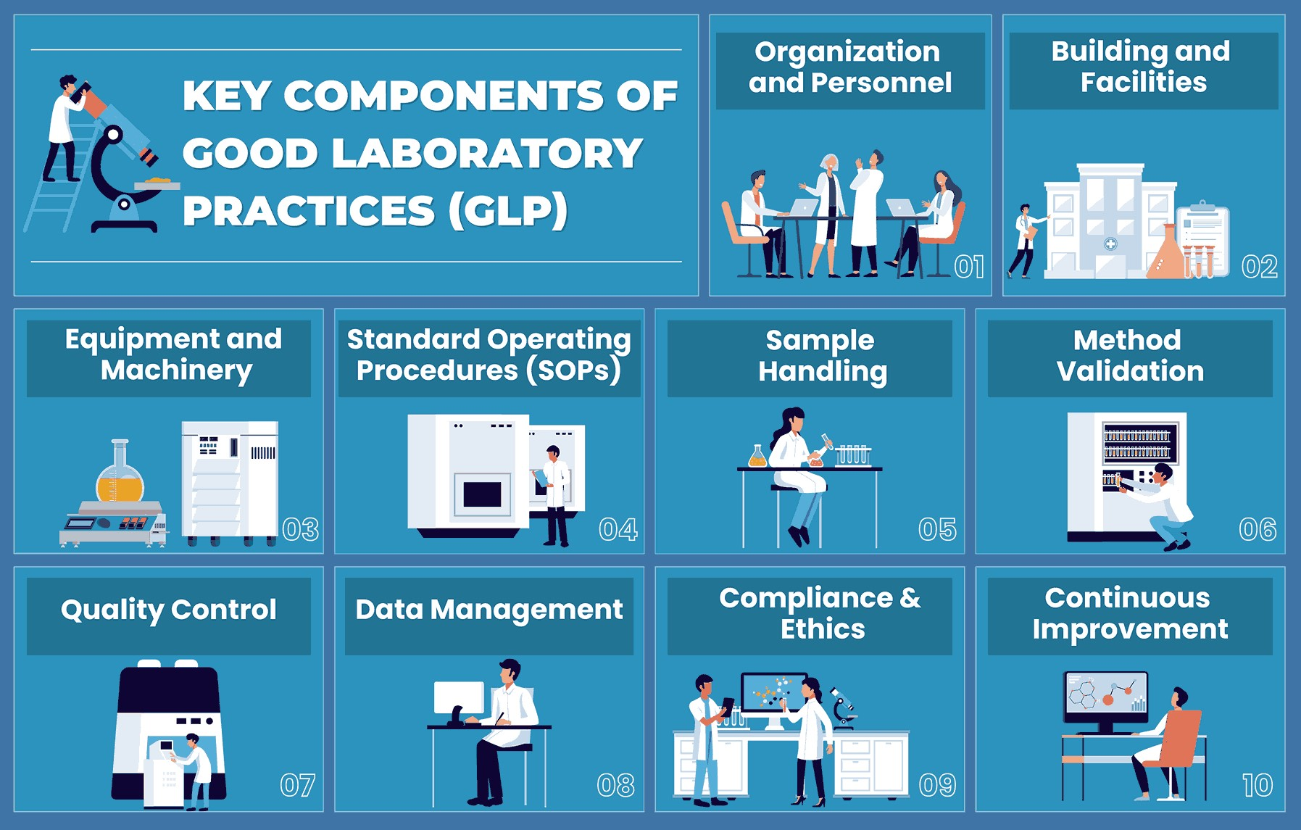

Slide 10
Why GLP and Safety Matter
Regulatory Compliance: GLP is required for studies submitted to regulatory agencies for product registration.
Data Integrity: Ensures that data are credible, reproducible, and defensible.
International Acceptance: Facilitates mutual acceptance of data across countries, reducing duplicate testing

Slide 11
Why GLP and Safety Matter
Ethical Responsibility: Protects human health, animal welfare, and the environment.
Operational Excellence: Promotes efficiency, reduces errors, and enhances the overall quality of research.

Slide 12
Conclusion
Adhering to both laboratory safety protocols and GLP principles is essential for any research institution aiming to produce valid, reliable, and internationally accepted scientific data. Together, they form the foundation of responsible and reputable scientific practice

Slide 13
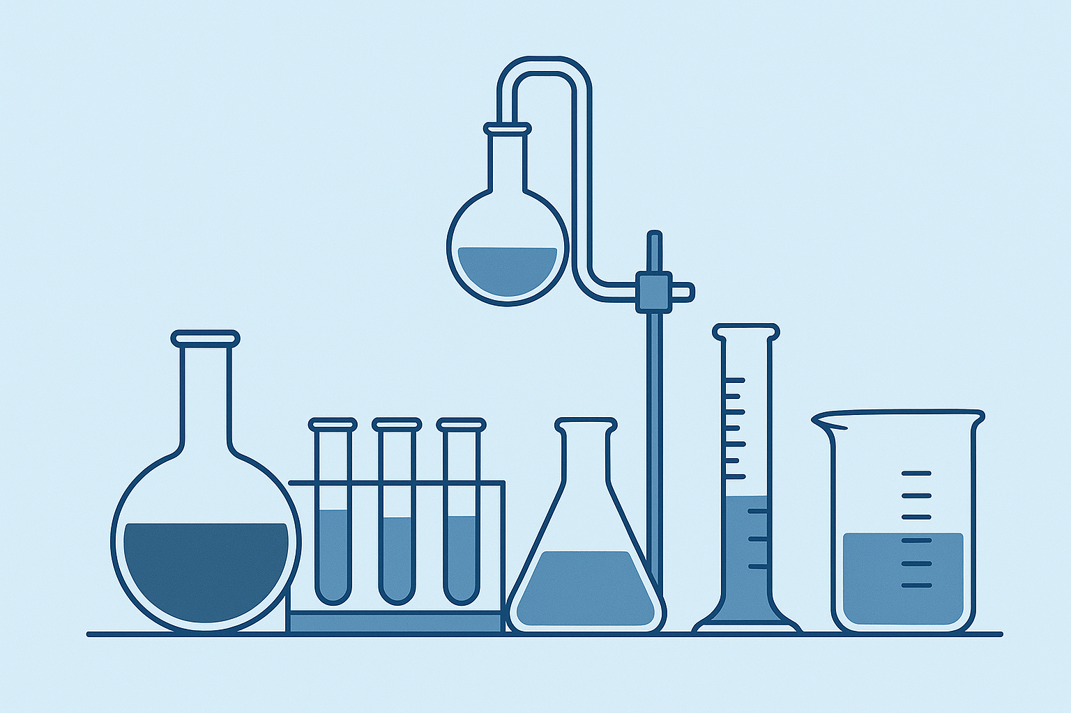
Thank you

