Slide 1
Experiment-1
Fundamentals of Spectrophotometer
Assay of sodium salicylate by calibration curve method
Outcomes: -
After completing this experiment, the student should be able to:
1. Prepare standard solutions of sodium salicylate.
2. Construct a calibration curve based on Beer-Lambert’s Law.
3. Use Beer-Lamber’s Law to determine molar absorptive.
4. Explain the fundamental principle behind spectrophotometric analysis

Slide 2
Introduction: -
Most analytical methods require calibration {a process that relates the measured analytical signal to the concentration of analyte (the substance to be analyzed)}, the three most common analysis methods include the preparation and use of a calibration curve, the standard addition method, and the internal standard method. In this experiment, we will use a spectrophotometer to prepare a calibration curve for the quantitative analysis of sodium salicylate.

Slide 3
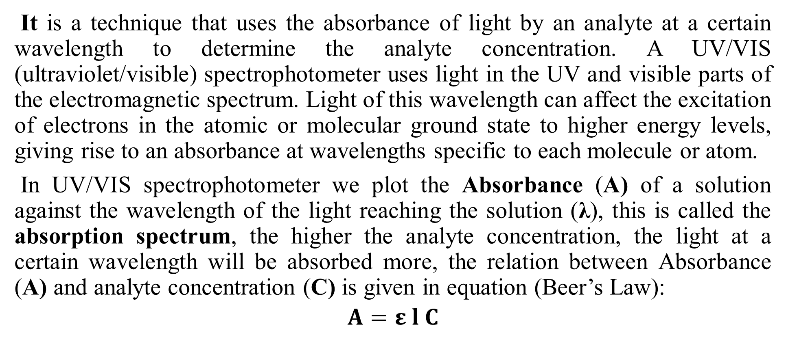
Spectrophotometer:
It is a technique that uses the absorbance of light by an analyte at a certain wavelength to determine the analyte concentration. A UV/VIS (ultraviolet/visible) spectrophotometer uses light in the UV and visible parts of the electromagnetic spectrum. Light of this wavelength can affect the excitation of electrons in the atomic or molecular ground state to higher energy levels, giving rise to an absorbance at wavelengths specific to each molecule or atom.
In UV/VIS spectrophotometer we plot the Absorbance (A) of a solution against the wavelength of the light reaching the solution (λ), this is called the absorption spectrum, the higher the analyte concentration, the light at a certain wavelength will be absorbed more, the relation between Absorbance (A) and analyte concentration (C) is given in equation (Beer’s Law):
$$A=ε l C$$

Slide 4
The absorption spectrum:
We place a cuvette filled with a sample solution in the cell holder (blank solution than sample solution), the instrument will record the light intensity and absorbance relative to the light intensity that passes through the blank solution alone (the Absorbance to zero), this must be repeated at different wavelengths to obtain the spectrum of the dissolved solute (A vs. λ) absorption spectrum, from absorption spectrum we find the wavelength with the highest absorbance, the wavelength of the absorption peak (λ_{max}), at this wavelength the spectrophotometric method is most sensitive for the analyte, next we determine the absorbance (A) at λ_{max} for several standard solutions of different concentration.

Slide 5
The calibration curve method:
To use the calibration curve method, several standards containing exactly known concentrations of the analyte are introduced into an instrument, and the instrumental response is recorded, ordinarily this response is corrected for instrument output obtained with a blank, ideally, the blank contains all of the components of the original sample except for the analyte, always starting with the lowest concentration, from these absorbance values, the resulting data are then plotted to give a graph of corrected instrument response versus analyte concentration, and this graph (calibration curve) in turn can be used to find the concentration of an unknown.

Slide 6
Sodium salicylate
A sodium salt of salicylic acid. It can be prepared from sodium phenolate and carbon dioxide under higher temperatures and pressure. Historically, it has been synthesized by refluxing methyl salicylate (wintergreen oil) with an excess of sodium hydroxide. Sodium salicylate is of the salicylate family. Sodium salicylate is used in medicine as an analgesic and antipyretic. It also acts as a non-steroidal anti-inflammatory drug (NSAID) and induces apoptosis in cancer cells, and necrosis. It is also a potential replacement for aspirin for people sensitive to it. It may also be used as a phosphor to detect vacuum ultraviolet radiation and electrons.

Slide 7
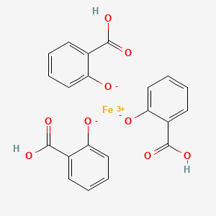
Materials and Equipment:
UV/VIS spectrophotometer and polystyrene cuvettes or quartz cuvettes (Absorption cells).
Pipette, (5.00mL) volumetric flasks, beakers.
Ferric nitrate, Nitric acid, sodium salicylate.

Slide 8
Prepare solutions in 5mL volumetric flasks, then fill to the mark with D.W., as follows: -
Table (1) for calibration curve
Type of Soln. | Vol. of Standard Soln. (mL) | Vol. of FeNO₃ dilute (mL) | Concentration (mg/L) | Absorbance (A)
Blank | 0 | 1
No.1 | 1 | 1
No. 2 | 2 | 1
No. 3 | 3 | 1
No. 4 | 4 | 1
Unknown 2 mL | 0 | 1

Slide 9
Measuring the absorption spectrum and determining λ_{max}: -
Prepare a graph of absorbance (A) vs. wavelength (λ) and determine λ_{max} (maximum wavelength). Attach this graph to the lab report, (Plotting Use the program Excel to plot the absorption spectrum and determine λ_{max}).
Measuring the calibration curve and determining Unknown concentration: -
Draw a plot having the X-axis as concentration (mg/L) and the Y-axis as Absorbance at λ_{max} (Plotting Use the program Excel to plot the calibration curve).
Use Beer’s law to calculate ε for Sodium Salicylate, given path length l to be 1 cm.
Use a calibration curve to calculate the concentration of an unknown solution.
Find an application for a calibration curve equation, to calculate the concentration of unknown solution.

Slide 10
Thank you for listening

