Slide 1
The Common Cold & Pharyngitis
Dr. Haider Raheem Mohammad

Slide 2

Respiratory System
• Diseases of the respiratory tract are among the most common reasons for consulting a general practitioner (GP). The average GP sees approximately 700 to 1000 patients each year with respiratory disease. Although respiratory disease can cause significant morbidity and mortality, the vast majority of conditions are minor and self-limiting.

Slide 3
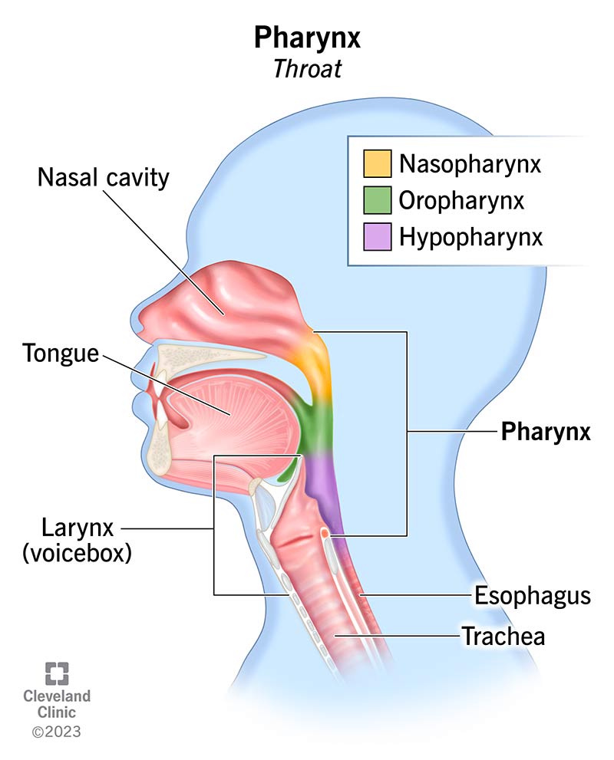
Upper Respiratory Tract
• The upper respiratory tract comprises those structures located outside the thorax – the nasal cavity, pharynx and larynx.

Slide 4
Lower Respiratory Tract
• The lower respiratory tract is located almost entirely within the thorax. It is comprised of the trachea, bronchial tree and lungs.
Anatomy of the lower respiratory tract.

Slide 5
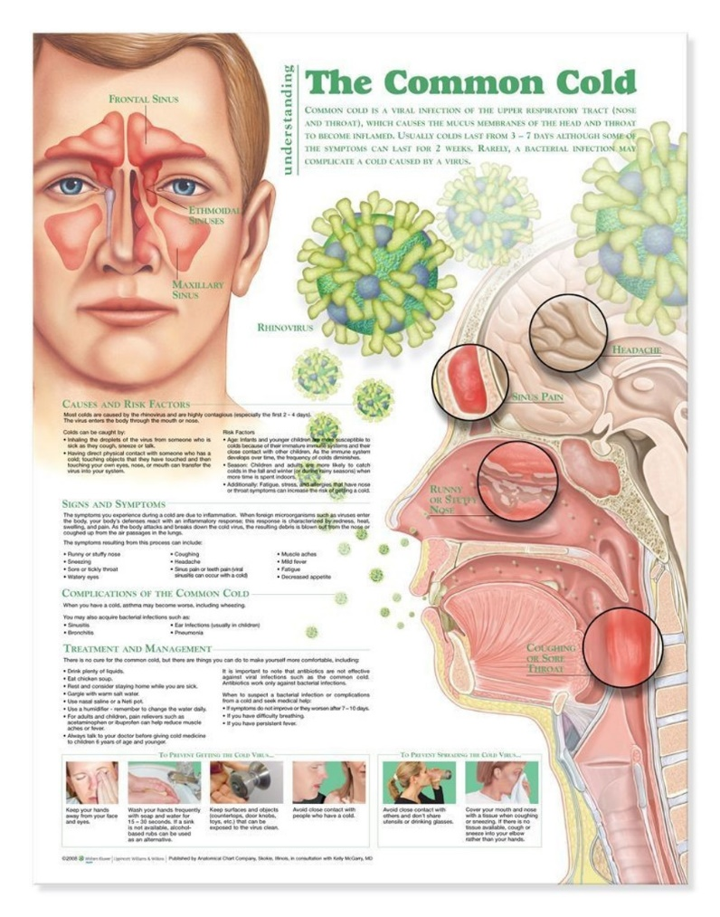
The Common Cold
• The common cold is an upper respiratory syndrome of rhinorrhea and nasal obstruction, frequently accompanied by sore throat, sneezing, and cough. This viral syndrome is among the most common illnesses of humankind.
• Colds, along with coughs, represent the largest caseload for primary healthcare workers.
• Because the condition has no specific cure and is self-limiting, with two-thirds of sufferers recovering within 1 week, it would be easy to dismiss the condition as unimportant.

Slide 6
Prevalence and Epidemiology
• The common cold is extremely prevalent and, like cough, is caused by a viral URTI.
• Children contract colds more frequently than adults, with on average 5 to 6 colds per year compared with 2 to 4 colds in adults, although in children this can be as high as 12 colds per year.
• In the UK, colds peak in December and January, possibly due to increased crowding indoors during cold weather.

Slide 7
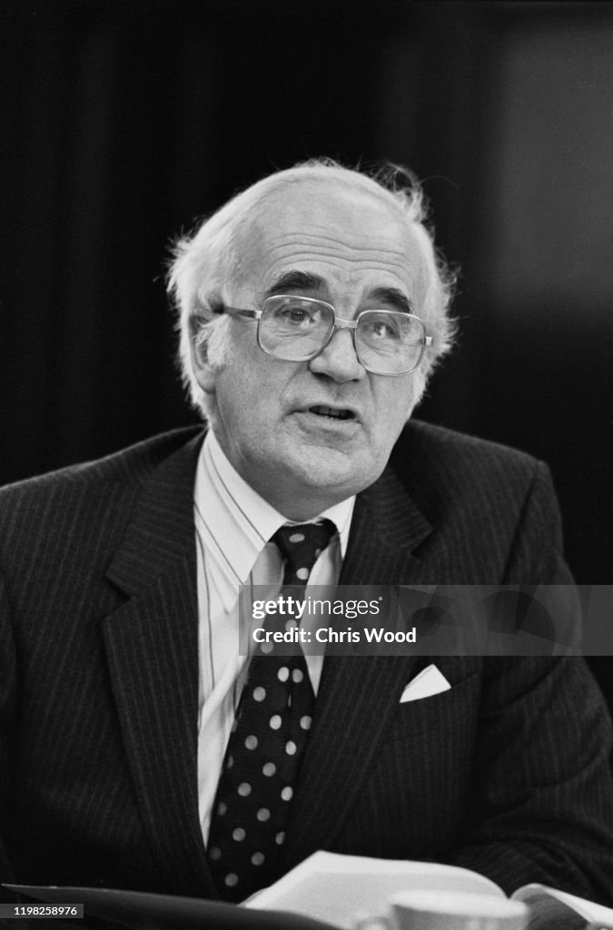
Aetiology (Causes)
• More than 200 subtypes of viruses can produce symptoms of the common cold, including rhinoviruses (accounting for 30%–50% of all cases), coronaviruses, parainfluenza virus, respiratory syncytial virus, and adenovirus.
Human coronaviruses were discovered by David A.J. Tyrrell and colleagues during cold epidemics in 1965. Electron micrographs revealed virus particles that are surrounded by an envelope containing embedded proteins, which confer on them the appearance of a “halo” (Latin, corona).

Slide 8
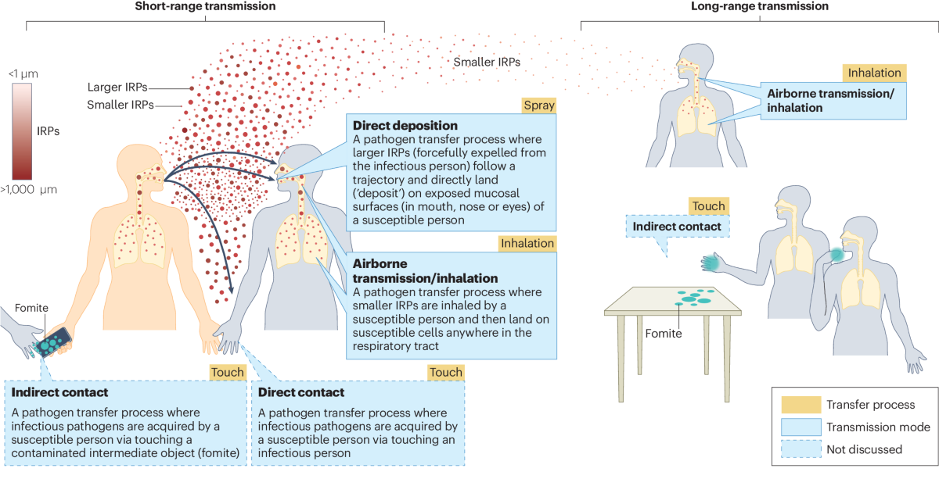
Transmission
• Transmission is primarily by the virus coming into contact with the hands, which then touch the nose, mouth and eyes (direct contact transmission).
• Droplets shed from the nose coat surfaces such as door handles and telephones. Cold viruses can remain viable on these surfaces for several hours.

Slide 9
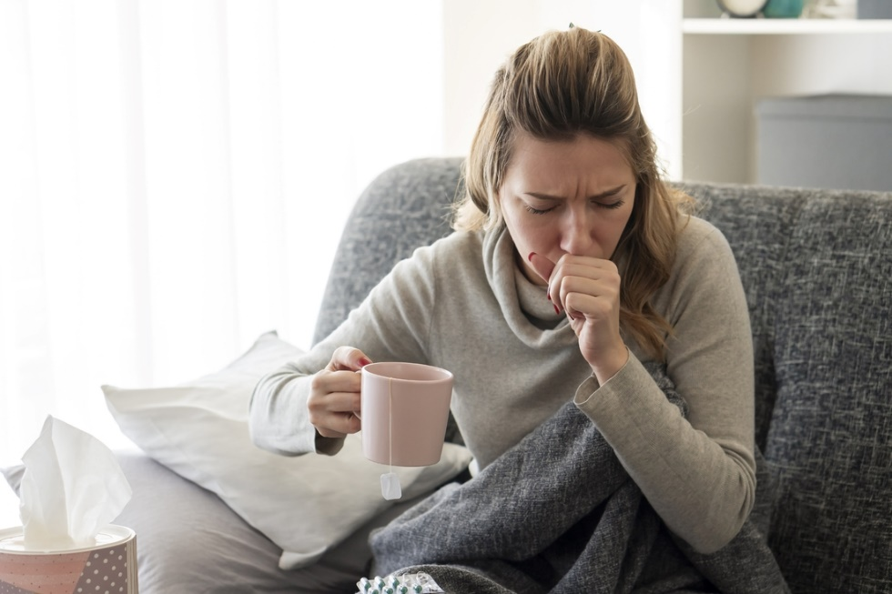
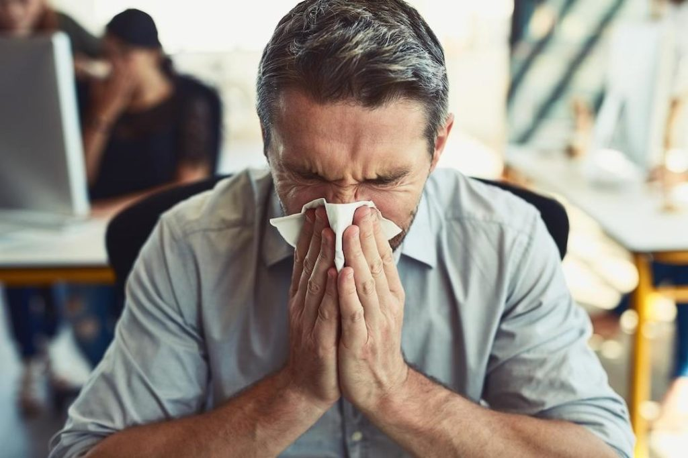


Transmission
• Transmission by coughing and sneezing does occur.
• This is why good hygiene (washing hands frequently and using disposable tissues) remains the cornerstone of reducing the spread of colds.
Colds are most contagious during the first 1 to 2 days of symptoms.
At home
At work

Slide 10
Pathophysiology
• Once the virus is exposed to the mucosa, it invades the nasal and bronchial epithelia, attaching to specific receptors and causing damage to the ciliated cells.
• This results in the release of inflammatory mediators, which, in turn, leads to inflammation of the tissues lining the nose.
• Permeability of capillary cell walls increases, resulting in oedema, which is experienced by the patient as nasal congestion and sneezing.
• Fluid might drip down the back of the throat, spreading the virus to the throat and upper chest, causing cough and sore throat.

Slide 11
Clinical Features (Signs & Symptoms)
• Symptoms of the common cold are well known.
• Following an incubation period of between 1 and 3 days (although this can be as short as 10–12 hours), the patient develops a sore throat and sneezing, followed by profuse nasal discharge and congestion.
• Cough and upper airway cough syndrome (UACS) commonly follow.
• In addition, headache, mild to moderate fever (<38.9°C), and general malaise may be present.
Most colds resolve in 1 week, but up to 25% of people will have symptoms lasting 14 days or more.

Slide 12
Severe colds can mimic symptoms of flu.

Slide 13
Diagnosis & Differential Diagnosis
Most people will accurately self-diagnose a common cold.

Slide 14
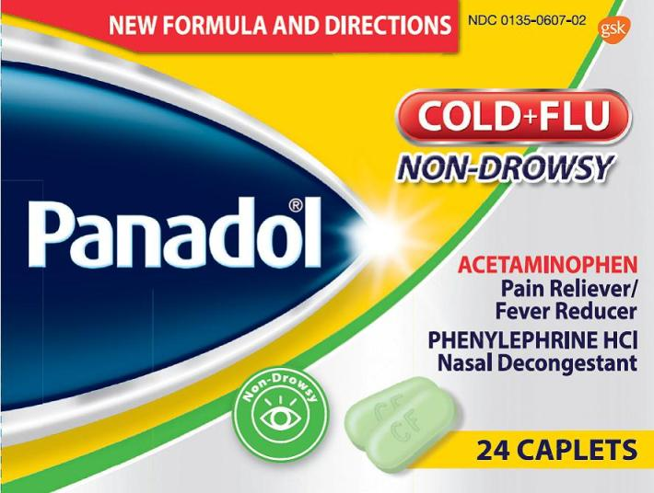
Treatment
• Many of the active ingredients found in cold remedies are also constituents of cough products. Often, they are combined and marketed as cough and cold or flu remedies.
• Chemoprophylaxis or immunoprophylaxis is generally not available for the common cold.

Slide 15
Multiingredient Preparations
• There is no shortage of cold and flu remedies marketed. Many combine three or more ingredients.
• In most cases, the patient will not require all the active ingredients to treat symptoms, or the ‘drug cocktail’ administered will not contain active ingredients that have proven efficacy.
• All four combinations (antihistamine-analgesic-decongestant, analgesic-decongestant, analgesic-antihistamine, and decongestant-antihistamine) were effective, although they had an increased risk of adverse effects, in particular analgesic-decongestant formulations.

Slide 16
Antihistamines
• A Cochrane review found that antihistamines when used as monotherapy had a small effect on nasal congestion, rhinorrhea or sneezing in older children and adults on the first 2 days of treatment but did not have significant benefit with midterm (3–4 days) or long-term (6–10 days) use.
• Only two trials were evaluated in young children, with conflicting results. However, the larger study, which was more robustly conducted, showed no benefit of antihistamines on the common cold.
• First-generation antihistamines are now included in relatively few cough and cold remedies.

Slide 18
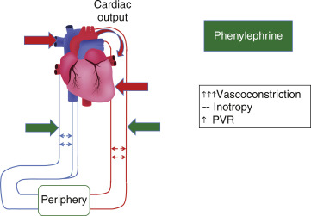
Sympathomimetics
• Sympathomimetics serve to constrict dilated blood vessels and swollen nasal mucosa, easing congestion and helping breathing.
• systemic sympathomimetics can also increase blood pressure, which might, although unlikely with short courses of treatment, alter control of blood pressure in hypertensive patients and disturb blood glucose control in diabetics.
• A topical sympathomimetic could be given to such patients to negate this potential interaction.

Slide 19
Sympathomimetics
• The most likely side effects of sympathomimetics are insomnia, restlessness, and tachycardia.
• Patients should be advised not to take a dose just before bedtime because their mild stimulant action can disturb sleep.

Slide 20
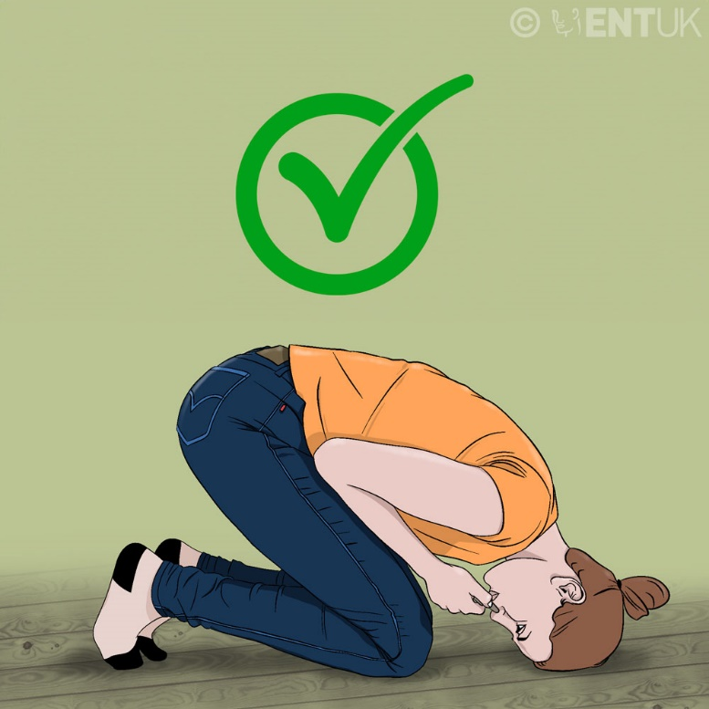
Nasal Sympathomimetics
• Nasal administration of sympathomimetics represents the safest route of administration.
• They can be given to most patient groups, including pregnant women after the first trimester and patients with preexisting heart disease, diabetes, hypertension, and hyperthyroidism.
The best way to administer nose drops is to have the head in the downward position facing the floor. Tilting the head backward and towards the ceiling is incorrect because this facilitates the swallowing of the drops.

Slide 22
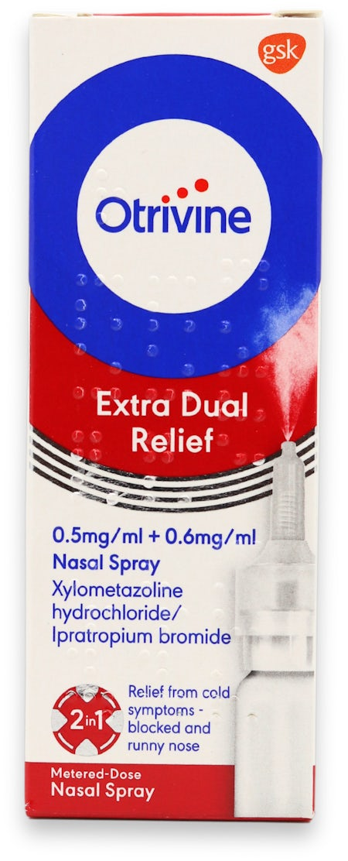
Anticholinergic-Decongestant Combination
• In 2017, ipratropium was reclassified to allow OTC sales. It is available as a combination product with xylometazoline.
• It is licensed for the symptomatic treatment of nasal congestion and rhinorrhoea in connection with common colds in people over 18 years.
• Dosing is one puff in each nostril three times a day. It should be restricted to a maximum of 7 days’ use (presumably because of the potential for rebound effects associated with xylometazoline).
• Side effects include nasal dryness and nose bleeds.

Slide 23
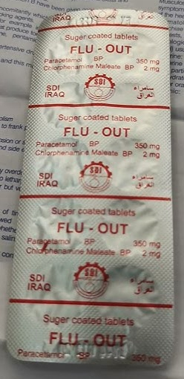
Alternative Medicine
• Zinc lozenges
• Vitamin C (preventive treatment)
Vitamin C has been widely recommended as a cure for the common cold. However, controversy still remains whether it is effective in combating the common cold.
• Echinacea (preventive treatment)
• Vapour inhalation
Steam inhalation has long been advocated to aid relief of symptoms of the common cold, usually with the addition of menthol crystals.
• Saline sprays
• Garlic (preventive treatment)
Several compound cold treatments contain vitamin C in the range 40–300 mg per dose (100 mg in FLU-OUT tablets in old days).

Slide 24
Complications
• Complications of the common cold include bacterial superinfections of the upper respiratory tract, such as acute otitis media and acute sinusitis, and exacerbations of asthma.

Slide 25
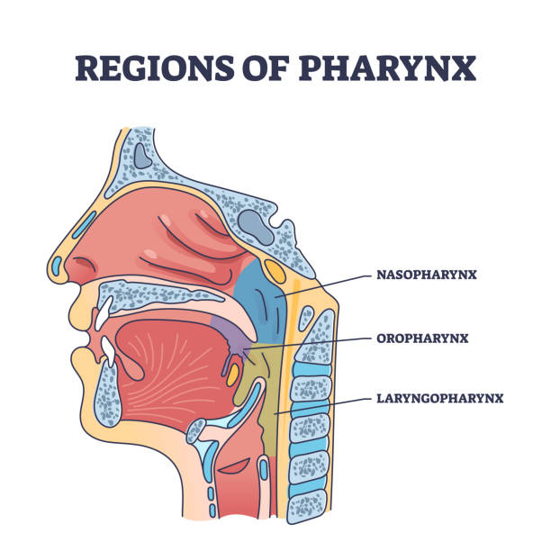
Pharynx
• The pharynx is a tubelike structure approximately 12 cm long that serves as a common pathway for the respiratory and digestive tracts.
• It has three anatomical divisions – the nasopharynx, oropharynx and laryngopharynx.
• It is lined with a ciliated mucous membrane that helps with the removal of dust particles as to does the larynx.
• It also affects speech production by changing shape to allow vowel sounds to be formed.

Slide 26
Pharyngitis (Sore Throats)
• Any part of the respiratory mucosa of the throat can exhibit symptoms of pain.
• This includes the pharynx (pharyngitis) and tonsils (tonsillitis), yet clinical distinction between pharyngitis and tonsillitis is unclear.
• Pain can range from irritation to severe pain.
• Sore throats are often associated with the common cold.

Slide 27
Prevalence and Epidemiology
• Sore throats are extremely common.
• Four to six times as many people will visit the pharmacy and self-treat.
• On average, an adult will experience two to three sore throats each year.

Slide 28
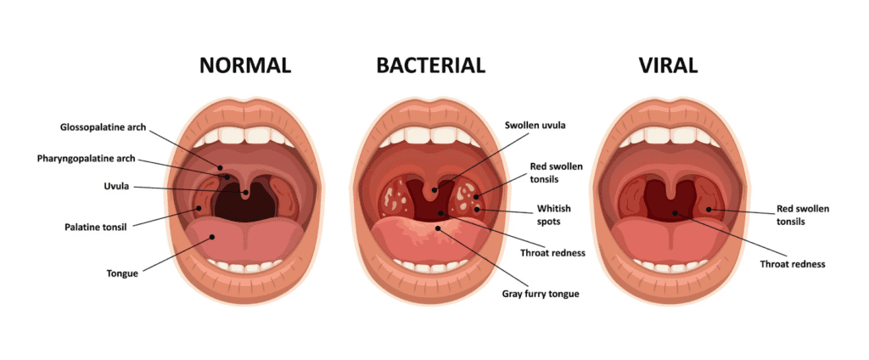
Aetiology (Causes)
• Viral infection accounts for between 70% and 90% of all sore throat cases.
• Remaining cases are nearly all bacterial, with the most common cause being group A beta-haemolytic Streptococcus (also known as Streptococcus pyogenes).

Slide 29
Clinical Features (Signs & Symptoms)
• Acute pharyngitis is characterized by the rapid onset of sore throat and pharyngeal inflammation (with or without exudate).
• Patients will present with a sore throat as an isolated symptom or as part of a cluster of symptoms that include rhinorrhoea, cough, malaise, fever, headache and hoarseness (laryngitis).
Symptoms are relatively short-lived, with 40% of people being symptom free after 3 days and 85% of people symptom free after 1 week.

Slide 30
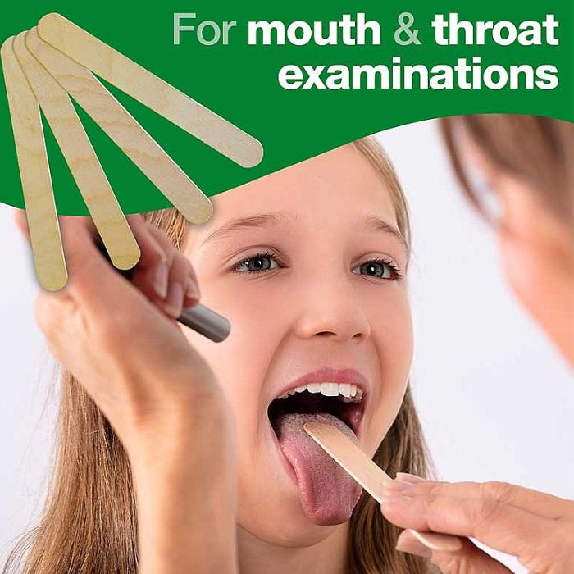
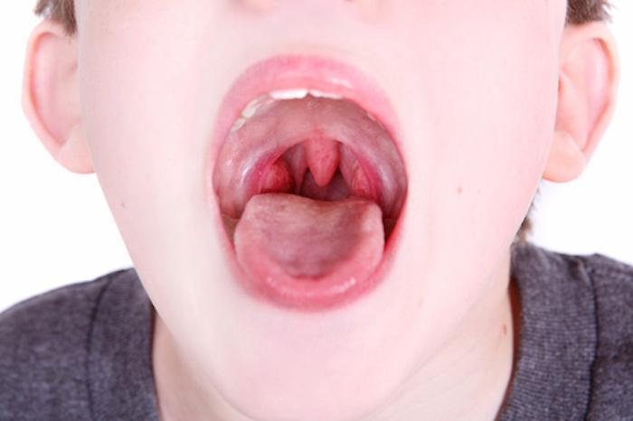
Physical Examination
• The examination requires a good light source (e.g., pen torch). These steps should be followed:
1. Get the person seated so that the examiner can be at eye level.
2. Ask the patient to say ‘ah’; this should allow you to see the posterior throat. Pay particular attention to the size of the tonsils. Are they red and swollen? Is there any exudate present? Is there any sign of ulceration?
3. Check for the posterior wall of the throat. It should appear pink and moist, without exudate or lesions when healthy. Redness or exudate suggests pharyngitis.

Slide 31
Diagnosis & Differential Diagnosis
• The overwhelming majority of cases will be acute and self-limiting, whether viral or bacterial in origin.
Clinically, differentiation between viral and bacterial infection is extremely difficult, although specific symptom clusters are suggestive for sore throat of bacterial origin, but these are not foolproof.

Slide 32
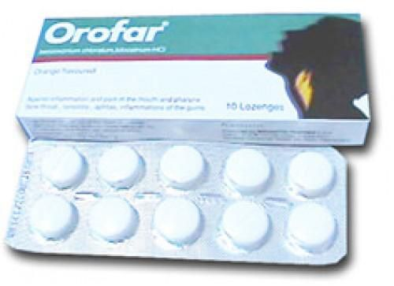
Treatment
• Because most sore throats are viral in origin and self-limiting, medication aims to relieve symptoms and discomfort while the infection runs its course.
• Lozenge and spray formulations incorporating antibacterial and anaesthetics provide the mainstay of treatment.
• In addition, systemic analgesics and antipyretics will help reduce the pain and fever associated with sore throat.

Slide 33
Local Anaesthetics (Lidocaine, Benzocaine)
• All local anaesthetics have a short duration of action, and frequent dosing is required to maintain the anaesthetic effect, whether formulated as a lozenge or spray.
• They appear to be free from any drug interactions, have minimal side effects, and can be given to most patients, including pregnant and breastfeeding women.
• Most products do contain a sugar base, but the amount of sugar is too small to affect blood glucose control substantially and therefore can be recommended to diabetic patients.

Slide 34
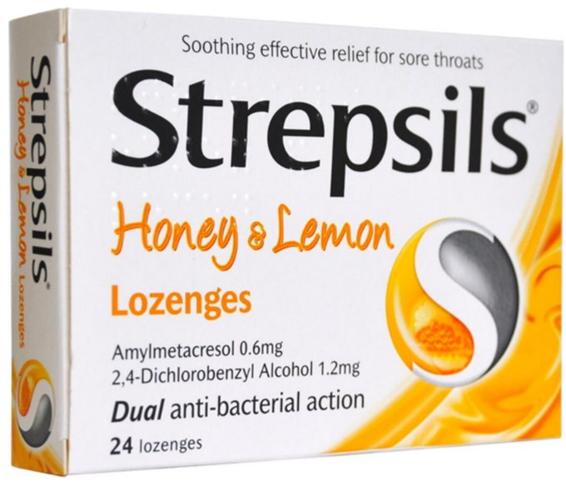
Antibacterial and Antifungal Agents
• Antibacterial agents include chlorhexidine, tyrothricin, dequalinium chloride, and benzalkonium chloride.
• The use of antibacterial and antifungal agents should not be routinely recommended because the vast majority of sore throats are caused by viral infections against which they have no action.
• However, because adverse effects are rare, and stimulation of saliva from sucking the lozenge may confer symptomatic relief, the use of such products may possibly be justified.

Slide 35
Antibacterial
• Treatment is with oral penicillin (or erythromycin in penicillin-allergic
patients) for 10 days, or with a single intramuscular dose of benzathine penicillin.
• Cephalosporins are very effective in eradicating streptococci, and cefdinir and cefpodoxime have Food & Drug Administration (FDA) approval for 5-day treatment courses, as does the macrolide azithromycin.

Slide 36
Antiinflammatories (Benzydamine, Flurbiprofen)
• Benzydamine occasionally causes stinging, in which case the rinse can be diluted with water. The rinse should be used every 1½ to 3 hours when required.
• Strefen lozenges (8.75 mg flurbiprofen) can only be given to adults and children older than 12 years. The dose is one lozenge to be sucked every 3 to 6 hours, with a maximum of five lozenges in 24 hours. They are contraindicated in patients with peptic ulceration.

Slide 37
Analgesics
• There is good evidence to indicate that simple systemic analgesia (e.g., paracetamol, aspirin, ibuprofen) is effective in reducing the pain associated with sore throat.

Slide 38

Thank You

