Slide 1
Diarrhoea & Constipation
Dr. Haider Raheem Mohammad

Slide 2
Diarrhoea
• Diarrhoea can be defined as an increase in frequency of the passage of soft or watery stools relative to the usual bowel habit for that individual.
• Stool weight was previously used to define diarrhoea (> 200 g stool per day), but is no longer recommended as normal stool volumes can exceed this value.
• The World Health Organization (2017) defines diarrhoea as the passage of three or more loose or liquid stools per day.

Slide 3
Diarrhoea
• It is not a disease but a sign of an underlying problem, such as an infection or gastrointestinal disorder.
• It can be classified as acute (<14 days), persistent (>14 days), or chronic (lasting longer than a month).
Macroscopic characteristics of the colon.

Slide 4
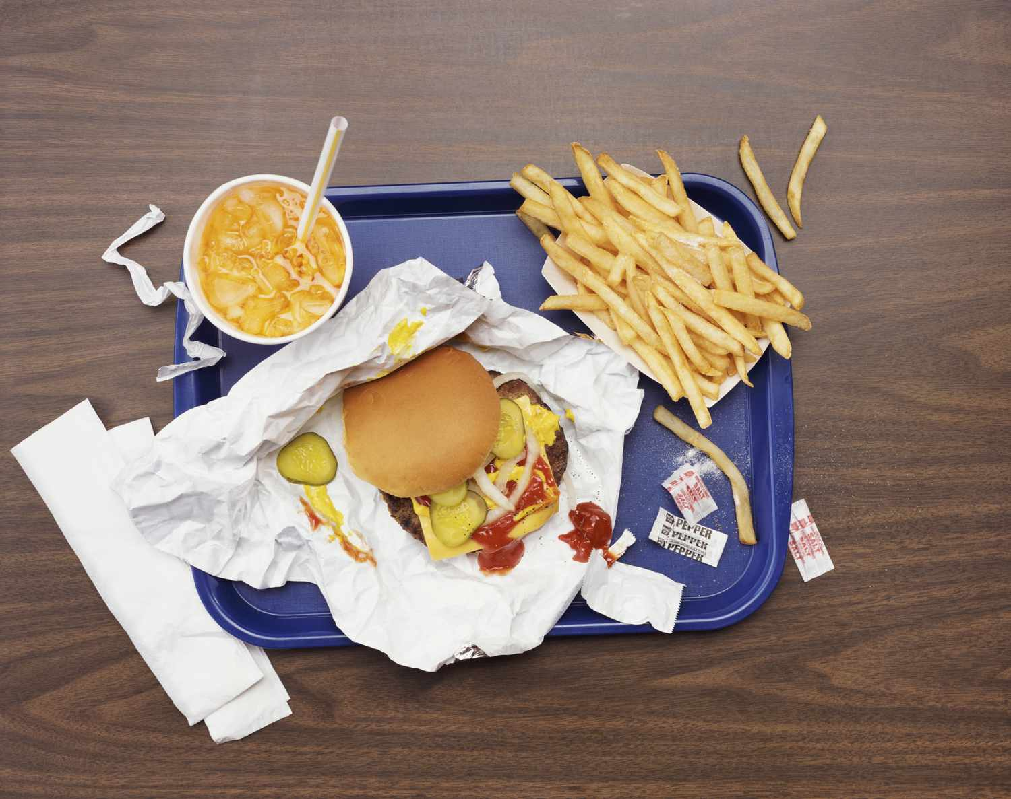
Prevalence and Epidemiology
It has been reported that children under the age of 5 years have between one and three bouts of diarrhoea per year and adults, on average, just under one episode of diarrhoea per year.
Many of these cases are thought to be food-related.

Slide 5
Aetiology
The aetiology of diarrhoea depends on its cause.
Acute gastroenteritis, the most common cause of diarrhoea in all age groups, is usually viral in origin. Commonly implicated viruses are the rotaviruses (now vaccine preventable) and noroviruses.
Viruses tend to cause diarrhoea by blunting the villi of the upper small intestine, decreasing the absorptive surface.

Slide 6
Aetiology
Bacterial causes of diarrhoea are normally a result of eating contaminated food or drink, which cause diarrhoea by a number of mechanisms.
For example, enterotoxigenic Escherichia coli produces enterotoxins that affect gut function with secretion and loss of fluids, enteropathogenic E. coli interferes with normal mucosal function, and enteroinvasive E. coli, Shigella, and Salmonella spp. cause injury to the mucosa of the small intestine and deeper tissues.
Antigenic structure of Enterobacteriaceae.

Slide 8
Physiology
Approximately 8 to 9 L of fluid enters the small bowel in a 24-hour period. This includes 1 to 2 L from dietary consumption, with the remainder produced by salivary, gastric, biliary, pancreatic, and intestinal secretions.
All but 1 to 2 L is absorbed in the small intestine and then enters the colon.
Almost all of this fluid is absorbed as it travels through the colon, leaving less than 200 g/day of stool.
Overall efficiency of water absorption is 99%, and reduction of this efficiency by as little as 1% may lead to diarrhea.
Fluid loads along the GI tract.

Slide 9
Pathophysiology
• Disruption of the absorption of ions, solutes, and water or increased secretion of electrolytes results in water accumulation in the lumen and therefore diarrhea.
• Diarrhea frequently represents a protective response to a variety of intestinal insults and assaults.
• When infectious agents, toxins, or other noxious substances are present in the intestine, fluid secretion and motility are stimulated to expel the unwanted material, thereby producing diarrhea.

Slide 10
Classification of Diarrhoea
Fecal electrolytes and the fecal osmotic gap.

Slide 11
Clinical Features of Acute Diarrhoea
Symptoms are normally rapid in onset, with the patient having a history of prior good health.
Nausea and vomiting might be present before or during the bout of acute diarrhoea. Abdominal cramping, flatulence and tenderness are also often present.
If rotavirus is the cause, the patient might also experience viral prodromal symptoms such as cough and cold.
The most severe symptom in many patients is urgency of defecation, while faecal incontinence can occur in acute and chronic diarrhoeal illnesses.

Slide 12
Clinical Features of Acute Diarrhoea
Acute infective diarrhoea is usually watery in nature, with no blood present.
Complete resolution of symptoms should be observed in 2 to 4 days.
Infective diarrhoea is usually short-lived and patients who present with a history of diarrhoea lasting more than 10 days rarely have an infective cause.
Chronic diarrhoea can be categorised as being caused by disease of the colon or small bowel, or due to malabsorption.
Most patients will present to the pharmacy with a self-diagnosis of acute diarrhoea.

Slide 16

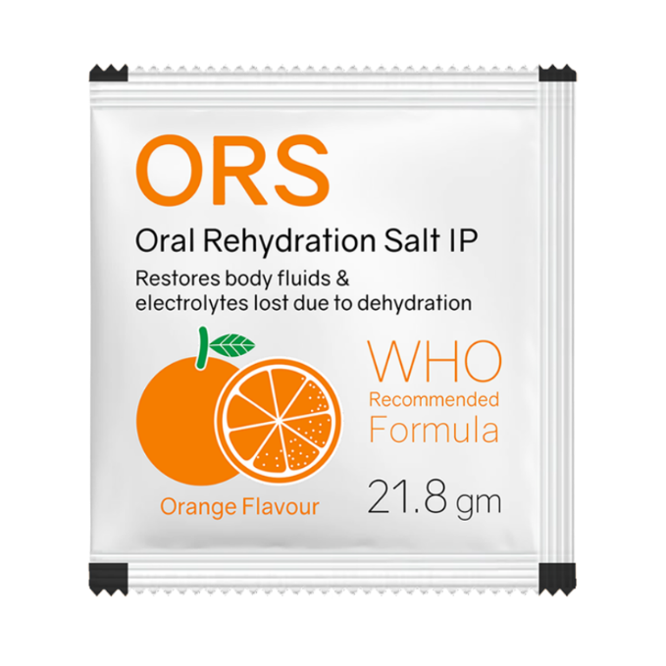
Treatment
Acute infectious diarrhoea still remains one of the leading causes of death in developing countries, despite advances in its treatment.
Goals of OTC treatment are therefore concentrated on the relief of symptoms.
Given that most causes of diarrhoea only last 24 to 48 hours, the main aim of treatment should be to reduce any potential dehydration caused by fluid loss.
Agents that change the motility of the gut to reduce diarrhoea (e.g., loperamide) should be reserved for situations where staying at home and resting would be impractical or inconvenient.

Slide 17
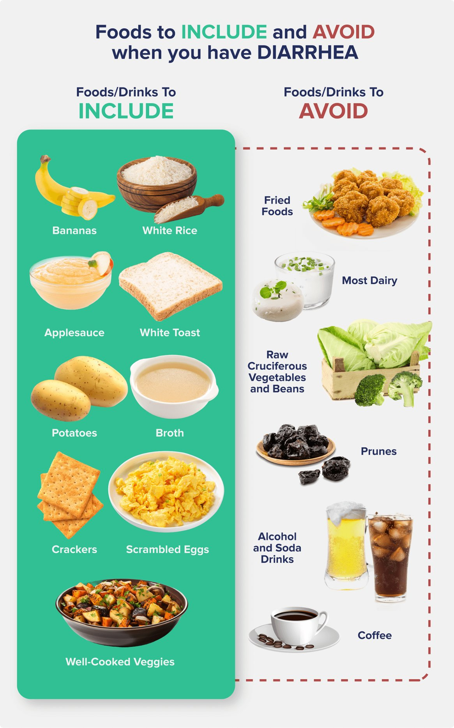
Treatment
Patients with diarrhoea should be advised to drink plenty of clear, non-milky fluids, such as water and diluted squash. If the diarrhoea is severe, ORS may be useful.
ORS should be considered in people who are 60 years of age or older, frail, or with comorbidities, such as cardiovascular disease or thrombotic tendencies (e.g. with a history of deep vein thrombosis).
The patient can be advised to continue their usual diet, but fatty foods and foods with a high sugar content might be best avoided as they may not be well tolerated. Light soup is a good compromise.

Slide 18
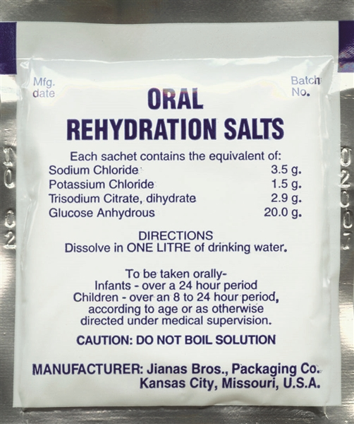
Oral Rehydration Solution (ORS)
It has proved to be a simple, highly effective treatment, which has decreased mortality and morbidity.
The formula recommended by WHO contains glucose (75 mmol/L), sodium (75 mmol/L), potassium (20 mmol/L), chloride (65 mmol/L) and citrate (10 mmol/L) in an almost isotonic fluid.

Slide 19
Oral Rehydration Solution (ORS)
The volume of solution given is dependent on how much fluid is lost.
In adults, 2 L of ORS should be given in the first 24 hours, followed by unrestricted normal fluids, with 200 mL of rehydration solution per loose stool.
The solution is best sipped every 5 to 10 minutes rather than drunk in large quantities less frequently.
In infants, 1 to 1.5 times the usual feed volume should be given.

Slide 20
Loperamide
Loperamide is a synthetic opioid analogue that is thought to exert its action via opiate receptors.
It slows intestinal tract time increasing the water resorbing capacity of the gut.
The dose is two tablets immediately, followed by one tablet after each further bout of diarrhoea.
It has minimal central nervous system (CNS) side effects.
OTC doses are therefore limited to 16 mg/day and cannot be used in children under 12.

Slide 21
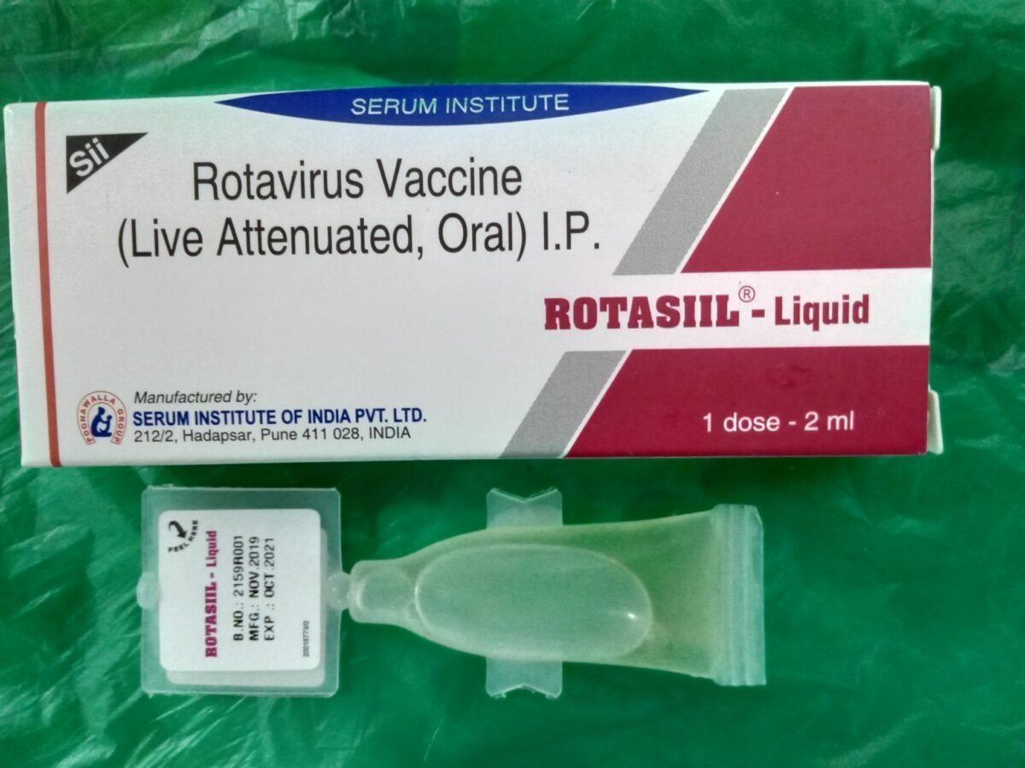
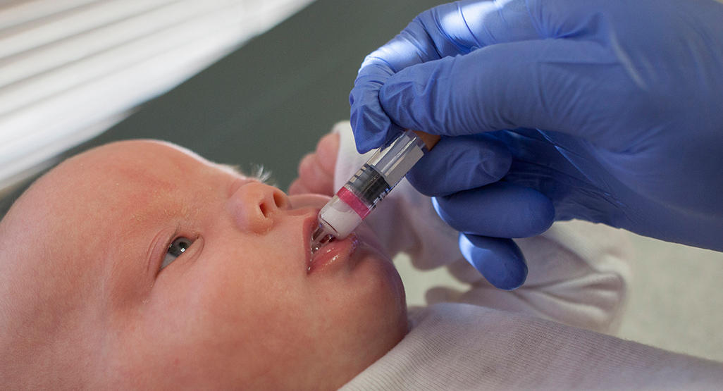
Rotavirus Vaccine
From 2013, the rotavirus vaccine was added to the routine UK childhood vaccination schedule.
The oral vaccine is given as two doses, the first at 2 months and the second at 3 months, alongside other routine childhood vaccinations.
Since its introduction, cases of rotavirus have decreased by more than 80%.

Slide 22
Constipation
Constipation is defined as infrequent passage of hard stools. Patients may also complain of straining, a sensation of incomplete evacuation and either perianal or abdominal discomfort.
Constipation, like diarrhoea, is a symptom rather than a condition.
Constipation can be acute, typically lasting less than 1 week, or chronic, lasting greater than 4 weeks.

Slide 23
Prevalence and Epidemiology
Constipation is very common. It occurs in all age groups but is especially common in older adults.
Many older adults have normal frequency of bowel movements but strain at stool. This is probably a result of a sedentary lifestyle, a decreased fluid intake, poor nutrition, avoidance of fibrous foods and chronic illness.
Women are two to three times more likely to suffer from constipation than men, and 40% of women in late pregnancy experience constipation.

Slide 24
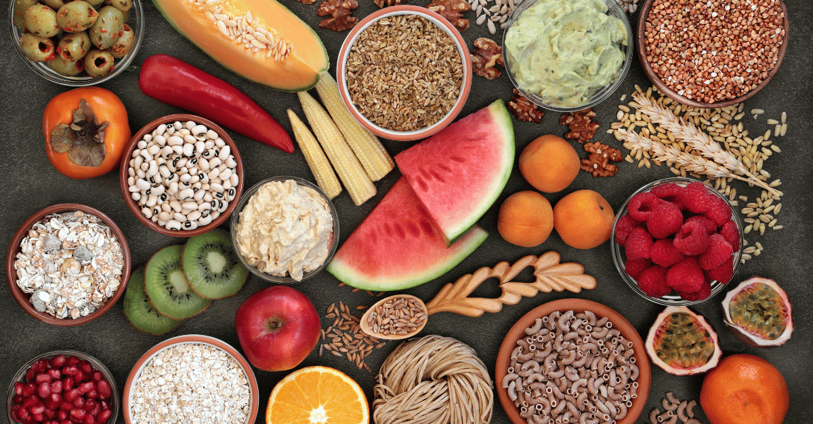
Aetiology
The most common cause of constipation is decrease in intestinal tract transit time of food, which allows greater water resorption from the large bowel, leading to harder stools that are more difficult to pass.
This is usually caused by a deficiency in dietary fibre, a change in lifestyle and/or environment, and medication.
Caffeine can stimulate gut muscles to contract, leading to a bowel motion; however,
it can also aggravate constipation by contributing to dehydration. Patients should therefore
avoid excessive intake of caffeine in coffee, tea and soft drinks.

Slide 25
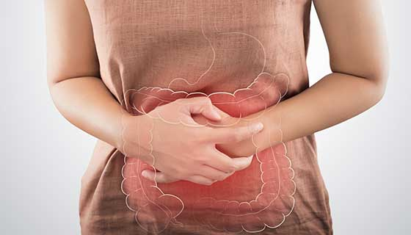
Clinical Features of Constipation
Besides the inability to defecate, patients might also have abdominal discomfort and bloating.
In children, parents might also notice that the child is more irritable and has a decreased appetite.
Specks of blood in the toilet might be present and are usually due to straining at stool.
If blood loss is substantial (stools appear tarry, red or black), referral is needed.

Slide 26
Clinical Features of Constipation
The onset, duration and characteristics are important; for example, a neonatal onset suggests Hirschsprung’s disease, while a recent change in bowel activity in middle age should raise the suspicion of an organic disorder, such as colonic carcinoma.
Lateral view of a barium enema in a 3-yr old girl with Hirschsprung disease. The aganglionic distal segment is narrow, with distended normal ganglionic bowel above it.

Slide 27
Differential Diagnosis
The first thing a pharmacist should do is to establish the patient’s current bowel habit compared with normal.
Constipation does not usually have sinister pathology.
Chronic constipation is normally due to a primary cause, such as dietary intake (e.g. insufficient fibre), lifestyle factors (e.g. sedentary lifestyle) or disorders of rectal evacuation.
Secondary causes of chronic constipation are numerous, including drugs such as opiates, and many disease states, including neurological disorders (e.g., multiple sclerosis, Parkinson disease), metabolic and endocrine conditions (e.g., diabetes, hypothyroidism) and psychological causes (e.g., depression, eating disorders).

Slide 30
Treatment
For uncomplicated constipation, nondrug treatment is advocated as first-line treatment for all patient groups because simple dietary and lifestyle modifications (increasing exercise) will relieve most acute cases of constipation.
Fibre intake should be increased to approximately 30 g/day in the form of fruit, vegetables, cereals, grain foods, and whole-grain bread.

Slide 31
Treatment
It is important to remind patients that adequate fluid intake (2 L/day) is needed when following a high-fibre diet.
Effects of a high-fibre diet are usually seen in 3 to 5 days.

Slide 32
Bulk-forming laxatives
Bulk-forming laxatives exert their effect by mimicking increased fibre consumption, swelling in the bowel and increasing faecal mass.
In addition, they encourage the proliferation of colonic bacteria, and this helps further increase faecal bulk and stool softness.
Patients should be advised to increase their fluid intake while taking bulk-forming medicines.

Slide 33
Bulk-forming laxatives
The effect is usually seen in 12 to 36 hours but can take as long as 72 hours.
Side effects commonly experienced include flatulence and abdominal distension.
They are well tolerated in pregnancy and breastfeeding and have no teratogenic effects.
They appear to have no drug interactions of any note.
Laxatives
Laxatives are milder in action and deal with evacuation of rectum. With use of laxatives, there is elimination of formed stools.
Cathartics
Cathartics are severe in action and deal with evacuation of colon. With their use, liquid form of stool is eliminated.
Purgatives
In between the two.

Slide 34
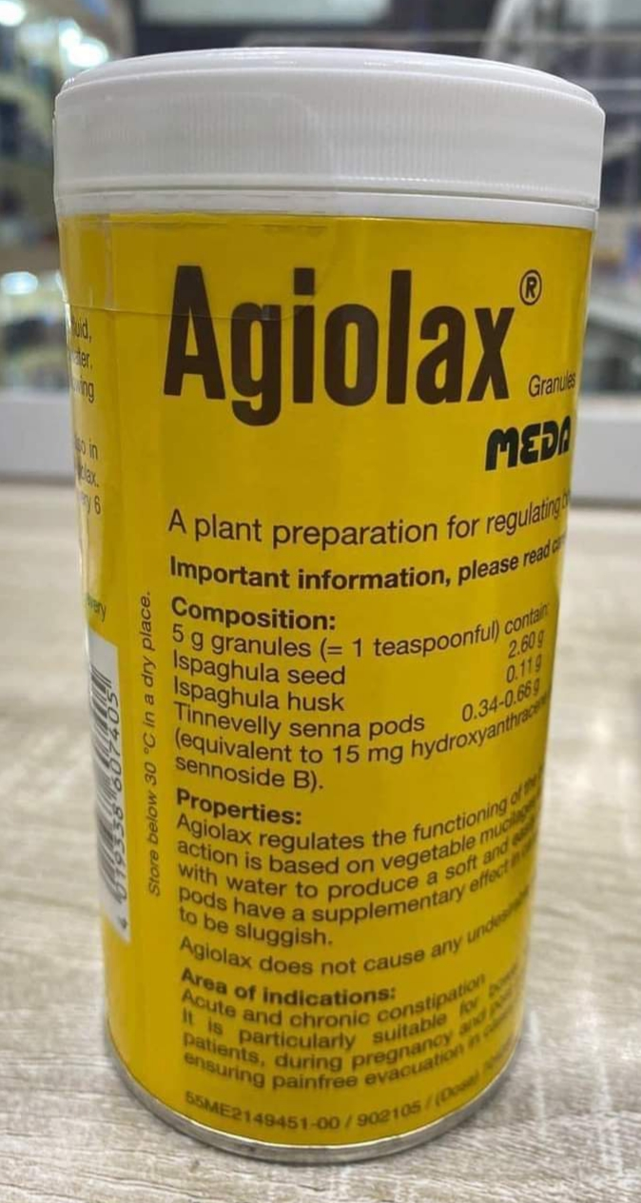

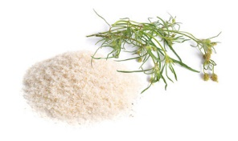
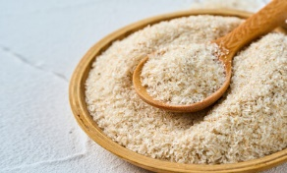
Bulk-forming Laxatives
Ispaghula husk (Fybogel®)
Ispaghula husk has to be reconstituted with water before taking.
Adults should take one sachet or two level, 5-mL spoonsful twice daily; for children between 6 and 12 years, ½ to one, 5-mL spoonful twice daily.
Pod: is a general term used to designate all dry, dehiscent,
apocarpous or syncarpous fruits, as capsules, follicles and
legumes.

Slide 35
Stimulant Laxatives
Stimulant laxatives increase GI motility by directly stimulating the colonic nerves. It is this action that presumably causes abdominal pain and is the main side effect associated with stimulant laxatives.
Additionally, stimulant laxatives are associated with the possibility of nerve damage with long-term use and are the most commonly abused laxatives.

Slide 36
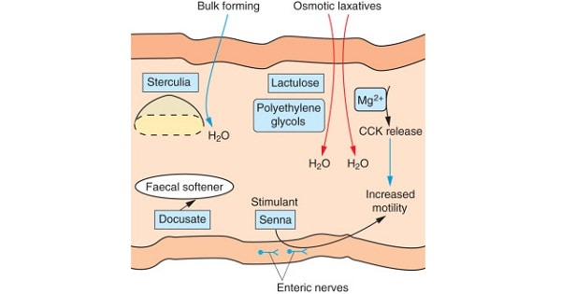
Stimulant Laxatives
Their onset in action is quicker than other laxative classes, with patients experiencing a bowel movement in 6 to 12 hours when taken orally.
They can be taken by all patient groups, have no drug interactions, and are safe in pregnancy and breastfeeding. However, because of their ability to cause muscle contractions, they are best avoided in pregnancy, if possible.

Slide 37
Stimulant Laxatives
Bisacodyl (Dulcolax®)
Bisacodyl is available as tablets or suppositories and can be given to patients older than 4 years. The dose for children is 5 mg (one paediatric suppository) and, for adults and children older than 10 years, the dose is 5 to 10 mg (one or two tablets or one Dulcolax 10-mg suppository).
Glycerol suppositories
Glycerol suppositories are normally used when a bowel movement is needed quickly. The patient should experience a bowel movement in 15 to 30 minutes. The 1-g suppositories are designed for infants, the 2-g for children and the 4-g for adults.

Slide 38
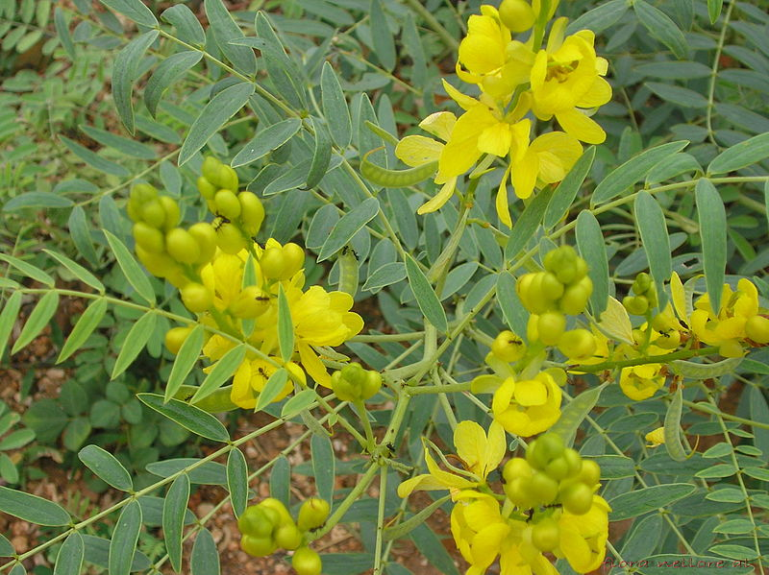
Stimulant Laxatives
Senna (e.g., Senokot®, Ex-Lax Senna®)
Senna is available as syrup, tablets, or granules.
Proprietary products tend to have lower dosing schedules than those advocated in the BNF/BNF-C.
Adults and children older than 12 years should take 15 mg each day (two tablets or 10 mL), preferably at bedtime.
Senna alexandrina

Slide 39
Osmotic Laxatives
These (e.g., lactulose, macrogol [polyethylene glycol] and magnesium salts) act by retaining fluid in the bowel by osmosis or by changing the pattern of water distribution in the faeces.
Flatulence, abdominal pain and colic are frequently reported.
They can be taken by all patient groups, have no drug interactions and are safely used in pregnancy and breastfeeding.

Slide 40
Osmotic Laxatives & Stool Softener
Lactulose
Lactulose is given twice daily for all ages. The dose for adults is initially 15 mL (adjusted upwards depending on response).
It has been reported that up to 20% of patients experience troublesome flatulence and cramps, although these often settle after a few days.
It may take 48 hours or longer to have an effect.
Docusate sodium
Docusate sodium is a nonionic surfactant that has stool softening properties, which allow penetration of intestinal fluids into the faecal mass. It also has weak stimulant properties.
It can be given to children aged 6 months and older.

Slide 41
Constipation in Pregnancy
Constipation commonly occurs during pregnancy; hormonal changes are responsible for this, and it has been estimated that one in three pregnant women suffers from constipation.
Dietary advice concerning the intake of plenty of high-fibre foods and fluids can help.
Oral iron, often prescribed for pregnant women, may contribute to the problem.
Stimulant laxatives are best avoided during pregnancy; bulk-forming laxatives are preferable, although they may cause some abdominal discomfort to women when used late in pregnancy.

Slide 42

Thank you

