Slide 1

Common cold medicines
Assistant lecturer Ola Nassr
12 Nov 2015 MSc Clinical Pharmacy

Slide 2
Prevention
For influenza Prophylaxis, vaccination is recommended for
  high-risk groups
  all persons over 65 years.

Slide 3
There is usually no reason to see a doctor as a cold will clear up on its own within a week or two, and there is no prescription-only medicine that can cure a cold.
Symptoms can be treated with over-the-counter medicines and warm drinks.
Rest, preferably by staying in bed. (flu)
Drink as much as possible, as large amounts of fluid are lost during a fever.

Slide 4
Treatment
  Antibacterial are not effective or appropriate as both infections are viral.
  The same non-prescription medicines are used to treat the symptoms of both the common cold and influenza.
  over-the-counter preparations often contain a combination of ingredients intended to treat two or more symptoms.

Slide 5
Symptoms
Fever and malaise
Rhinorrhea
Nasal congestion
Sore throat
cough

Slide 6
Fever and malaise
  Paracetamol, aspirin and ibuprofen
  Aspirin is restricted in its use by its pronounced side-effect profile.

Slide 7
Nasal congestion and rhinorrhoea
(runny nose)
Sedating antihistamines
  They are usually co-formulated with sympathomimetics to counteract the congestion and the sedation that they tend to cause.

Slide 8
Cautions and contra-indications
caution in prostatic hypertrophy, urinary retention, susceptibility to angle closure glaucoma, and pyloroduodenal obstruction.
Caution may be required in epilepsy.
Children and the elderly are more susceptible to side-effects.
Hepatic impairment
Sedating antihistamines should be avoided in severe liver disease—increased risk of coma.

Slide 9
Pregnancy
Most manufacturers of antihistamines advise avoiding their use during pregnancy; however,
there is no evidence of teratogenicity except for hydroxyzine.
The use of sedating antihistamines in the latter part of the third trimester may cause adverse effects in neonates such as irritability, paradoxical excitability, and tremor.

Slide 10
Breast-feeding
although not known to be harmful, most manufacturers advise avoiding their use in mothers who are breast-feeding.

Slide 11
Side-effects
Drowsiness is a significant side-effect with most of the older antihistamines.
  paradoxical stimulation may occur rarely, especially with high doses or in children and the elderly.
  Drowsiness may diminish after a few days of treatment .
Side-effects that are more common with the older antihistamines include:
  headache, psychomotor impairment, and antimuscarinic effects such as urinary retention, dry mouth, blurred vision, and gastro-intestinal disturbances.
Other rare side-effects of antihistamines include hypotension, palpitation, arrhythmias, extrapyramidal effects, dizziness, confusion, depression, sleep disturbances, tremor, convulsions.

Slide 12
Non-sedating antihistamines
Driving Although drowsiness is rare, nevertheless patients should be advised that it can occur and may affect performance of skilled tasks (e.g. driving); excess alcohol should be avoided.
Loratidine, citrizine, telfast.

Slide 13
Systemic nasal decongestants
Compounds used are sympathomimetic amines: pseudoephedrine, phenylephrine and ephedrine.
Pseudoephedrine is available over the counter; it has few sympathomimetic effects.
Systemic decongestants improve air circulation and mucus drainage.
Nasal decongestants for administration by mouth may not be as effective as preparations for local application but they do not give rise to rebound nasal congestion on withdrawal.

Slide 14
They are central nervous stimulants and should not be taken near bedtime.
Systemic decongestants should be used with caution:
  in diabetes,
  hypertension,
  hyperthyroidism
  susceptibility to angle-closure glaucoma,
  prostatic hypertrophy
  ischaemic heart disease
  in patients taking monoamine oxidase inhibitors.

Slide 15
Pregnancy
defective closure of the abdominal wall (gastroschisis) reported very rarely in newborns after first trimester exposure.
Breast-feeding
may suppress lactation; avoid if milk production insufficient

Slide 16
Hepatic impairment
manufacturer advises use with caution in severe impairment.
Renal impairment
use with caution in mild to moderate impairment; manufacturer advises avoid in severe impairment.
Side-effects
nausea, vomiting,
hypertension, tachycardia,
headache, anxiety, restlessness, insomnia; rarely hallucinations, rash;
very rarely angle-closure glaucoma; urinary retention also reported.

Slide 17
Local decongestants
Sympathomimetic amines exert a rapid and potent vasoconstricting effect, confined to the area of application, when applied directly into the nose in the form of drops or spays.
Compounds used are oxymetazoline, xylometazoline, ephedrine and phenylephrine.

Slide 18
  They can be used by patients for whom systemic decongestants are contraindicated, but should be avoided by patients taking monoamine oxidase inhibitors.
  If used for prolonged periods they can cause a rebound effect, with congestion often returning worse than before, and should therefore not be used for more than about 5–7 days.

Slide 19
Sore throat
Demulcents
Sucking anything produces saliva, lubricating and soothing inflamed tissues and washing infecting organisms off them. Any lozenge or pastille, regardless of ingredients, will do this.

Slide 20
glycerin, lemon and honey pastilles may be effective for soothing a sore throat.
Because they contain no medicament they can be used as often as necessary to stop the throat feeling dry, thereby relieving discomfort.
Some products contain ingredients with volatile constituents, e.g. eucalyptus oil and menthol, which produce a sensation of clearing blocked nasal and upper respiratory passages and can be useful in relieving other symptoms of colds.
The main disadvantage of most demulcent throat lozenges and pastilles is their high sugar content.

Slide 21
Antibacterials
The antibacterial compounds used in sore-throat lozenges are unlikely to be effective against the rhinoviruses that are largely responsible for the common cold.
A sore throat complicated by a secondary bacterial infection, such as tonsillitis, would normally be treated with a systemic antibiotic.

Slide 22
  Local anaesthetics Benzocaine is the only local anaesthetic included in sore-throat lozenges;
  benzocaine and lidocaine are used in sore-throat sprays.
  A local anaesthetic may be helpful if swallowing is uncomfortable.
  Local anaesthetics can cause sensitisation in some individuals with prolonged use, so usage should be limited to 5 days.

Slide 23
Children under 6 years old
In March 2009, an important statement was issued by the Medicines and Healthcare products Regulatory Agency (MHRA), which says:
The new advice is that parents and carers should no longer use over-the-counter (OTC) cough and cold medicines in children under 6.
  There is no evidence that they work and
  they can cause side-effects, such as allergic reactions, effects on sleep or hallucinations.
  The risks of side-effects are reduced in older children. This is because they weigh more, get fewer colds and can say if the medicine is doing any good.

Slide 24
Alternatives to cough and cold medicines for infants
Saline nose drops or spray keep nasal passages moist and helps avoid stuffiness.
Acetaminophen or ibuprofen can be used to reduce fever, aches and pains. Parents should carefully read and follow the product’s instructions for use label.
Drinking plenty of liquids will help the child stay well hydrated.

Slide 25
Hayfever
allergic hypersensitivity reactions in the nasal mucosa and the conjunctiva of the eye associated with the presence of pollens in the atmosphere in the summer months.
Histamine is the main chemical mediator responsible for the inflammatory response of hayfever.
All oral formulations for treatment of hayfever are antihistamines and act through competitive antagonism of histamine at the H1 -receptor.

Slide 26
Antihistamines are generally effective in controlling symptoms of hayfever, including sneezing, nasal itching, rhinorrhoea and, to a lesser extent, allergic conjunctivitis, but they have little or no effect on nasal congestion.
For maximum effectiveness, therefore, antihistamines should be taken when symptoms are expected, rather than after they have started.

Slide 27
Sedating antihistamines
are lipophilic and readily cross the blood–brain barrier
as well as binding to H1 -receptors, bind to and block muscarinic receptors and, in some cases, alpha-adrenergic and serotonergic receptors in the brain, and,
as a result – can cause several generally undesirable side-effects, including sedation, dry mouth, blurred vision, urinary retention, constipation and gastrointestinal disturbances.

Slide 28
Sedating antihitamines available without prescription are: – chlorphenamine – clemastine – diphenhydramine – promethazine.
Choice is often based on personal preference and factors such as the degree of sedation caused and duration of action, which do differ between compounds.

Slide 29
Non-sedating antihistamines
are less lipophilic and do not reach the brain to a significant extent – are much less likely to cause centrally mediated adverse side-effects. (However, a few individuals exhibit drowsiness and other central nervous system side-effects in response to non-sedating antihistamines and even to placebo, and impairment of function, if it occurs, is not always accompanied by subjective feelings of drowsiness.

Slide 30
Patients should therefore be warned that these antihistamines may affect driving and other skilled tasks and that excess alcohol should be avoided.)

Slide 31
Compounds available are: – acrivastine – cetirizine – loratadine. The incidence of sedation is extremely low for all three drugs, but loratadine is less likely to be sedating than acrivastine or cetirizine.

Slide 32
Beclometasone, fluticasone and sodium cromoglicate are effective in relieving all nasal symptoms of hayfever.
They take some days to achieve optimum effect, and treatment should ideally be started at least 2 weeks before symptoms are expected.
Patients should be advised that, if symptoms are already present when treatment is started, it could be several days before an effect is noted and several weeks before full relief is obtained.

Slide 33
Beclometasone and fluticasone are presented as aqueous non-aerosol sprays. Absorption from the nasal mucosa is low, and systemic effects are highly unlikely at recommended doses (although pregnant and lactating women are advised to avoid using them unless a doctor regards treatment as essential).
Any local reactions, such as stinging, burning and aftertaste, are mild and transient.

Slide 34
Treatment may need to be maintained throughout the hayfever season, and repeated each year.
The preparations can be used for up to 3 months without consulting a doctor.
Beclometasone and fluticasone are licensed for use in adults of 18 years and over.
They should be avoided if there is infection in the nose or eye.
There are otherwise no significant contraindications or interactions.

Slide 35
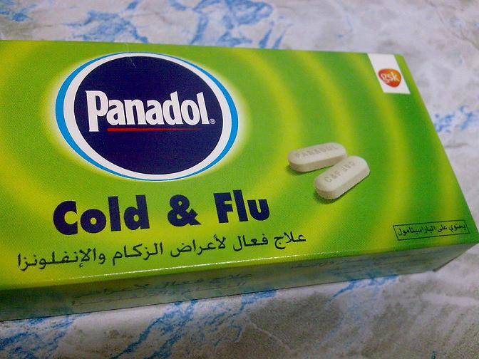
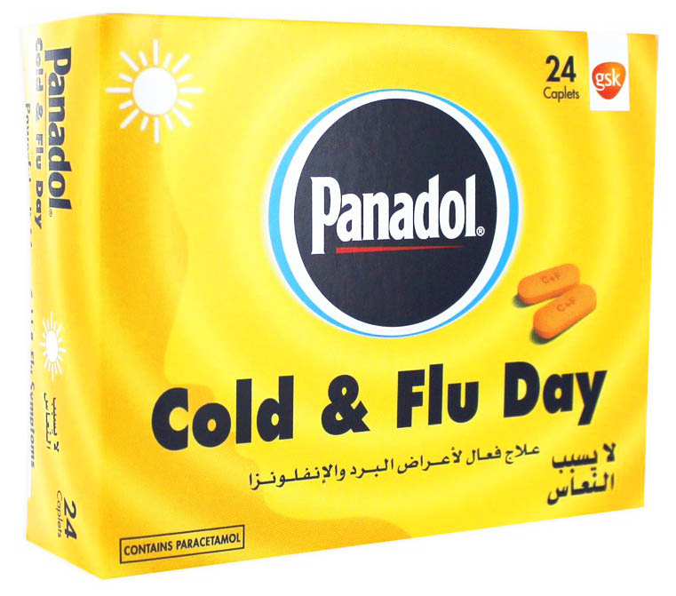
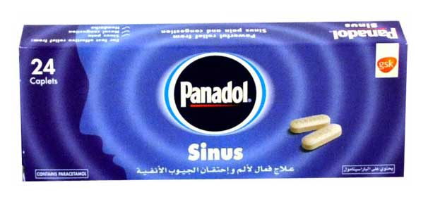
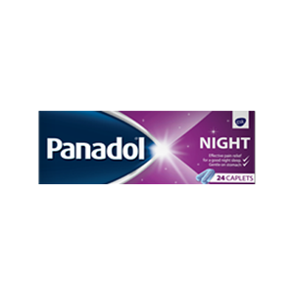

Slide 36
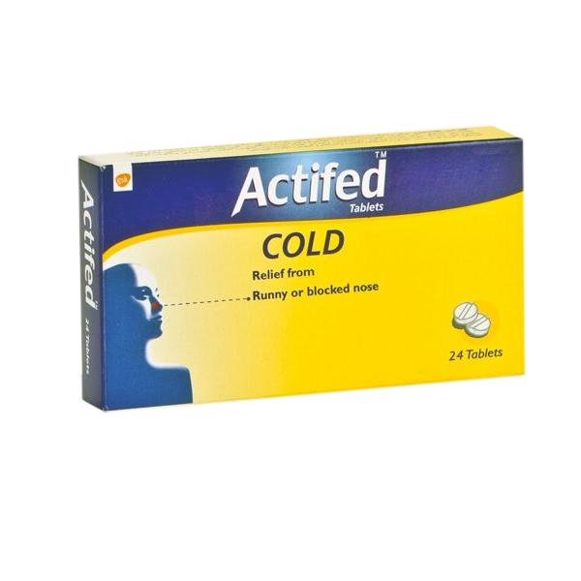
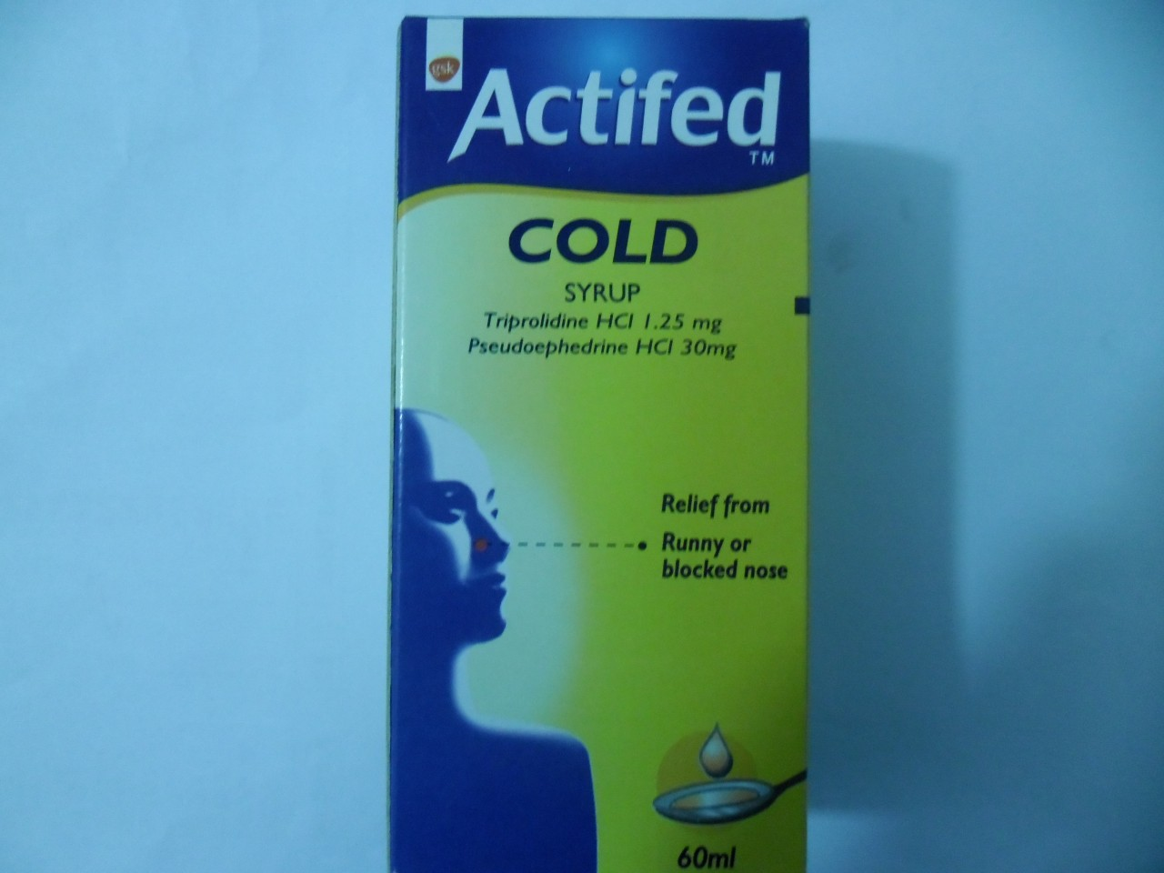

Slide 37
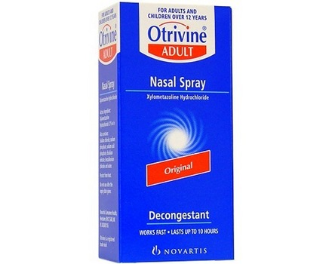

Slide 38
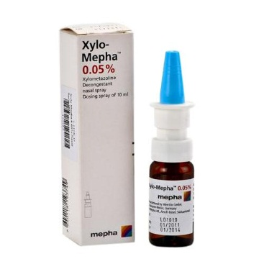
Spray versus drops

Slide 39
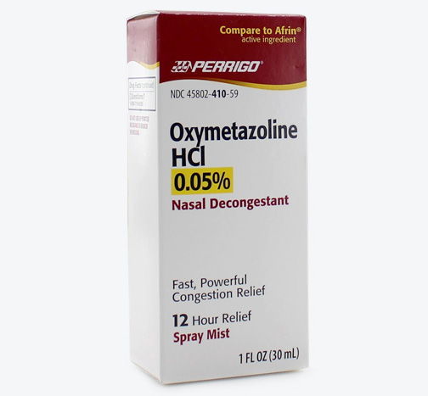

Slide 40
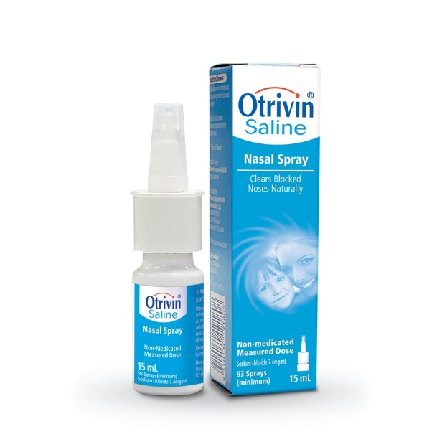

Slide 41
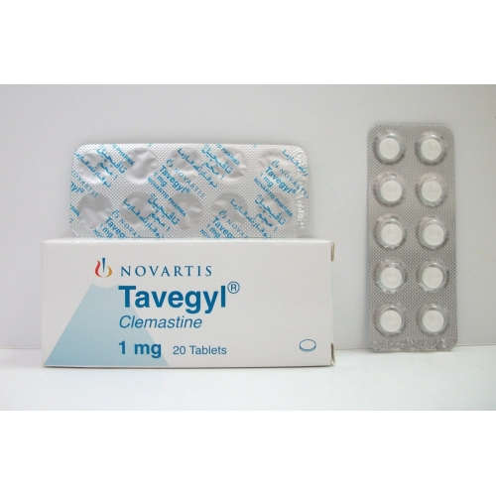

Slide 42
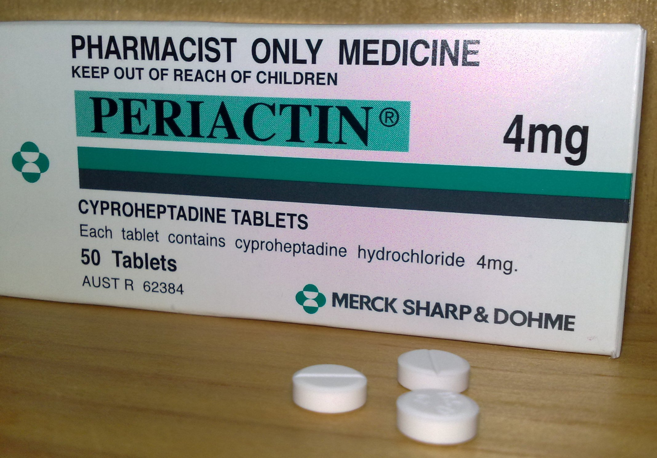

Slide 43
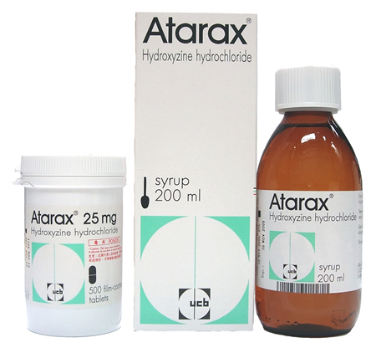
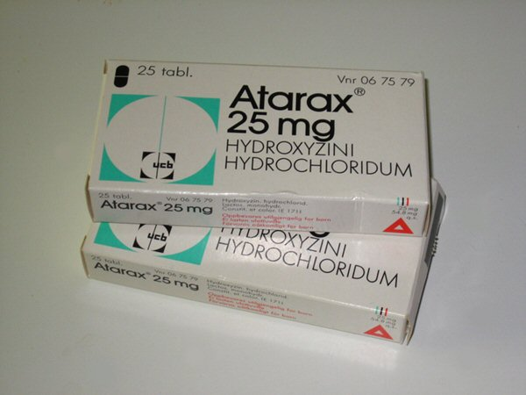

Slide 44
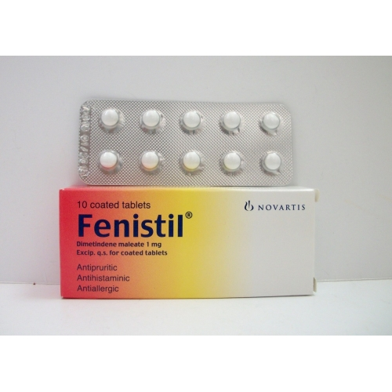
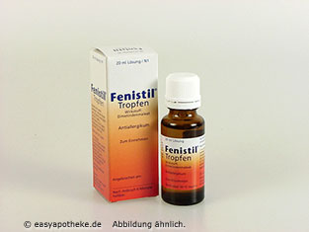

Slide 45
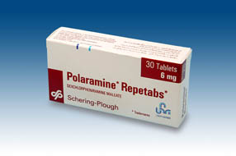

Slide 46
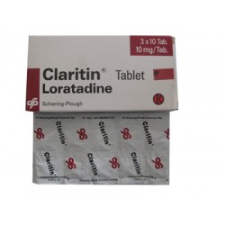

Slide 47
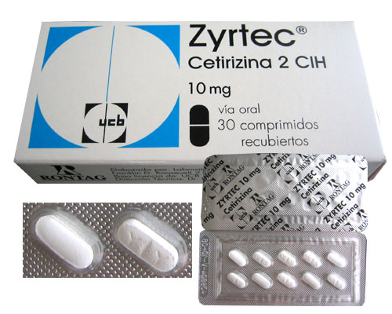

Slide 48
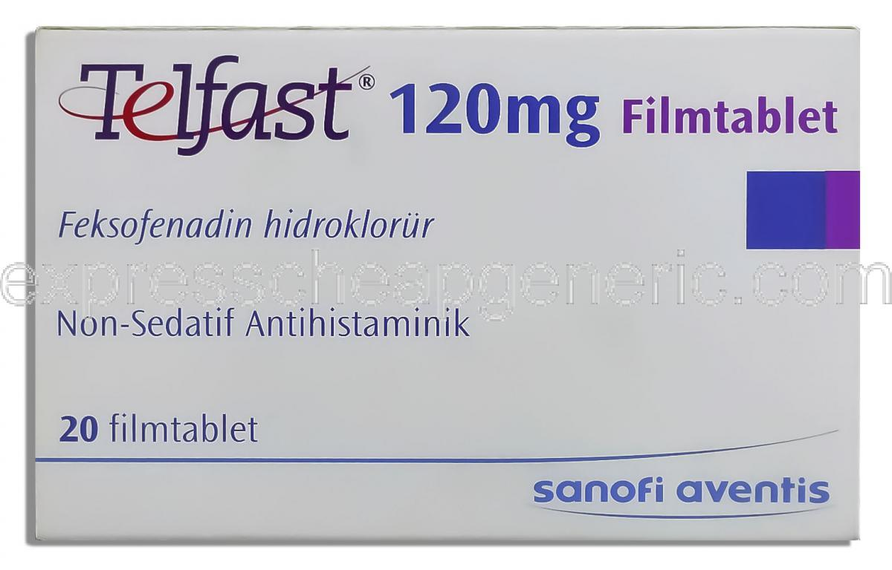
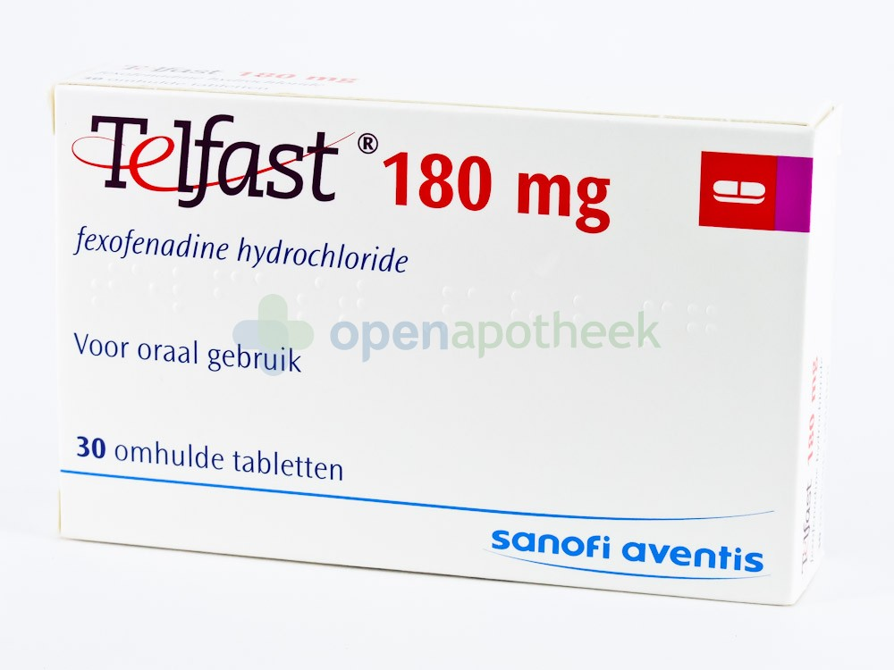

Slide 49
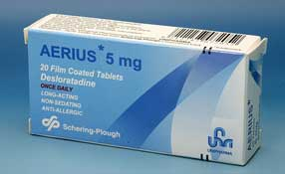

Slide 50
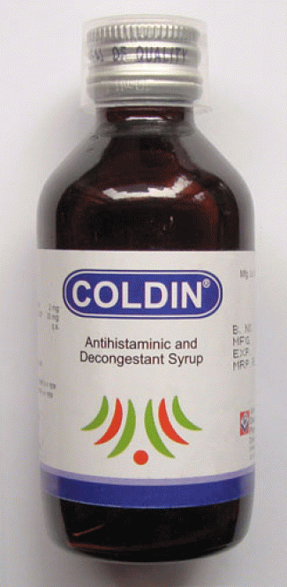

Slide 51
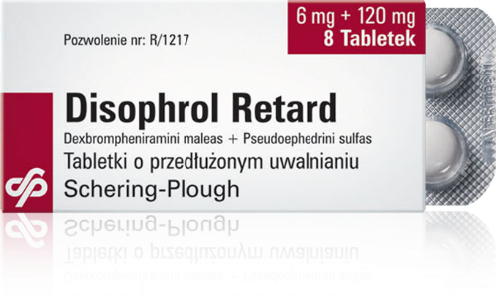

Slide 52
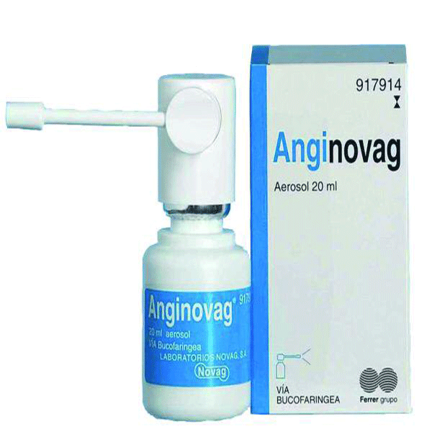
Anginovag consists of
  Dequalinium Chloride
  Enoxolone,
  Hydrocortisone Acetate,
  Lidocaine Hydrochloride,
  Tyrothricin.

Slide 53
