Slide 1
A Review of the Fundamentals of Research Methodology
Mohammed Al-zubaidi, PhD

Slide 2
Learning Objectives
You will know by the end of this session:
What is ‘research’, types and importance?
Steps for scientific researching

Slide 3
What is scientific research
Research is the systematic and physical process of gathering information and the mental process of deriving the answer to your question from the information you gathered. It involves the application of scientific methods to discover new facts or verify and test existing knowledge.
Research writing is the process of sharing the answer to your research question along with the evidence on which your answer is based, the sources you used, and your own reasoning

Slide 4
Types of researches

Slide 5

A. Basic (Pure) Research
- Aims at expanding knowledge
Not immediately applicable to real-world problems. e.g. Studying the structure of DNA
B. Applied Research
- Solves practical problems using scientific methods. E.g. Researching a new method for reducing traffic congestion

Slide 6
C. Qualitative research
Explores behaviors, experiences, and perceptions
Uses interviews, focus groups, and open-ended questions
It helps create in-depth understanding of problems or issues.
This is a non-statistical method.
D. Quantitative research
Based on numerical data
Is a structured way of collecting data and analyzing it to draw conclusions.
Statistical (all about numbers).
E. Mixed Methods Research
Combines both quantitative and qualitative techniques for deeper understanding

Slide 7
What Is the Purpose of a Research?
1. Exploratory (To gain familiarity with a phenomenon):
It is conducted to handle new problem areas which haven’t been explored before.
To explore a group of questions. The answers & analytics may not offer a final conclusion to the perceived problem.
Example: The survey poll that can be send to students to understand their opinions about the timing of a weekly conference. Based on such information, decision is taken.

Slide 8
What Is the Purpose of a Research?
2. Descriptive (To describe a situation):
Three main purposes of descriptive research: describing, explaining & validating the findings.
Focuses on expanding knowledge on current issues through a process of data collection.
To describe the behavior of a sample population.
Example: Across-section study planned to include a questionnaire form among medical students in order to know their opinions about continuous medical education.

Slide 9
What Is the Purpose of a Research?
3. Explanatory (To test a hypothesis):
Can be conducted for a problem that was not well researched before, demands priorities, generates operational definitions.
They are not used to give us some conclusive evidence but helps us in understanding the problem more efficiently.
Examples: Literature Research, In-depth study of every single problem & a Case Analysis Research.

Slide 10
Steps for a Research Process?

Slide 11
Steps of Research Process
1- Identify and define research problem
2- Review of literature
3- Formulate hypotheses or research questions
4- Preparing the research design
5- Sampling
6- Data collection
7- Data analysis
8- Interpretation and report writing

Slide 12
Step 1: Identify and Define Research Problem
“Research Question & Topic”
Begin from a question to which you don’t know the answer & that can’t be answered just by going to the appropriate reference source.
That is, begin from a research question, not a homework question.

Slide 13
Step 2: Review of Literature
“Gathering information”
Decide what kind of information or data will be needed in order to build the answer to the question.
Gather information &/or collect data.
Work with the information/data to derive or construct your answer.

Slide 14
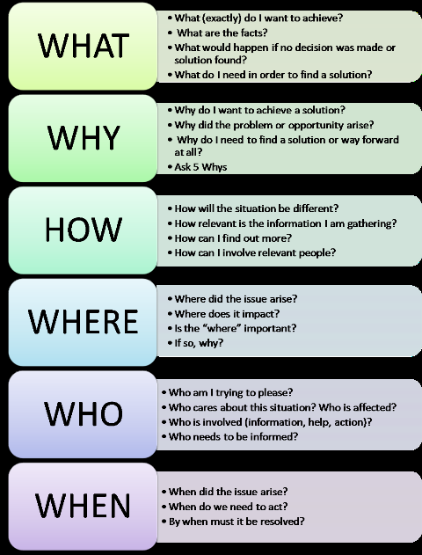
Getting Started:
Step 1+2
How to select Research topic?
5Ws & 1H

Slide 15
Examples of a Research Topic?

Slide 16
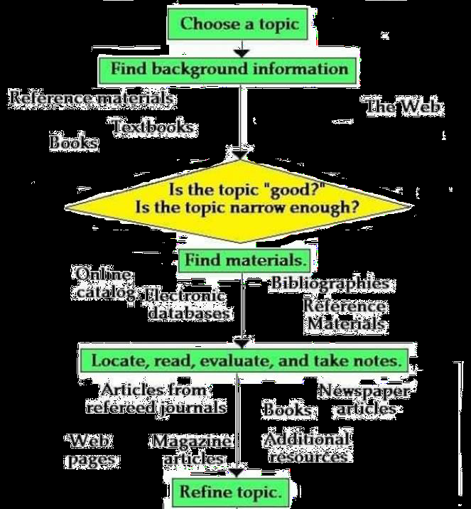
Getting Started: Step 1+2

Slide 17
Step 3: Formulate hypotheses or research questions
A hypothesis is a statement about the relationship between two or more variables.
It is a specific, testable prediction about what you expect to happen in a study.
e.g. “Students who study in groups perform better in mathematics than those who study alone.”
There are two types:
Null Hypothesis (H₀): No effect or difference
Alternative Hypothesis (H₁): There is an effect or difference

Slide 18
Examples
Example 1
A study designed to look at the relationship between sleep deprivation and test performance
Hypothesis : ?

Slide 19
Examples
Hypothesis :
"This study is designed to assess the hypothesis that sleep-deprived people will perform worse on a test than individuals who are not sleep deprived."

Slide 20
Examples
Example 2:
A researcher might be interested in the relationship between study habits and test anxiety.
Hypothesis?
"Test anxiety decreases as a result of effective study habits."

Slide 21
Step 4: Preparing the study Design
Introduce the overall methodological approach for investigating your research problem.
Is your study qualitative or quantitative or a combination of both (mixed method)?

Slide 22
Step 5: Sampling
Sampling is selecting a portion from a population to represent the whole.
Probability Sampling (random selection, e.g., simple random, stratified, cluster).
Ensuring every population member has a known chance of being included, leading to generalizable, unbiased results, ideal for conclusive research.
- Non-Probability Sampling (non-random selection, e.g., convenience, purposive, snowball)
It is faster and cheaper, and it is suitable for exploratory research but risks sampling bias and limited generalizability.

Slide 23
Step 6: Data Collection
Describe the specific methods of data collection you are going to use, such as:
Surveys
Interviews
Questionnaires
Observation
Archival research.

Slide 24
Step 7: Data Analysis
Explain how you intend to analyze your results. Will you use statistical analysis?
Describe how you plan to obtain an accurate assessment of relationships, patterns, trends, distributions, ..etc.

Slide 25
Step 8: Data Interpretation & Research writing
Simply state what you found.
Presented in a logical order.
Use the past tense to describe your results.

Slide 26
To Sum Up
Research is a systematic inquiry to describe, explain, predict & control an observed phenomenon.
The research purpose can be either Exploratory, descriptive or explanatory.
Research can be: Basic, applied, quantitative/ qualitative or mixed.
There are 8 Steps for Scientific Researching.

