Slide 1
Common Software Problems
OS glitches, missing drivers, viruses Use
Task Manager,
MSConfig
Antivirus
Windows Memory Diagnostic
System Restore

Slide 2

Task Manager

Slide 3
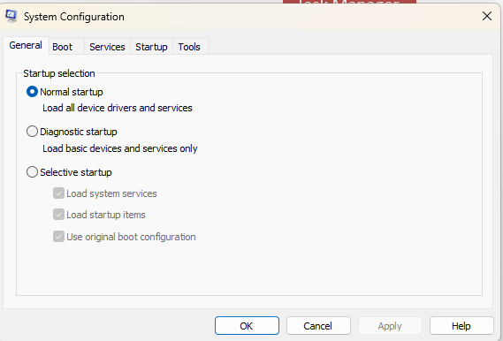
System Configuration
Run: MSConfig

Slide 4
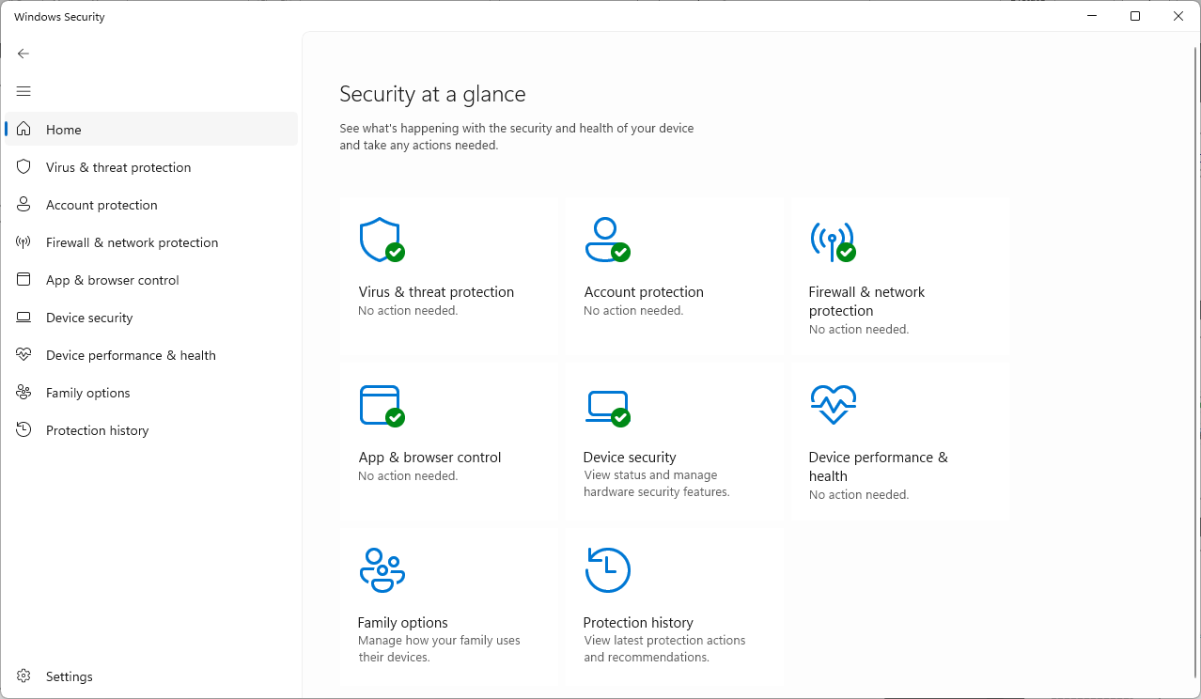
Windows Security

Slide 5
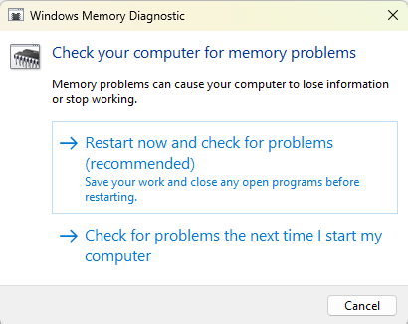
Memory Diagnostic

Slide 6
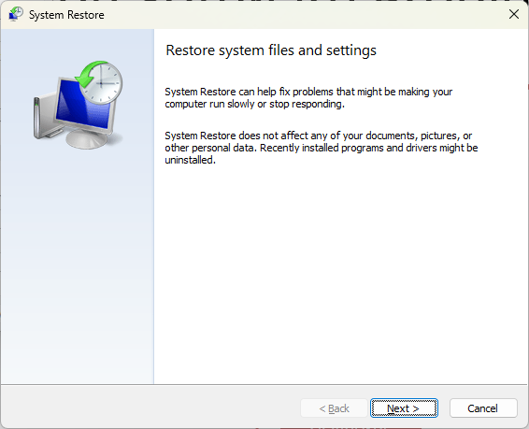
System Restore
Windows System Restore is a built‑in Microsoft Windows recovery feature that creates and manages “restore points” — snapshots of system files, installed applications, Windows Registry entries, and system settings at a specific moment in time.
Reverting to a previous restore point rolls back those system changes—without touching your personal files—helping you recover from software malfunctions, corrupted updates, or misconfigured drivers

Slide 7

Windows Safe Mode
Safe Mode starts Windows in a basic state, and uses a limited set of files and drivers. If a problem does not happen in Safe Mode, it means that the default settings and basic device drivers do not cause the problem. Observing Windows in Safe Mode enables you to narrow down the source of a problem, and can help you troubleshoot problems on your computer.

Slide 8

How to Boot in Safe Mode
Press the Windows + I on the keyboard to open Settings.
If that does not work, click Start and then select Settings.
Click Update & Security, and on the left pane select Recovery.
Under Advanced Startup, click Restart Now.
After the computer restarts, on the Choose an Option screen, select Troubleshoot > Advanced Options > Startup Settings > Restart.
After the computer restarts, a list of options appears. Select 4 or F4 to start the computer in Safe Mode. If you must use the Internet, select 5 or F5 for Safe Mode with Networking.

Slide 9

Lab Task 1: Simulation
Scenario cards with problems
Identify issue type
List 3 possible fixes

Slide 10
Lab Task 2: Windows Tools
Use Device Manager
Check Task Manager
Safe Mode (describe steps)
Antivirus scan (demo only)

Slide 11
Quiz & Assessment
Show screenshots of problems
Students suggest fixes
Wrap-up & take-home lab report

