Slide 1
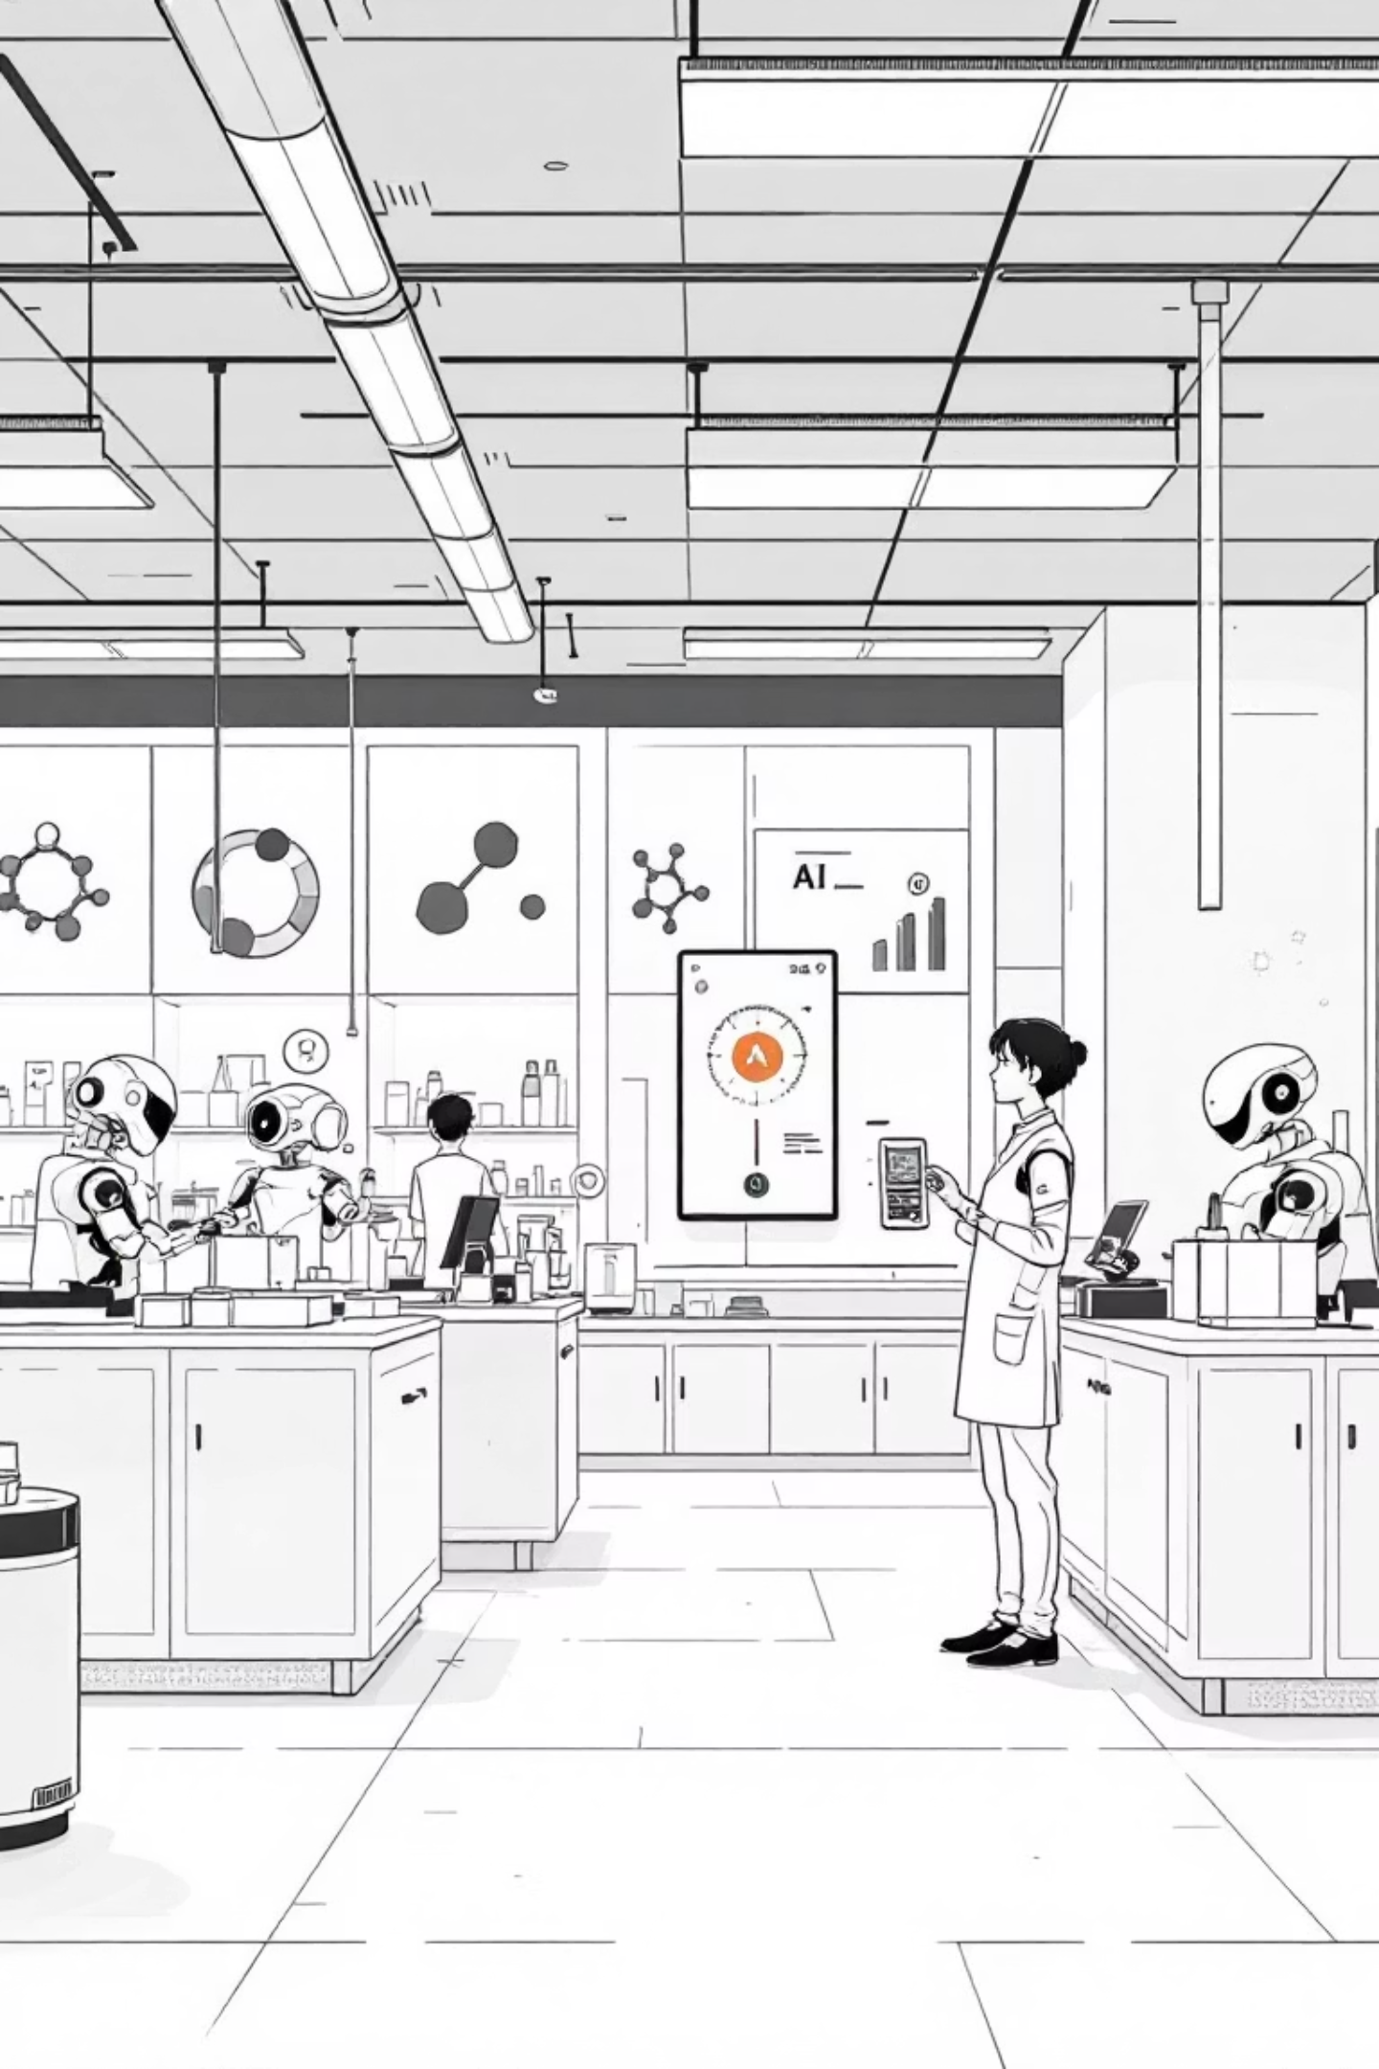
Introduction to AI & Machine Learning
A practical exploration for second-year pharmacy students discovering how artificial intelligence is transforming healthcare and pharmaceutical sciences.

Slide 2
What is Artificial Intelligence?
Core Definition
Everyday Examples
In Pharmacy Practice
AI simulates human intelligence in machines, enabling them to think, learn, and make decisions like humans do.
Voice assistants (Alexa, Siri)
Drug interaction checkers
Netflix recommendations
Automated dispensing systems
Spam email detection
Clinical decision support
GPS navigation routing

Slide 3
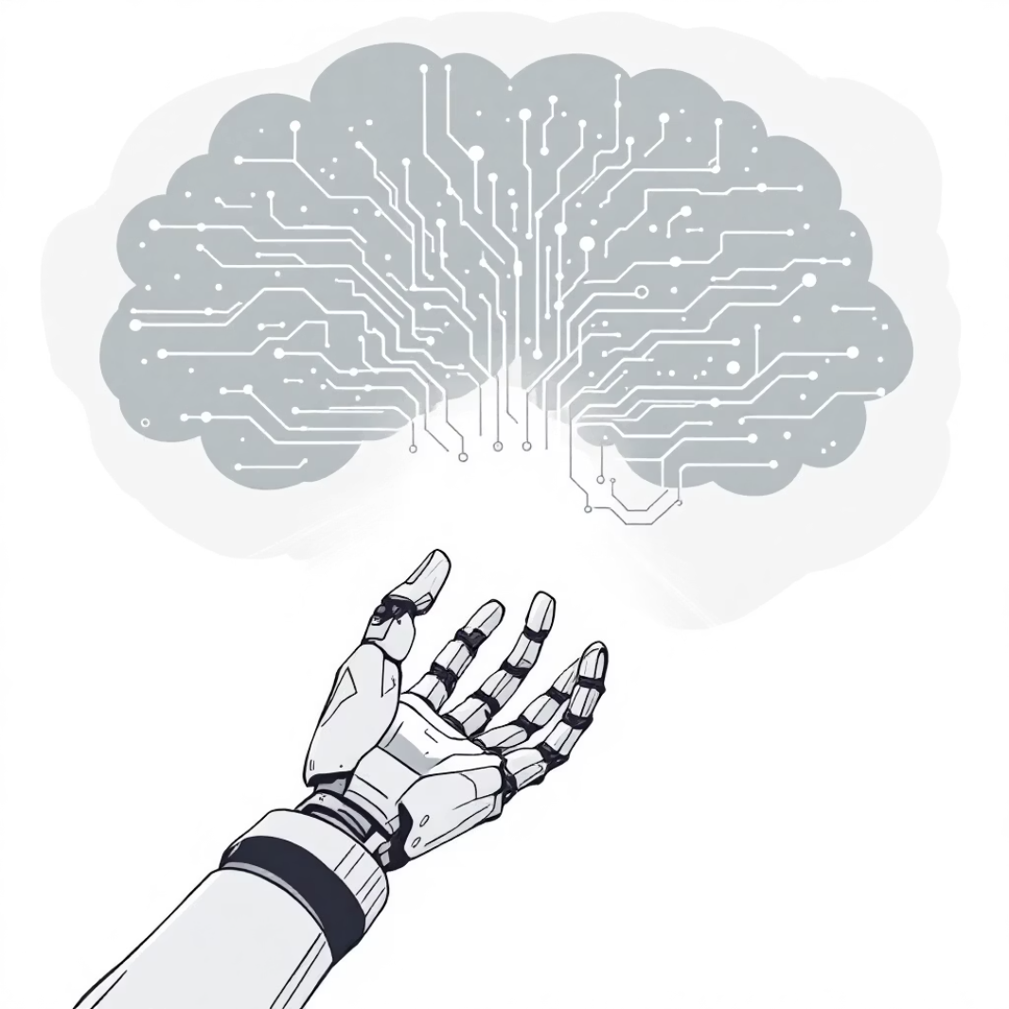
Two Main Types of AI Systems
Narrow AI (Weak AI)
Designed for specific tasks only. Examples include Siri answering questions, Google Translate converting languages, and pharmacy robots counting pills.
Current Reality: All AI we use today is narrow AI.
General AI (Strong AI)
Hypothetical AI that matches human cognitive abilities across all domains. Could reason, learn, and adapt like humans.
Status: Not yet achieved - remains a future goal.

Slide 4



AI vs Traditional Programming
Traditional Programming
AI & Machine Learning
Programmers write explicit rules and instructions. The computer follows these fixed commands exactly.
Systems learn patterns from data and make predictions. The computer discovers rules by analyzing examples.
Example: "If blood pressure > 140, flag as high"
Example: AI learns to identify drug interactions by studying thousands of patient cases
Key Insight: AI doesn't just follow rules - it creates its own rules based on data patterns.

Slide 5
How Traditional and AI work
 | Traditional | AI
Logic | Human explicitly defines all the rules and logic. | The system learns the rules from data rather than being directly programmed.
Example | You write if-then statements: if temperature > 30, turn on fan. | You train a model to predict whether to turn on the fan based on past temperature and comfort data.
Core idea | Rule-based | Data-driven
Programmer’s job | Write detailed instructions for every possible case. | Provide examples and data so the machine can learn patterns on its own.
Outcome | Output is fully predictable based on code. | Output is probabilistic — it depends on how well the model has learned.

Slide 6
Traditional Programming | AI
Explicitly programmed | Learns from data
Fixed | Adaptable
Probabilistic | Input + Rules → Output
Input → [Algorithm]→ Output | Learning
Spam detection, Speech recognition | Calculators, web browsers
[wait for students to say dataset, learning algorithm, prediction]
Notes:
[wait for students to say dataset, learning algorithm, prediction]

Slide 7
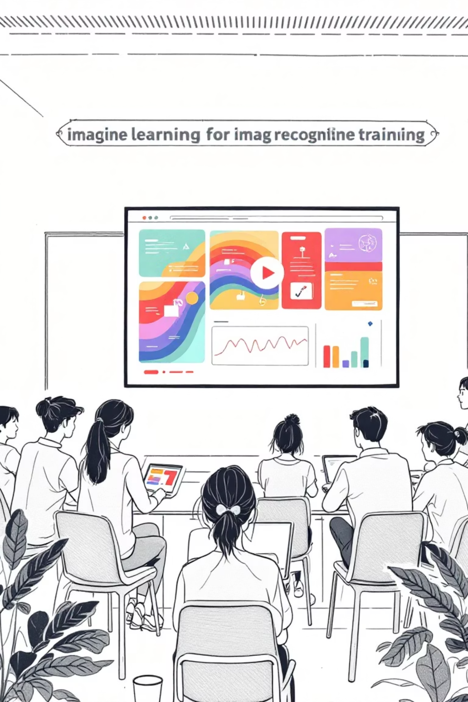
Hands-On Learning Activity
Build Your First AI Model
1
Access Teachable Machine
Visit teachablemachine.withgoogle.com and choose "Image Project" to start training your model.
2
Collect Training Data
Gather 10-15 photos each of different pill shapes, medical devices, or pharmacy items you want to classify.
3
Train & Test
Watch your AI learn patterns, then test it with new images to see how well it recognizes your categories.

Slide 8
AI Research Areas
Natural language processing (NLP): NLP works to develop AI systems that understand written and spoken words and can interact with humans, using language.
• Perception: AI systems have senses just as we do. AI systems use sonar, accelerometer, infrared, magnetic, and other electronic sensors to gather data. Being able to combine all the data from sensors and then construct information from it is a difficult challenge.
• Knowledge representation: involves encoding information about the world into formats that the AI system can understand. Humans possess a vast collection of general knowledge based on their experiences. AI systems need to build knowledge bases to solve problems. Developing a knowledge base and using it efficiently have been demonstrated by IBM’s AI computer Watson.
• Planning: AI systems need to set goals and then achieve them. An AI system might need to plan how to move a blue block out of the way to reach a red one or how to rotate a block as it moves to fit through a narrow opening.
• Problem solving: Humans tend to make intuitive judgments when solving a problem rather than performing a step-by-step analysis. AI programming combines a rules-based approach with trying to make judgments with incomplete information.
• Learning: Like humans, AI algorithms adapt and learn through experience. Supervised learning is used when the system can be trained with a huge number of examples. Unsupervised learning is when a system can look at data and build rules on its own to decide what it is seeing.

