Slide 1
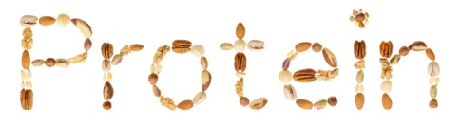
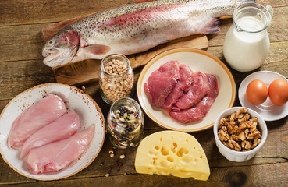

Slide 2
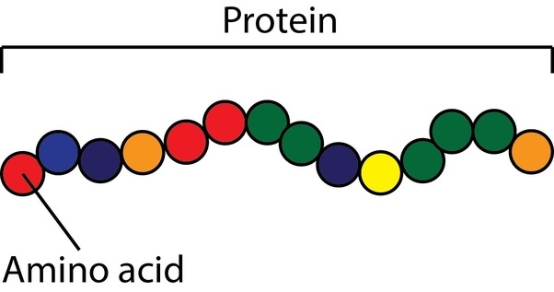
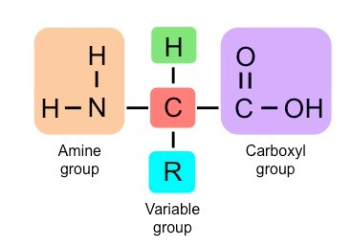
Proteins
Proteins are polymers made up of amino acid units.
Amino acid consist of an amino group, carboxyl group, H atom and R group.

Slide 3
Function of proteins
Act as structural such as : Skin , hair , nails ,
muscle and connective tissue
Act as catalysts such as enzyme
Act as hormones such as insulin
Act as transport such as hemoglobin

Slide 4
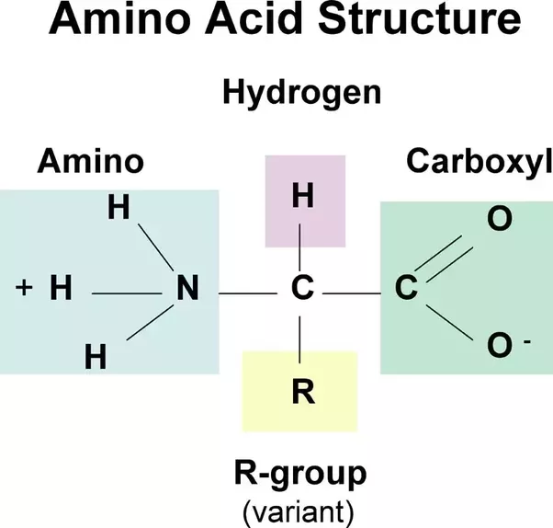
Properties of Proteins
Isoelectric point (pi)
Positive and negative charge are equal
at specific pH
(no net electric charge)
Amphoteric
Notes:
4

Slide 5
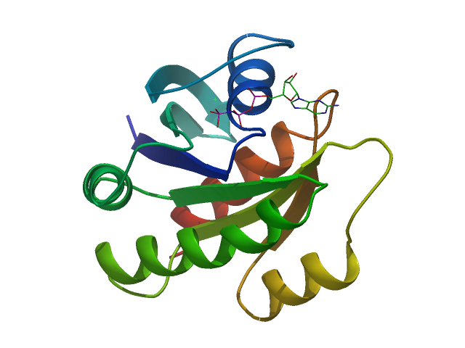
Precipitation of proteins
Effect of strong acid and strong base
Effect of neutral salts
Effect of alkaloid reagents
Effect of polar solvent
Effect of heat

Slide 6
Effect of acid and base on proteins
-
-
-
-
+
+
-
+
+
-
-
-
-
-
+
+
-
-
-
-
-
+
+
-
+
+
-
-
-
+
+
+
+
-
-
+
+
+
-
-
-
-
-
+
+
+
-
-
-
-
-
-
+
+
-
-
-
-
-
+
+
+
+
-
-
-
+
+
-
-
-
-
-
+
+
>
pI
pH
>
pI
acidic solution
pH
Basic solution
+
-
+
+
-
+
-
+
-
-
+
-
-
+
-
-
+
+
-
+
-
+
-
+
-
+
-
-
-
+
-
+
pH
=
pI
Neutral solution

Slide 7
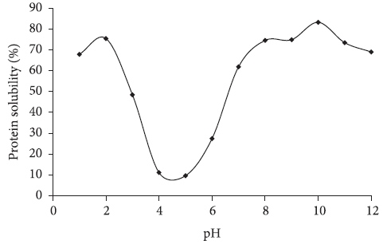
Solubility of β-lactoglobulin
pH= 5.3 minimum solubility

Slide 8
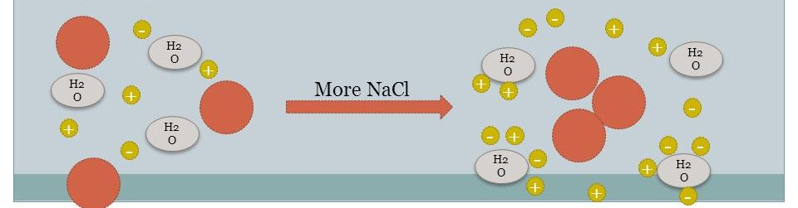
Effect of neutral salts
Salting in
Salting out
Low con. Of salt
High con. Of salt
Soluble
ppt

Slide 9
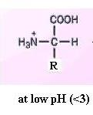
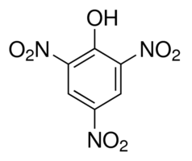
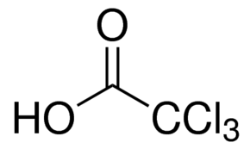
Effect of alkaloid reagent
acid
Insoluble salt
Picric acid
trichloroacetic acid

Slide 10
Effect of polar solvent
Polar solvent such as ethanol, methanol and acetone
Organic solvent with water made miscible solution.
Miscible solution decrease the solubility of protein.

Slide 11
Effect of heat
Protein types are :
- Fibrous protein (insoluble in water)
Globular protein (soluble in water)
Protein coagulation results in the disorganization of a protein’s structures without the hydrolysis of peptide bonds lead to precipitation of protein.

Slide 12
Precipitation effects
1- acid and base effect :
2- neutral salt effect :
1ml HNO3 (con.)
1ml albumin
2ml NaOH
(saturated)
1ml albumin
3 drop
lead actate
3ml albumin
10 drop
cupric sulphate
3ml albumin
3- alkaloid reagent effect :
4- polar solvent effect:
5ml water
10 drop tannic acid
1ml albumin
2ml ethanol
1ml albumin

