Slide 1
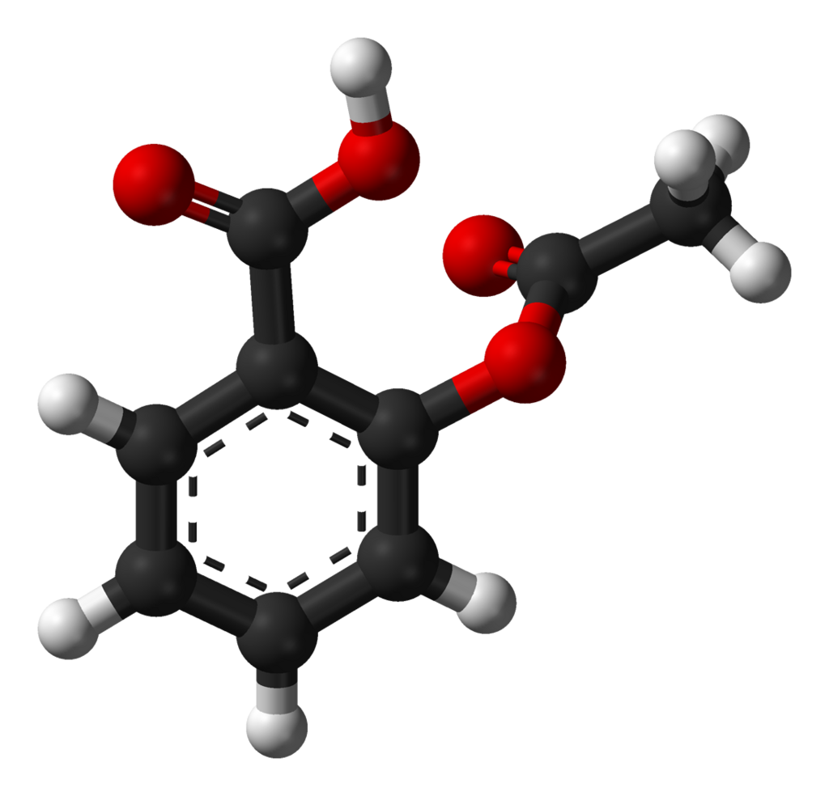
Aspirin
By
M.S. : MOHAMMED AL-DAHLAKI

Slide 2
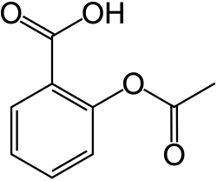
Aspirin
Aspirin (acetylsalicylic acid, C₉H₈O₄) was originally derived from willow bark extracts, which had been used since ancient times for pain relief and fever reduction. In 1897, Felix Hoffmann, a chemist at Bayer, successfully synthesized a stable industrial form, which was later marketed in 1899 under the trade name Aspirin.Structurally, aspirin is known as 2-acetoxybenzoic acid and contains both an ester and a carboxylic acid functional group. It is typically synthesized by the acetylation of salicylic acid using acetic anhydride or acetyl chloride. The compound is stable under dry conditions but undergoes hydrolysis in the presence of moisture, breaking down into salicylic acid and acetic acid. The acetyl substitution not only enhances the compound’s chemical stability but also underlies its major pharmacological actions, including analgesic, antipyretic, anti-inflammatory, and antiplatelet effects.

Slide 3
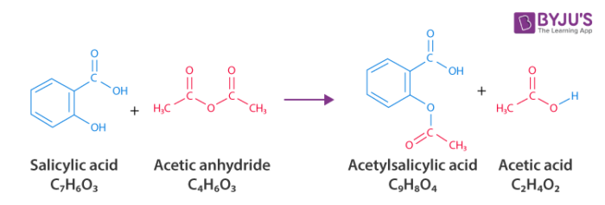
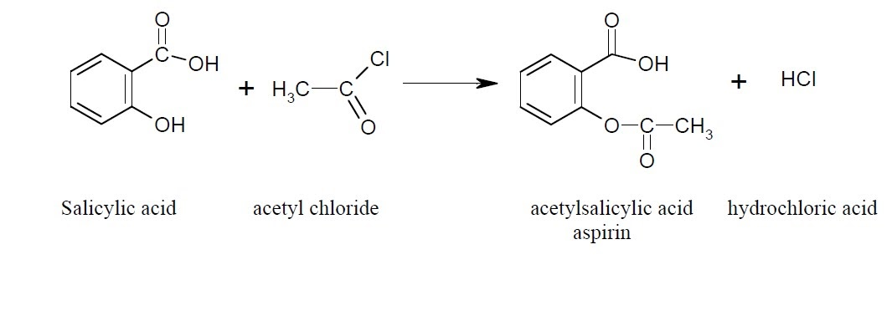
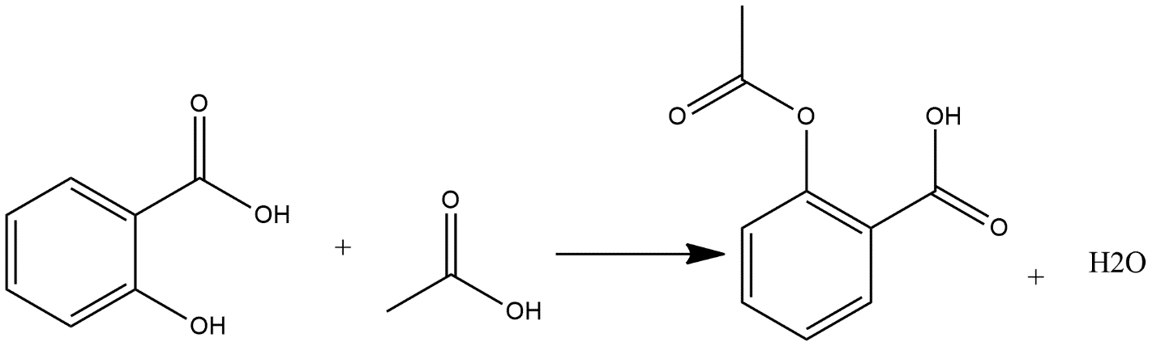
Methods of preparation for aspirin

Slide 4
Step-by-step reaction mechanism
Nucleophilic attack: The phenolic oxygen of salicylic acid attacks the carbonyl carbon of acetyl chloride.
Tetrahedral intermediate: The C=O π bond shifts to oxygen, forming a tetrahedral intermediate.
Collapse & leaving group: The intermediate collapses; the C–Cl bond breaks to expel Cl⁻, forming the aryl ester framework.
HCl formation: HCl is generated (or the ester is initially protonated with Cl⁻ present).
Proton transfers: Internal proton shuttling (or from HCl) gives neutral aspirin (acetylsalicylic acid).
Role of triethylamine (TEA): TEA deprotonates the phenolic –OH (boosting nucleophilicity to Ar–O⁻) and scavenges HCl to form [Et₃NH]Cl, preventing acid buildup—thus accelerating the reaction and improving yield/selectivity.
Role of pyridine (if used): Pyridine captures HCl to form pyridinium chloride (PyH⁺Cl⁻) and can weakly activate acylation (by transient acyl–pyridinium formation), thereby buffering acidity and helping drive the reaction to completion without over-acidifying the medium.

Slide 6
Name of reaction
Nucleophilic acyl substitution
Type of reaction;
Acetylation reaction

Slide 7
Procedure
In a 50 mL round-bottom flask, place 1 g of salicylic acid and add 4 mL of glacial acetic acid.
Add two drops of sulfuric acid (H₂SO₄) and heat the mixture until the acid completely dissolves.
Add 1 mL of acetyl chloride to the mixture
Then, add about 10 drops of triethylamine gradually. The process should be carried out inside a fume hood due to the release of vapors.
Stir the mixture for 20- 30 minutes in room temperature, then cool it down and add 10 mL of cold water while stirring until a white precipitate forms.
Filter the precipitate and recrystallize it using a small amount of warm ethanol (or an ethanol–water mixture), as hot water alone may cause aspirin to hydrolyze..

Slide 8
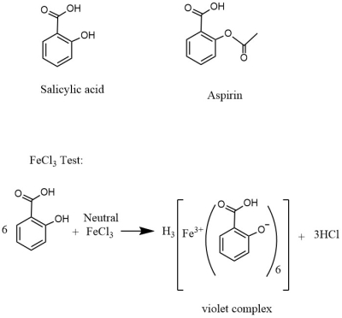
Ferric Chloride test for Salicylic Acid
Obtain three small test tubes. Add 0.5 mL of water to each test tube. Dissolve a small amount (about 0.05g) of salicylic acid in the first tube. Add a similar amount of your product to the second tube. The third test tube, which containing only solvent, will serve as the control. Add one drop of 1% ferric chloride solution to each tube and note the color after shaking. Formation of an iron-phenol complex with Fe(III) gives a definite color ranging from red to violet, depending on the particular phenol present.

Slide 9
Physical Properties of Aspirin
White crystalline solid, faint acetic odor.
Molecular formula: C₉H₈O₄, M.W.: 180.16 g/mol.
Melting point: 135–136 °C (decomposes before boiling).
Sparingly soluble in cold water, more soluble in hot water; freely soluble in ethanol and chloroform.
Density: ~1.40 g/cm³.
Unstable in moisture → hydrolyzes to salicylic acid and acetic acid.

Slide 10
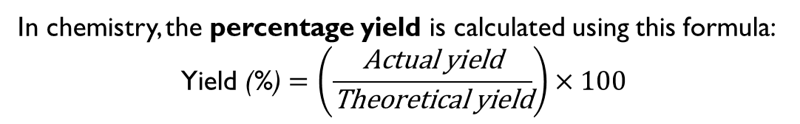
calculation
m=ρ×V
Where:
m = mass (g or kg)
ρ = density (g/cm³ or kg/m³)
V = volume (cm³, m³, or mL)
In chemistry, the percentage yield is calculated using this formula:
$$\text{Yield}\text{ (\%}\text{)}=\left(\frac{\text{Actual} \text{yield}}{\text{Theoretical} \text{yield}}\right)×100$$

Slide 11
Safety Notes (Short)
Acetyl chloride: Corrosive, fuming, reacts violently with water handle in fume hood, wear gloves/goggles, keep dry.
Triethylamine / Pyridine: Volatile, toxic, irritating use in fume hood, avoid inhalation and skin contact.
DCM (solvent): Harmful vapors, possible carcinogen handle in fume hood.
HCl (aqueous): Corrosive add slowly with stirring.
General: Always cool with ice bath, add acetyl chloride dropwise, never mix directly with water, dispose of wastes properly.

