Slide 1
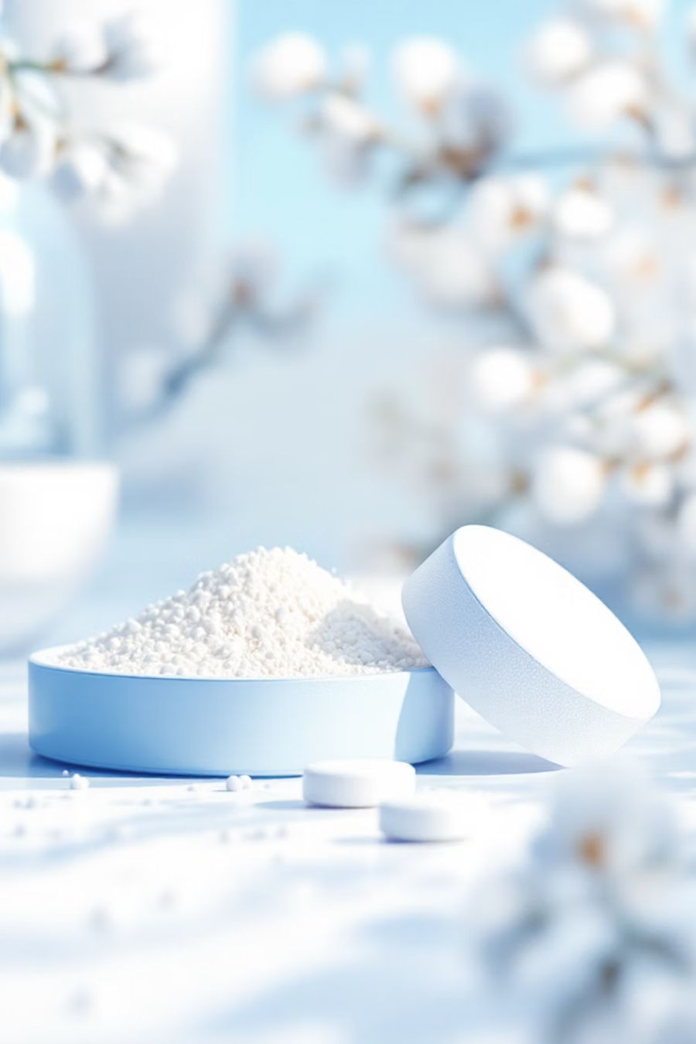
Lab.4: Hydrolysis of Acetyl Salicylic Acid Solution in Sorenson Phosphate Buffer at pH 8
Presented By:
Assist. Prof. Anas Tareq
Lecturer Zeina Dawood
Lecturer Nora Zawar
Lecturer Sura Zuhair

Slide 2
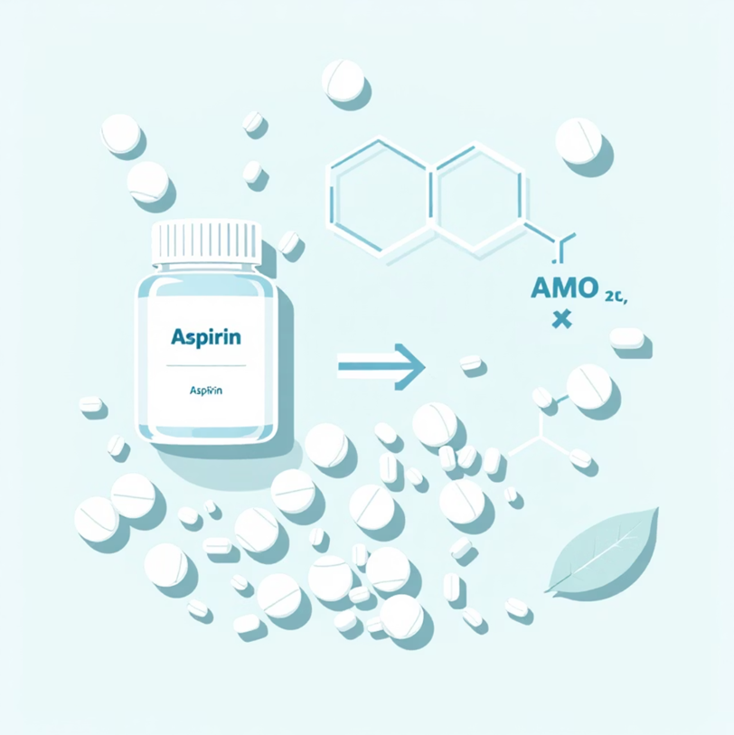
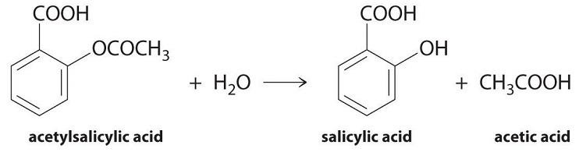
Introduction
Aspirin is a weak acid.it is soluble at 20 C° in 300 parts of water.
It is unstable in aqueous solutions, degrading to salicylic acid and acetic acid
Aspirin also degrades in solid dosage forms when exposed to moisture and therefore , should be stored in tightly closed containers and kept in a dry environment .
The hydrolysis reaction is critical as it directly impacts the drug's effectiveness and shelf life.

Slide 3

Aim of Experiment
To study the effect of temperature on the hydrolysis of aspirin, and to calculate the shelf life of aspirin.
Shelf life of any drug: it is the time required for the drug to lose 10% of its effectiveness.

Slide 4

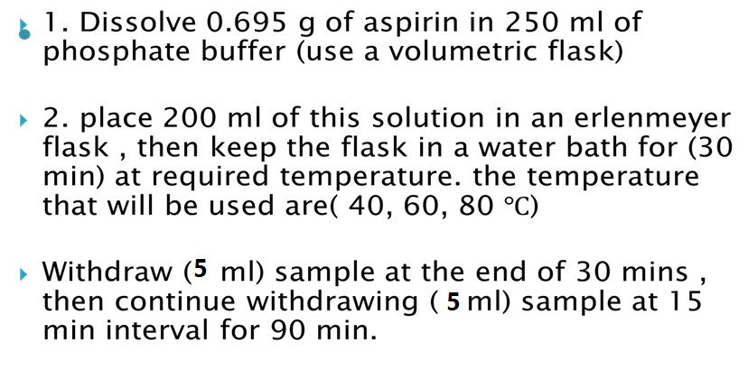

Procedure :

Slide 5

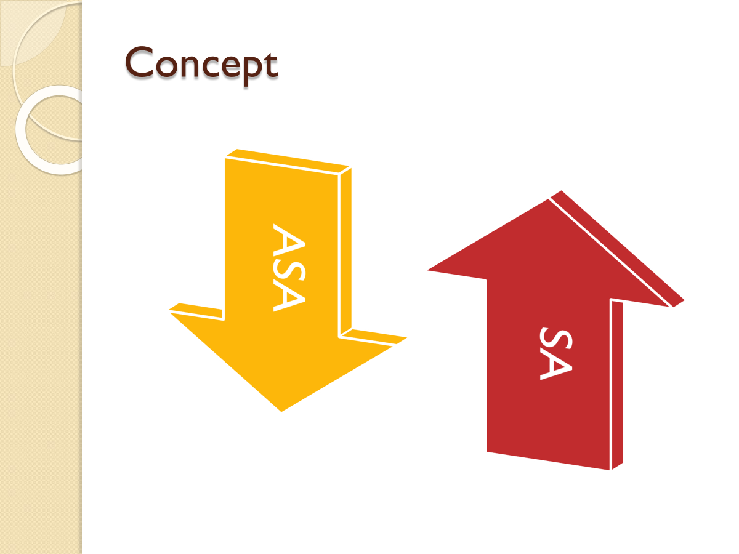
Notes:
absorbance increases with time.
Concentration of S.A at zero time is ZERO since ASA is not hydrolyzed yet , however , the initial concentration of ASA is 2.78 mg/ml ??

Slide 6
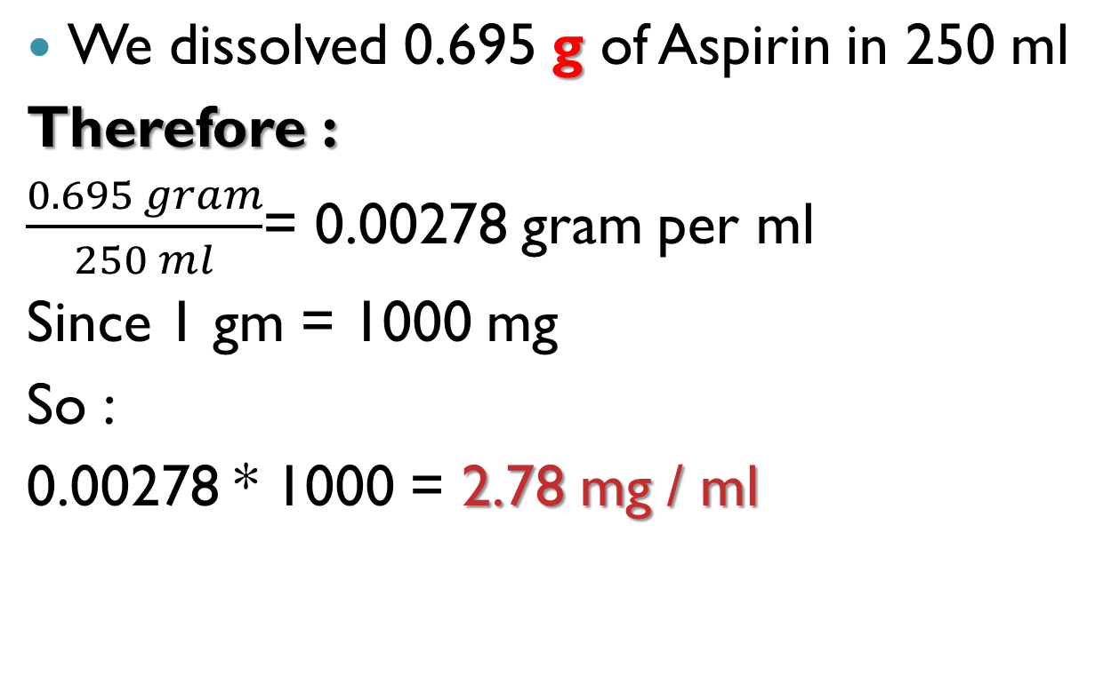
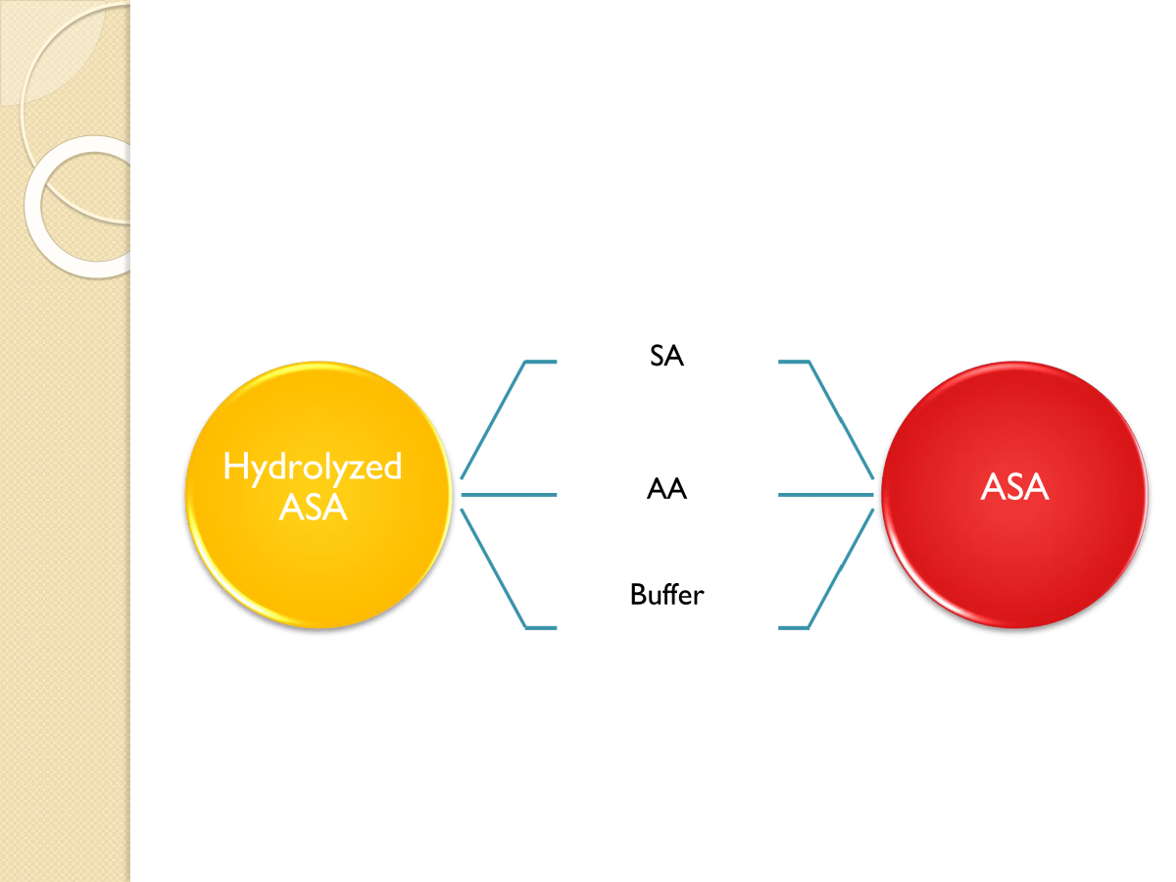
Is the initial conc. of ASA 2.78 mg/ml?

Slide 7
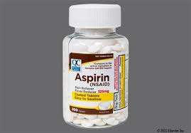
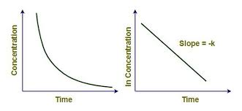
Sorenson phosphate buffer (pH 8)
Consists of two solutions
A-1/15 M Monopotasium phosphate KH2PO4
B- 1/15 M Disodium phosphate Na2HPO4.2H2O
The rate of ASA hydrolysis follows a first-order reaction
Use the calibration curve equation
Y= C + bX

Slide 8
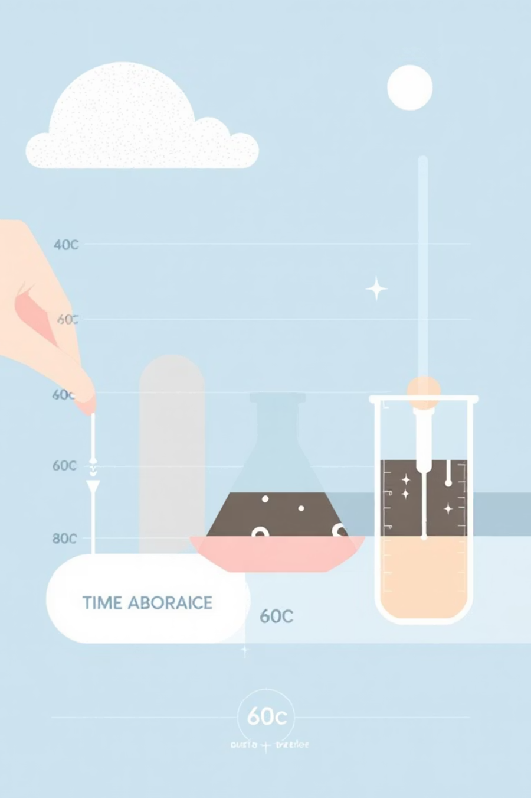
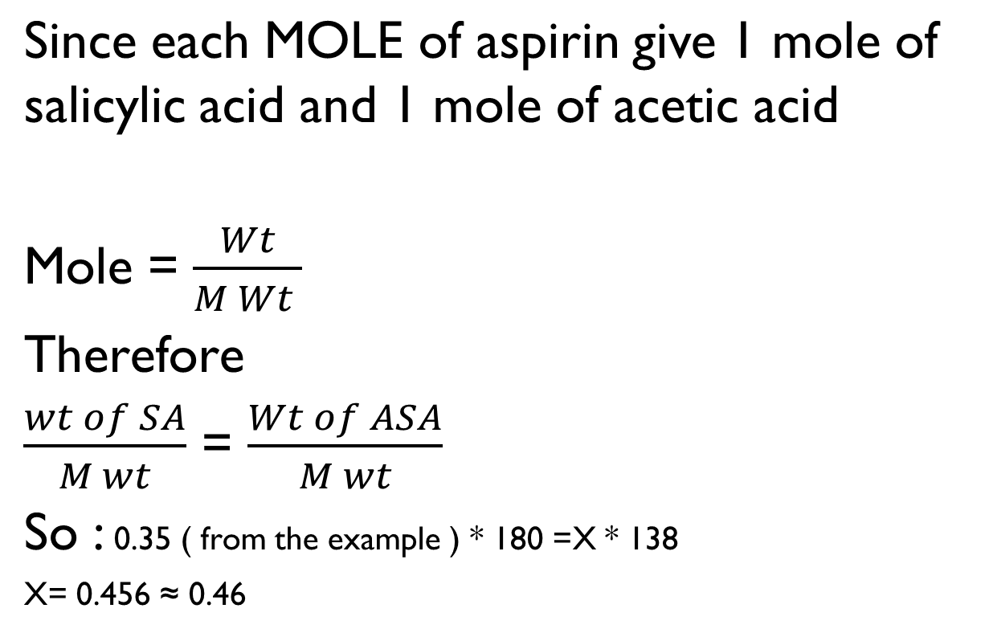
We are seeking ASA, not SA

Slide 9
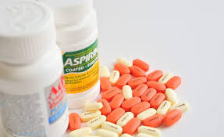
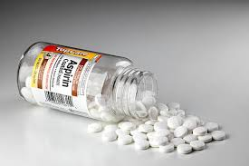



Calculate remaining ASA from Initial conc. Of ASA – conc. Of ASA degraded
2.78 – 0.46 = 2.38 mg
Time | Absorbance | Conc. of S. A | Conc. of aspirin hydrolyzed | Conc. Of aspirin remined (ct) | Log ct
0 | 0 | 0 | 0
30
45
60
75
90

Slide 10
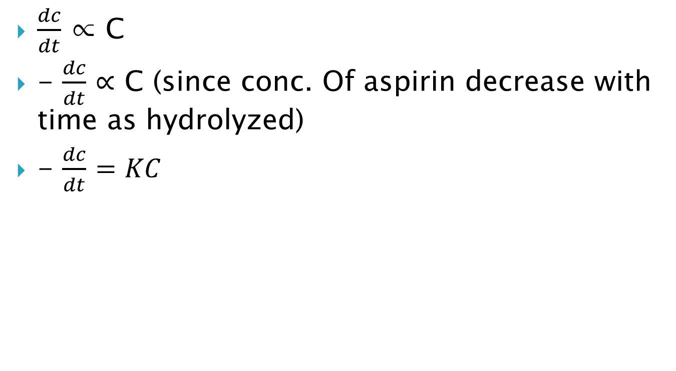
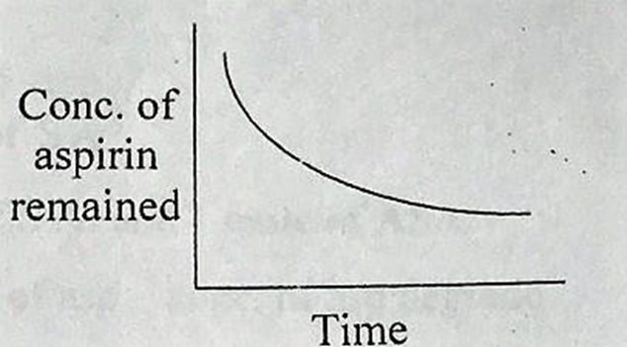
First order Kinetics

Slide 11
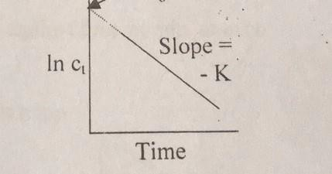
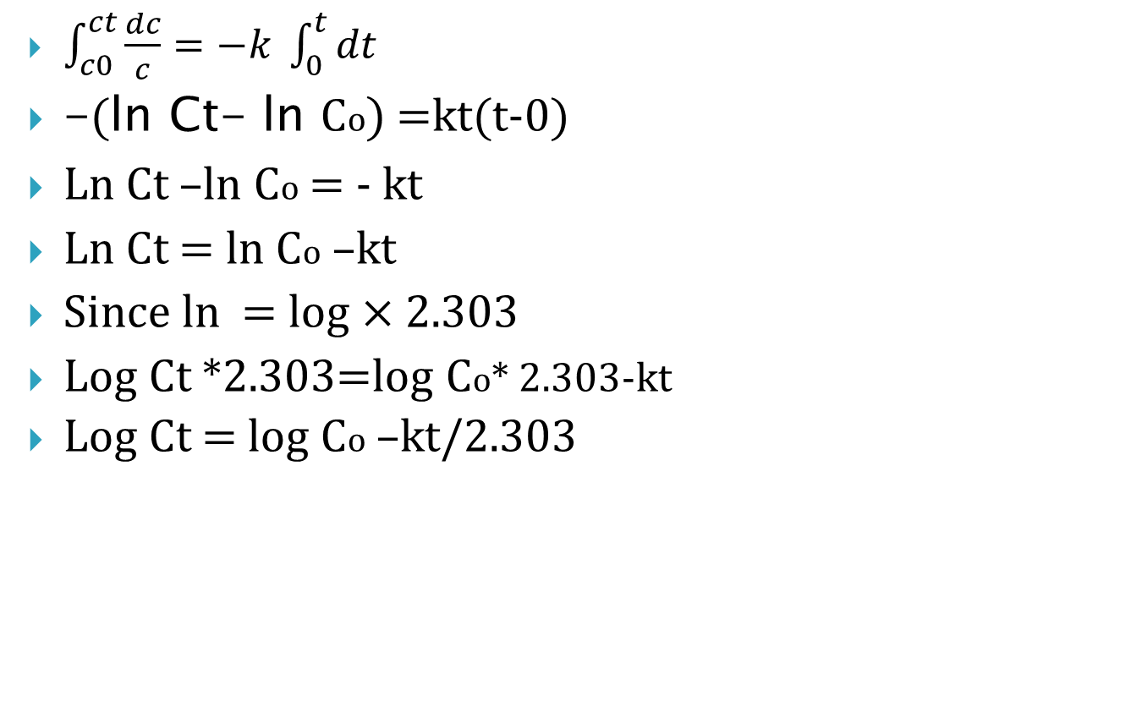
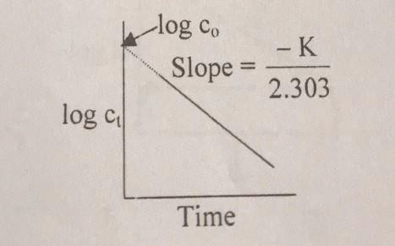
Data Analysis: Plotting and Calculating :

Slide 12
What to do with data ?
1-take the Log, or Ln, for each calculated conc.
2-Plot the log/ ln of conc. against time in min for
each temp.
You will have 3 plots
3-Calculate K for each temp.
4
4-Take log K and plot 1/𝑇
5-(draw Arrhenius plot ) to find K at 25 ℃

Slide 13
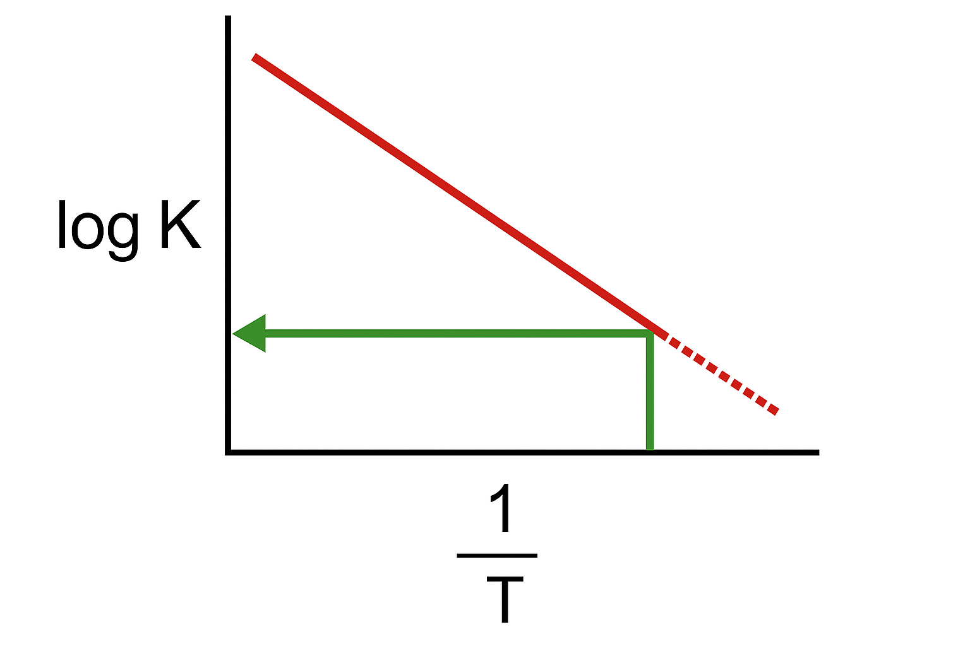
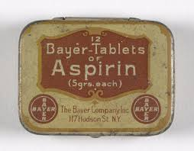
Arrhenius equation :
Log K= log A - (𝐸𝑎 )/(2.303 𝑅)*1/𝑇
Where A= frequency factor ,
Ea = energy of activation ,T= absolute temp.(temp. +273)
R= gas constant .
t10%= 0.105/ K25℃

Slide 14
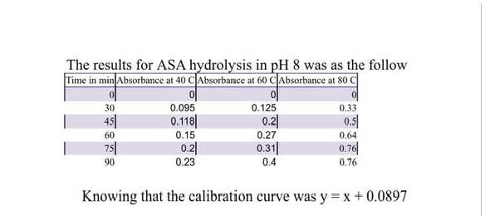
Repot to have done according to these results
1- Calculate K for each temp.
2- Calculate the Aspirin shelf life
Note: the calibration curve was in mg/ml

Slide 15


