Slide 1
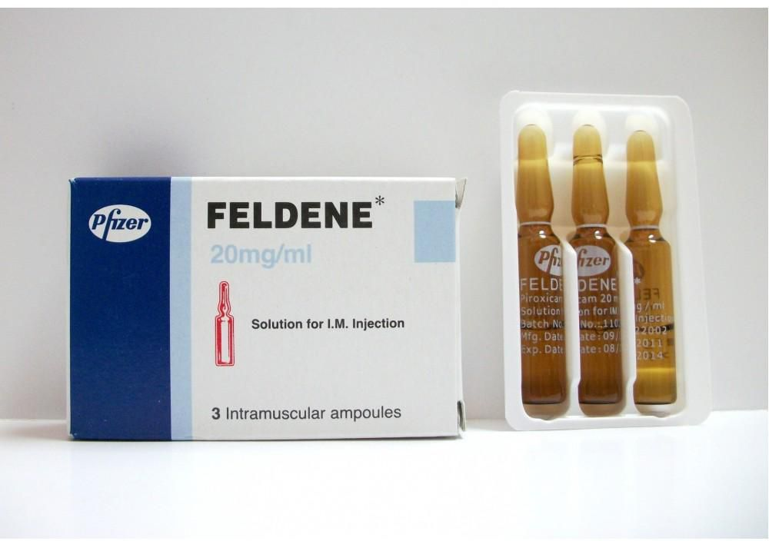
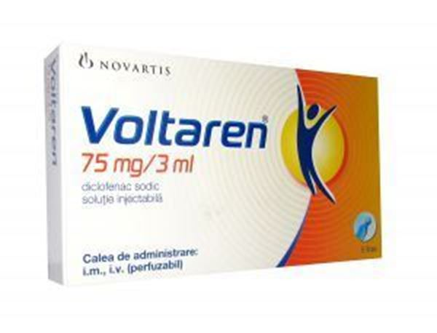
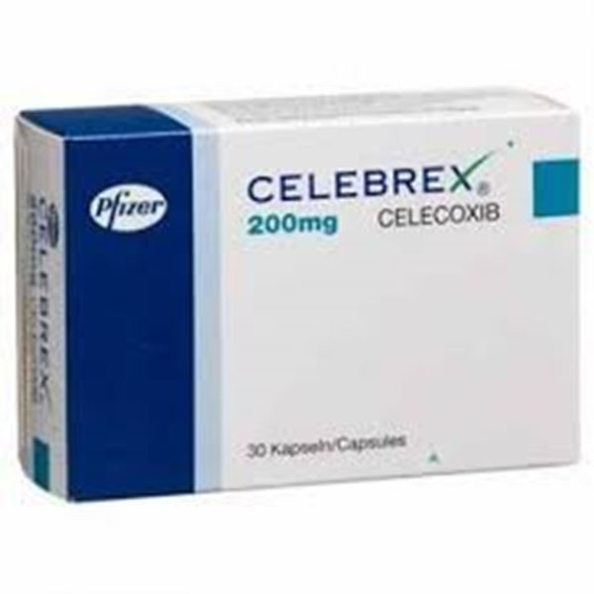
Evaluation of Nonsteroidal Anti-Inflammatory Drugs (NSAIDs)
(Lab 4)
Department of Pharmacology & Toxicology
Mustansiriyah University
2022-2023

Slide 2
Synthesis of prostaglandins & leukotrienes:

Slide 3
Nonsteroidal Anti-Inflammatory Drugs (NSAIDs):
• The NSAIDs are a group of chemically dissimilar agent that differ in their antipyretic, analgesic, & anti-inflammatory. activities.
• They act primarily by inhibiting the cyclooxygenase (COX) enzymes that catalyze the first step in prostanoid biosynthesis. This leads to decreased prostaglandin synthesis with both beneficial & unwanted effects.
• Traditional NSAIDs include aspirin, ibuprofen, naproxen & many other generic & brand name drugs.

Slide 4
NSAID
• A newer NSAID like celecoxib, is a "COX-2 inhibitor" or a "COX-2 selective" NSAID.
• NSAIDs are used to relieve pain & reduce signs of inflammation.
• NSAIDs also are a common treatment for chronic (long-term) health problems such as rheumatoid arthritis & osteoarthritis.

Slide 5
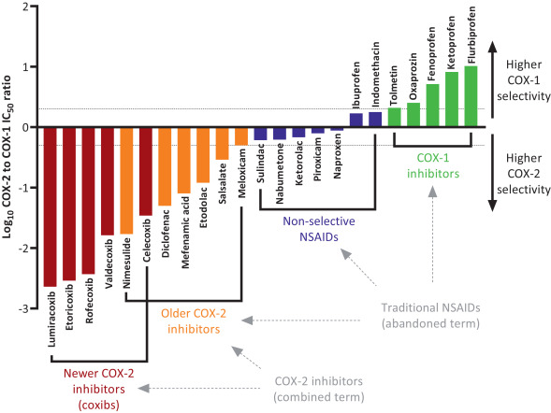

Slide 6
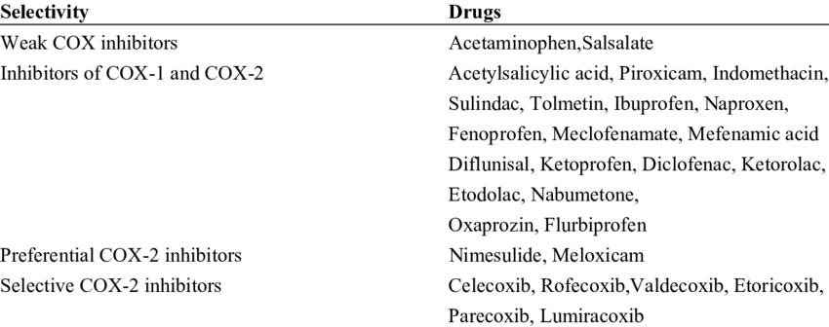

Slide 7
General unwanted effects of NSAIDs:
• Dyspepsia, nausea & vomiting. Gastric damage may occur in chronic users, with risk of haemorrhage.
• Skin reactions.
• Reversible renal insufficiency seen mainly in individuals with compromised renal function.
• All NSAIDs (except COX-2 inhibitors) prevent platelet aggregation & therefore may prolong bleeding.

Slide 8
In vivo analgesic evaluation techniques:
❖ Principle:
Pain is induced in a suitable animal & the response of the animal to the painful stimuli is recorded with or without administration of the analgesic agent.
❖ Classification of methods:
1. Methods for central analgesic activity:
• Hot plate method
• Tail immersion method
• Tail clip method
2. Method for peripheral analgesic activity:
• Writhing method
• Formalin test in rats

Slide 9
Writhing method:
• The painful stimulus is induced by IP injection of an irritant substance (e.g. acetic acid).
• The animals create a characteristics stretching behavior, which is called writhing. (writhing is constriction of abdomen, turning of trunk (twist) & extension of hind legs).
• The number of writhes for each animal is counted during certain time period (eg, during 30 minutes), beginning 5 minutes after injection of acetic acid.

Slide 10
Experimental protocol:
• Groups of animals are the control & the treated mice.
• The control group is given acetic acid IP & after 5 minutes the number of writhes is recorded for each
animal during 20 minutes.
• Treated animals are administered the drug (diclofenac or piroxicam) IP, 5 minutes prior to acetic acid
administration. Then acetic acid is given IP.
• Five minutes are allowed to elapse, the mice are then observed for a period of 20 minutes & the number of
writhes is recorded for each animal.

Slide 11
• If the drug possesses analgesic activity, the animal that received the drug will give lower number of writhes than the control, i.e. the drug having analgesic activity that inhibits writhing.
• Calculate % inhibition:
% inhibition = [No. of writhing in control group - No. of writhing in treated group] / No. of writhing in control group] × 100
Writhing test
Group | No. of writhing | % inhibition
Control | 40 | 0
Group I: Drug A | 20 | 50%
Group II: Drug B | 30 | 25%

Slide 12
THANK YOU FOR YOUR
ATTENTION

