Slide 1


Identification of
Carboxylic acid
Second stage/ First semester
2025-2026
Lab 4
Done by:
Assistant Lecturer: Hawazin Aziz Hamim

Slide 2
Carboxylic acid
Carboxylic acids are organic compounds characterized by the presence of at least one carboxyl group (-COOH)
The general formula of a carboxylic acid is R-COOH.

Slide 3
Classification of carboxylic acid
Classified according to substituent bonded to carboxyl group into :
- Aliphatic acid ( alkyl group)
- Aromatic acid ( aryl group)

Slide 4
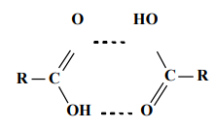
Physical properties
Only formic acid, acetic acid, and lactic acid are liquids at room temperature.
The other carboxylic acid are solids.
Low molecular weight carboxylic acids are soluble in water.
Water insoluble acids ( when have high molecular weight) dissolve in both sodium hydroxide solution and sodium bicarbonate solution.
Melting point and boiling point higher than alcohol and aldehyde due to hydrogen bonds: two molecules of the carboxylic acid are held together by two hydrogen bonds rather than one.

Slide 5
General carboxylic acids.
1-Sodium bicarbonate test
reacts with acidic solutions to form carbon dioxide
which is released as gas from the solution
resulting in so-called brisk effervescence due to carbon dioxide formation.
Sodium hydrogen carbonate can be used to test for general carboxylic acids.
If effervescence occurs that mean an acid group is present.

Slide 6
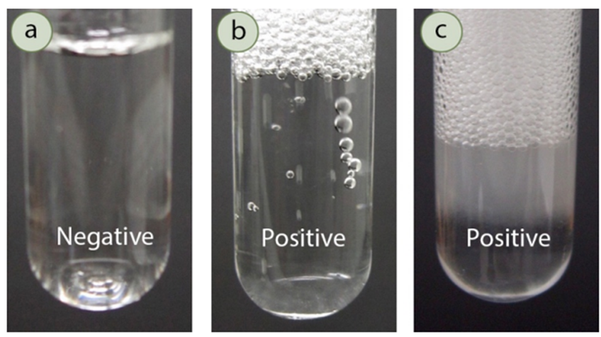
Sodium bicarbonate procedure
Put 2 mL of a saturated aqueous solution of sodium bicarbonate (10 % N) in a clean test tube.
Add a few drops of the liquid compound or a few crystals of the solid compound to it
Add the compound slowly so that effervescence is clearly visible.
Results:

Slide 7
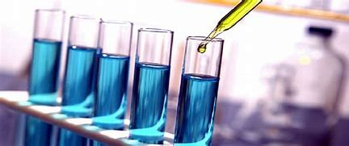
Chemical Tests
General Test ( ferric chloride test)
procedure:
1- Add 0.5 ml or few mg of carboxylic acid + drop by drop dil. NH4OH solution (ammonia solution). shaking as indicated by changing the color of litmus paper to blue until ammonia odor appear
2- Gently heating the test tube in a water bath with shaking ( till ammonia odor disappear) in this case the solution is neutral
On cold: add one or few drops of 10% M FeCl3
Results:
Formic acid and acetic acid gives: dark red color.
Succinic acid and benzoic acid gives: light brown precipitate
Salicylic acid gives: a violet color.
Oxalic, citric, tartaric or lactic acids gives: no color change

Slide 8
Steps and condition to needed to make this test
Type of reaction: complex formation

Slide 9
Note: elimination of the excess ammonia is important since the brown orange precipitate of ferric hydroxide formed by this excess interferes with the color of the ferric salt of the acid resulting in a false result.
False negative result

Slide 10
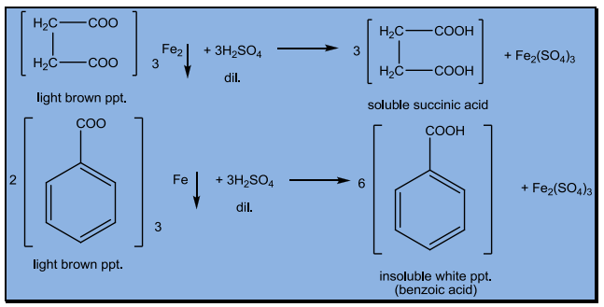
Distinguish between Succinic acid and benzoic acid:
add to the precipitate few drops of dilute sulfuric acid to liberate the free carboxylic acid again.
In one case the liberated acid is water soluble and it is succinic acid which is aliphatic.
On the other hand benzoic acid is liberated as a white precipitate because it is insoluble in water since it is aromatic.

Slide 11
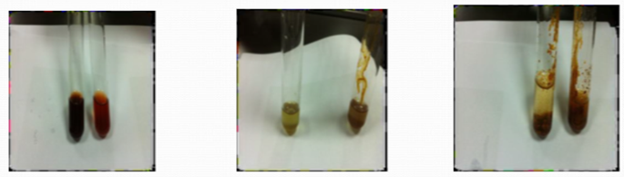


Red color formic & acetic

Slide 12

Especial tests:
1-Especial tests of Formic acid
A-Reduction test ( Alkaline Kmno4):
Procedure:
1 ml of the carboxylic acid heat for 1 minute
add 3 ml of Na2CO3 or 10 % M sodium bicarbonate solution
Then add one drop of 1% M potassium permanganate solution
Observe the disappearance of a brown precipitate of manganese oxide.
Results:
Formic acid: de-colorization violet color of KMno4 and formation brown ppt.
Acetic acid: no reaction
Type of reaction: decarboxylation

Slide 13
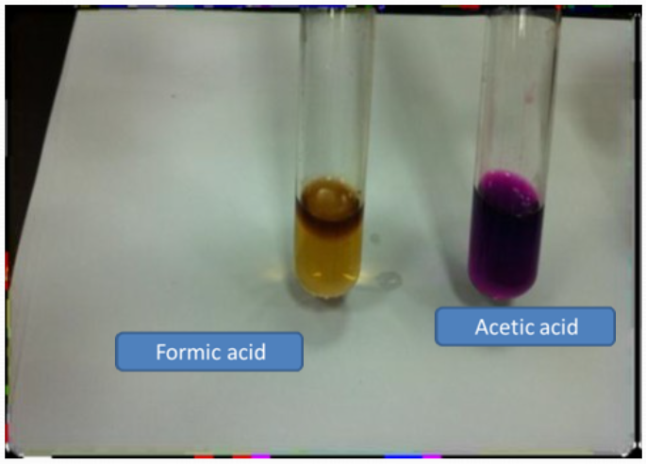

Slide 14
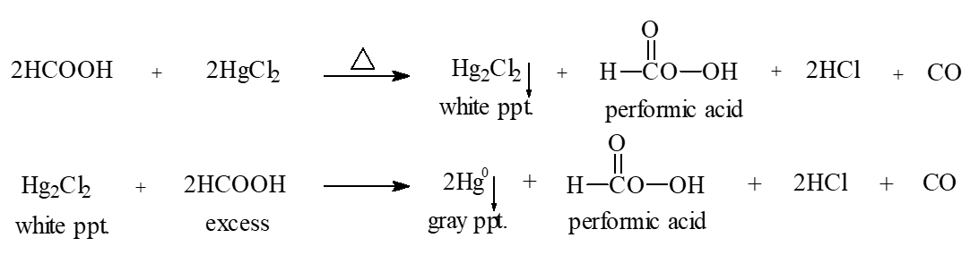
B-HgCl2 test.
Formic acid reduces mercuric ion (Hg+2) to mercurous ion (Hg+) (white precipitate) in the presence of excess acid, to mercury (gray ppt).

Slide 15
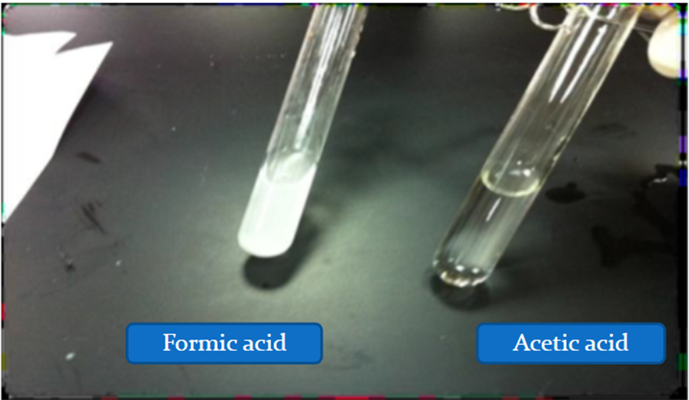

Slide 16
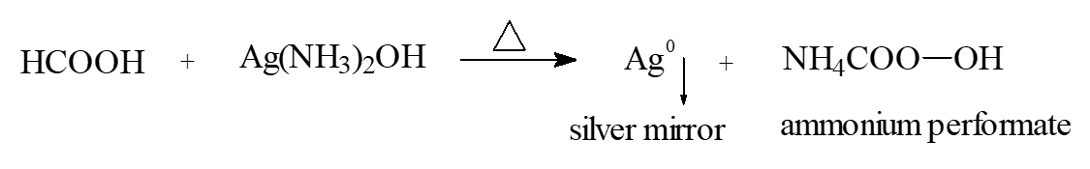
C-Tollen's test
Reagent is Ag(NH3)2OH.
Depends on formation salt of acid and metal (Ag) as silver mirror

Slide 17
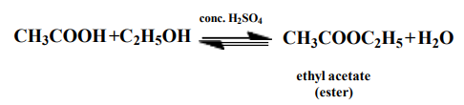
2) Esterification test: especial test of acetic acid)
Procedure:
Mix 1 mL of acetic acid with 2 mL of ethanol in a test tube add to this mixture 2–3 drops of concentrated sulphuric acid.
Heat the test tube in a water bath for 10 minutes
pour the mixture into another test tube containing 5 mL sodium bicarbonate solution.
Results:
Formic acid: no reaction
Acetic acid : fruity odor

Slide 18

3-A:Acidic KmnO4 test. Special test for oxalic acid
Oxalic acid doesn't react with alkaline potassium permanganate solution.
With acidic potassium permanganate solution it reacts causing de-colorization of the reagent
Procedure:
Dissolve 0.5 gm of the acid in 2 - 3 ml of distilled water add 2 - 3 ml of dilute sulfuric acid. Heat gently (water bath)
then add 1% M potassium permanganate solution drop by drop.
Results: - observe the disappearance of the violet color of the reagent.

Slide 19
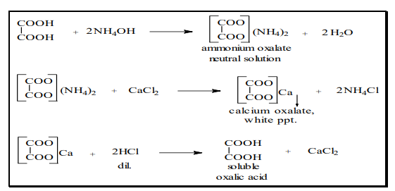
3-B: CaCl2 test(Special test for oxalic acid)
Procedure:
1ml of carboxylic acid the add NH3 drop by drop until solution litmus paper color change to blue
Gently heating the test tube in a water bath with shaking ( till ammonia odor disappear) in this case the solution is neutral
On cold : add few drops of 10 % M calcium chloride solution
Result:
a white precipitate of calcium oxalate is formed.
type of reaction: complex formation

Slide 20
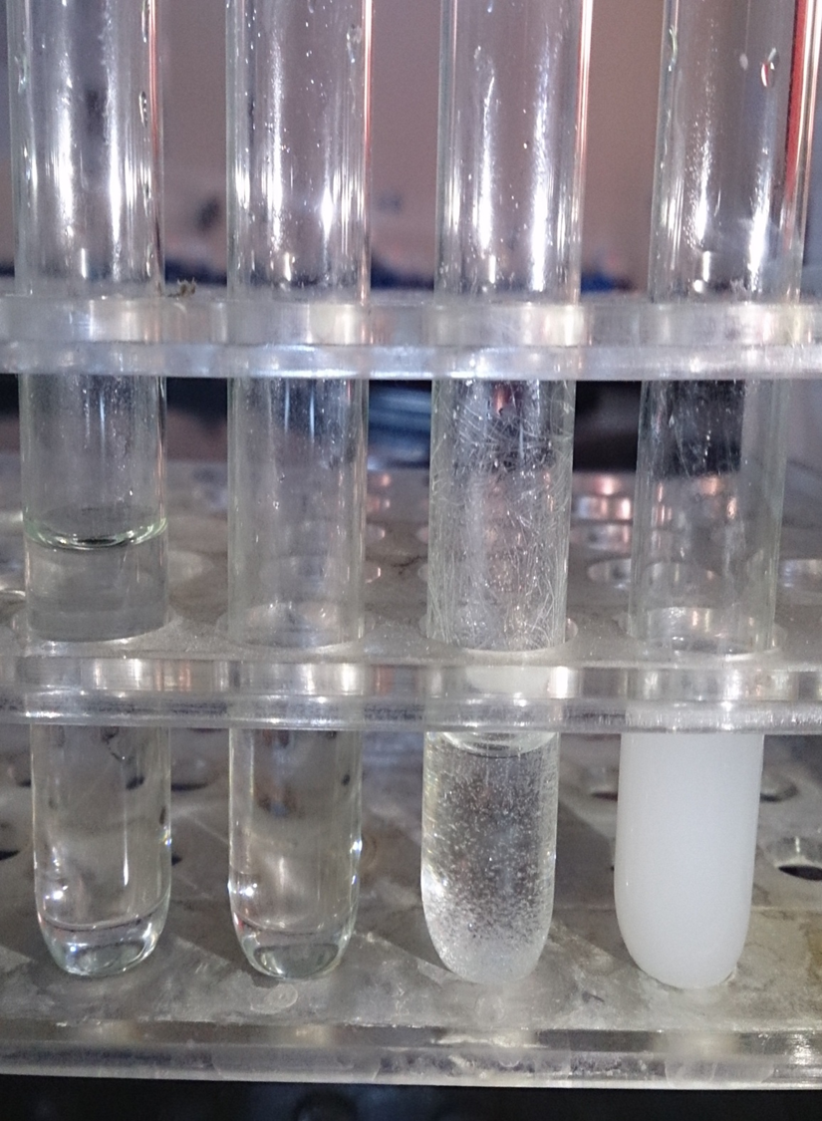
benzoic
acid
Formic
acid
tartaric
acid
oxalic
acid

Slide 21
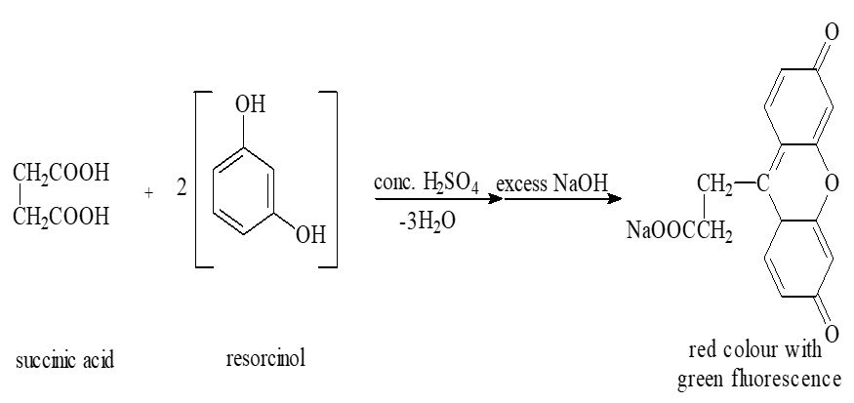
4-Fluorescence test for succinic acid
reagent resorcinol and concentrated sulfuric acid
Heat the mixture until the mixture melts.
Cool and add excess of 10% sodium hydroxide solution to get a red color with green fluorescence.

Slide 22
Acid | Tests result with description
 | FeCl3 | Alkaline KMNO4 | esterification | Acidic KMNO4 | CaCl2
Formic | Red color | Brown ppt. | - | -
Acetic | Red color | - | Fruity odor
Citric | Yellow |  |  | + ve | White ppt. after boiling
Oxalic | - |  |  | Decolonization of violet color | White ppt. immediately
Succinic | Light brown ppt.
Tartaric | Yellow |  |  |  | White ppt. On wall tube
Benzoic | Light brown ppt.
Salicylic | violet |  | Special odor

Slide 23
Referances
1) Robert T. Morrison , Robert N. Boyd, Organic Chemistry, sixth edition.
2) Azhar M. Jasim , Duraid H. Mohammad , A Laboratory Manual on Practical Organic Chemistry for 2nd year students, University of Baghdad , College of Pharmacy, Department of Pharmaceutical Chemistry, 2012.

Slide 24


