Slide 1


Identification of ester
Second stage/ First semester
2025-2026
Lab 6
Done by:
Assistant Lecturer: Hawazin Aziz Hamim

Slide 2
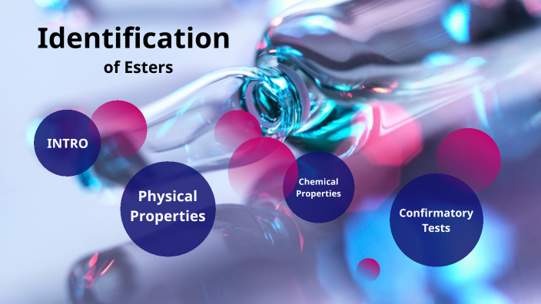

Slide 3
The names of esters are similar in form to those of the salt of carboxylic acids.
HCOOCH3 CH3COOCH3 CH3COOCH2CH3
Methyl formate methyl acetate ethyl acetate
Methyl benzoate

Slide 4
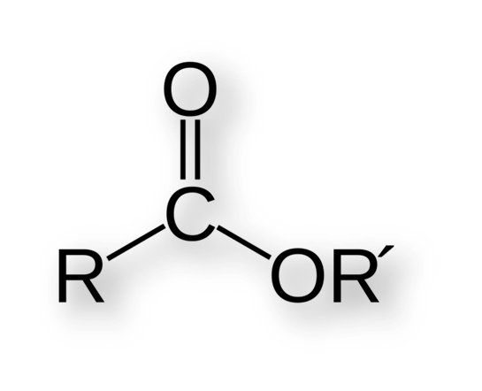
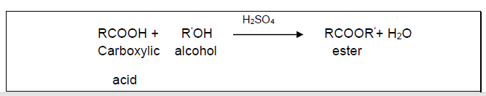
Esters:
The general formula for an ester is RCOOR‘.
An ester can be prepared by reacting an alcohol with carboxylic acid.
The R group in the general formula was part of the acid. The other group, symbolized R‘was part of the alcohol.
Sulfuric acid catalyzes the reaction.

Slide 5
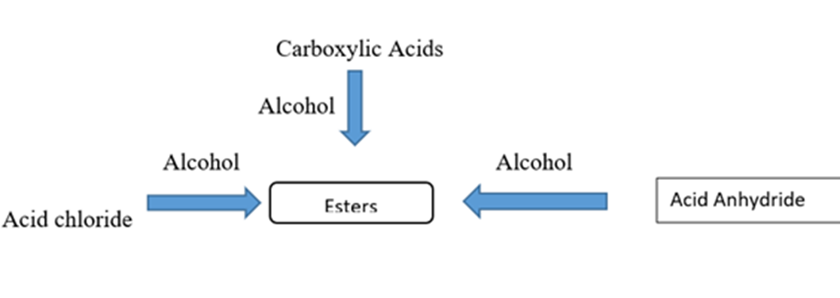

Slide 6
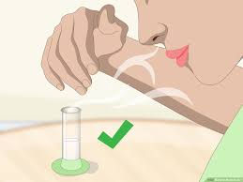
Physical properties:
Colorless, liquids
fruity aromas.
The aroma and flavor of many foods are due to of esters.
Chemical properties:
Soluble in water , H2SO4

Slide 7
General Test
Ferric hydroxamate test
Reagent is NH2OH.HCl, FeCl3
Depends on hydroxyl amine hydrochloride react with ester under basic condition to form hydroxamic acid then addition (FeCl3) under acidic condition to form complex color.
Produced deep red color.

Slide 8
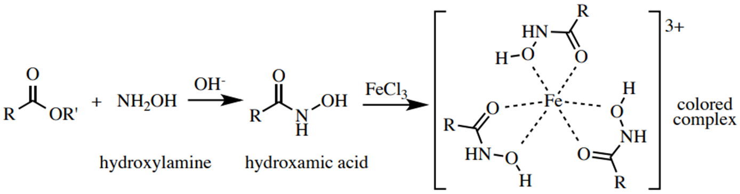
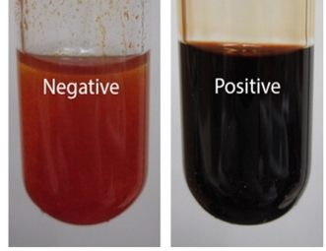
Chemical equation:

Slide 9
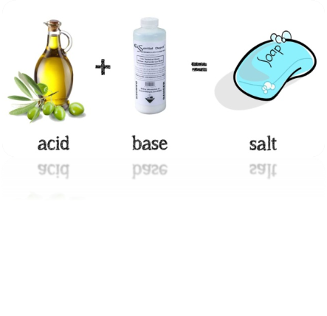
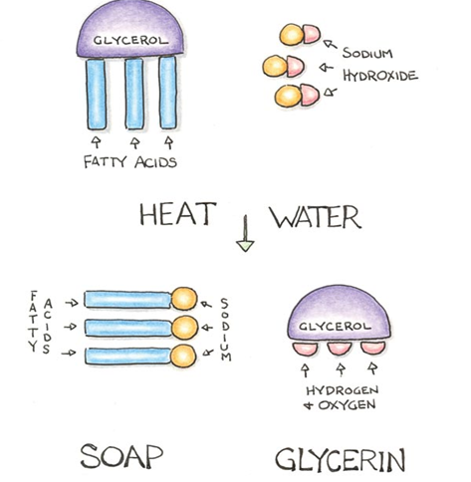
The preparation of soap (Saponification)
Soap is prepared by the hydrolysis of triglycerides in the presence of strong base like NaOH or KOH.
- fatty acids salt as products of the hydrolysis. Then neutralized by the NaOH or KOH to form the soap (salt of a fatty acid).
- The reaction that produces soap is called Saponification

Slide 10


