Slide 1
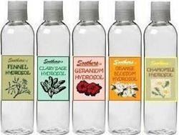
AROMATIC WATERS (AQUA AROMATICA)
Dr. ibtihal
Lec. zahraa
Ass.lec.Mustafa M.Noori
Ass. Lec. lamyaa

Slide 2
AROMATIC WATERS
Aromatic waters are colorless , clear and free from fibers, particles contains more or less saturated clear or almost clear aqueous or weak alcoholic solutions of volatile oils or other odoriferous volatile substances.

Slide 3
Uses of Aromatic Waters
They provide pleasantly flavoured mediums for the administration of water-soluble medicinal.
They also mask the undesirable tastes in suspensions and emulsions.
Several aromatic waters are not used as vehicles for oral medication e.g. Rose water, Hammemlis water and Camphor water. Rose water is a perfume, Hammdmlis water is used as astringent in after shave lotions & other cosmetic products, camphor water is frequently prescribed in eye drops and eye washes for its slight refreshing, . stimulating effect

Slide 4
Methods of preparation
  Distillation Method .
  Solution Method .
  Alternative Method .

Slide 5
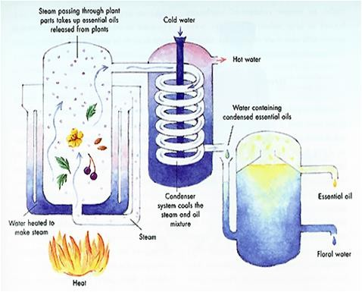
Distillation
Distil the drug, in a suitable still, with a, sufficient quantity of potable water or dilute alcohol until the specified volume of aromatic water has been collected. Set aside for 12 hours, separate the undissolved portion of the distillate if any, and filter if necessary.

Slide 6
Solution Method
Triturate the specified amounts of the substance with of the talc , then gradually add recently boiled and cooled distilled water, in successive small portions, and agitate the mixture frequently for 15 minutes. Set aside for 12 hours, filter and pass sufficient of the water through the filter to produce the final volume of almost clear filtrate.

Slide 7
Solution Method
Purified talc used in this process serves two purposes:
That of dispersing the volatile substances so as to make it more completely soluble in water.
Aids the filtration from excess of volatile oil as ordinary filter paper will not hold back finely dispersed particles, especially oils. The talc is a good adsorbent and the undissolved volatile material is adsorbed and prevented from passing through the filter.

Slide 8
Alternative Method
Dissolve the specified amount of the substance in part of alcohol, add to the solution sufficient recently boiled and cooled distilled water in successive small portions, to produce solution, shaking vigorously after each addition. Add if necessary part of talc and shake vigorously. Set aside far a few hours, with occasional shaking then filter.

Slide 9
Stability of Aromatic Waters
Excessive exposure to light and to changes in temperature cause aromatic waters to loose some of their desirable characteristics. Since the solutes are volatile materials loss of aroma occurs on prolonged exposure to the hot atmosphere. Since aromatic waters are saturated solutions, lowering the temperature causes separation of the aromatic component, thus producing cloudiness.

Slide 10
Preservation of Aromatic Waters
Aromatic waters should be freshly prepared and should not be made in larger quantities than can be used within a reasonable time as they deteriorated when kept too long, usually through the development of micro-organisms" all traces of their agreeable odour disappearing.

Slide 11
Notes
To avoid as far as possible the presence of micro- organisms the water used for preparing aromatic water should be recently boiled, distilled water, as that ordinary distilled water is usually contaminated by the presence' of such micro-organisms. No preservative should be added to aromatic waters.
If they become cloudy or otherwise deteriorate, they should be discarded. Alcohol should not be added as preservative:. Moreover, aromatic water should be protected from strong light; and freezing, which hasten decomposition.

Slide 12
Camphor water: Aqua camphorae :
Camphor water is a saturated aqueous solution of camphor.
It is the only aromatic water prepared from a solid.
Rx/
Camphor 1 gm
Alcohol 15 ml.
Purified water to 1000 ml.
Mitte 100 ml
Uses: as carminative internally and antiseptic externaly

Slide 13
Method of preparation
Dissolve the camphor in the alcohol and add purified water to this alcoholic solution in successive portions, shaking vigorously after each addition until all the camphor is dissolved.
Adjust to the required volume with purified water.

Slide 14
Peppermint water (Aqua menthae)
Peppermint water is a clear saturated aqueous solution of peppermint oil in distilled water. .
Rx/
Peppermint oil 1.5 ml
Talc 15 gm
Purified water 1000 ml
Mitte 100ml
Uses: Carminative and flavoring vehicle, mildly sedative to the stomach.

Slide 15
Method of preparation
Triturate the peppermint oil with powder talc in a mortar till well mixed.
Add gradually purified water in portions and triturate.
Transfer the content of the mortar to a suitable bottle and rinse the mortar with the remaining water adding the rinsing to the contents of the bottle.
Shake the bottle for 10 minutes.
Filter through a dry small filter paper.
Return the first portion of the filtrate and re-filter it again
If the filtrate remains turbid, re-filter it till become clear

Slide 16
Thank You

