Slide 1
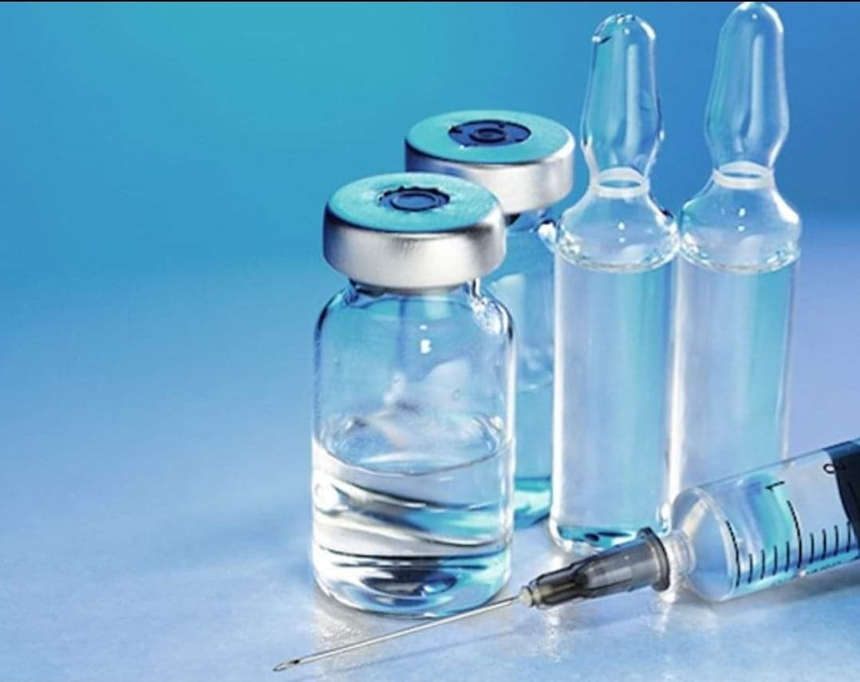
Quality Evaluation of Parenteral Preparations
Dr. ibtihal
Lec. zahraa
Ass.lec.Mustafa M.Noori
Ass. Lec. lamyaa

Slide 2
Learning Objectives
Understand key quality parameters of parenteral products
Learn essential testing methods
Recognize regulatory and sterility requirements
Review evaluation techniques for safe administration

Slide 3
Introduction to Parenteral Preparations
Parenteral products are sterile dosage forms administered via injection.
They bypass the gastrointestinal tract.
Require strict quality control for safety and efficacy.

Slide 4
Key Quality Parameters
Sterility
Pyrogen and endotoxin levels
Particulate matter
pH and tonicity
Container–closure integrity

Slide 5
Sterility Testing
Ensures absence of viable microorganisms.
Methods:
1-Membrane filtration
2-Direct inoculation
Conducted under aseptic conditions.

Slide 6
Pyrogen & Endotoxin Testing
Pyrogens cause fever reactions.
Limulus Amebocyte Lysate (LAL) test for endotoxins.
Rabbit pyrogen test (less commonly used today).

Slide 7
Particulate Matter Evaluation
Ensures absence of visible and sub-visible particles.
Methods:
1-Visual inspection
2-Light obscuration particle count test
3-Microscopic particle count method

Slide 8
Physicochemical Tests
pH measurement
Osmolality and tonicity
Assay of active ingredient
Stability studies

Slide 9
Container–Closure Integrity
Ensures package prevents contamination.
Tests include:
• Dye ingress test
• Vacuum decay test
• Pressure decay test

Slide 10
Conclusion
Quality evaluation ensures safety, sterility, and efficacy.
Critical for patient protection.
Parenteral products require rigorous testing at all stages.

Slide 11
Thank You

