Slide 1
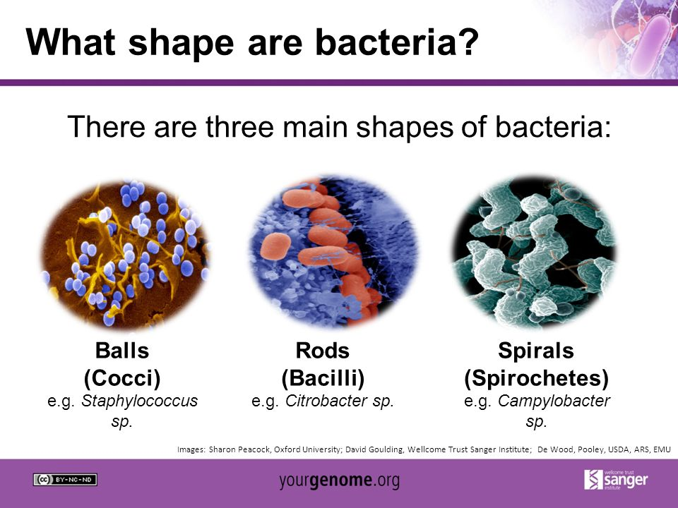
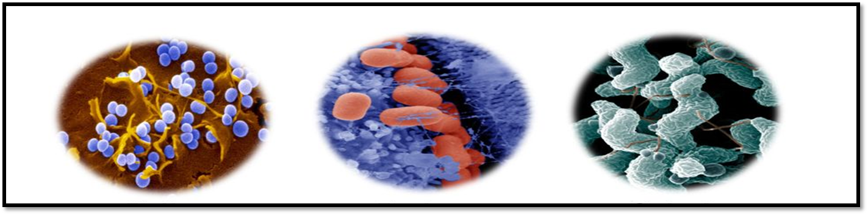
Medical Microbiology
Lab.2
2nd
2025-2026
By
Lec.Ishraq Hasan Elewi
Lec. Zainab Farooq Shafeeq
Assist Lec. Dhuha Khudair Kariem
Assist Lec . Marwah Lafta
Assist Lec. Abeer Mahmood

Slide 2
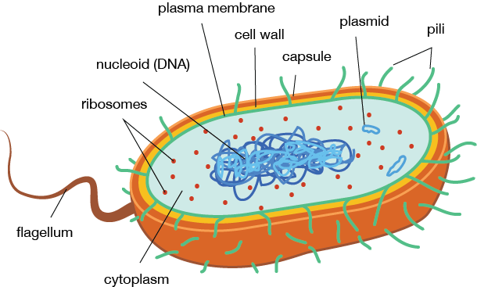
Bacterial Morphology
Bacteria: are unicellular free living organisms without chlorophil having doth DNAand RNA

Slide 3
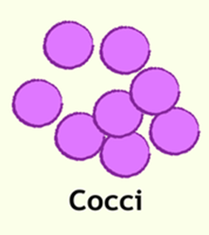

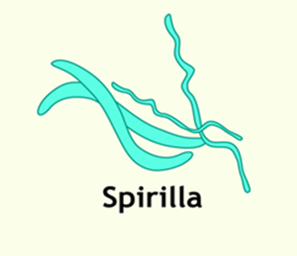
Bacterial morphology
Can be grouped into three types
1- Spherical (cocci)
2- Rod – shaped
(bacili)
3 – Helical
(spirilla)

Slide 4

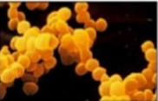
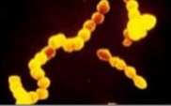
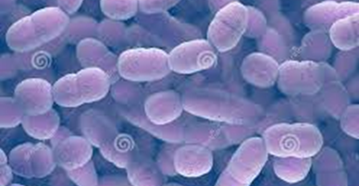
1- Spherical ( cocci) : bacteria may occur single , in pairs ,
in tetrads , in chain and in irregular masses.
Staphylococcus aureus
(in clusters)
Streptococcus pyogenes
(in chain)
Streptococcus pneumoniae
(in pairs)

Slide 5
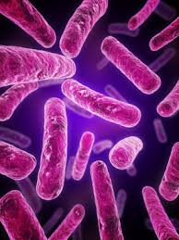
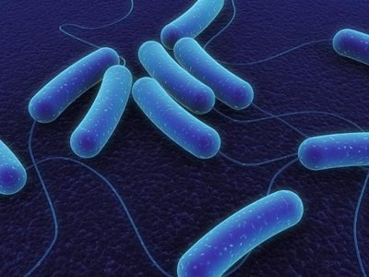
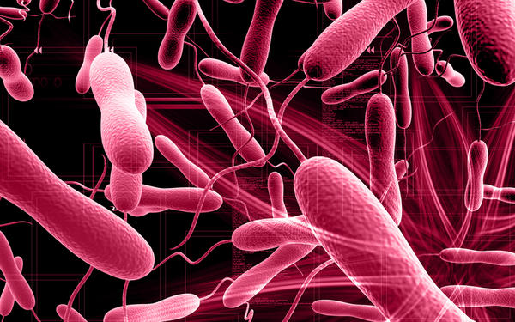
2- Rod – shaped(bacilli): bacteria may vary considerably in length may have square , round , or pointed end and may be motile or non-motile
Bacillus subtilis
Escherichia coli
3- Helical and curved bacteria : exite as slender spirochaetes , spirillum and bent rods (vibrios).

Slide 6
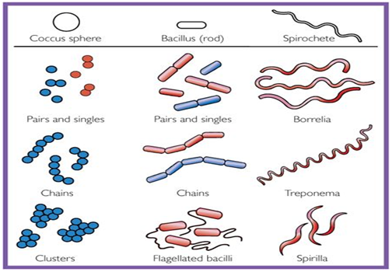

Slide 7
Smear preparation and simple stain
Smear preparation
Principles
A bacterial smear is a dried preparation of bacterial cells on a glass slide.
In bacterial smear that has been properly processed :
1- The bacteria are evenly spread out on the slide in such a concentration that they are adequately separated from on another.
2- The bacteria are not washed off the slide during staining.
3- Bacterial form is not distorted.

Slide 8
Procedure:
In making a smear the bacteria from either a broth culture or an agar slant or plate my be used . If a slant or plate is used , a small mount of bacterial growth is transferred to a drop of water on a glass slide and mixed , and the mixture is spread out evenly over a large area on the slide .
If the medium is liquid , place one or two loops of the medium directly on the slide and spread the bacteria over a large area.
Allow the slide to air dry at room temperature. The next step is to attach the bacteria to the slide by heat fixing . This is accomplished by gentle heating , passing the slide several time through the hot portion of flame of a Bunsen burner . Most bacteria can be fixed to the slide and killed in this way without serious distortion of cell structure.

Slide 9
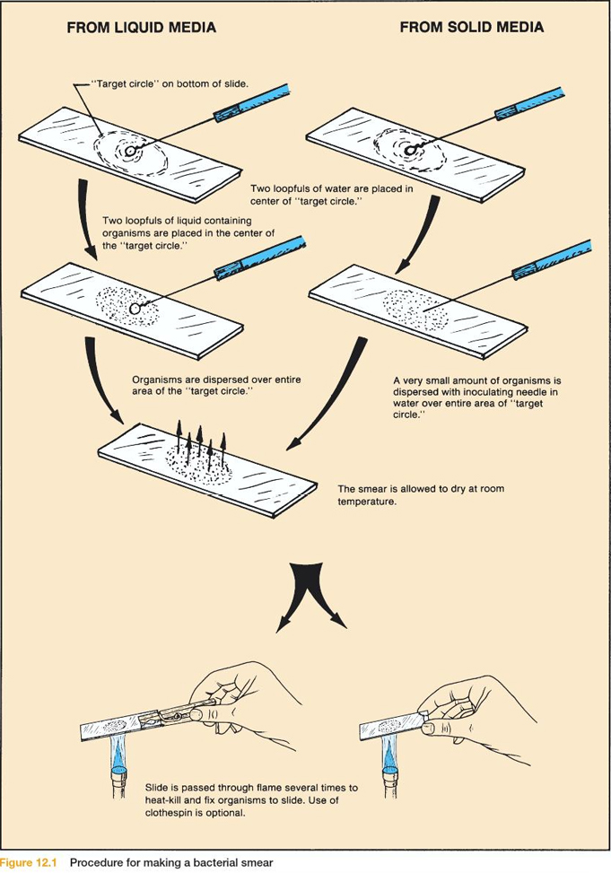

Slide 10
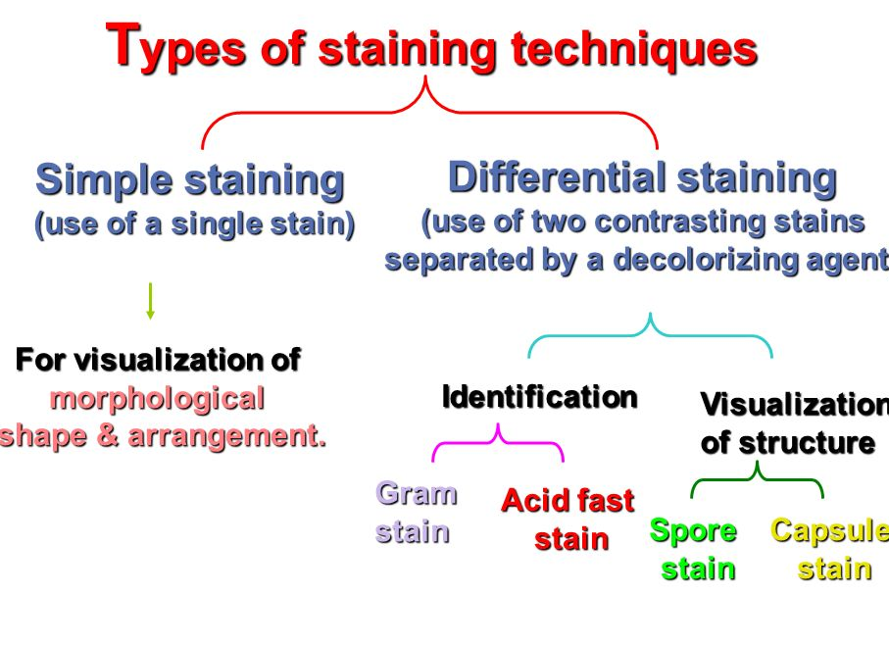

Slide 11
Simple stain
Principles
Simple staining is carried out to visualize bacteria and to compare morphological shapes and arrangements of bacterial cells.
In simple stain , the bacterial smear is stained with single basic dye .
Bacterial cell surface is slightly negative so it tends to bind strongly to the cationic chromogen of basic dyes.
Commonly used dyes for simple staining are :
Crystal violet (20-30 sec. staining time).
Methylene blue (60 sec. staining time).
Carbolfuchsin (5-10 sec. staining time).

Slide 12
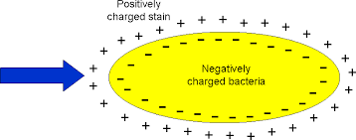
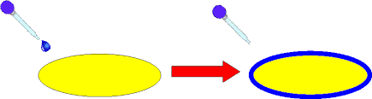

Slide 13
