Slide 1

Al-Mustansyria University
College Of Pharmacy
Biochemical Activities Bacteria

Slide 2
Triple Sugar Iron Agar Test
Triple sugar iron agar test is generally used for the identification of enteric bacteria , also used to distinguish the Enterobacteriaceae from other gram negative intestinal bacilli by their ability to catabolic glucose , lactose or sucrose and to liberate sulfide from ferrous ammonium sulfate or sodium thiosulfide .
TSI agar slant contain 1% concentration of lactose and sucrose , and 0.1% glucose concentration .
The pH indicator phenol red , is also incorporated in to medium to detect acid production from carbohydrate fermentation .
TSI slant are inoculated by streaking the slant surface using a zig-zag streak pattern and than stabbing the agar deep with straight inoculating needle , incubation is for 18-24 hours in order to detect the presence of sugar fermentation , gas production , and H2S production .

Slide 3
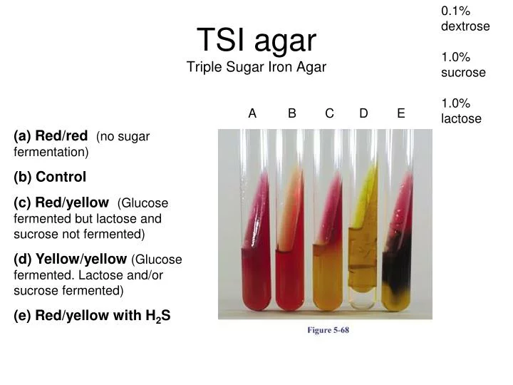

Slide 4
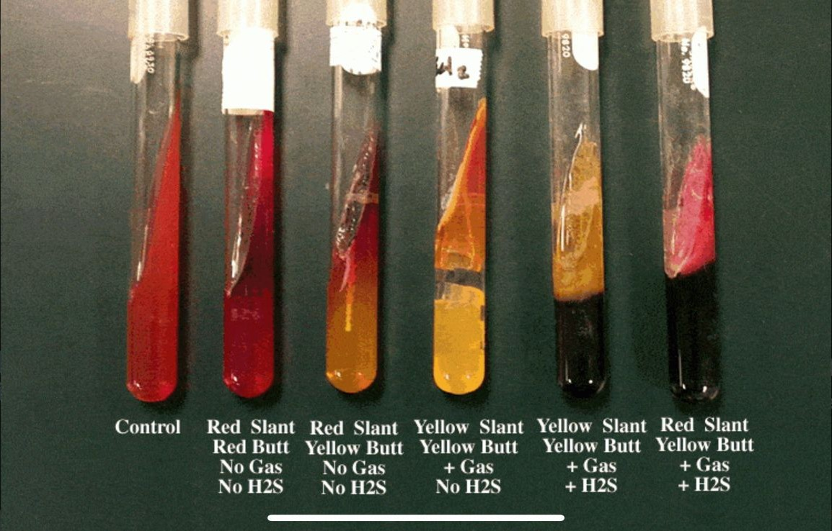

Slide 5
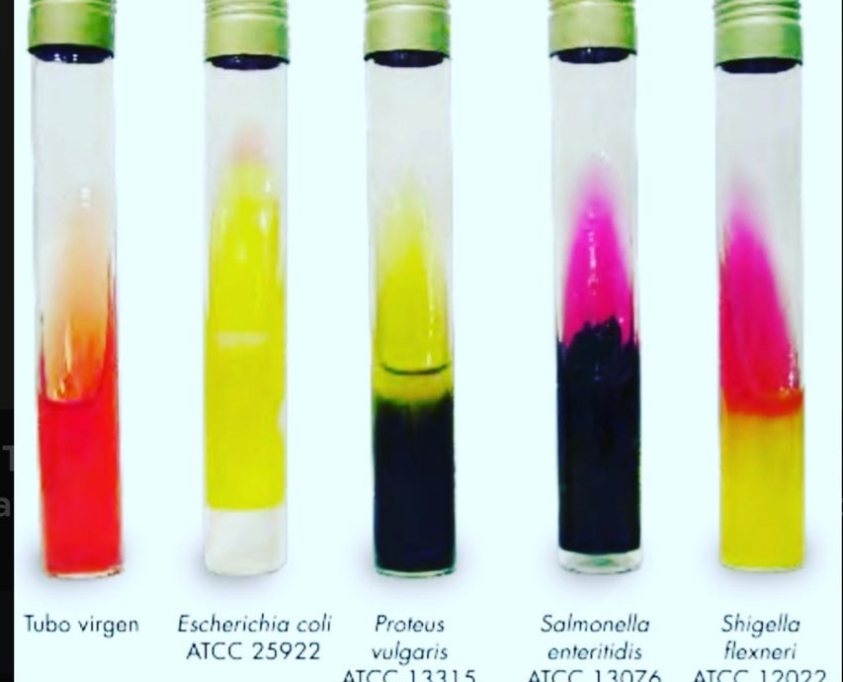

Slide 6
TSI
Triple Sugar Iron Agar Test
result | slant | bottom | gas | H₂S | Scientific name
K\K | Red | Red | _ | _ | Pseudomonas spp.
A\A | yellow | yellow | + | _ | Escherichia coli
A\A | yellow | yellow | _ | + | Proteus vulgaris
K\A | red | yellow | _ | _ | Shigella spp.
K\A | red | yellow | + | + | Salmonella spp.

Slide 7
The IMViC Test
The identification of enteric bacteria is of prime importance in determining certain food born and water borne disease .
Many of the bacteria that are found in the intestines of humans and mammals belong to the family of Enterobacteriaceae .
These bacteria are short , gram negative , non sporing bacilli .
They can be subdivided into lactose fermenters and non fermenters

Slide 8
IMViC Test
I = test for production indole from tryptophan.
M = methyl red test for acid production from glucose .
V = voges-proskauer test for production of acetoin from glucose .
C = test for the use of citrate as the sole for carbon source .

Slide 9
Indole production
The amino acid tryptophan is found in nearly all proteins .
Bacteria that contain the enzyme tryptophanase can hydrolyze tryptophan to its metabolic products , namely , indole , pyruvic acid and ammonia .
The bacteria use the pyruvic acid and ammonia to satisfy nutritional needs ; indole can be detected by the addition of Kovac’s reagent , which reacts with the indole producing a bright red compound on the surface of the medium .

Slide 10
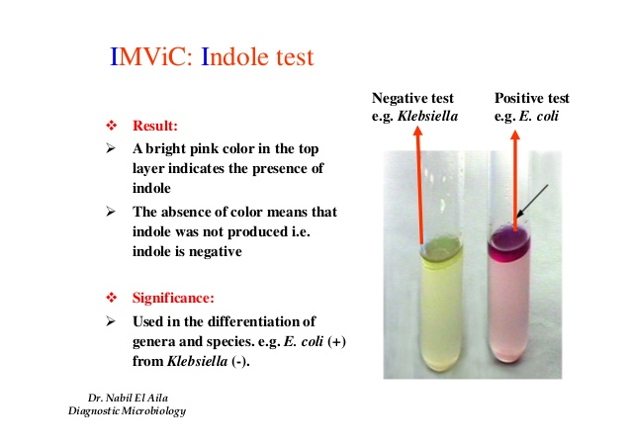

Slide 11
Methyl red test
A considerable number of gram negative intestinal bacteria can differentiated on the basis of the end produced when they ferment glucose in MR-VP medium (glucose phosphate peptone water) broth tube.
Genera of bacteria as Escherichia , Salmonella , Proteus , ferment glucose to produse large amounts of (lactic , acetic , succinic and formic acids) .
Methyl red is a pH indicator ( red at pH less than 4.4 and yellow at a pH greater than 6 ) .

Slide 12
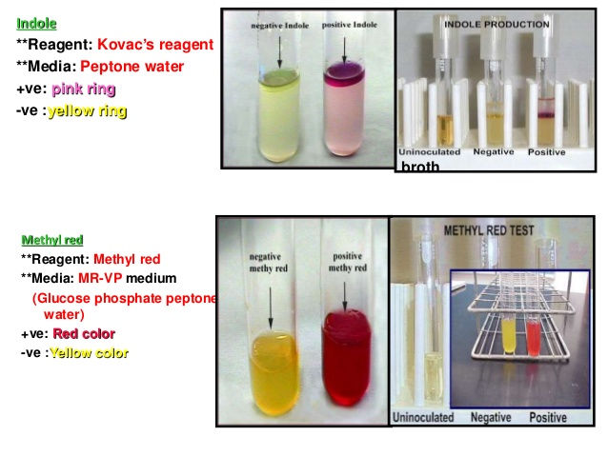

Slide 13
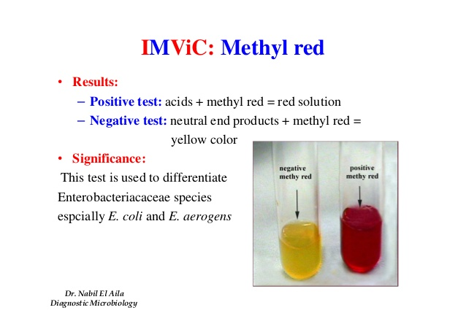
Methyl red test
Klebsiella pneumoniae
Escherichia coli

Slide 14
Voges-Proskauer test
The Voges – Proskauer test identifies the bacteria that ferment glucose , leading to 2,3 butanediol accumulation in the medium the addition of 40% KOH and 5% solution of α-naphthol in absolute ethanol ( Barrit’s reagent ).
In the presence of the reagent and action a cherry red color develops in the culture medium 15 minutes following the addition of Barrit’s reagent represents apositive VP test ; absence of red color is negative VP test.

Slide 15
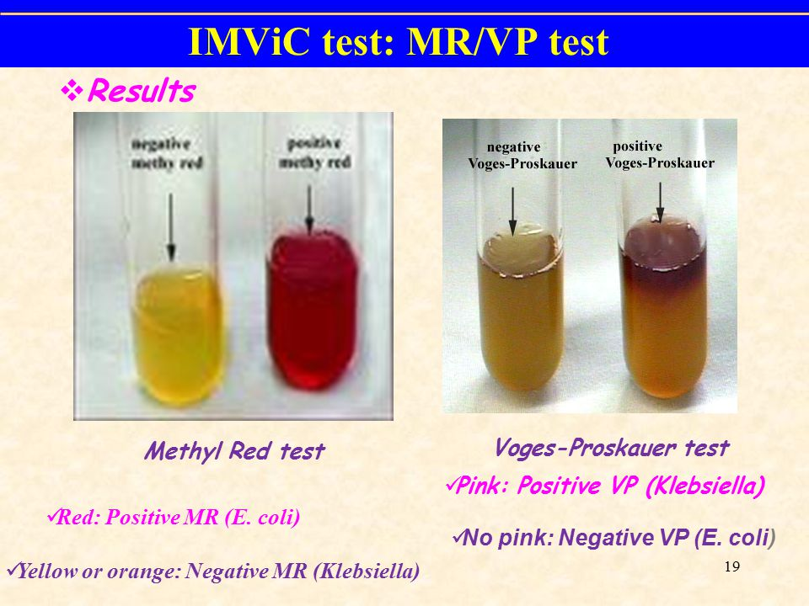
Voges-Proskauer test
Klebsiella pneumoniae
Escherichia coli

Slide 16
Citrate utilization
This test determines the ability of bacteria to use citrate as a sole carbon source for their energy needs .
This ability depends on the presence of citrate permease that facilitates transport of citrate into the bacterium .
Once inside the bacterium , citrate is converted to pyruvic acid and CO2.
Simmon citrate agar slant contain sodium citrate as the ( carbon source) ammonium ion (NH4) as the ( nitrogen source) & the pH indicator (Bromothymol blue) .

Slide 17
This test is done on slants since O2 is necessary for citrate utilization .
When bacteria oxidize citrate , they remove it from the medium and liberate CO2.
CO2 combine with sodium (supplied by sodium citrate) and water to from sodium carbonate – an alkaline product .
This raises the pH , turns the pH indicator to a blue color and represents a positive citrate test ; absence of a color change is negative citrate test .
Citrate negative cultures will also show no growth in the medium and the medium remains green.

Slide 18
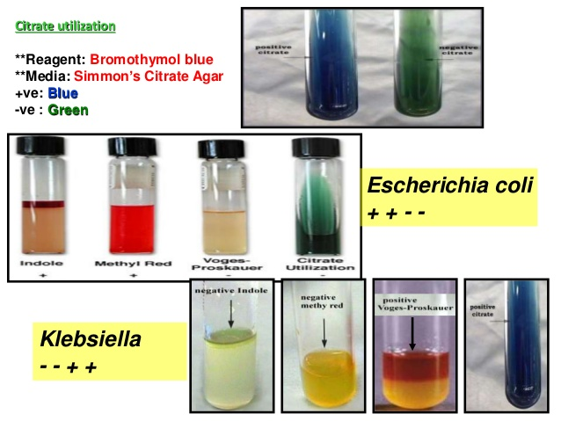

Slide 19
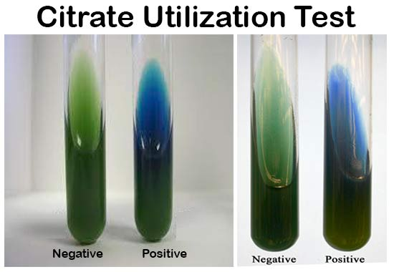
Citrate utilization
Escherichia coli
Klebsiella pneumoniae

Slide 20
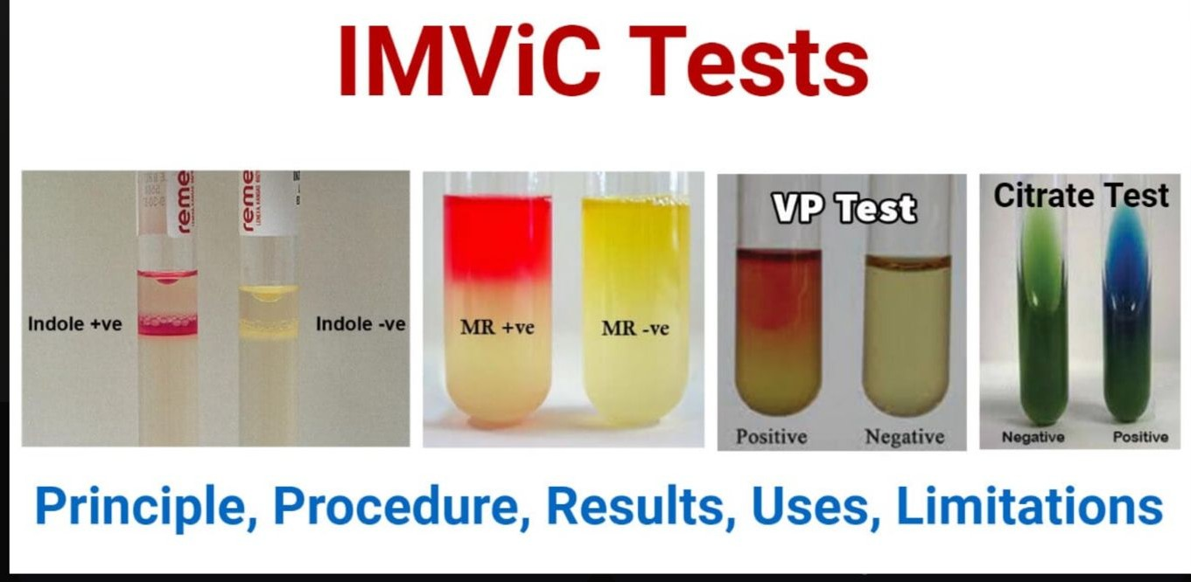

Slide 21
IMViC tests
No. | Bacteria | Indole (I) | Methyl red (M) | Voges Proskauer (V) | Citrate (C)
1. | Escherichia coli | + | + | _ | _
2. | Klebsiella pneumoniae | _ | _ | + | +

