Slide 1


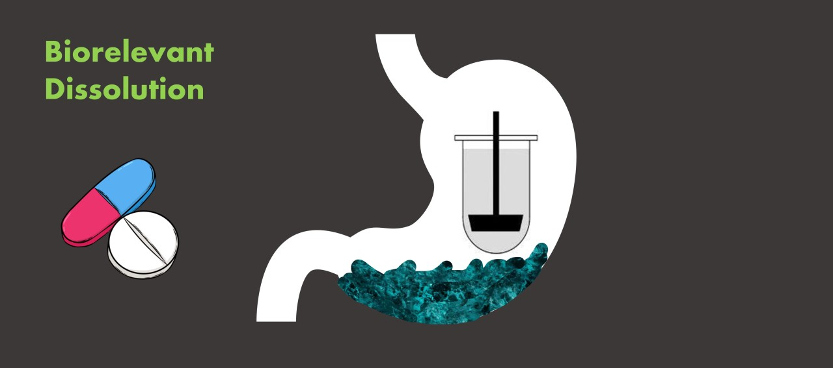
In vitro dissolution study of per – oral tablet
Assistant Prof. Anas Tariq
Lec. Nora Zawar
Lec. Zeina Dawood
Lec. Sura Zuhair

Slide 2
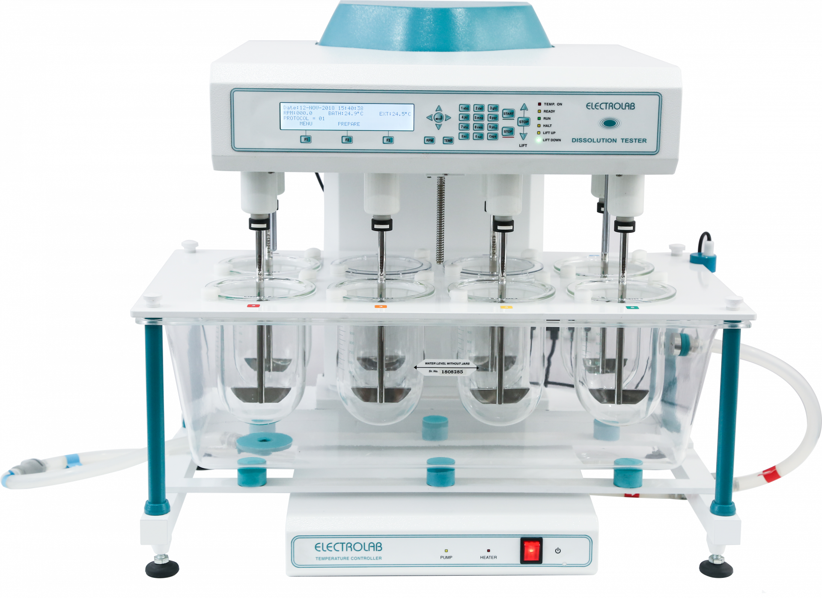
Introduction :
Dissolution is a process of going into solution form .
A basic principle of drug absorption is that absorption takes place only after a drug is in solution.
this means that drug given orally in solid dosage form must dissolve in GIT fluid before absorption occurs

Slide 3
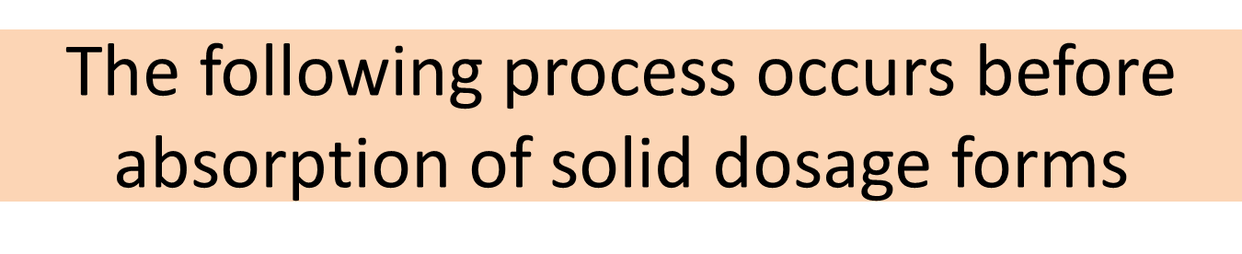
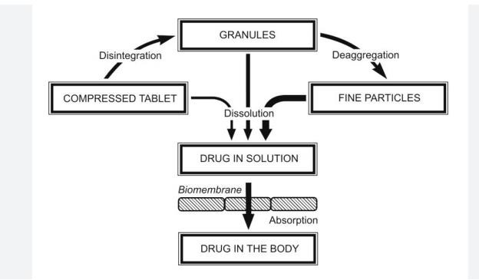

Slide 4
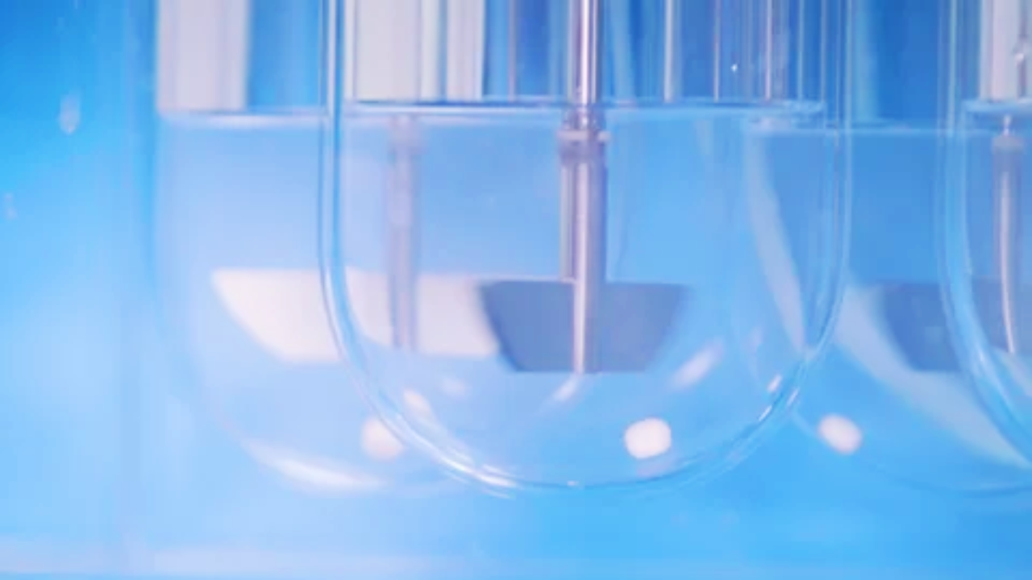
DISSOLUTION RATE : Is DEFINED AS THE AMOUNT OF SOLID SUBTANCE THAT goes into solution per unit time under standard condition of temperature , Ph and solvent composition
Dissolution is the rate limiting step for hydrophobic poorly soluble drug for example, griseofulvin and spironolactone

Slide 5
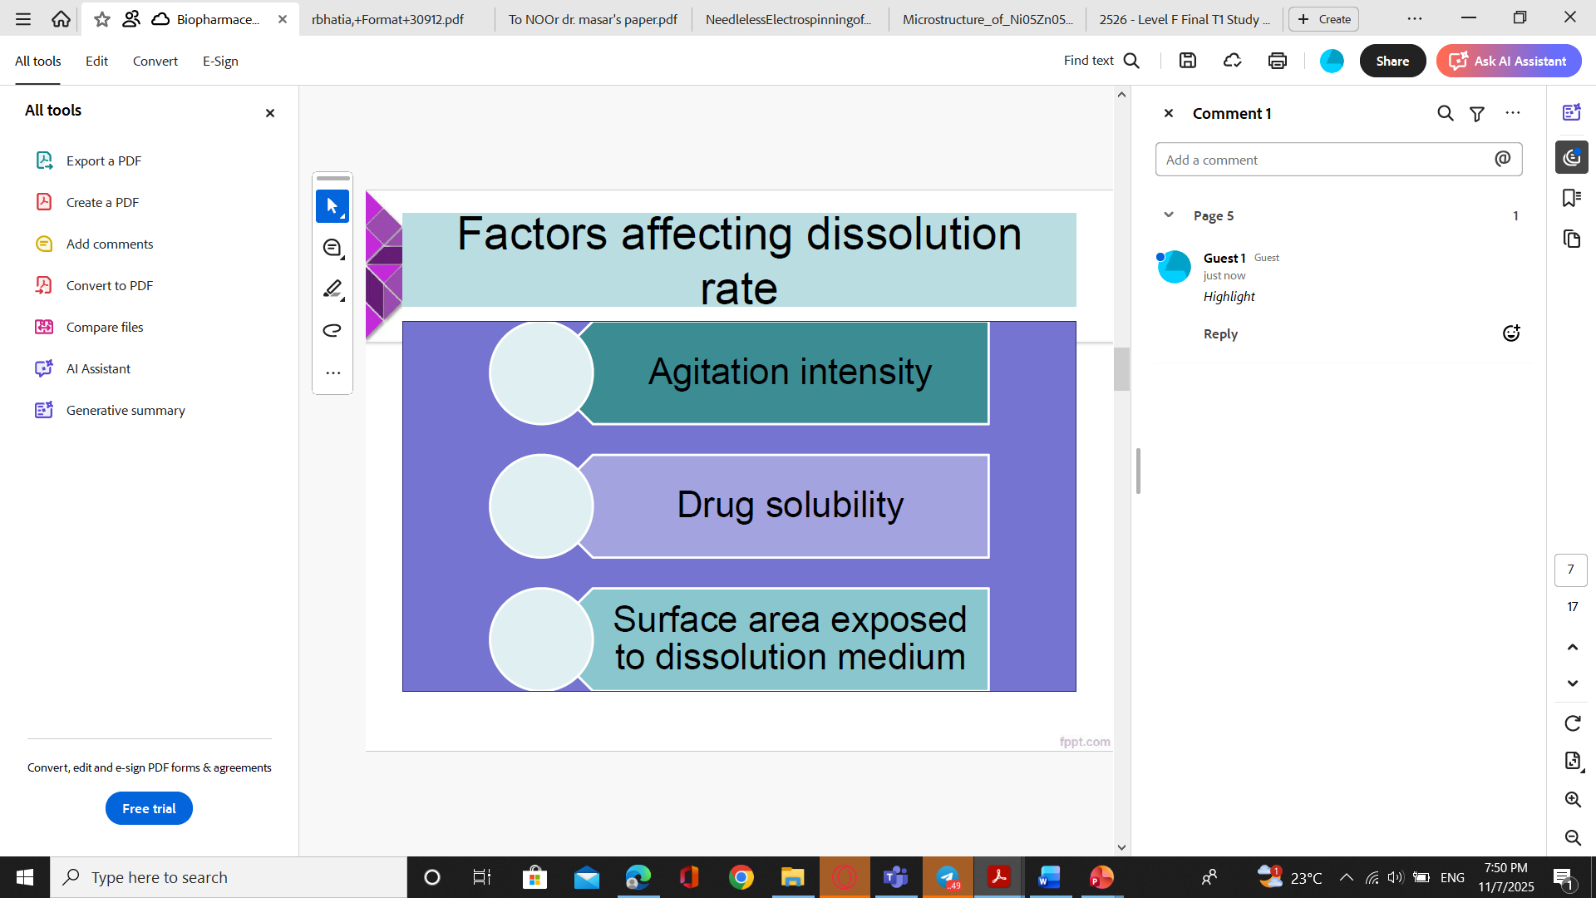
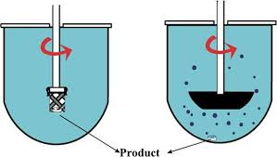

Slide 6
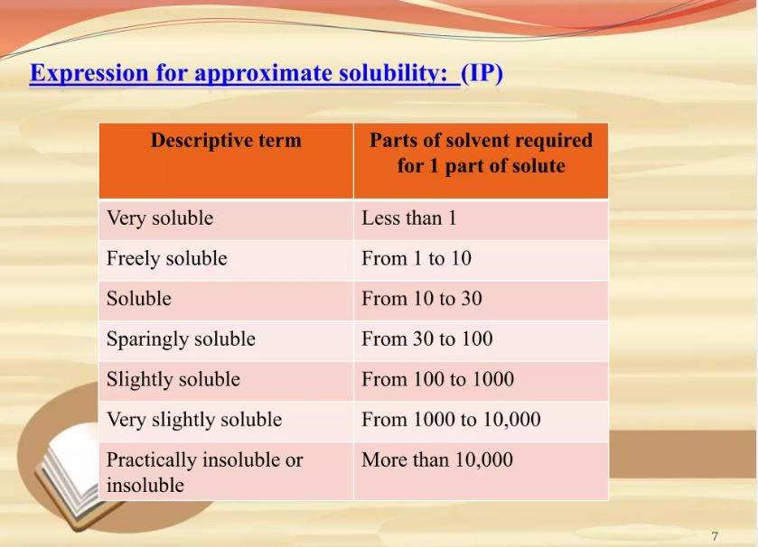
Expression of solubility

Slide 7
BCS CLASSIFICATION
BCS Class | Solubility | Permeability | Examples of Drugs | Formulation / Bioavailability Considerations
Class I | High | High | Metoprolol, Propranolol, Verapamil, Acetaminophen | Usually good oral absorption; dissolution is rate-limiting. Standard immediate-release (IR) formulations are suitable.
Class II | Low | High | Ketoconazole, Danazol, Carbamazepine, Ibuprofen | Dissolution is the limiting step. Use solubility enhancement techniques (e.g., nanoparticles, solid dispersions, surfactants).
Class III | High | Low | Metformin, Cimetidine, Atenolol, Ranitidine | Permeability is rate-limiting. Formulation focuses on permeability enhancers or transporter considerations.
Class IV | Low | Low | Hydrochlorothiazide, Furosemide, Paclitaxel | Poor oral bioavailability; requires special delivery systems (nanofibers, nanoparticles, lipid carriers).

Slide 8
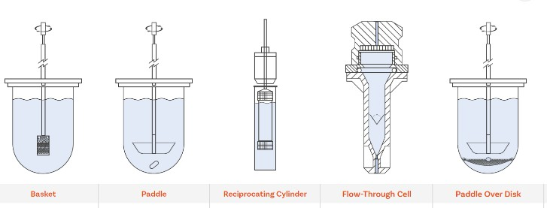
TYPES OF DISSOLUTION APPARTUS

Slide 9
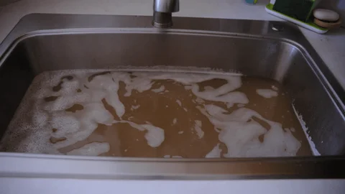
What is sink condition?

Slide 10
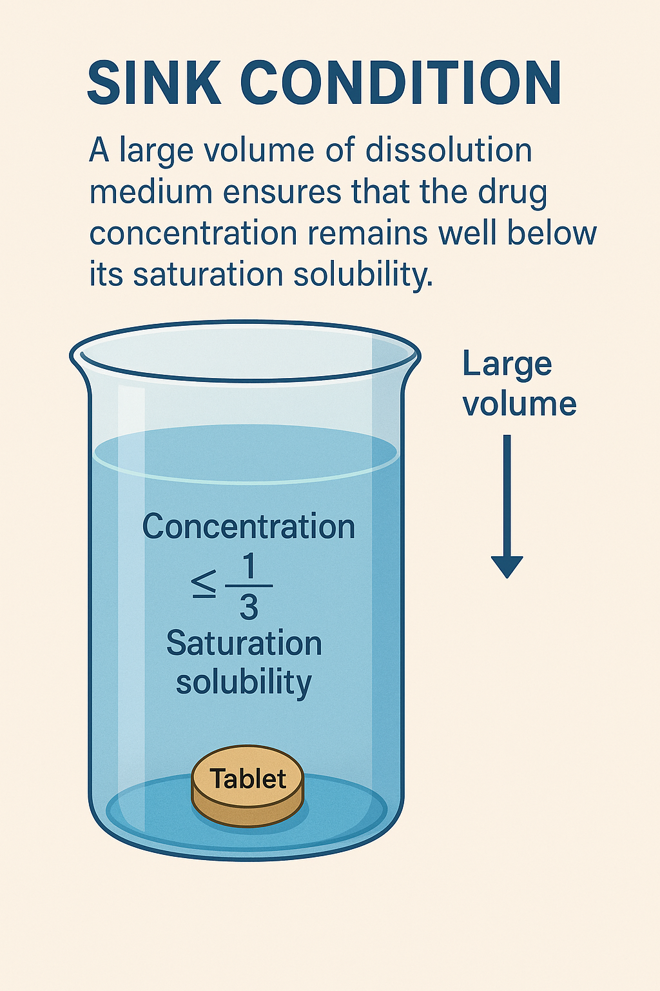
Dissolution tests can be conducted in simple buffer solutions or in more bio-relevant dissolution media
Dissolution tests are normally performed under sink conditions
Sink condition is the ability of the dissolution media to dissolve at least 3 times the amount of drug that is in your dosage form.
Having sink conditions helps your dissolution have more robustness as well as being more biologically relevant.

Slide 11
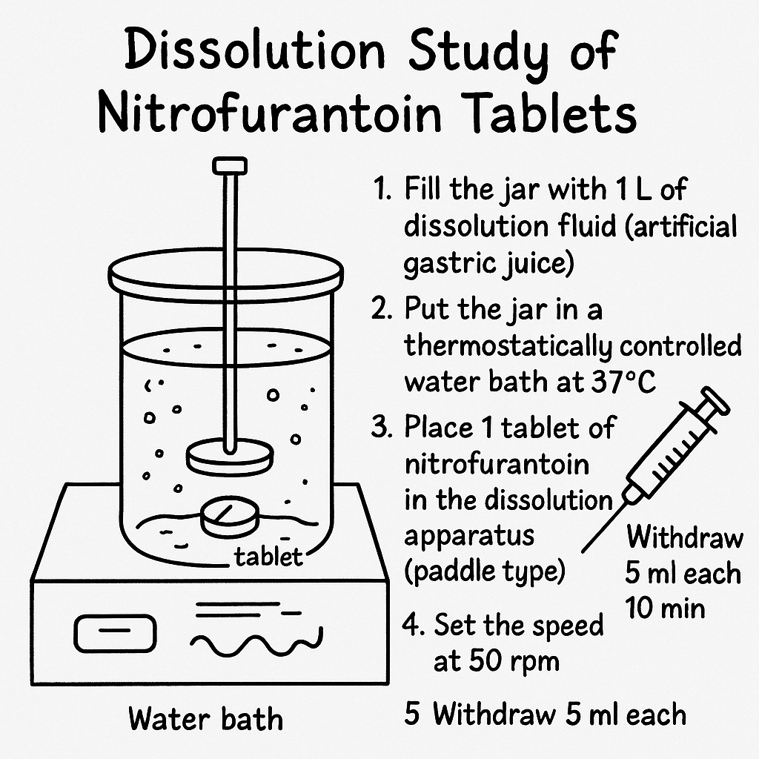
Procedure ( Dissolution study of nitrofurantoin tablets)
Fill the jars with 1 L of dissolution fluid (artificial gastric juice)
Put the jars in a thermostatically controlled water bath at 37 (switch water bath on)
Place 1 tablet of nitrofurantoin in the dissolution apparatus (paddle type).
Set the speed on 50 r.p.m
Withdraw 5 ml each 10 min for 50 minutes

Slide 12
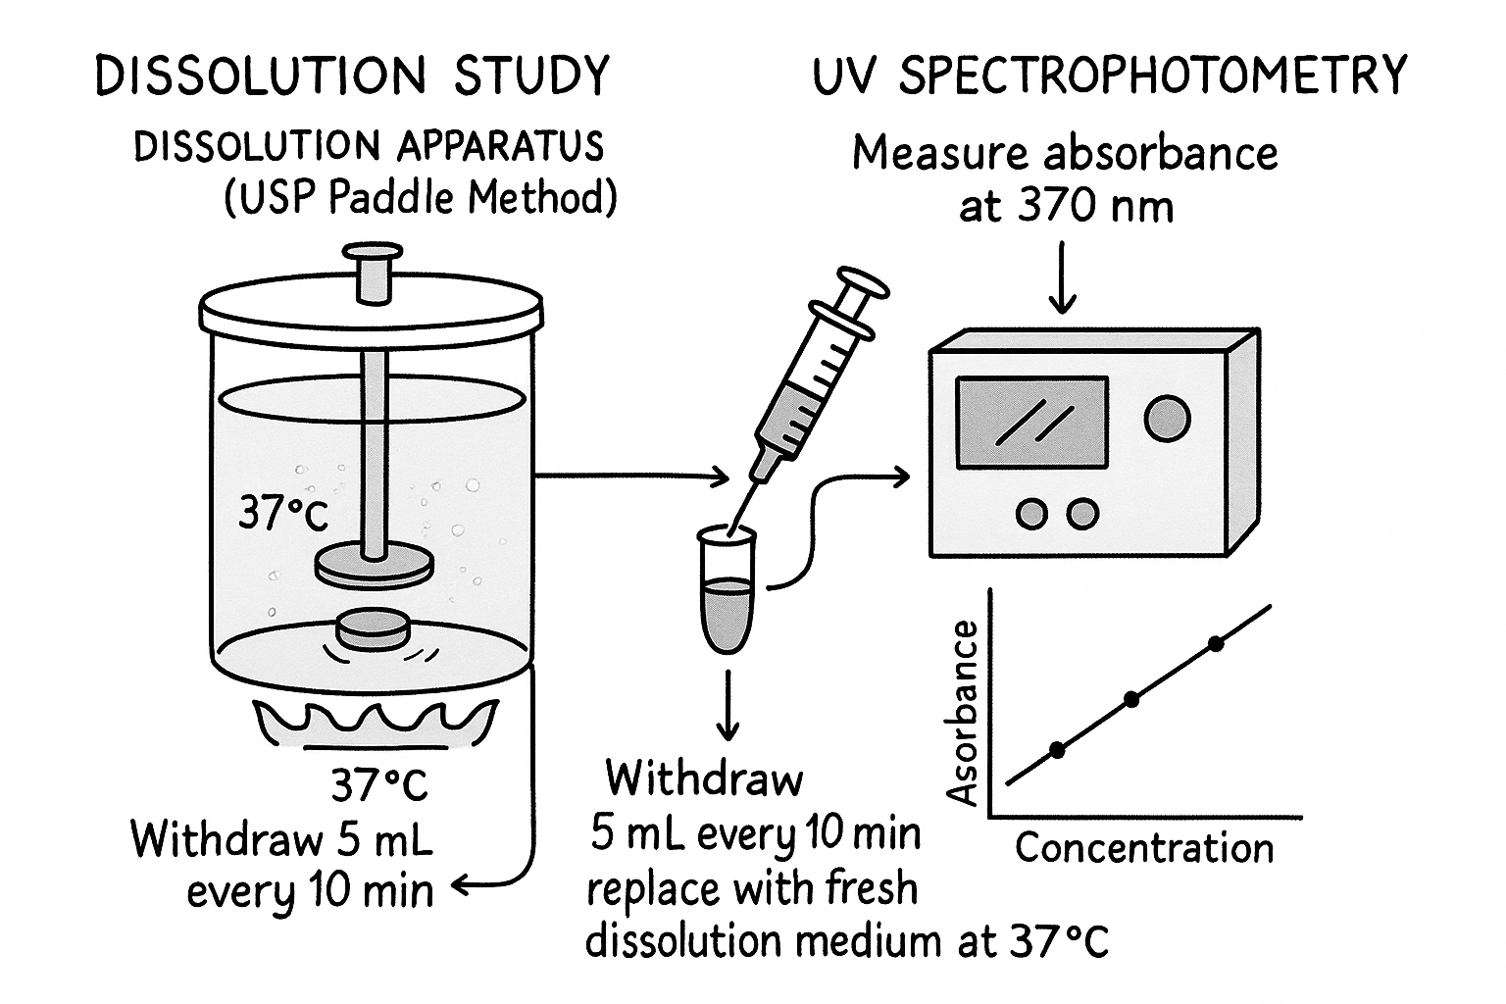
Substitute for the volume withdrawn each time interval using a fresh (artificial gastric juice) previously maintained at 37º C
Analyze samples of nitrofurantoin by reading the
absorbance on a UV spectrophotometric at 370 nm.
Use the straight line equationy=0.0036+0.07x to
obtain the concentration of the dilutions.
Note : the conc. Is in mcg/ml

Slide 13
1-Con.(mcg/ml)X vol. of dissolution media =(mcg amount of drug released into the dissolution media then convert it to mg
2- multiply the amount with dilution factor (if you made dilution )
3-% of drug released = amount of drug release /amount of drug in the tablet *100
4- then put the time column and percent of drug release column together then click insert, scatter with smooth lines and markers

Slide 14
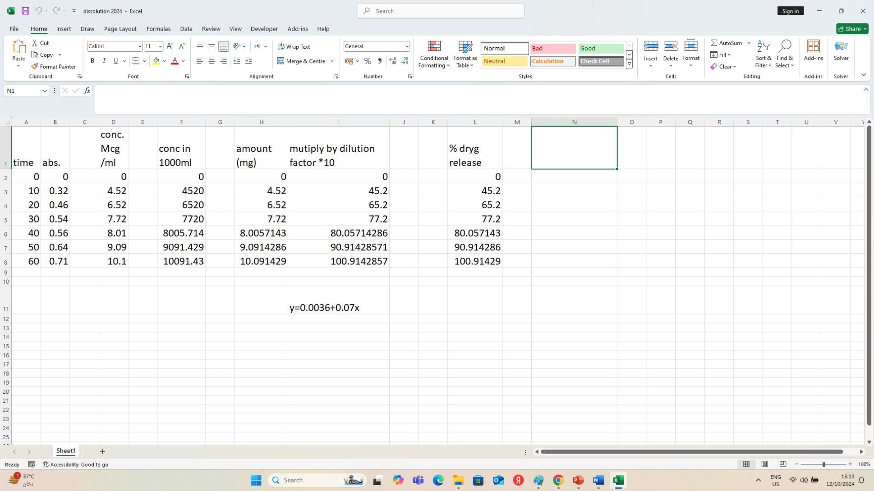

Slide 15
Chart Title
120
100
80
60
40
20
0
percent of drug release
0
10
20
30 40
time in minutes
50
60
70

