Slide 1

Solubility
of Organic Compounds
M.Sc. Hala Ayad M. R.

Slide 2

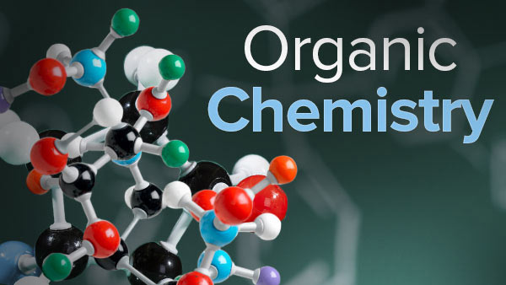
study of the structure, properties, and reactions of organic compounds.
organic compounds
=
(C, H) + (O), (N), (S)

Slide 3

Functional group of organic compounds
When (H) of hydrocarbon compounds substituted by atom or group of atoms
Functional group = (X)
When H
replaced by
X

Slide 4
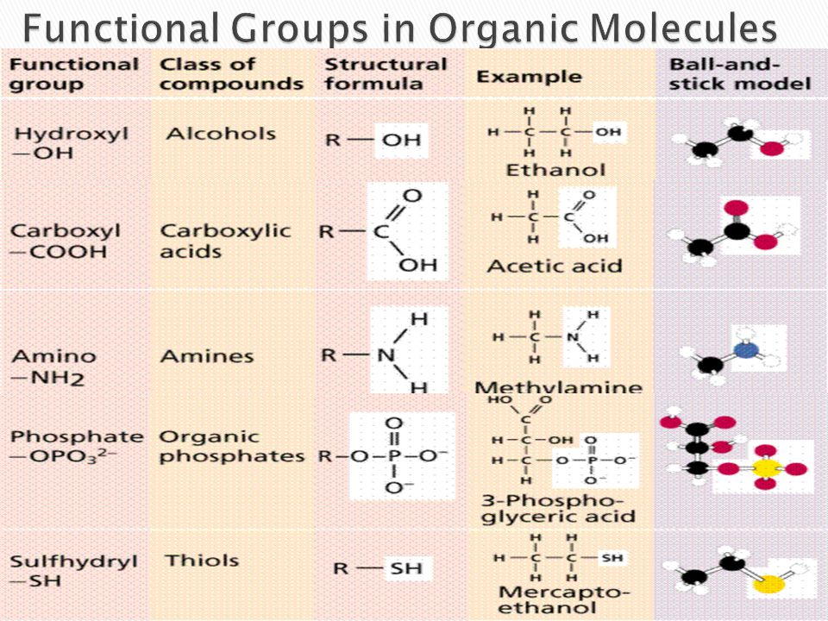
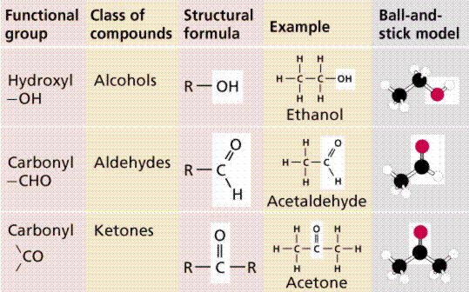

Slide 5
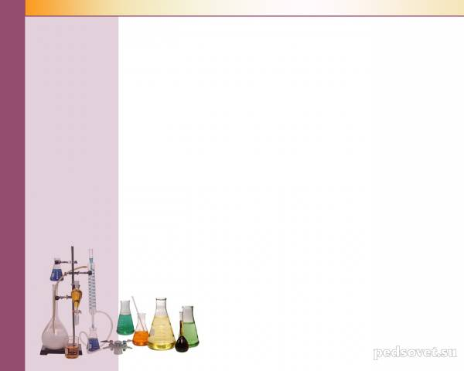
Identification of Organic Compounds
identify of the molecular structure of the chemical organic compounds.
why identify of molecule ????
Many of organic compounds may contain impurities which formed as:-
by product results during storage under unsuitable condition
decomposed of compound.

Slide 6
•
There
are many
steps
most be
study
for
identify an organic
Physical Properties:
unknown:
2. Chemical
1.
Properties
1.
2.
3.
4.
Physical state
Color & odor. M.p. & b.p. solubility
(L
or
S).
1.
2.
3.
Acidity study.
functional gr. study
Specific tests

Slide 7

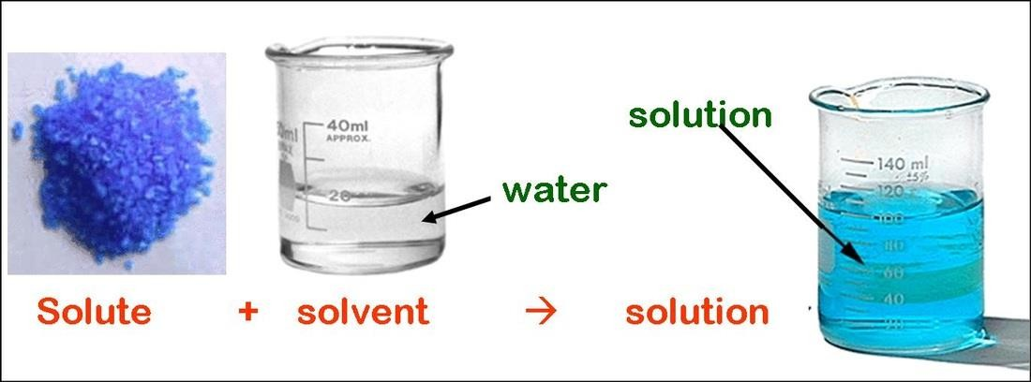
Solubility
difinition
Solubility
compounds,
liquid, called
is
the
mix
amount
of
in a
called a solute dissolves
a solvent.

Slide 8
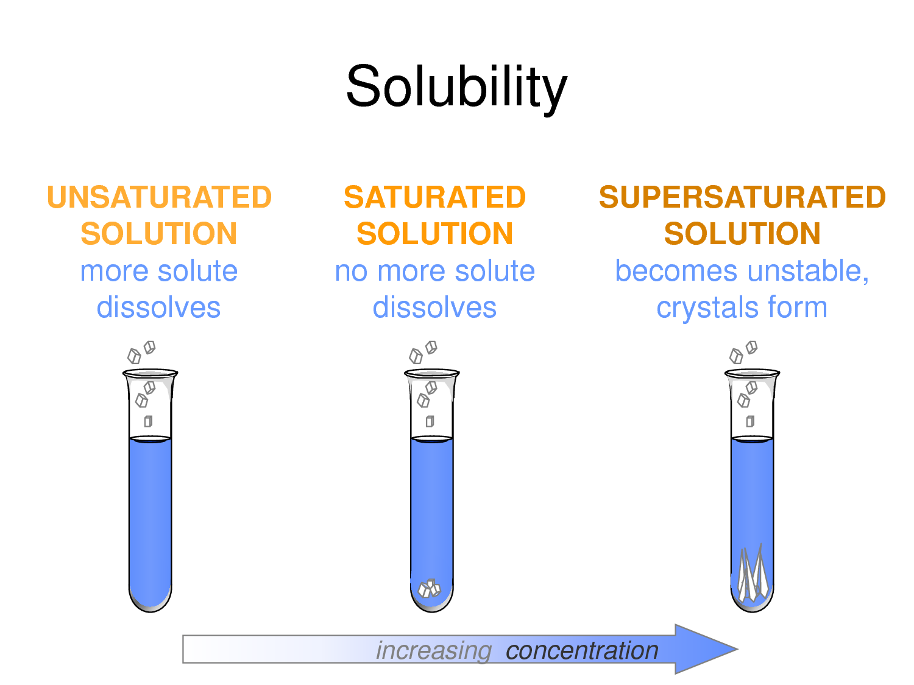

Slide 9
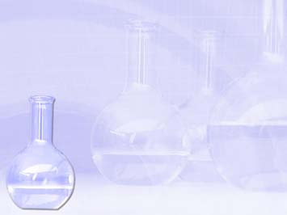
•NOT
•NOT
•NOT
•High
Toxic
Expensive and variable
harmful
poling point.

Slide 10
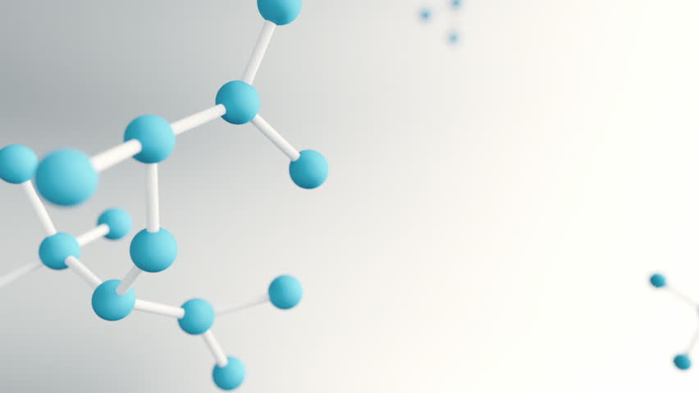
In solubility classification will obtained:-
1. Information about molecular size of compounds
2. Identification of functional group
Solvent compounds
Water alcohol, aldehyde, ketone, carboxylic acid, amine
(only those with less 5 carbon atom )
NaOH 5% carboxylic acid, phenol
NaHCO₃ 5% carboxylic acid
HCl 5% amine
H₂SO₄ con. neutral

Slide 11

Water was the first solvent used for dissolved
any
organic compounds.
•
•
•
•
Soluble = solid dissolves
in water
water
Insoluble = solid doesn’t dissolve in
Miscible = 2 liquids that dissolve
Immiscible = 2 liquids that don’t dissolve

Slide 12
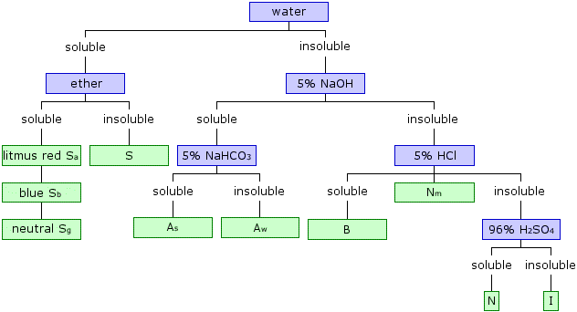
carboxylic acids
amines
Alcohols carbonyl esters nitriles amides
salts of organic acids,
hydrophilic functional groups
strong organic acids
weak organic acids
amines
Alcohols carbonyl
esters
nitriles
amides

Slide 13
(o-toluidine, p-naphthol, 1-propanol, benzoic acid, p-nitro benzaldehyde)
Alcohols aldehydes ketones esters nitriles amides
salts of organic acids
strong organic acids
weak organic acids
amines
Alcohols, carbonyl esters nitriles amides

Slide 14


