Slide 1


ALCOHOLS COMPOUNDS
R-OH
M.Sc. Hala Ayad M. R.

Slide 2
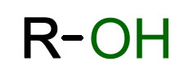
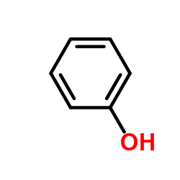
When (H) of hydrocarbon compounds substituted by (OH) hydroxyl group
Alcohol
Phenol
OH attached to aliphatic
hydrocarbon
OH attached to aromatic
hydrocarbon

Slide 3
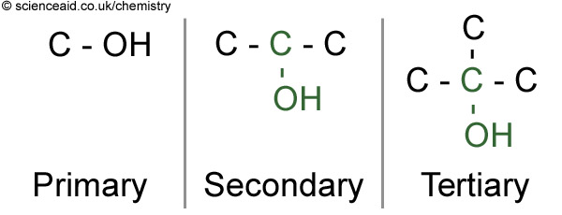
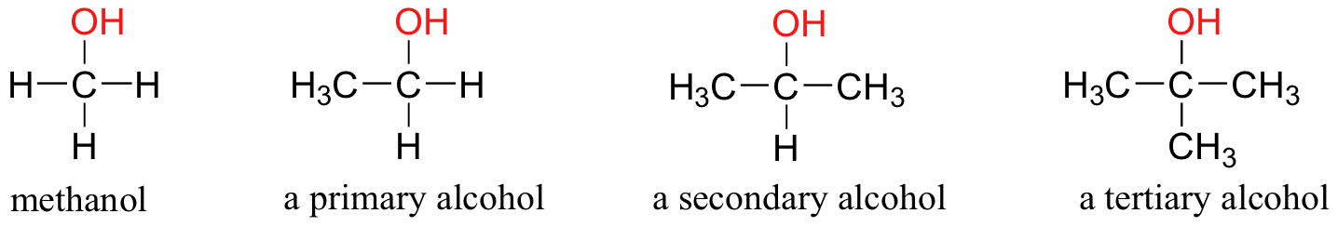
Alcohols
divided to :-
(1°)
(2°)
(3°)
(OH) attached To
(-C ) that attached one (C)
(OH) attached to (C) that attached
2 (C)
(OH) attached to
(–C) that attached
3 (C)

Slide 4

Physical properties:
- Colorless liquid,
- have characteristic odor
- miscible in water, toxic
Chemical properties:
- They are neutral compounds because they don’t change the color of litmus paper.

Slide 5
Alcohol tests

Slide 6
General test :
Ceric ammonium nitrate (CAN) is the inorganic compounds with the formula (NH4)₂Ce(NO₃)₆. water-soluble
oxidizing agent
alcohols oxidized by (CAN)
red complex (+) (NH4)₂Ce(NO₃)₅
phenols to give a brown to greenish brown precipitate (-).

Slide 7
equation:-
Produced color

Slide 8
Lucas test :
used to distinguish between types of alcohol compounds (1° , 2° , 3° ) depends on the rate of reaction (stability of carbocation)
ZnCl₂\HCl reagent
replacement (-OH) group of alcohol with (-Cl) from reagent and formed alkyl chloride (R-Cl) as cloudy (+).

Slide 9
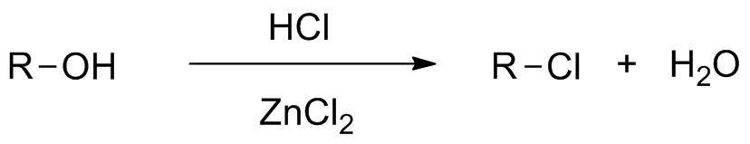
(1°)
(2°)
(3°)
Not
Formed
(-)
Formed
After (3-5 min)
(+)
Formed
Immediately
(+)
Produced
alkyl halid (cloudy)

Slide 10
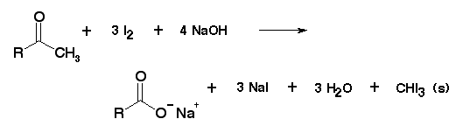
Iodoforms Test : (for terminal CH₃ group)
- Reagent is I₂\KI in alkalin medium (NaOH).
- Depends on alcohol oxidized to aldehyde or ketone then addition (I₂) to (-CH₃) to form (triiodo derivatives) then formation (CHI₃) and carboxylic salt.
- Produced yellow ppt (+).
iodoform

Slide 11

NaOI + NaI + H2O
NaOH +I2
oxidizing agent

Slide 12
Summery
CAN Test : (for all alcohol comp.)
Lucas Test : (for distinguish type of alcohol)
Iodoforms Test : (for terminal CH₃ group)
Alcohol | Lucas test | Iodoform test | CAN Test
Methanol | - | - | +
Ethanol | - | + | +
Isopropanol | + | + | +
Tert-butanol | + | - | +

Slide 13
Procedure

Slide 14
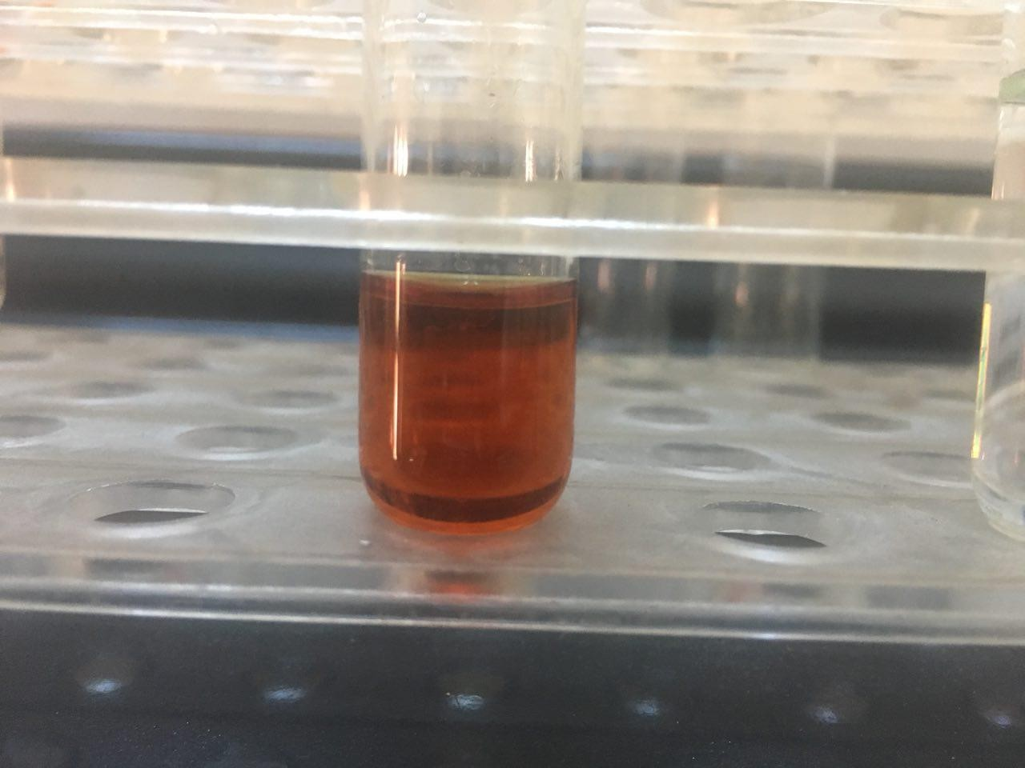
Procedure
In test tube add (4-5) drops of alcohol compounds, dissolved in water if not dissolved added few drops of dioxan.
2. Add (2-4) drops of (CAN) shake the mixture well and observe the result.
3. Positive result is red color that means alcohol compounds.
General test

Slide 15
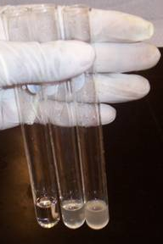
Procedure:- (in dry test tube)
Lucas test
1° alcohol
(methanol or ethanol) (0.5ml)
(1ml) ZnCl₂\HCl (con.)
3° alcohol
(tert-butanol) (0.5ml)
(1ml) ZnCl₂\HCl (con.)
Not
Formed
Formed
Immediately
Formed
After (3-5 min)
2° alcohol (isopropanol) (0.5ml)
(1ml) ZnCl₂\HCl (con.)

Slide 16
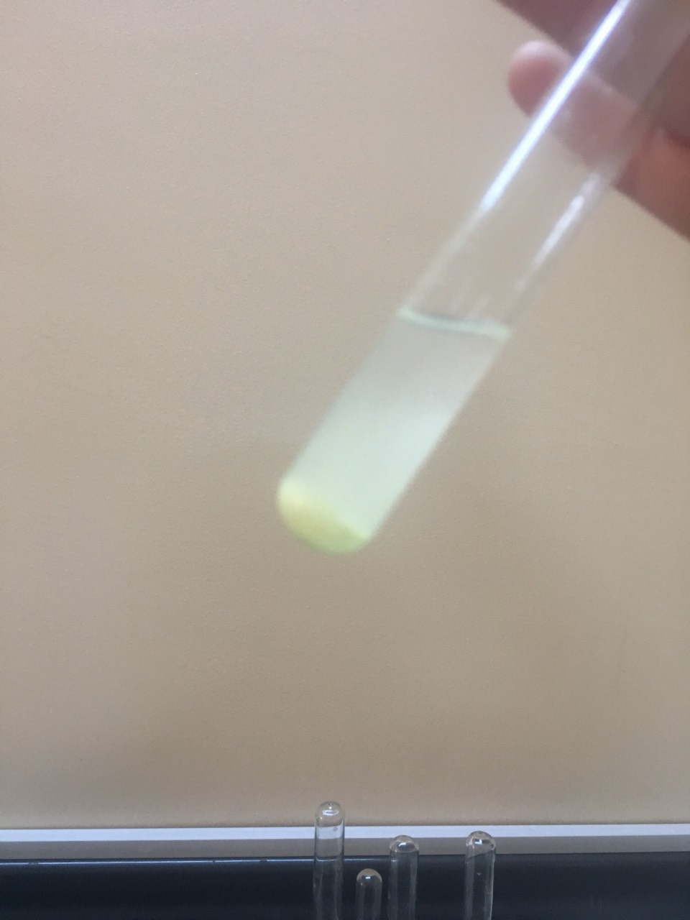
Procedre:
(0.5ml) of compound
(1ml) of water
(1ml )of iodine solution (I₂\KI)
until red color produced
warm for (3-15min) then cool then added
3 drops 10%NaOH
iodoform test
Yellow ppt

Slide 17
Unknown
(isoprpanol, ethanol, , tert-butanol, methanol)
Unknown
1. (5 drops) of unknown
2. (1 ml) water
3. ( 4 drops) of (CAN)
CAN Test :
CAN test
(+) alcohol
(-) not alcohol
Lucas test
1. (0.5 ml) of unknown
2. (1 ml) ZnCl₂\HCl (con.)
3. If you need heat so
Heated for (3-5 min)
in water bath
Lucas ‘s Test :
(dry test tube )
(-) 1°
(+) 2° , 3°
Iodoform test
Iodoform test
(+)
Contain
(-CH₃) terminal
(-) not
Contain
(-CH₃) terminal
(+)
Contain
(-CH₃) terminal
(-) not
Contain
(-CH₃) terminal
1. (0.5 ml) of unknown
2. (1 ml) water, (1ml) I₂\KI
3. Heated for (15 min)
in water bath then cooled
4. Drops of (10%NaOH)
iodoform Test :

Slide 18
