Slide 1


M.Sc. Hala Ayad M. R.

Slide 2
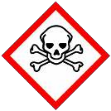



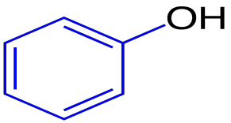

Aromatic compound contains one or more hydroxyl group (OH).
General structure
of phenol compounds

Slide 3
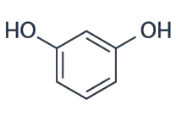
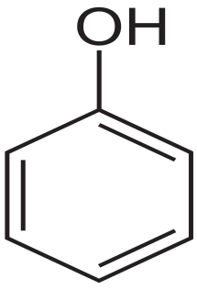
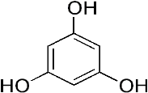
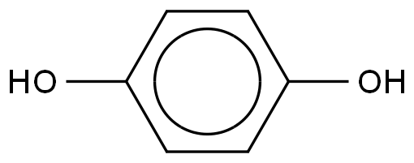
Phenol classified according to the number of (OH)
group into:
Dihydric phenol
Monohydric phenol
Poly phenol
Resorcinol
Benzen-1,3,5-triol
phenol
hydroquinone

Slide 4

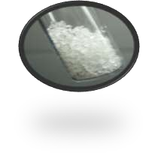
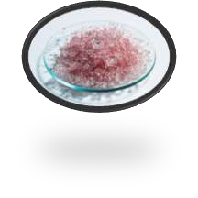
Physical State:
Solid crystal in pure state (except m- cresol)
Air
Pure State

Slide 5
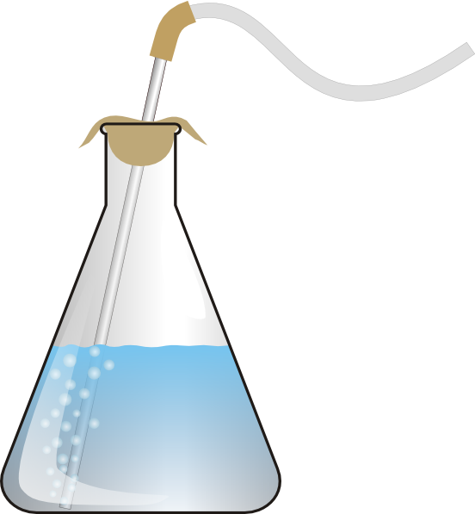

II. Solubility
phenols are polar and can formed hydrogen bond
phenols are less soluble in water but more soluble in sodium hydroxide

Slide 6
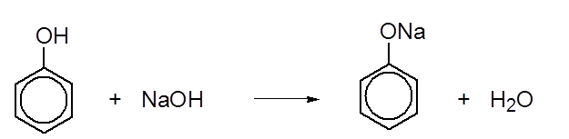
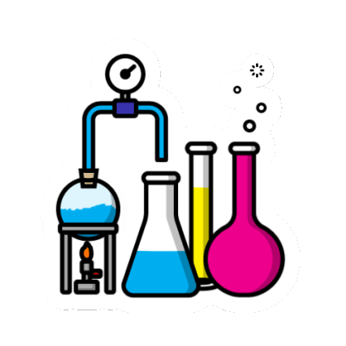
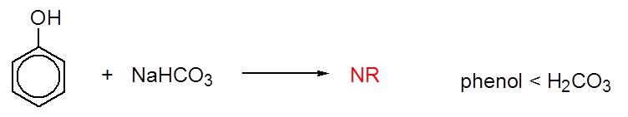

Slide 7

Tests of phenols

Slide 8

The effect of the compound on the litmus paper:-
change the color of litmus paper
(blue to red, red still red).
weak acid compounds

Slide 9
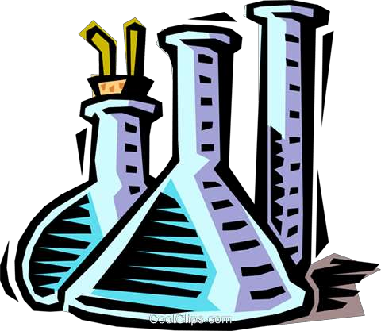
General test for phenols
a. Ferric chloride test (Complex Formation)
Ferric phenolate complex

Slide 10
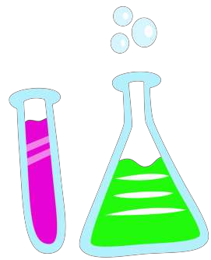
b. Chloroform test
Also called (Reimer-Tiemann reaction)
depends on add (-CH=O) group to o- position of phenol.
(O-Formylation of phenol compounds).

Slide 11
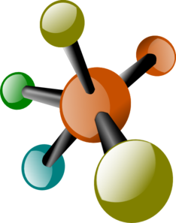
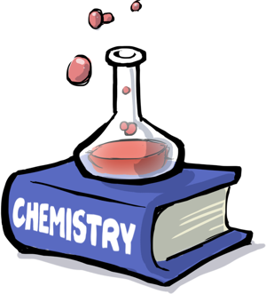
Complete the chemical reaction??
HO
OH
CHO
CHCl₃
NaOH
phenol
OH
OH
CHCl₃
NaOH
Resorcinol
OH
OH
COH OH
OH
CH₃
HOC
CHCl
CH₃
O-cresol
3
NaOH

Slide 12
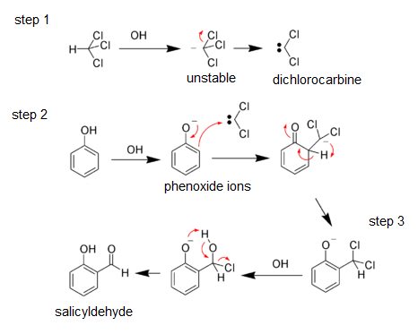
Mechanism for formylation phenol:
Used excess of NaOH:-
To formation dichloro carbine (:CCl₂).
To formation phenoxide ione.
To complete the reaction.

Slide 13

Procedure

Slide 14
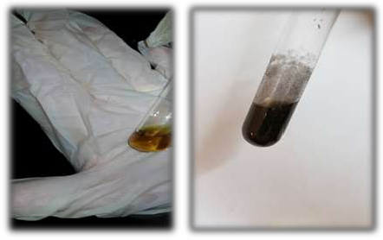
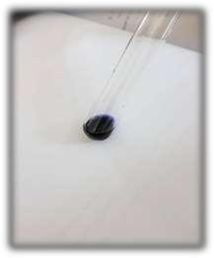
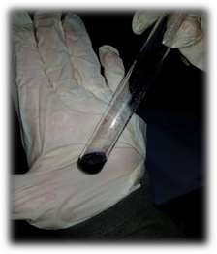
Ferric chloride test
In different test tube, Few amounts of different phenol compounds dissolved in ethanol.
Add (2 drops) of 5% FeCl_{3 .}
observes the color change.
β-naphnol
(orange)
Resorcinol
(dark violet)
Phenol
(dark violet)

Slide 15
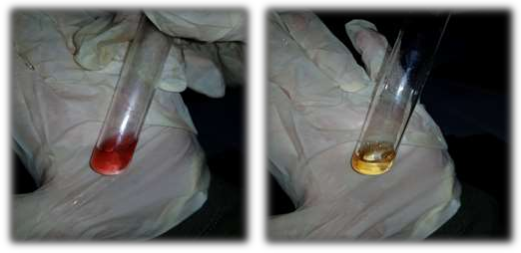
Chloroform test
(4-5 drops) of phenol dissolved in excess 30%NaOH (1ml).
(1ml) of (CHCl₃ ) then heat in water bath for (5min).
observes the color change
Resorcinol
(red)
Phenol
(pale yellow)

Slide 16
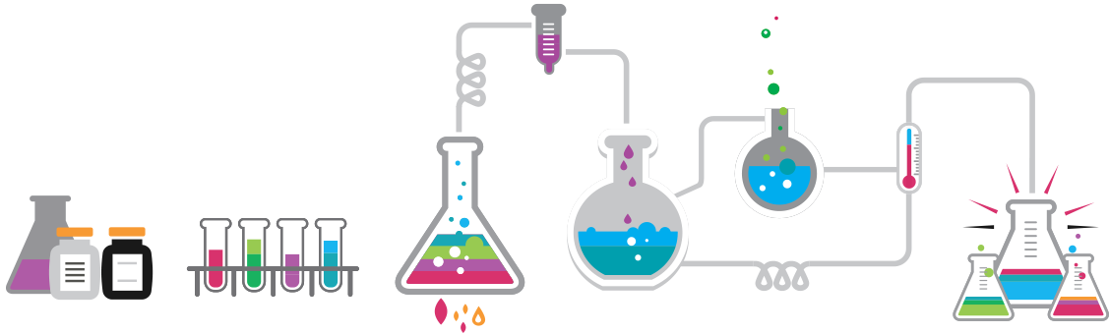
Thank you

