Slide 1


Carbonyl
Compounds
Aldehydes
Ketones
M.Sc. Hala Ayad M. R.

Slide 2
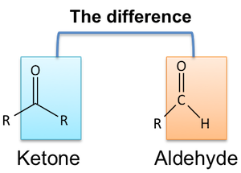



Slide 3

Physical properties
Colorless
Liquid (except formaldehyde is gas)
Have characteristic odor
(aliphatic) M.wt (low) miscible in H₂O
(aliiphatic, aromatic) M.wt (high) immiscible in H₂O

Slide 4
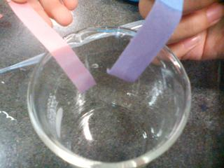
Chemical Properties
litmus paper effect
Aldehyde and ketone are neutral compounds (very weak base) no Change color of litmus
Red red
Blue blue

Slide 5
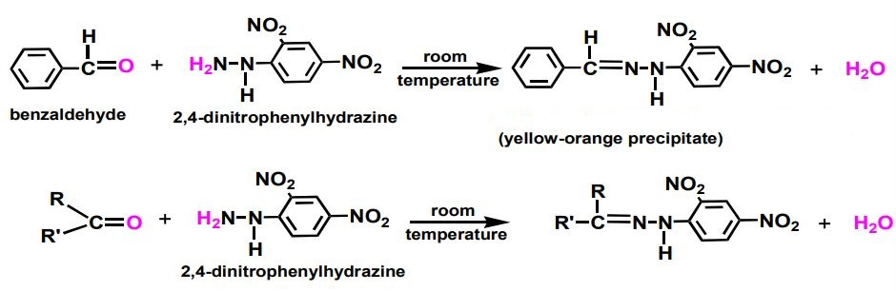
General test (for carbonyl compounds)
Type of reaction is (nucleophilic addition reaction).
Reagent is 2,4-dinitrophenyl hydrazine (2,4-DNP).
Depends on carbonyl group react with (N) atom by nucleophilic addition, then loss of (H₂O) to produced (C=N-NH).
Produced yellow or orange ppt.
hydrazone -C=N-NH-

Slide 6
    Tests used to distinguish between aldehydes and ketones:-
1- Fehling’s test: (for aldehyde only)
2-Tollens’ Test :
(for aldehyde only)

Slide 7
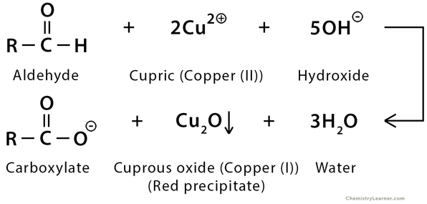
1- fehling’s test: (for aldehyde only)
Type of reaction is (oxidation–reduction reaction).
Depends on fehling’s reagent (Cu ⁺²) (oxidizing agent) oxidized aldehyde to acid, while aldehyde (reducing agent) reduced (Cu⁺²) to (Cu⁺¹).
Produced red precipitate for (Cu₂O).

Slide 8
2-Tollens’ Test : (for aldehyde only)
Type of reaction is (oxidation-reduction reaction).
Reagent is Ag(NH₃)₂OH.
Depends on aldehyde (reducing agent) oxidize to salt of acid, silver ion (Ag+) (weak oxidizing agent) reduced to silver metal (Ag) as silver mirror.
Produced silver mirror on the inner side of test tube.
AgNO₃ + NaOH AgOH + NaNO₃
AgOH + NH₄OH Ag(NH₃)₂OH + H₂O

Slide 9
    Specific tests :-
Iodoforms Test for terminal CH₃ group
Resorcinol Test
for formaldehyde
Cannizaro reaction
for benzaldehyde

Slide 10
Iodoforms Test : (for terminal CH₃ group)
Type of reaction is (halogenation-cleavage reaction).
Reagent is I₂\KI in alkalin medium (NaOH).
Depends on addition (I₂) to (CH₃) to form (triiodo derivatives) then cleavage to formation (CHI₃) and carboxylic salt.
Produced yellow ppt.
iodofrom

Slide 11
Resorcinol Test : (for formaldehyde)
Type of reaction is (o-substitution aromatic reaction).
Reagent is resorcinol.
Depends on substitution on aromatic ring.
Produced red violet ring and white ppt over ring.

Slide 12
Cannizaro reaction : (for benzaldehyde)
Type of reaction is (oxidation-redaction reaction).
Depends on 2 mole of benzaldehyde (which don’t have alpha H) in the presence of a strong basic medium to yield mixture of alcohol and salt carboxylic acid.
(one molecule of the aldehyde serves as the oxidizing agent while the other mole serves as the reducing agent).
Produced white ppt.

Slide 13

Procedure

Slide 14
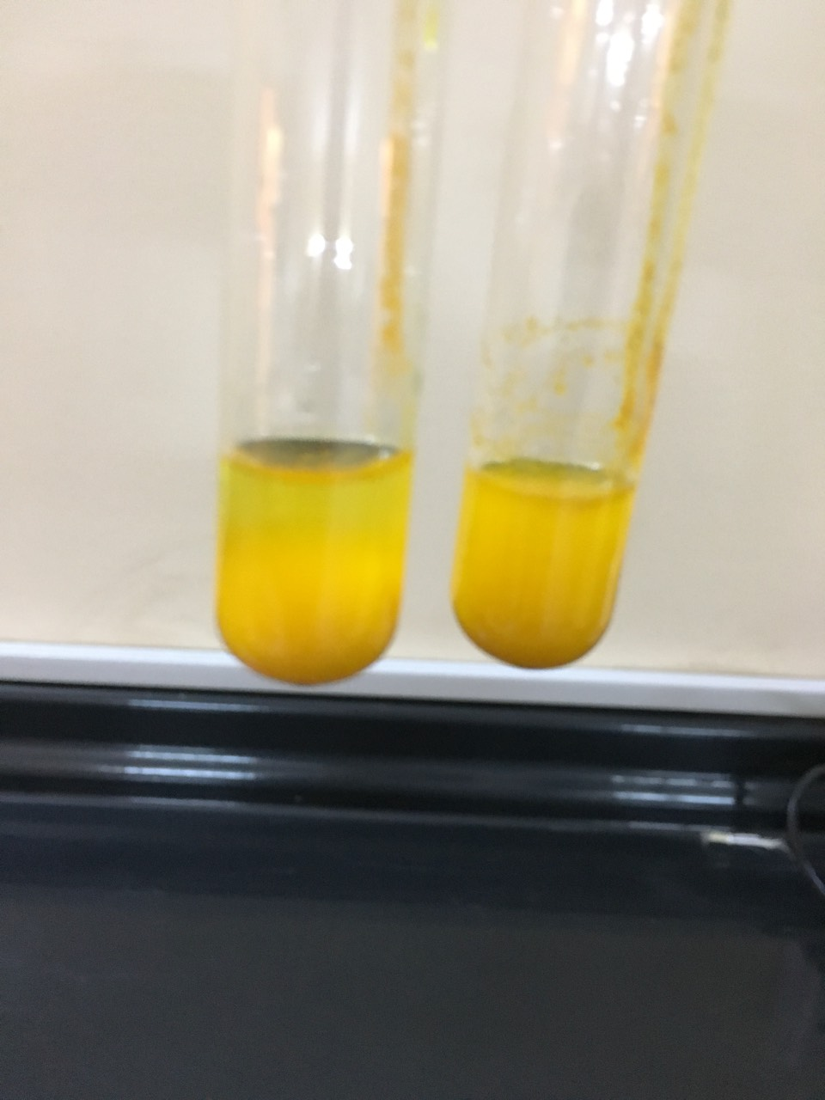
General test
In different test tube add (4-5) drops of carbonyl compounds, dissolved in water if not dissolved added few drops of ethanol.
2. Add (1ml) of (2,4-DNP) shake the mixture well and observe the result.
3. Positive result is yellow or orange ppt that mean (aldehyde or ketone).
Yellow-orange
ppt

Slide 15
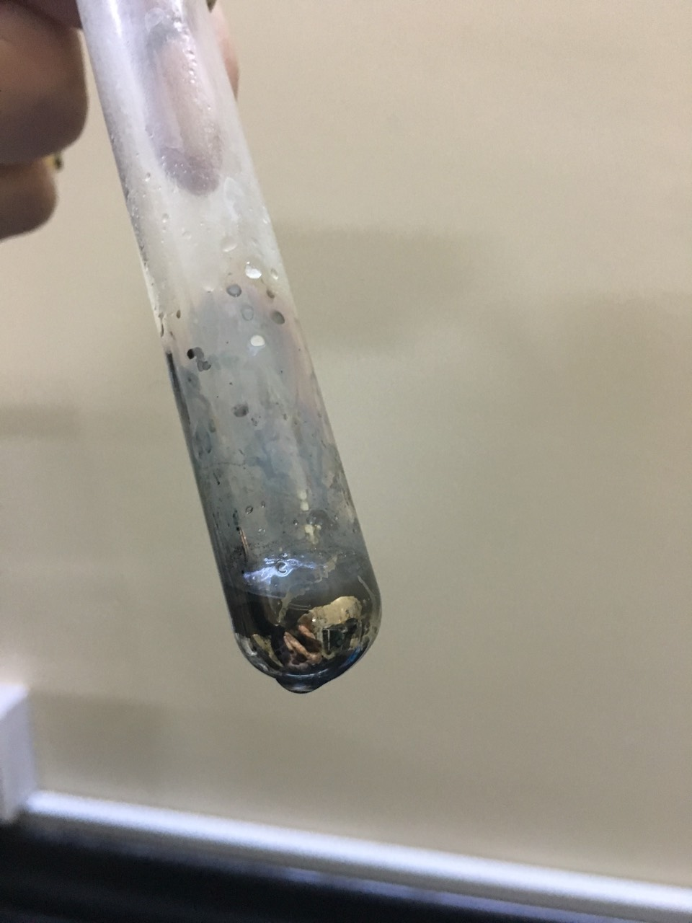
Tollen’s test
In different test tube add (2-4) drops of carbonyl compounds.
2. Add (2-4) drops of (AgNO₃\ NH₄OH), shake the mixture well
3. Added (2 drops) of (NaOH 10%) shake the mixture well and observe the result.
3. Positive result is Silver mirror that mean (aldehyde only).
silver mirror on
the inner side of
test tube

Slide 16
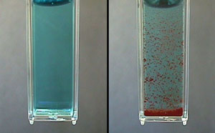
Fehling’s test
In test tube add (2-4) drops of carbonyl compound.
2. Add (1ml) of (solution A), shake the mixture well
3. Added (1ml) of (solution B) shake the mixture well.
4.Heat the mixture for (10-15 min).
5. Positive result is red ppt that mean (aldehyde only).

Slide 17
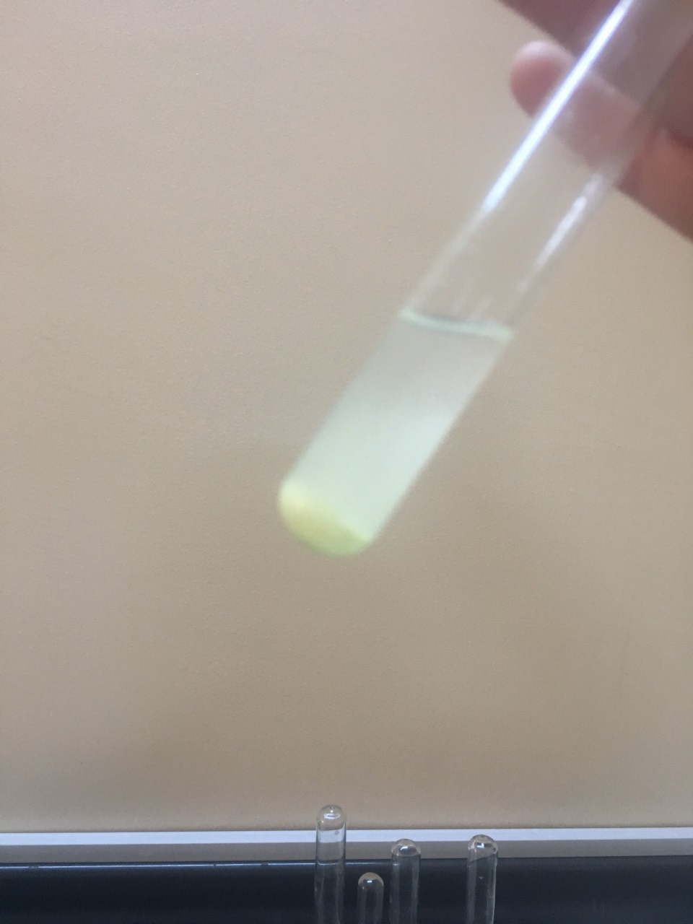
Iodoform test
In different test tube add (4-5) drops of carbonyl compounds
2. Add (1ml) of (I₂\KI) solution, shake the mixture well red color result.
3. Heat the mixture for (10-15min) on water bath then cool and dissolved in NaOH 10%..
3. Positive result is yellow ppt that mean (CHI₃).
Yellow ppt

Slide 18
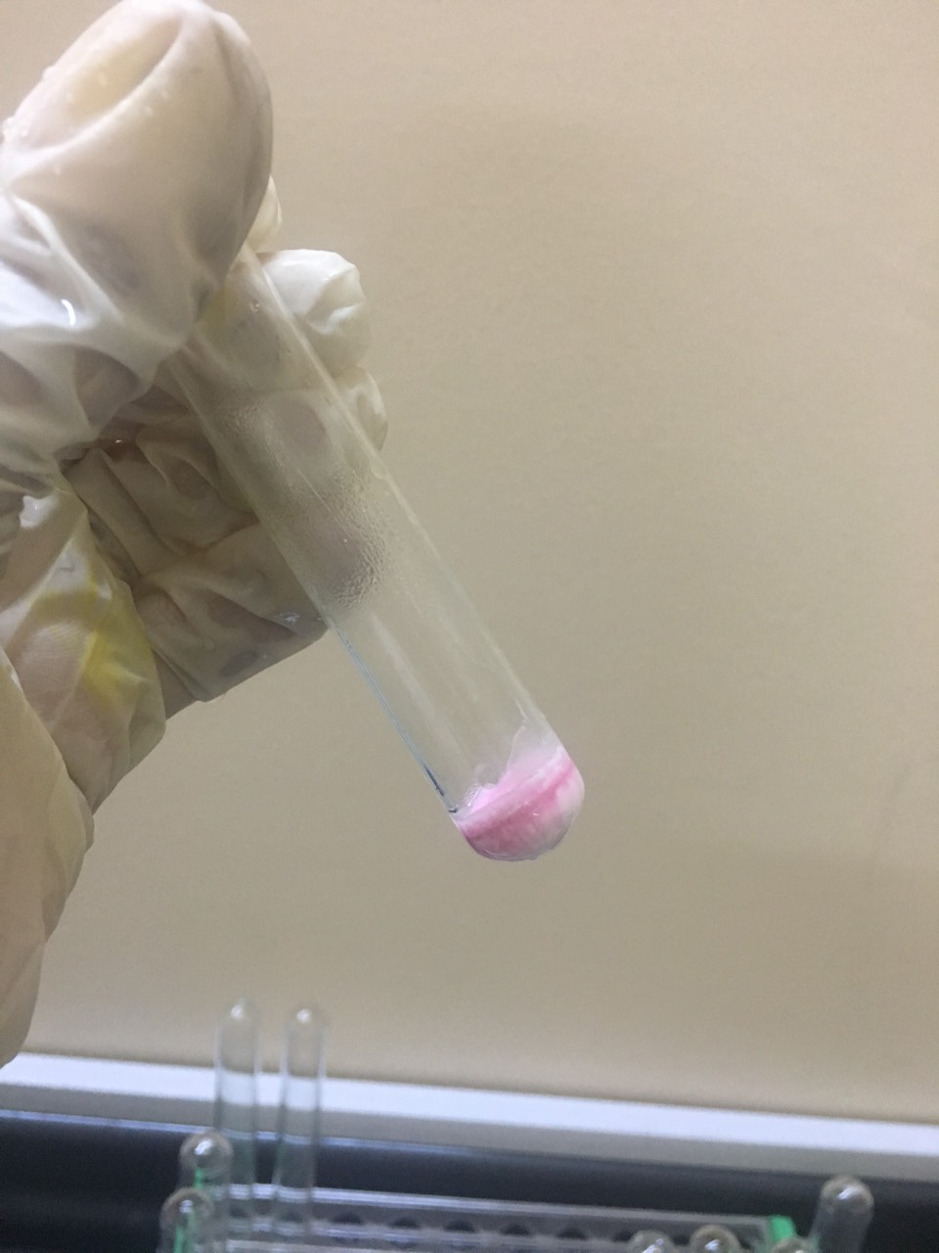
Resorcinol test
In test tube add (1ml) of formaldehyde.
2. Add (1ml) of resorcinol, shake the mixture well.
3. Add drop by drop (H₂SO₄ con.) on the wall of test tube.
4. The positive result is violet ring with white ppt.
Violet ring with
white ppt

Slide 19
Cannizaro test
In test tube add (4-5) drops of benzaldehyde dissolved in (0.5ml) of (NaOH 30%).
2. Heat the solution on water bath for (3 min).
3. Add (2-5) drops of water then (2-5) drops of HCl (con.) and observed the result (white ppt).

Slide 20

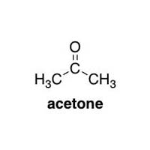
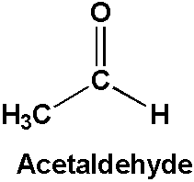
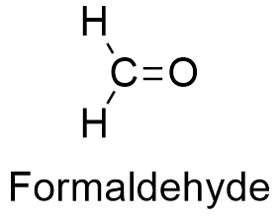
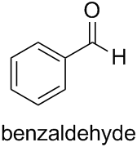
General test , iodoform
General test , iodoform,
fehling test , tollen,
General test,
Fehling test , tollen,
resorcinol
General test ,
Fehling test , tollen,
cannizaro

Slide 21

Unknown contain carbonyl compounds
General test: 2drop of unknown + (1ml) of water + (1ml) of 2,4-DNP
(+) yellow or orange ppt
(-) not aldehyde or ketone
Tollen test: 2drop of unknown + 2drop of NaOH (10%) + (1ml) of AgNO₃ (5%) +3drop of NH₄OH (2%)
(-) ketone
(+) silver mirror (aldehyde)
Iodoform test: (4 drops of compound + 1ml water + 1ml of
iodine solution + warm for 3min + cool +3 drops 10%NaOH
(-)
(benzophenone)
(+)
Yellow ppt
(acetone)
(-) no terminal (CH₃)
(+)
Yellow ppt
(acetaldehyde)
Resorcinol test: (1ml) of unknown + (1 drop) of resorcinol + drop by drop of H₂SO₄
(+) violet ring & white ppt (formaldehyde)
(-) (benzaldehyde)

