Slide 1

Carboxylic acid
M.Sc. Hala Ayad M. R.

Slide 2
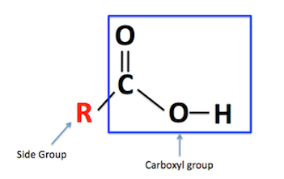

R = aliphatic group or H atom
(aliphatic acid)
R = aromatic group
(aromatic acid)

Slide 3
Carboxylic acid classified according to the number of (COOH)group into :-
Aliphatic acid
aromatic acid

Slide 4
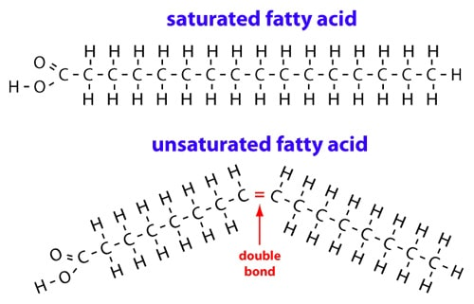
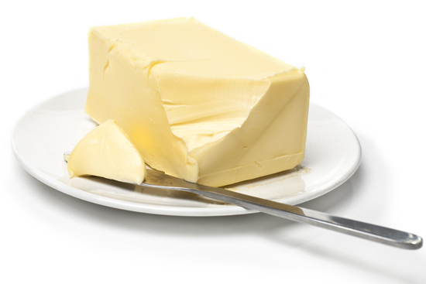
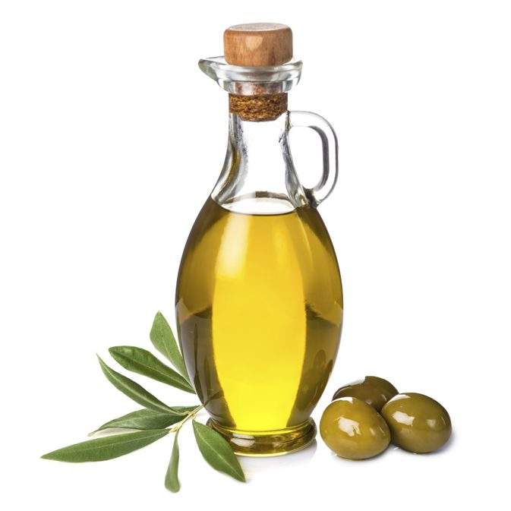
Types of fatty acids
The general formula of saturated fatty acid is: C_{n}H_{2n+1}COOH

Slide 5

Physical properties
Colorless or white
Solid (except formic acid, acetic acid and lactic acid is liquid)
m.p and b.p higher than alcohol because it can make:
- hydrogen bond.
- van der waals forces.
- dipole-dipole interaction.

Slide 6
Soluble in H₂O
When acid have low M.Wt
insoluble in H₂O
When acid have high M.Wt
Soluble in NaOH, NaHCO₃
deprotonation

Slide 7
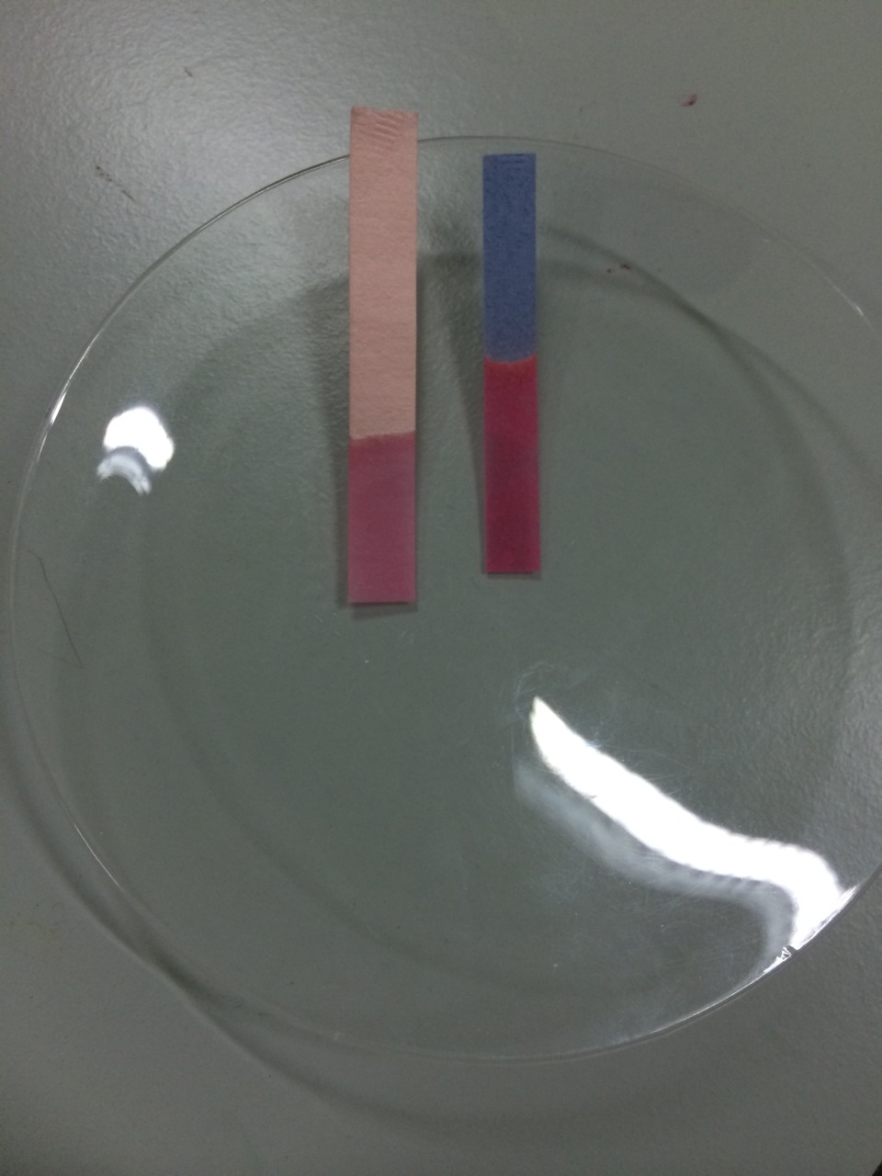
Chemical properties
litmus paper effect:-
- acidic compounds
- Change color of litmus
Red red
Blue red

Slide 8
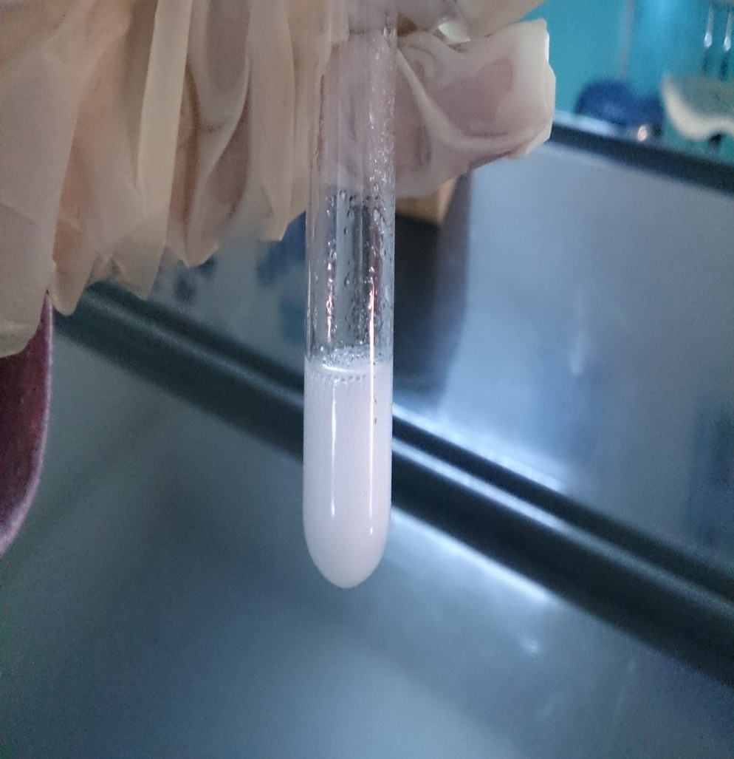
(general test for all carboxylic acid)
Soluble in NaHCO₃
deprotonation
CO₂

Slide 9

Ferric Chloride
Type of reaction is (complex formation).
Reagent is FeCl₃
Depends on neutral acid (salt of acid) react with reagent to produced specific color or ppt for each acids.
  Neutral Solution of acid (N.S of acid ) is the ammonium salt for acid (RCOONH₄).

Slide 10
RCOOH + NH₃(NH₄OH) RCOONH₄ + H₂O + NH₃
A- dark red ppt. Acetic acid or formic acid
B- pale brown ppt. Succinic acid or benzoic acid
C- violet color salicylic acid
D- no color change the acid is oxalic or citric or tartaric or lactic acid.

Slide 11
Specific test:
Formic acid
oxalic acid
lactic acid
succinic acid
1-HgCl₂ test 1-CaCl₂ test 1-iodoform test 1-Fluorescence test
2-tollen test 2-KMNO₄ test 2-H2SO4 test
3-KMNO₄ test

Slide 12
Permanganate test:
Specific test for ( formic acid & oxalic acid )
Type of reaction is ( decarboxylation reaction ).
Reagent is KMnO₄
Depends on loss (CO₂) from acid by KMNO₄
Produced change colors
+ MnO₂

Slide 13
Calcium chloride test:
Specific test for ( tartaric acid & oxalic acid )
Type of reaction is (complex formation).
Reagent is CaCl₂
Depends on neutral acid (salt of acid) react with reagent to produced specific white ppt for each acids.

Slide 14

HgCl2 test : formic acid give grey precipitate.
tollen test : formic acid give silver mirror.
H2SO4 test : lactic acid give black precipitate
Iodoform test : lactic acid give yellow precipitate
Fluorescence test : succinic acid give red color with green fluorescence

Slide 15
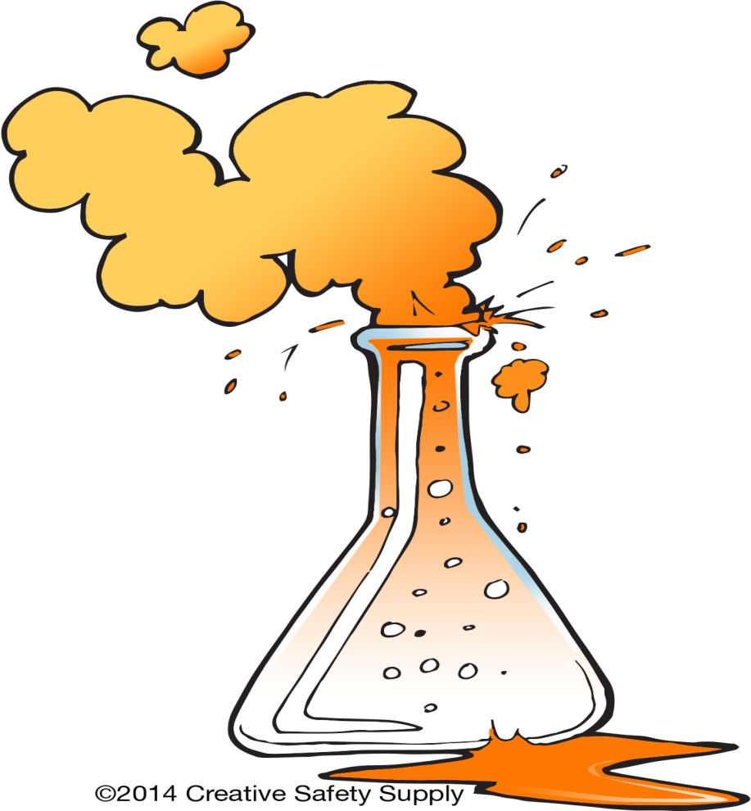
Procedure

Slide 16
(general test for all carboxylic acid)
1. Few amount of compound
2. (1ml) of sodium bicarbonate (NaHCO₃)
3.Observed result
CO₂

Slide 17
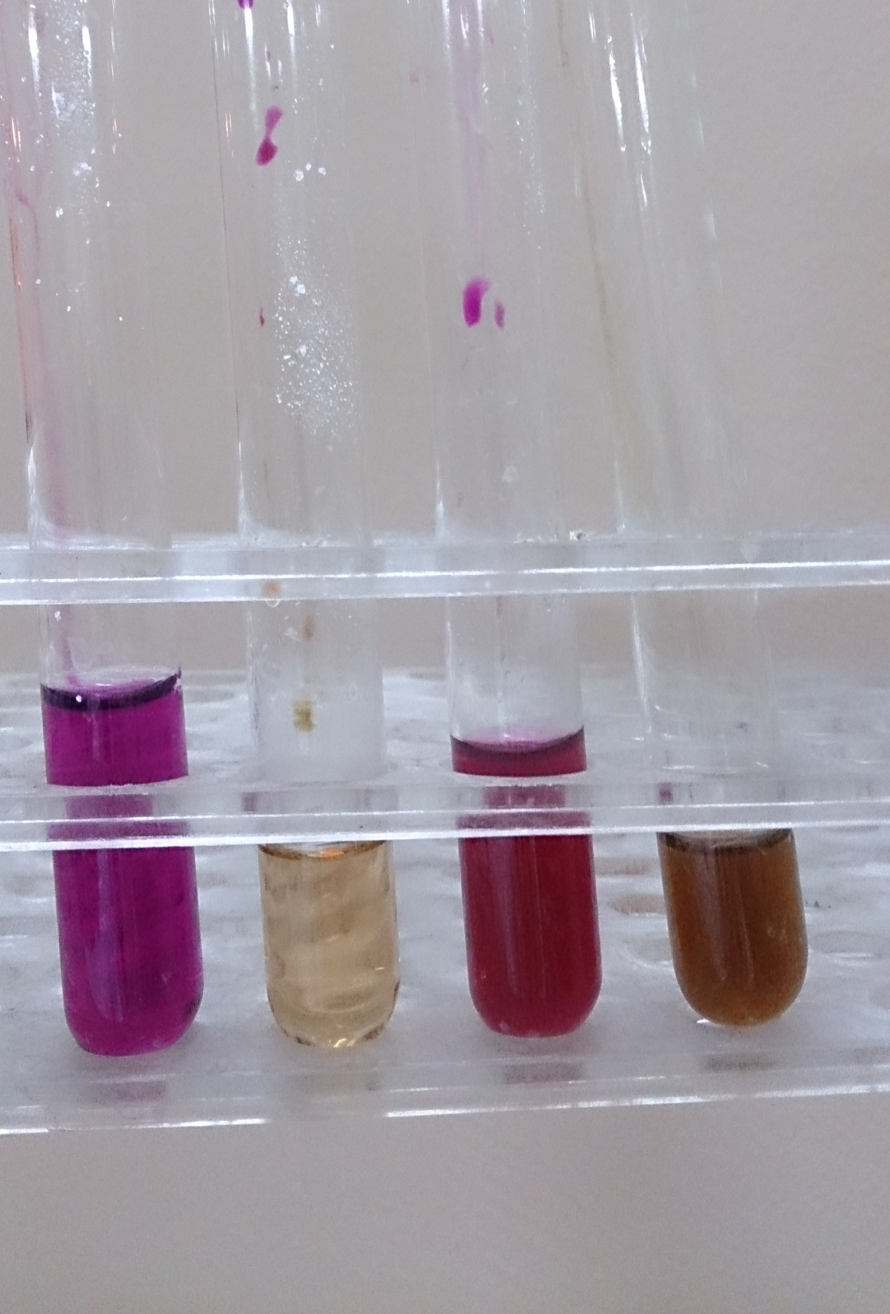
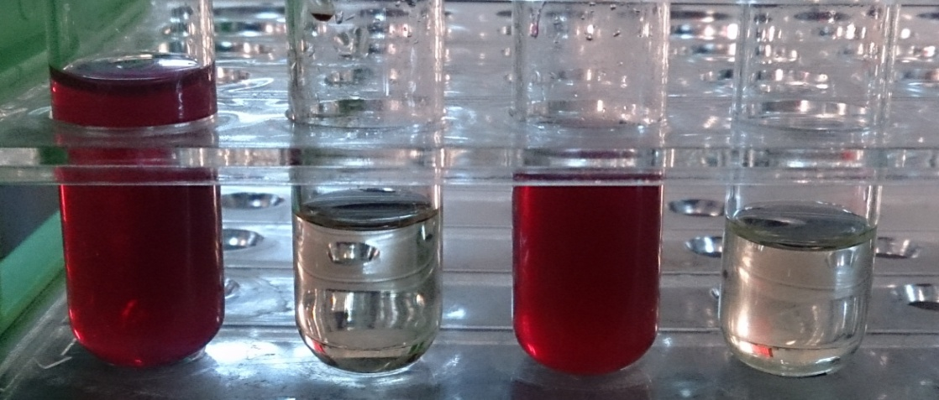
Permanganate test:
(1 ml) of compound
Heat for (1 min)
(3 ml) of (Na₂CO₃ dil.)
(1 drop) of KMNO₄ (1%)
benzoic
acid
tartaric
acid
oxalic
acid
Formic
acid
Note:- when let this test stand for several time give these colors

Slide 18
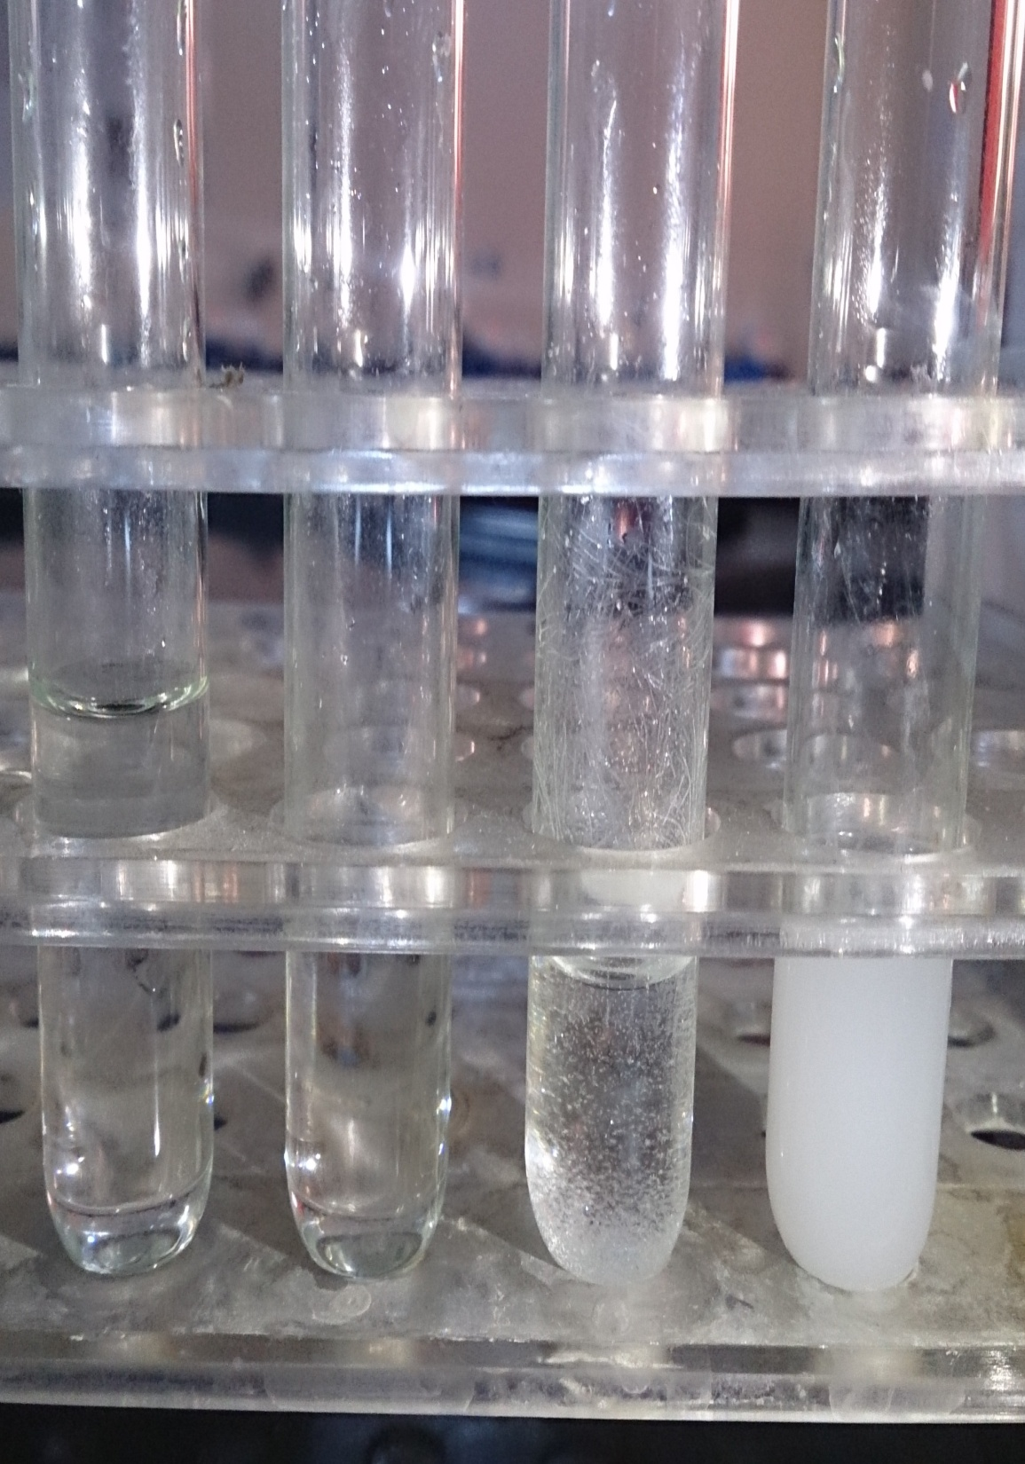
CaCl₂ test
benzoic
acid
Formic
acid
tartaric
acid
oxalic
acid
Neutral acid (N.S)
(1 ml) of compound
Drops of (NH₃ ) until litmus paper (red) change to (blue) (to have alkaline)
Test
Add (1ml) of (CaCl₂) to (N.S solution)
White ppt.
produced
after few minutes
White ppt.
produced
immediately

Slide 19
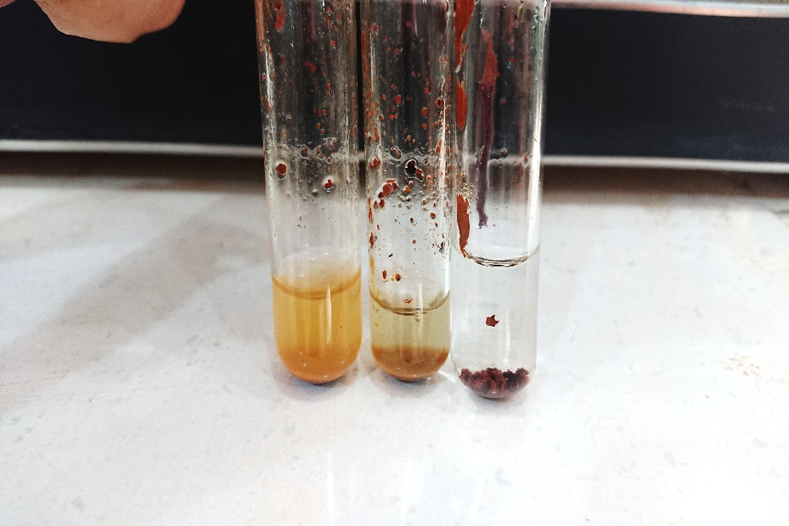
FeCl₃ test
(5 drops or few amount) of compound
(1 ml) of water
(1 ml) of (NH₃ )
(2 drops) of FeCl3
benzoic
acid
Formic
acid
succinic
acid

