Slide 1


Synthesis of Dibenzalacetone
By:
M.Sc. Hala Ayad M. R.

Slide 2
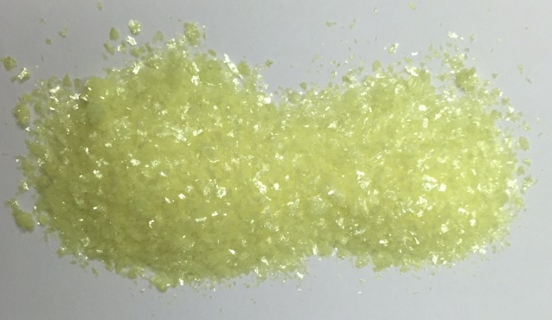
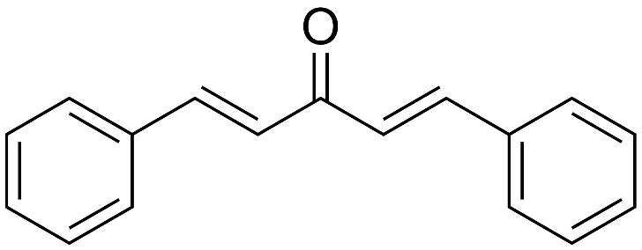
Before coming to synthesis …
IUPAC: 1,5-Diphenylpenta-1,4-dien-3-one
Dissolved in ethanol
Insoluble in water
Melting point: 110-111 °C
Solid, yellow

Slide 3

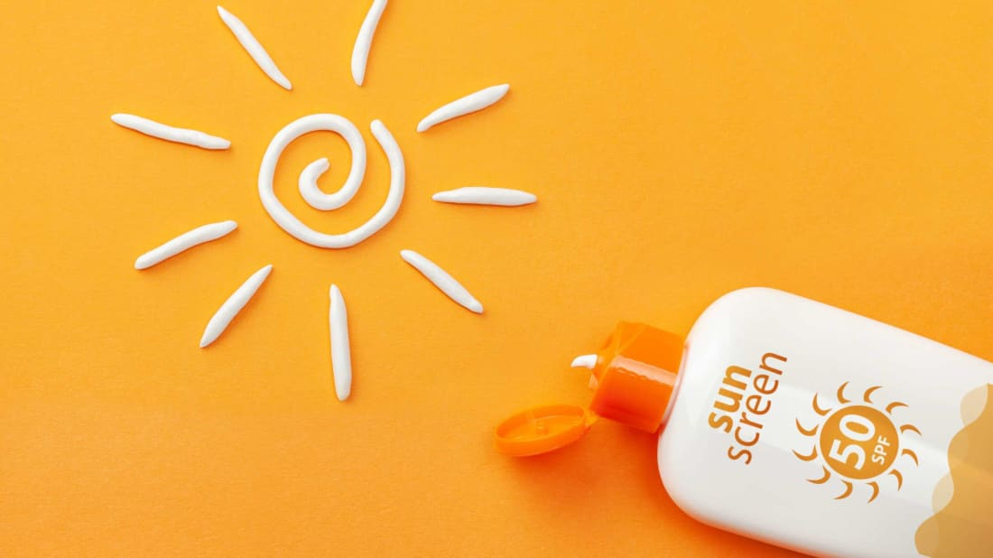
pharmaceutical uses :-
As antioxidant
One of ingredient in sunscreen
Because UV light absorbed by it and help skin from harmful rays of sun

Slide 4
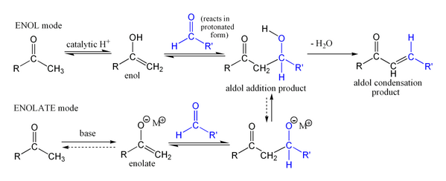
Theory:-
(Aldol condensation) :- Reaction between 2 aldehydes (have α-H) or 2 ketones (have α-H) in the presences of dilute base to form β-hydroxy carbonyl compound.
(claisen schmidt condensation):- When product of aldol condensation dehydration by using excess of base or higher temperature lead to form α,β-unsaturated carbonyl compound.

Slide 5
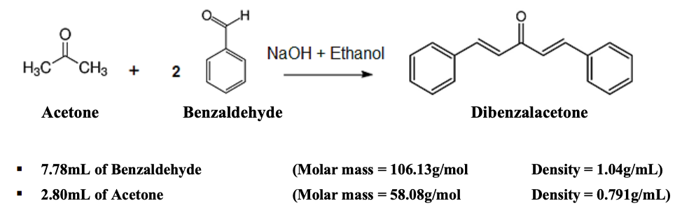


Chemical Equation

Slide 6
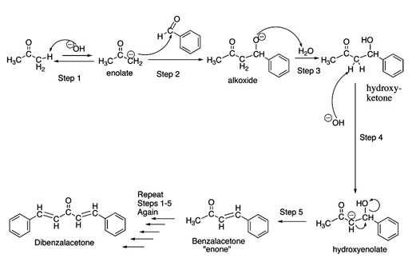
Mechanism of reaction
acetone
(Nu)
benzaldehyde

Slide 7

procedure
In beaker put (18ml) of solution NaOH and then put the beaker in ice bath. (solution 1)
In another beaker put (1.5ml) benzaldehyde then (1ml) acetone and mix well the solution. (solution 2)
Take half of solution 2 (1.5ml) by pipette and add it to solution (1) slowly with stirring. Make sure the temperature of mixture is below 20 ºC.
After (15min) appeared yellow to white then add the next half of solution (2) with stirring (20min). To from product.
Filtrated the crude product and washed with cold water to removed un-reactant and pH= neutral then dry the solid on watch glass. Determine the yield.

Slide 8

Calculate the yield % :-

Slide 9
Question
Excess of benzaldehyde is used. Why ?????
to make dibenzalactone not benzalacetone.
Added NaOH. Why ?????
to deprotonation of acetone and make enolate (nucleophile). (Step 1)
Acetone used . Why ???
because it have (α-H) to make (nucleophile).

Slide 10


