Slide 1
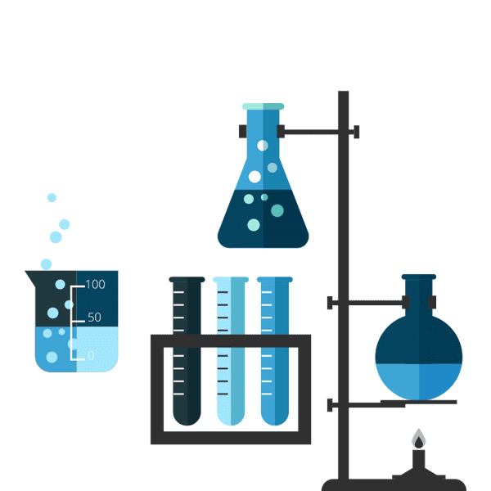
Recrystallization
Of
dibenzalacetone
By
M.Sc. Hala Ayad M. R.

Slide 2
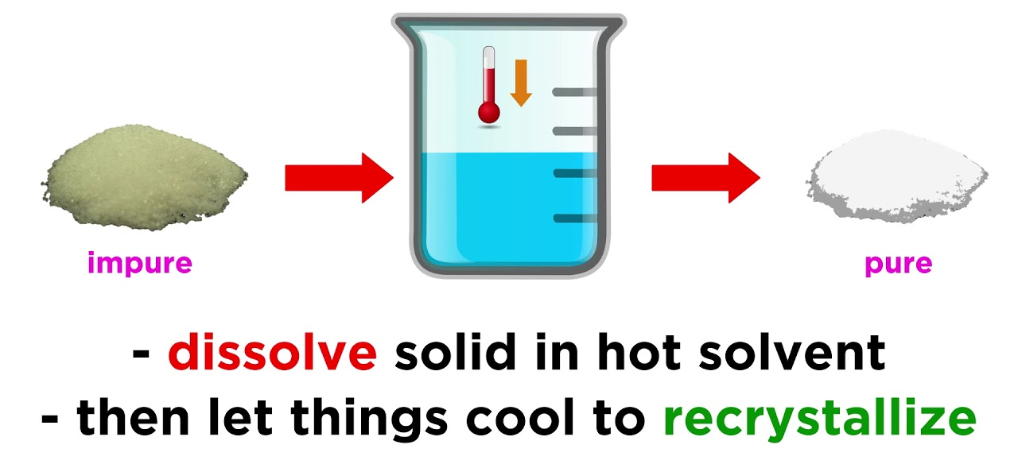
Crystallization
Compounds are soluble in solvent (liquid).
Crystals obtained by :-

Slide 3
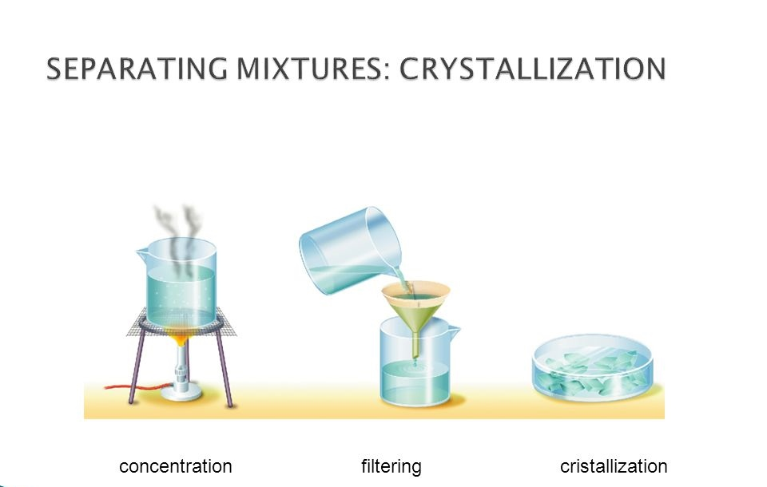
Procedure
Dissolve the precipitate with a minimal amount of hot ethanol with heat the solution until dissolved the precipitate.
Then let cool in room temperature or in ice bath to formed pure precipitate.
Filtrate.

Slide 4
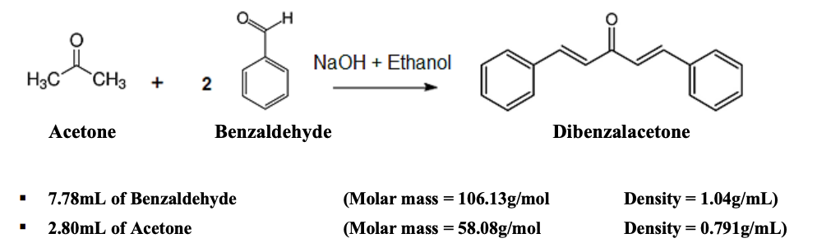
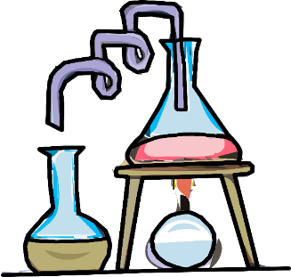
Calculate the yield % :-
Starting compounds
product
Limiting
reagent
Excess
reagent

Slide 5
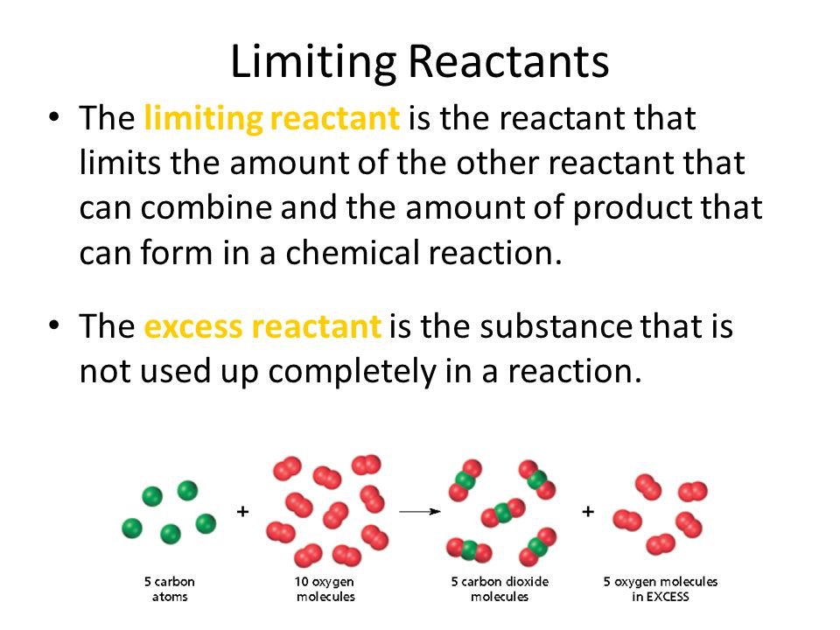

Slide 6

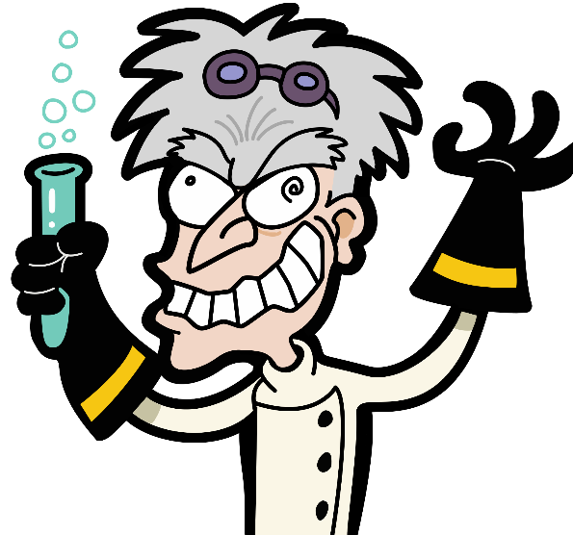
Theoretical:-
x
0.791 gm
58 gm/mol
234 gm/mol
X= 3.2 gm

Slide 7

Acetone :-
1 ml
0.791 gm/cm³
= 0.791 gm
benzaldehyde :-
1.5 ml
1.04 gm/cm³
= 1.56 gm

