Slide 1

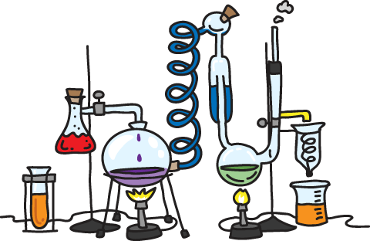
Preparation p-nitro acetanilide
Dr. Hala Ayad M.R.

Slide 2

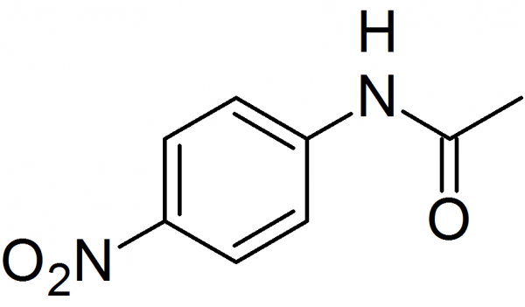
Before coming to synthesis …
IUPAC: N-(4-nitrophenyl) acetamide
Dissolved in water and ethanol, ether
Insoluble in cold water, ethanol
Melting point: 215 °C
Solid, light yellow

Slide 3
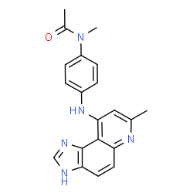

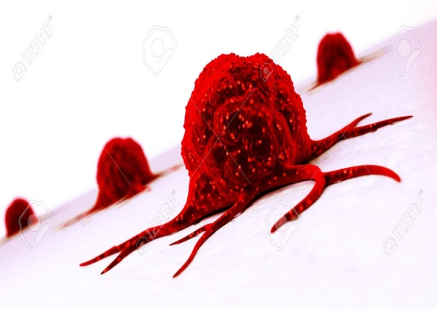
pharmaceutical use :-
Synthesis of Acodazole (imidazoquinoline)
Used as anti-neoplastic activity intercalates into DNA, resulting in disruption of DNA replication

Slide 4
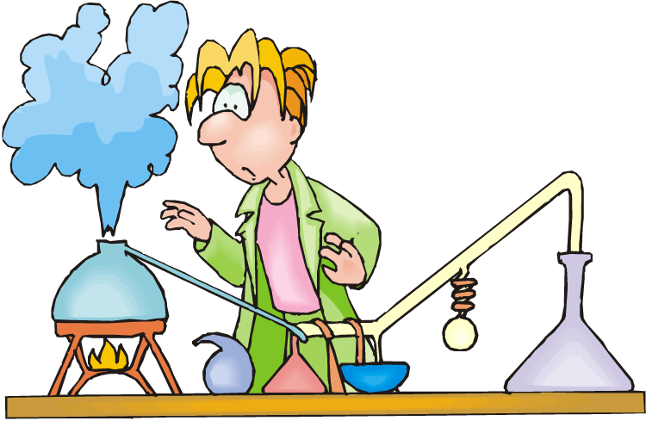
Chemical Equation
Why????

Slide 5

Nitration of acetanilide:-
To synthesize using mixture of concentrated sulfuric (H₂SO₄) and nitric acids (HNO₃).
Reaction type is electrophilic aromatic substitution.
Acetamido group (−NH-C=OCH3) directs nitronium ion (NO₂⁺) to (o-) and (p-) positions on aromatic ring
Great bulk of the acetamido group cause steric at the (o-) position SO (p-) is major product.

Slide 6

Mechanism (first step)
Sulfuric acid reacts with nitric acid to form the
nitronium ion (NO₂⁺), a strong electrophile.
(H₂NO₃⁺)

Slide 7
Mechanism (seconed step)
Electrophe substitution on aromatic ring by (NO₂⁺)
Attack on the electrophile
loss of proton to water

Slide 8

WHY USED (H₂SO₄) ??????
aromatic compound with nitric acid alone
slow and hazard reaction
So (It is used to make reaction faster and safer).
transfer H from (H₂SO₄) to (HNO₃) to
formed (H₂NO₃⁺) allowing to leave water (-H₂0) and formed nitronium ion (NO₂⁺).

Slide 9
procedure
Dissolved (0.7 gm) of acetanilide + (0.7 ml) glacial acetic acid in beaker.
Cool the solution in ice bath (20º C) THEN added (0.7ml) of cold H₂SO₄ (con.) with stirring. Mixture would become warm and formed yellow clear solution. Cooled for (10 min)
in test tube cooled mixture of (0.5 ml) of HNO₃ (con.) and (0.5 ml) of H₂SO₄ . Cooled for (10 min)
added slowly to solution of acetanilide with stirring in ice bath. at(10min).
Why ??
Why ??
Why ??

Slide 10

After complete the addition let mixture stand at room temperature for (20 min).
Pour the mixture into crushed ice in beaker with stirring and pale yellow precipitated was observed.
Filtrated the crude product and washed with cold water to removed acids check with a blue litmus paper then dry the solid on watch glass. Determine the yield.
Crude produced re-crystallization with minimum amount of hot ethanol. Determine the yield.
Why ??
Calculate the yield % :-

Slide 11
Question
Glacial acetic acid is used. Why ?????
it is a polar solvent dissolving acetanilide.
Cooled the reaction. Why ?????
is exothermic reaction.
Added slowly of mixture HNO₃ and H₂SO₄ . Why ???
to prevent dinitration.
Wash with cold water. Why ??????
to remove acid which hydrolyzed p-nitro acetanilide (yellow color)
to p-nitro aniline (orange color).

Slide 12


