Slide 1
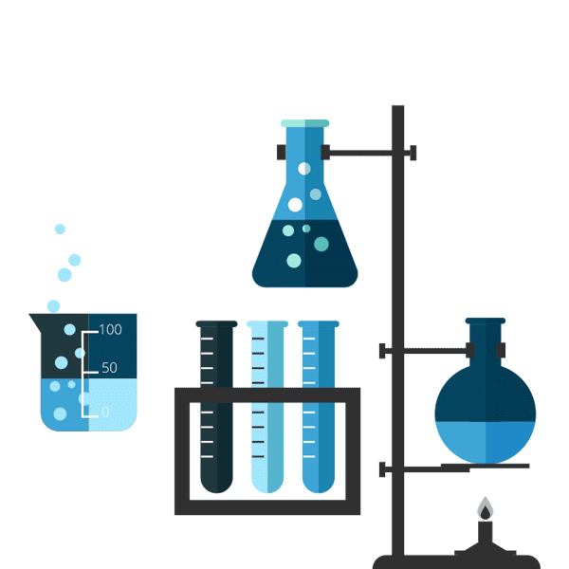
Preparation of
p-nitro aniline
M.Sc. Hala Ayad

Slide 2


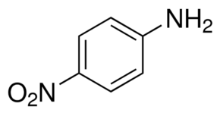
Before coming to synthesis ..
IUPAC: 1-amino-4-nitrobenzene
Dissolved in ethanol, ether
Insoluble in water
Melting point: 146 °C
Solid, orange

Slide 3
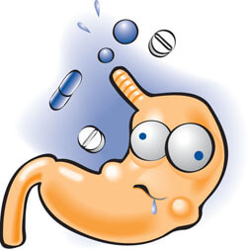
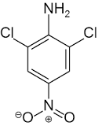
pharmaceutical use :-
Synthesis of Dicloran
Non-steroidal anti-inflammatory (NSAID) drug used to treat pain associated with conditions like Gout, Migraine, Rheumatoid Arthritis and in mild to moderate fever in some cases.

Slide 4
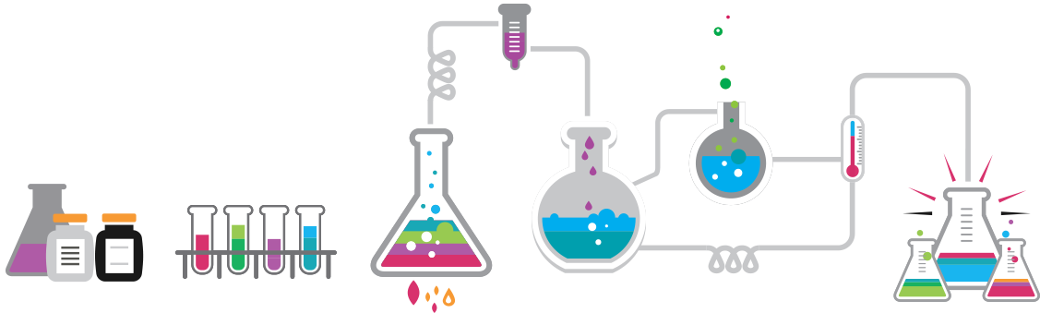
Chemical Equation

Slide 5
procedure
1. In round bottom flask add crude p-nitroacetanilide with 3 mL of water
and 4 mL of concentrated hydrochloric acid. Reflux the mixture gently for 15–20 minutes. an orange-colored solution is formed.
2. cool the mixture then pour the solution to beaker contain chipped ice
3. The mixture must be distinctly alkaline at the time of the mixing; test with indicator papers by adding 10% NaOH drop by drop.
4. Collect the orange-yellow precipitate of p-nitroaniline with suction and wash it with cold water. Recrystallize the product from a large volume of hot water; about 30 mL of water will be required per gram of material.

Slide 6


